Slide 1
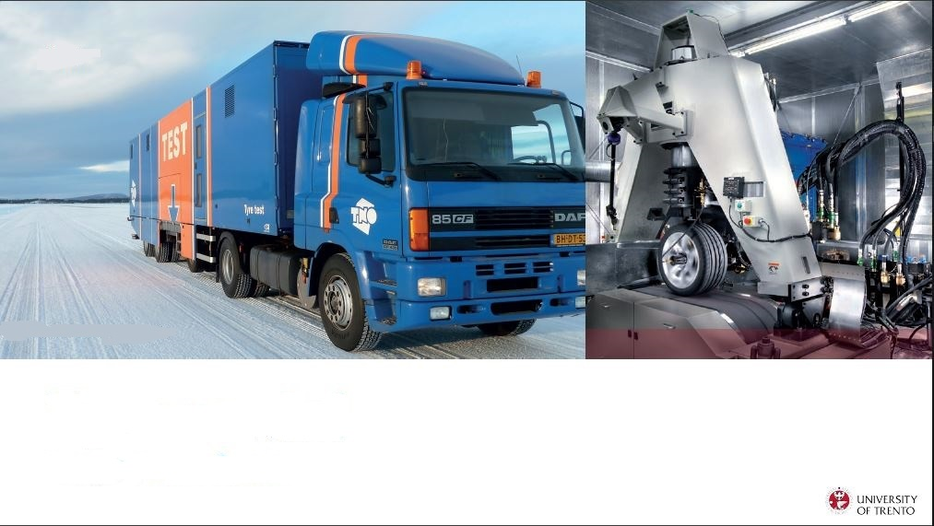
Tyre data fitting with MF96 formula
Nicolò Cavalieri – ID: 231202
Academic Year: 2022-2023
Assignment #1

