Slide 1

Assignment Lecture 1
Search Algorithms
TDT4137 – Introduction to Artificial Intelligence, 2026
Aleksandra Jekic, Department of Computer Science

Slide 2
Relevant for this assignment
Lecture 2 (yesterday) and Lecture 3, which covers some mathematical theory on A* relevant to this assignment (next week)
Chapter 3 in the Russell and Norvig book (4th edition, Global).
If you have taken TDT4120 Algorithms and data structures, some of this may be familiar to you and you will be used to this way of thinking. However, you can also get tricked. Even small, subtle differences in our versions of the algorithms can be significant.
Note also that older versions of the book have different algorithms.

Slide 3
How important is this?
If you look at the old exams, there is usually a lot on this topic.
May be easy to grasp intuitively, but small details can trip you up. Behind the scenes we joke that we are still discovering new subtle details.
In the exam, you may have to do these algorithms by hand. Most human brains require spaced repetition to do this confidently. This assignment is a good chance to build a solid foundation for your exam practice period.

Slide 4
What version to use?
Many different algorithms with many different properties have the same names. If you look up random A* content online, it is probably not our A*.
Small details that can make a really big difference (from main lectures):
  Does the algorithm save where it has been (graph search) or not (tree search)?
  When does the algorithm check if it found the goal?
  How does the algorithm generate the path to the goal after finding it?

Slide 5
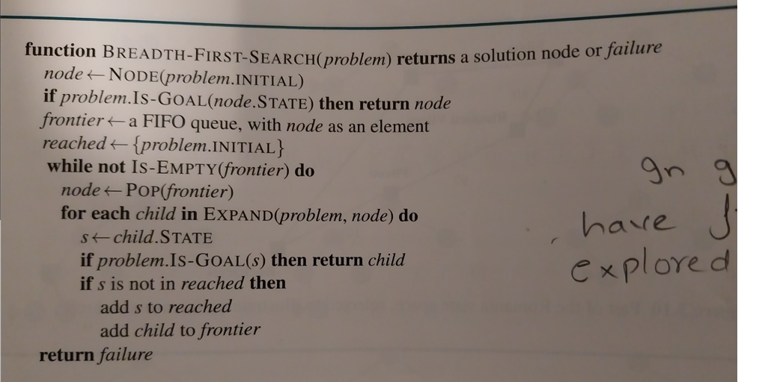
What version to use?
We have tried to make this as unambiguous as possible.
For Breadth-first-search (BFS), the official algorithm is the one found on page 95 in Norvig and Russell.
Biggest “gotcha” is that it checks for the goal immediately when discovering a new node.

Slide 6
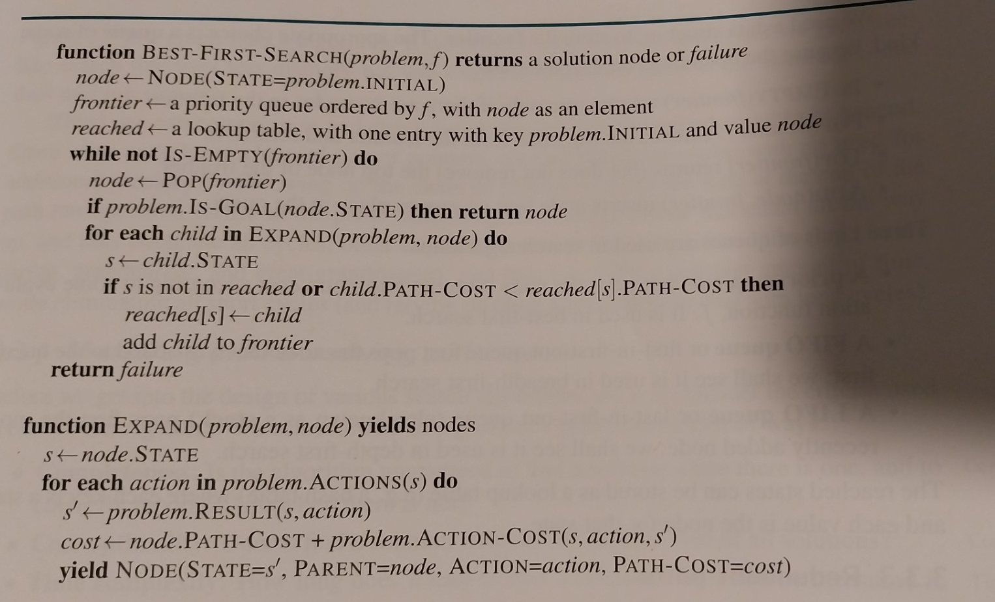
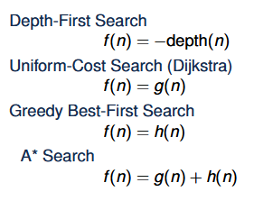
What version to use?
We have tried to make this as unambiguous as possible.
For all the other algorithms, please use Best-First-Search on page 91 with the appropriate function f to order the priority queue.

Slide 7
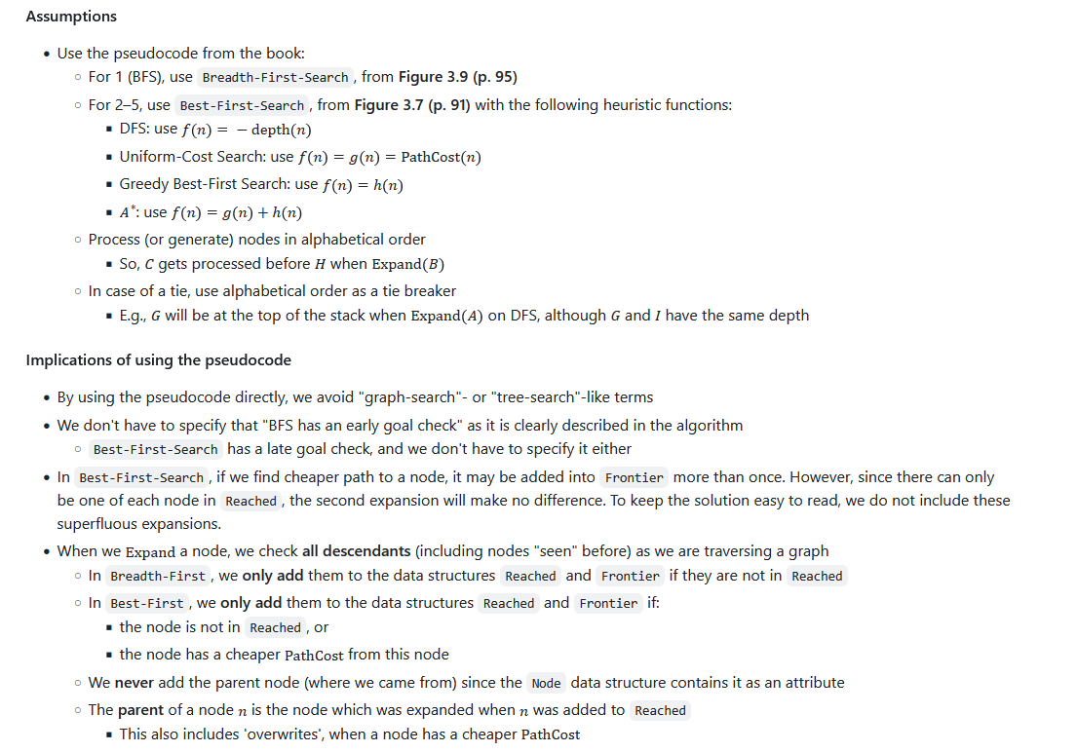
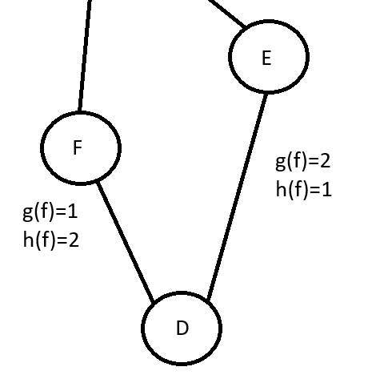
What version to use?
Process nodes in alphabetical order, when not specified.
If function f, used to order the priority queue, has a tie, fall back on alphabetical order.

Slide 8
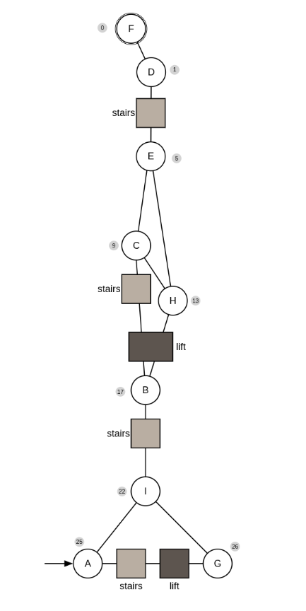
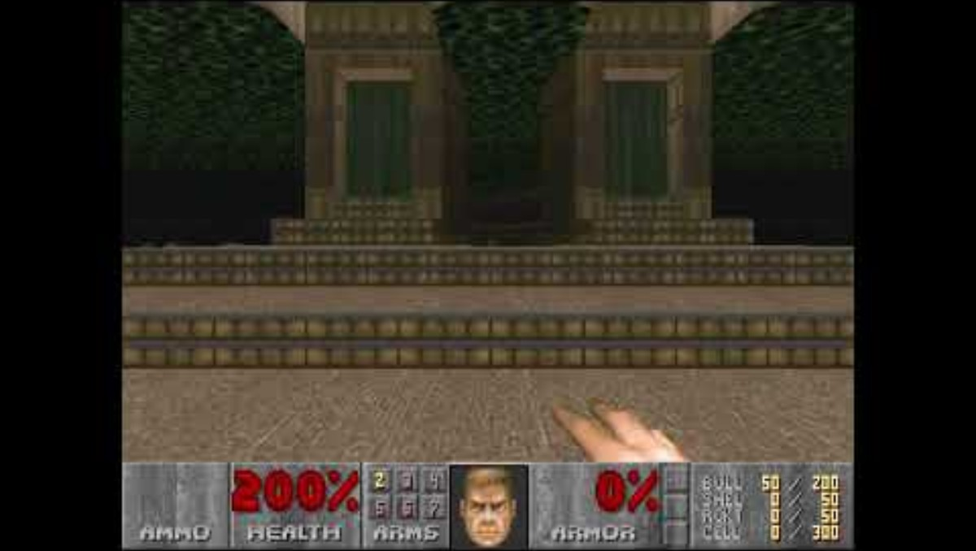
Assignment 1
Task: We want to impress a boy/girl/something by playing through the Phobos Anomaly level in the video game Doom (1993) as fast as possible.

Slide 9
Assignment 1
Task: We want to impress a boy/girl/something by playing through the Phobos Anomaly level in the video game Doom (1993) as fast as possible.
A is start. F is the goal. The numbers in the gray circles is the heuristic value.
Crossing any line costs 1. Stairs cost extra 1. Lift costs extra 2.
Going from A to G costs 1+1+2=4.
First task is just to write the cost of all possible paths so that we have them handy. (A, G) = 4, etc.

Slide 10
Assignment 1
The next part is to solve this manually with the following algorithms:
  Breadth-first search (BFS)
  Depth-first search (DFS)
  Uniform-cost search/Dijkstra (UCS)
  Greedy best-first search (GBFS)
  A* search
Example of solution:
  Order of expansion: S, A, B, (G)
  Found path: SBG
  Path cost: 4

Slide 11
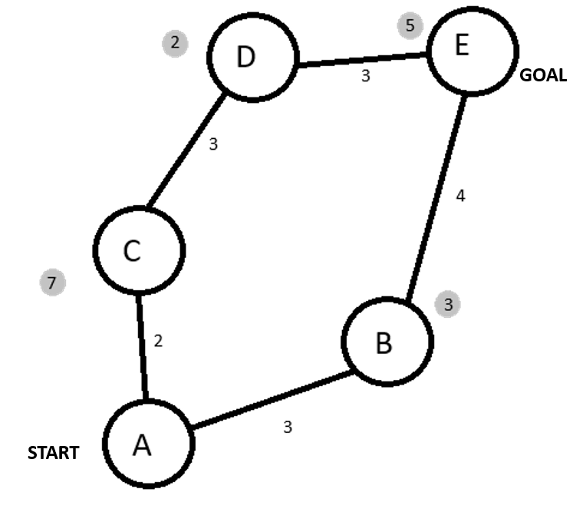
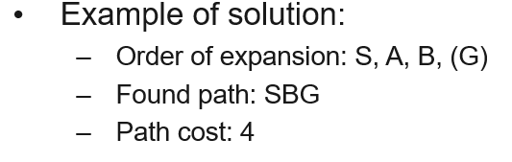
Assignment 1
Not going to spoil the Doom graph for you, but let’s see if we agree how this works.
Breadth-First Search (BFS).
Solution:
  Order of expansion: A, B, (E)
  Found path: A, B, E
  Path cost: 7

Slide 12
Assignment 1
Not going to spoil the Doom graph for you, but let’s see if we agree how this works.
Depth-first search (DFS).
Solution:
  Order of expansion: A, B, (E)
  Found path: A, B, E
  Path cost: 7

Slide 13
Assignment 1
Not going to spoil the Doom graph for you, but let’s see if we agree how this works.
Uniform-cost search/Dijkstra (UCS).
Solution:
  Order of expansion: A, C, B, D, (E)
  Found path: A, B, E
  Path cost: 7

Slide 14
Assignment 1
Not going to spoil the Doom graph for you, but let’s see if we agree how this works.
Greedy best-first search (GBFS).
Solution:
  Order of expansion: A, B, (E)
  Found path: A, B, E
  Path cost: 7

Slide 15
Assignment 1
Not going to spoil the Doom graph for you, but let’s see if we agree how this works.
A* search.
Solution:
  Order of expansion: A, B, C, D, (E)
  Found path: A, B, E
  Path cost: 7

Slide 16
Assignment 1
The final part of the assignment is about mathematical properties of the heuristic functions which can allow guarantees for the behavior of the algorithms.
A* search is cost-optimal if arc costs are positive and the heuristic is admissible and/or consistent. This will be covered in proper detail in the next week’s lecture.
Also see Chapter 3 in the Norvig and Russell book.

Slide 17
Assignment 1
A heuristic is admissible if it never overestimates the cost from a node to the goal node.
A heuristic is consistent if for every node n and all of its successors n’ generated by an action a, we have h(n) ≤ c(n, a, n’) + h(n’).
  Informally: The estimate of a node should be less than or equal to the estimate of a successor plus the cost of reaching the successor.
  Even more informally: The heuristic should not overestimate the cost relative to successive estimates.

Slide 18
Assignment 1
Is our simple graph admissible?
  No, because (D, E) = 3 while h(e)=5.
Is our simple graph consistent?
  No, because all consistent graphs are admissible.
  Or h(d) ≤ c(d, a, e) + h(e) which gives us 2 ≤ 3 + 5 and this is a contradiction. The graph is not consistent.

Slide 19
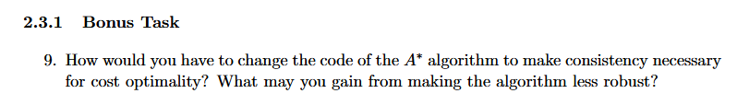
Assignment 1
The bonus task is a bit hard and not something you have to do.
This goes a bit into why there are so many variants of the algorithms and what can be lost and gained with small changes.
Tip: If you read the book closely, the answers should be apparent.

Slide 20
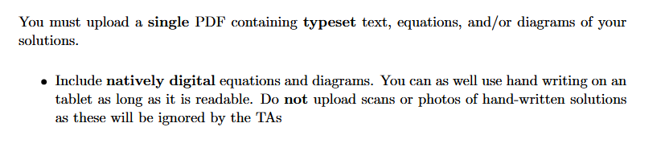
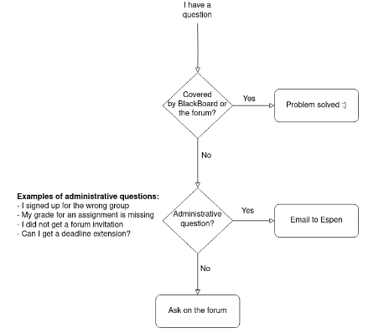

Practical reminders
Any questions or comments?

Slide 21

Closing slide

