Slide 1

Contemporary Programming
What’s a Byte?

Slide 2
We have data types
int
float
double
string
char
byte
…

Slide 3
Byte
8-bits
unsigned
0-255
No negative values!
Can be converted to other types

Slide 4
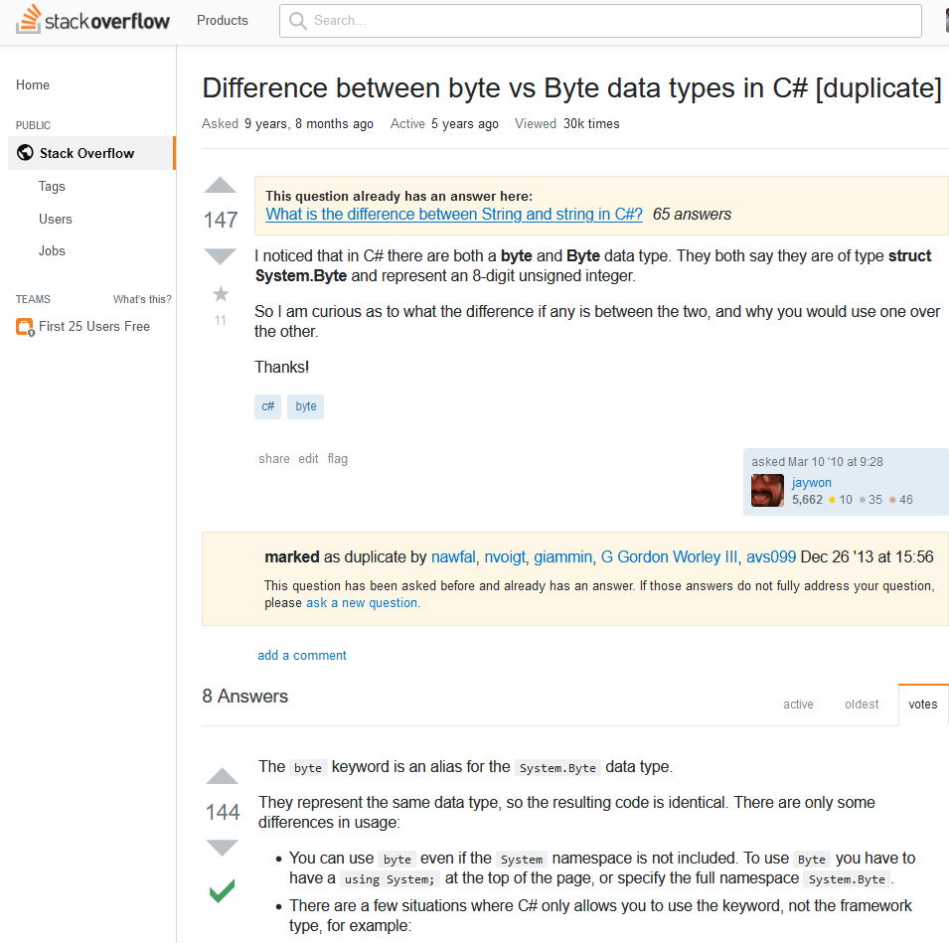
Byte and byte?
They’re the same
https://stackoverflow.com/questions/2415742/difference-between-byte-vs-byte-data-types-in-c-sharp

Slide 5
Why A Byte?
The smallest unit of addressable data in RAM and on the storage device.
No assumed format
No sign bit
No exponent
It’s just bits

Slide 6
What can we do with it?
Math
Bit-shifting
Masking
Hardware Control
Representing binary data
jpeg, png, wmv, avi, etc.

Slide 7
8 bits = 1 byte
7654 3210
nnnn nnnn
Bit Numbers (also powers of 2)
MSB
LSB
MSB = Most Significant Bit
LSB = Least Significant Bit

Slide 8
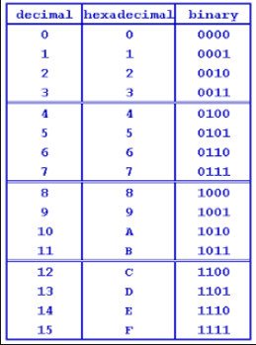


Hexadecimal, Decimal, Binary Notation
Base 2 maps into Base 16
Humans Base 10
Computers Base 16
[2]

Slide 9
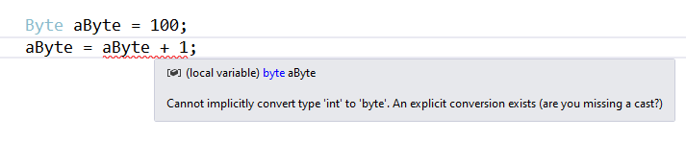

Type Conversions!
The + operator returns an int!
An int cannot be implicitly converted to a byte

Slide 10
Overflow
// Overflow? What is 0xff + 1 ?
myByte = (Byte)(myByte + 1);
Console.WriteLine(myByte);

Slide 11
Bitwise operators
&
|
~
>>
<<
Review your truth tables…

Slide 12
Masking Bits
// Masking the bits
Byte mask = 0x01; // The low bit is set, all other bits are off
Byte someData = 0x34; // What bits are set? Figure it out.
someData = (Byte)(someData | mask); // Turn on the low bit in someData, leave the other bits alone. What bits are set now? Figure it out.

Slide 13
Why do we care about individual bits?
Bitmapped graphics
8X8 2 Dimensional array of bits
Byte[] myPic = new Byte[8];
x x x x x x x x
x x x x x x x x
x x x x x x x x
x x x x x x x x
x x x x x x x x
x x x x x x x x
x x x x x x x x
x x x x x x x x

Slide 14

Sensors use Bitmaps
https://cdn.shopify.com/s/files/1/1367/9021/files/65300MN000_A00_F200_User_Manual.pdf

Slide 15
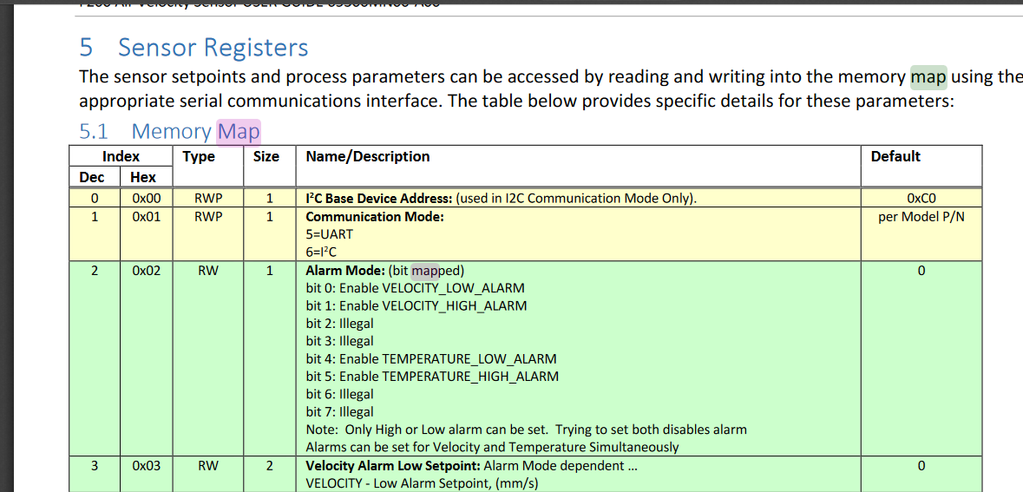
Bitmapped Control values
https://cdn.shopify.com/s/files/1/1367/9021/files/65300MN000_A00_F200_User_Manual.pdf

Slide 16

Try it
Turn on the VELOCITY_LOW_ALARM
Remember, you must preserve all the other bits!

Slide 17
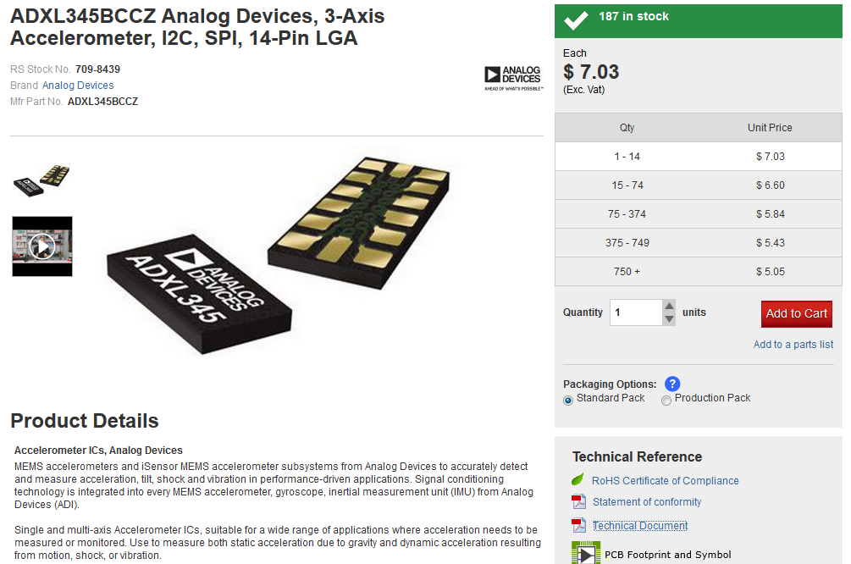
Accelerometer
https://americas.rsdelivers.com/product/analog-devices/adxl345bccz/adxl345bccz-analog-devices-3-axis-accelerometer/7098439?cm_mmc=US-PLA-DS3A-_-google-_-PLA_US_EN_CatchAll_New-_-Catch+All-_-PRODUCT_GROUP&matchtype=&pla-827276542976&gclid=EAIaIQobChMIwvz0_Yji5QIVh4FaBR0l1AqzEAkYBCABEgLMg_D_BwE&gclsrc=aw.ds

Slide 18
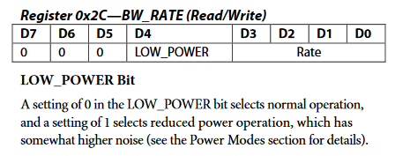
Accelerometer with Bitmapped Configuration
https://docs-emea.rs-online.com/webdocs/0e48/0900766b80e4845a.pdf

Slide 19
Try it
Turn OFF Low Power
Remember, you must preserve all the other bits!

Slide 20
References
[1] Dilbert courtesy of Dilbert.com
[2] 20th Century Fox

