Slide 1
Unit Testing Framework!
https://docs.microsoft.com/en-us/visualstudio/test/getting-started-with-unit-testing?view=vs-2019
[2]

Slide 2
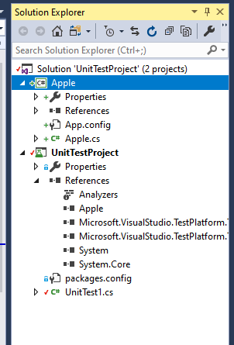
Solution with two projects
The Unit Test project has a Reference to the project to be tested

Slide 3
Unit Test
using System;
using Microsoft.VisualStudio.TestTools.UnitTesting;
namespace UnitTestProject
{
[TestClass]
public class UnitTest1
{
[TestMethod]
public void TestMethod1()
{
Fruits.Apple myApple = new Fruits.Apple();
Assert.AreEqual(myApple.IsRotten(), false);
}
}
}

Slide 4
Class to be tested
using System;
using System.Collections.Generic;
using System.Linq;
using System.Text;
using System.Threading.Tasks;
namespace Fruits
{
public class Apple
{
private Boolean mRotten;
public Apple()
{
mRotten = false;
}
public void MakeRotten() { mRotten = true; }
public Boolean IsRotten() { return mRotten; }
}
}

Slide 5
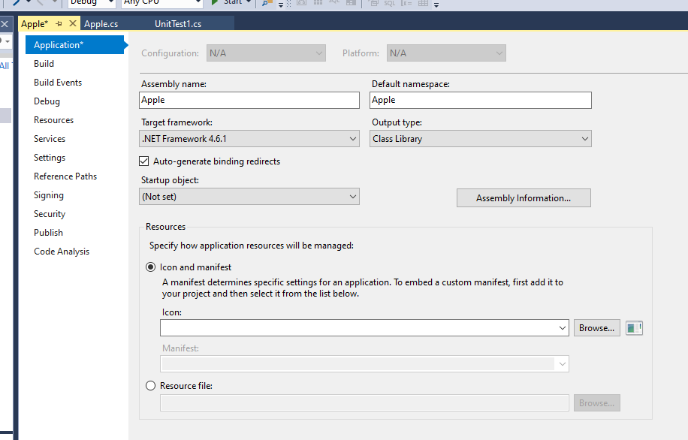
Test Class (Apple) will have no main method

Slide 6
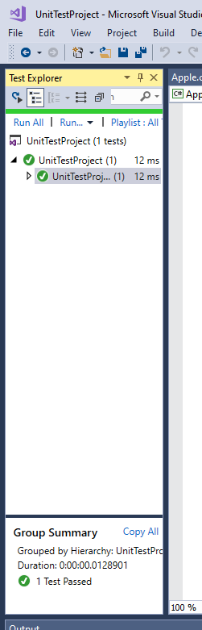
Run the Tests!

