Slide 1
Unit Testing & Dependency Injection
Writing Good Code
[2]

Slide 2
Unit Testing Framework!
https://docs.microsoft.com/en-us/visualstudio/test/getting-started-with-unit-testing?view=vs-2019
[2]

Slide 3
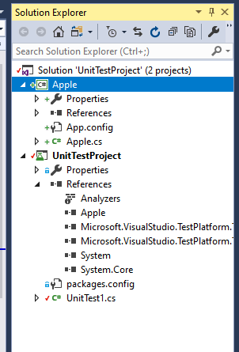
Solution with two projects
The Unit Test project has a Reference to the project to be tested

Slide 4
Unit Test
using System;
using Microsoft.VisualStudio.TestTools.UnitTesting;
namespace UnitTestProject
{
[TestClass]
public class UnitTest1
{
[TestMethod]
public void TestMethod1()
{
Fruits.Apple myApple = new Fruits.Apple();
Assert.AreEqual(myApple.IsRotten(), false);
}
}
}

Slide 5
Class to be tested
using System;
using System.Collections.Generic;
using System.Linq;
using System.Text;
using System.Threading.Tasks;
namespace Fruits
{
public class Apple
{
private Boolean mRotten;
public Apple()
{
mRotten = false;
}
public void MakeRotten() { mRotten = true; }
public Boolean IsRotten() { return mRotten; }
}
}

Slide 6
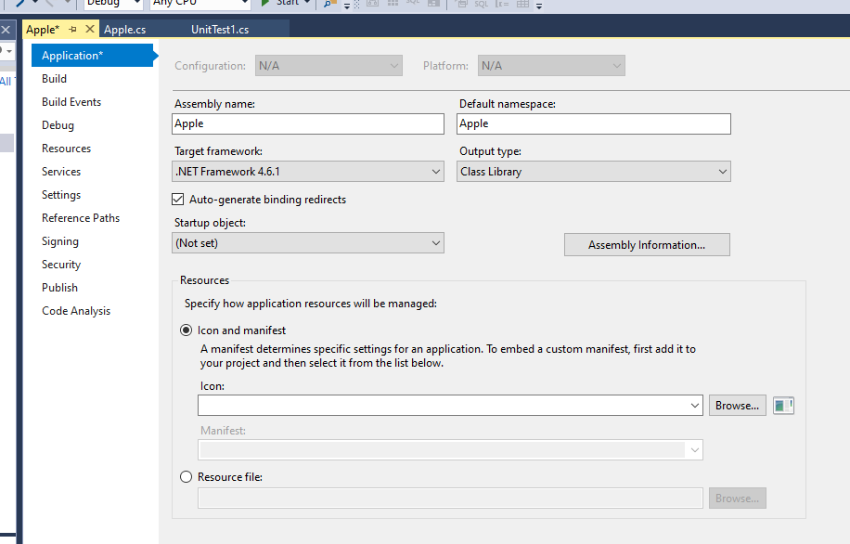
Test Class (Apple) will have no main method

Slide 7
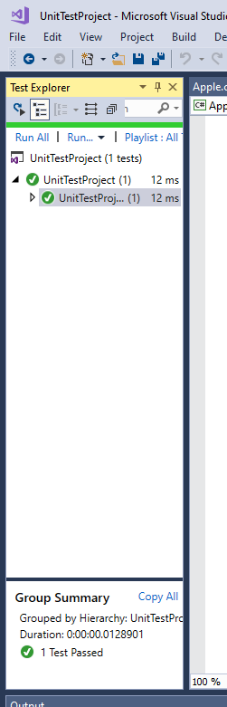
Run the Tests!

Slide 8
Now, introduce a Worm
A worm infests an apple
However, other things infest apples
Mites
Woolly Apple Aphids
Grubs

Slide 9
What’s the relationship?
An Apple “has-a” Worm
Conceptually that’s OK, but since other things can infest…

Slide 10
We should use an Interface
using System;
using System.Collections.Generic;
using System.Linq;
using System.Text;
using System.Threading.Tasks;
namespace IWormNamespace
{
public interface IWorm
{
void Infest();
}
}

Slide 11
An Apple can be infested by any class
that implements the interface.
using System;
namespace Fruits
{
public class Apple
{
private Boolean mRotten;
private IWormNamespace.IWorm mWorm;
public Apple(IWorm worm) // Dependency Injection of IWorm into Apple
{
// Instead of the Apple object instantiating a Worm object, it's
// passed to the constructor.
// AND worm is any class that implements the IWorm Interface
// rather than a specific class.
mWorm = worm;
mRotten = false;
}
public void MakeRotten() { mRotten = true; }
public Boolean IsRotten() { return mRotten; }
}
}

Slide 12
Here is our Worm class
using IWormNamespace;
using System;
namespace WormNamespace
{
public class Worm: IWorm
{
public void Infest()
{
Console.WriteLine("Worm is infesting apple...");
}
}
}

Slide 13
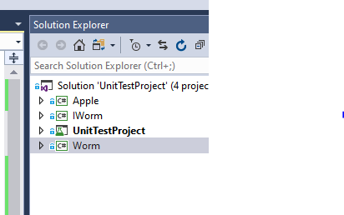
The entire Solution has 4 projects

