Slide 1

Staying Safe in NYC: A Crime Analysis of New York City
Van Steenbergen Nicolaas
Fish Alex

Slide 2
Objective of Project
Help tourists stay safe when traveling to NYC
In-depth analysis of crime in NYC to understand the trends and locations of crime.

Slide 3
The Data
NYPD Complaints
NYPD
Weather
National Centers for Environmental Information
Neighborhood Information
NY department of city planning

Slide 4
Cleaning Data: NYPD
NYPD complaint difficult to read in (1+GB csv file with 6 million rows)
Use regular expressions to get only 2015
Coded column names
More information than we needed
Did not include the neighborhoods, only latitude and longitude

Slide 5
Cleaning Data: Weather
Over abundance of information not needed
Only had high-low temperature
Had to make our own daily averages for 2015

Slide 6
Getting the Map Data
Use google API to track location of latitude and longitude, then use the neighborhood data set to create a new set with just latitude and longitude with neighborhood.
Merging new data set onto original was too big for a regular merge, had to utilize data.table techniques

Slide 7
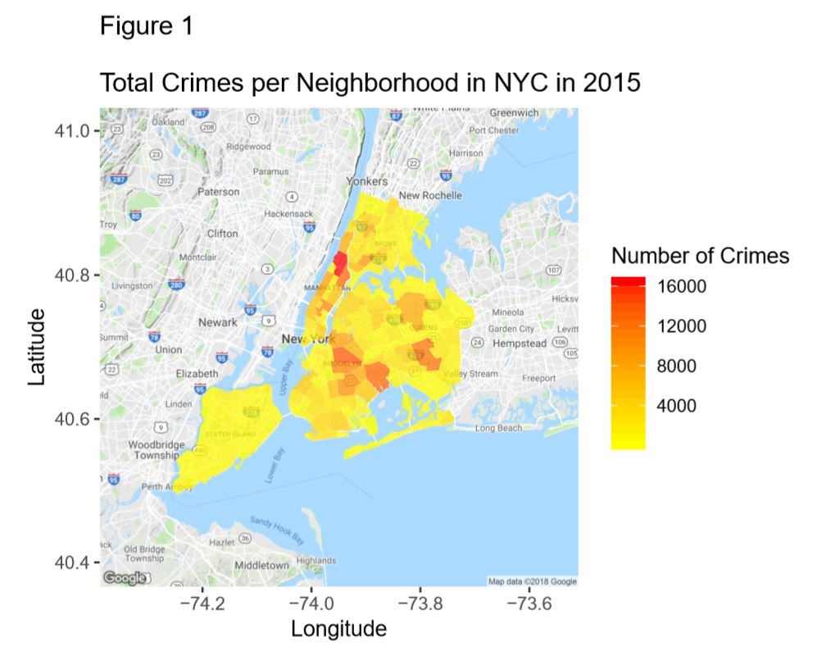
Data Product
Custom map that shows the levels of crime in each neighborhood on a given day
Can filter by severity of crime (Felony, Misdemeanor, Violation)
Helpful for tourists with no prior understanding of dangerous areas in the city

Slide 8
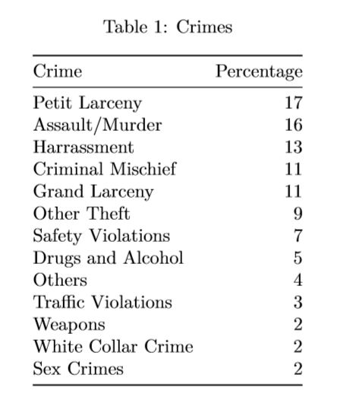
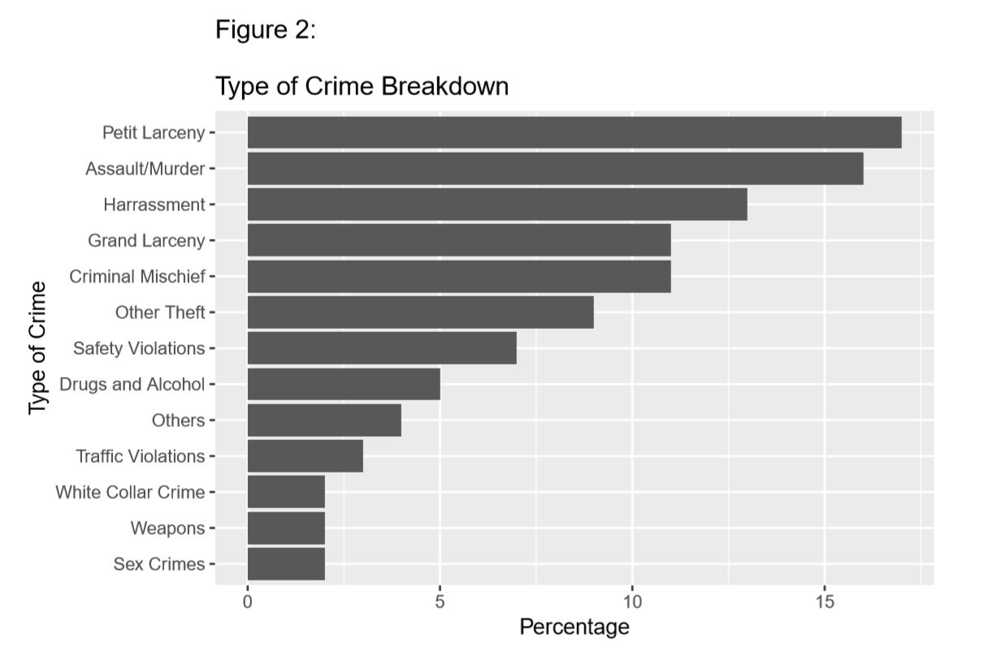
Our Findings: Crime Breakdown
96% of the crimes fit into 12 categories with 4% ‘other’
Manually grouped the categories
Petit Larceny is similar to Grand Larceny (Petit is under $1000)

Slide 9
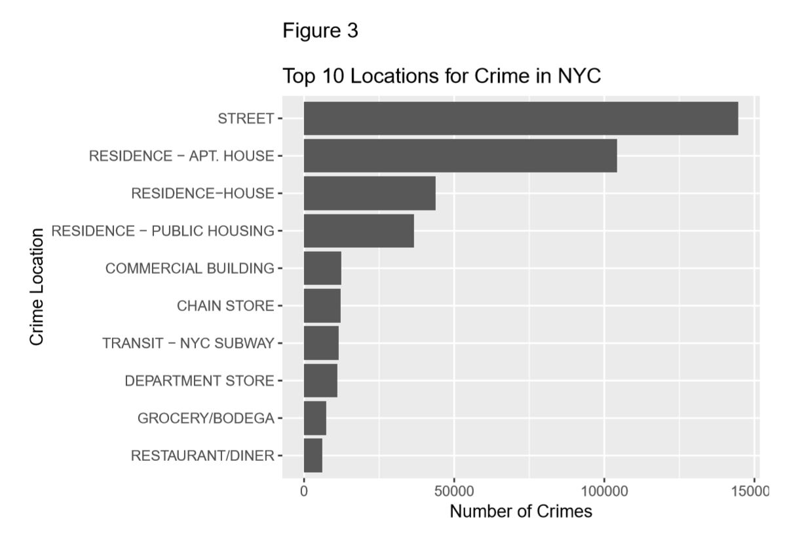
Our Findings: Crime Locations
Most of the crimes happen on the street
Residences come in a close second
Less public building crimes than anticipated

Slide 10
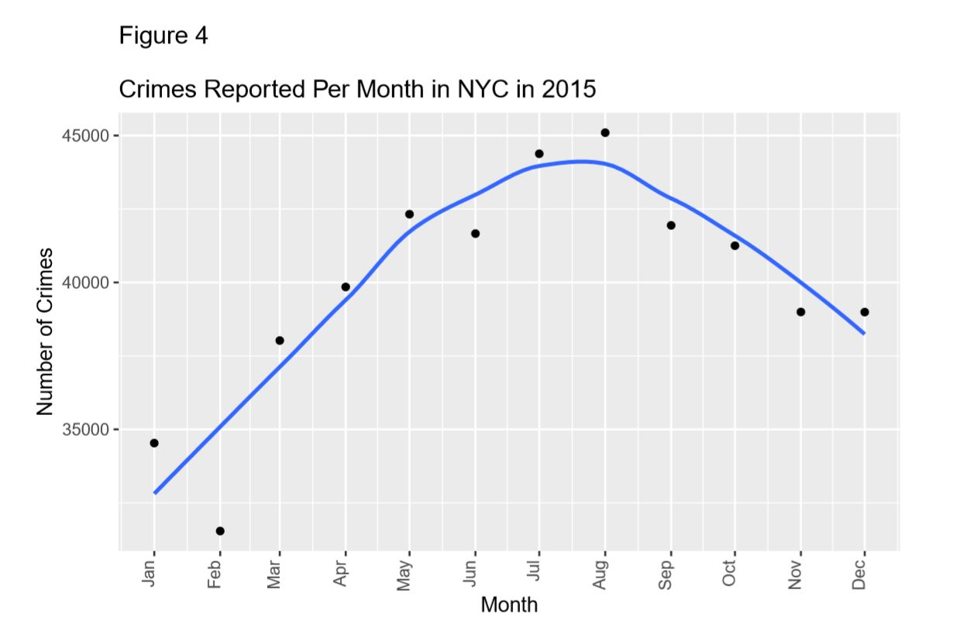
Our Findings: Crime Breakdown
Spikes in the summertime, potentially due to warmer weather and vacations
This means more people and more opportunity for crime

Slide 11
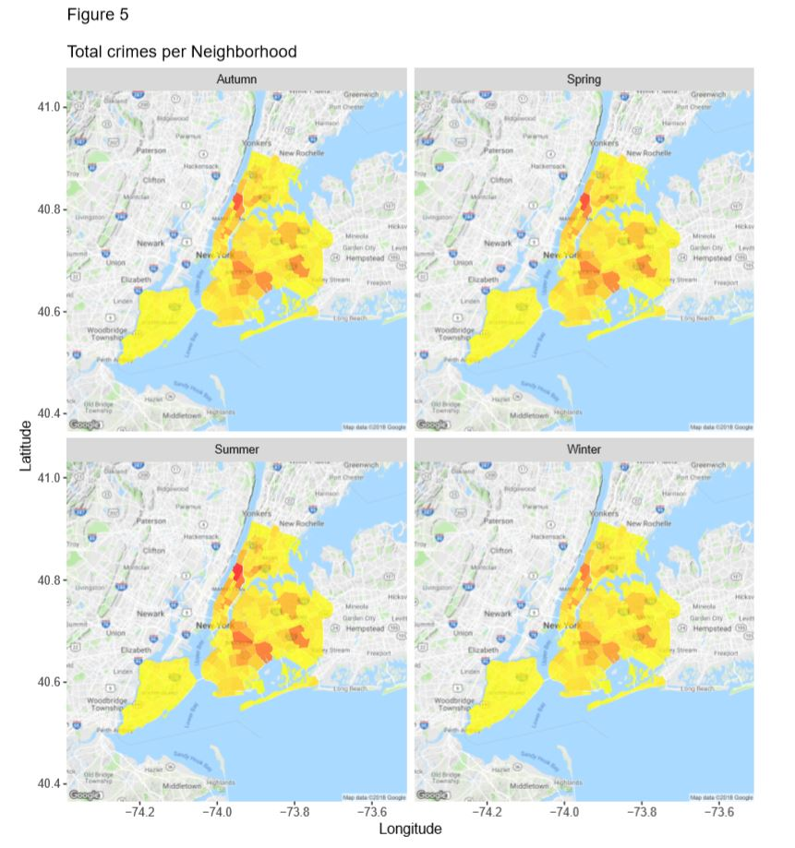
Our Findings: Seasonal Differences
A visible increase in crime for the Summer
Autumn and Spring also have high rates
Winter is the season with the least amount of crime

Slide 12
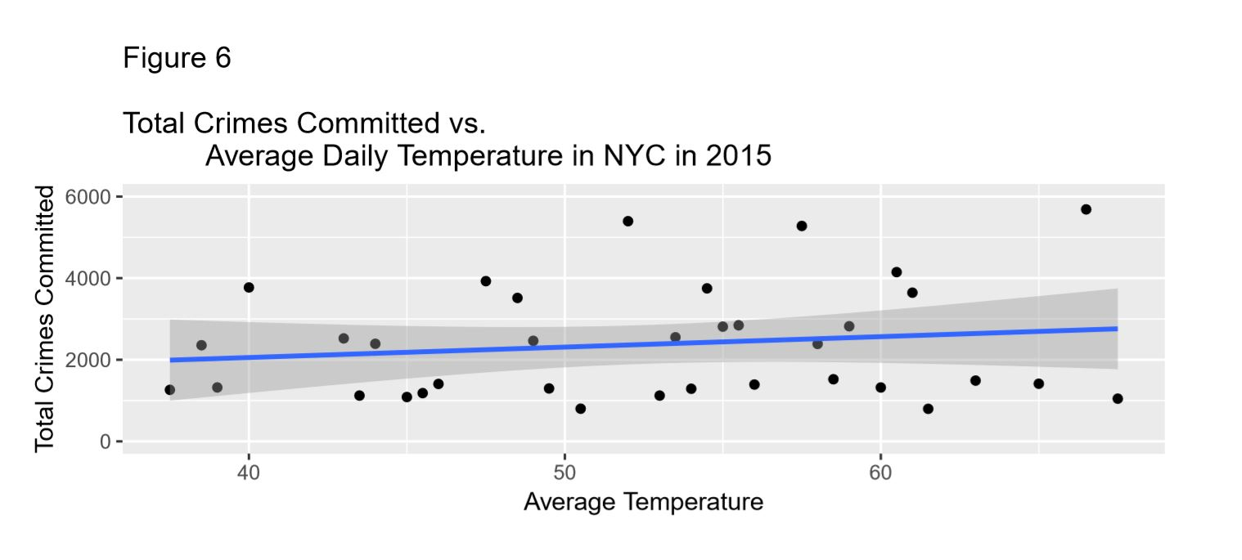
Our Findings: Temperature
Similarly to the seasons, the warmer it gets the more crime happens
Although isolating temperature is more subtle than the seasons

Slide 13
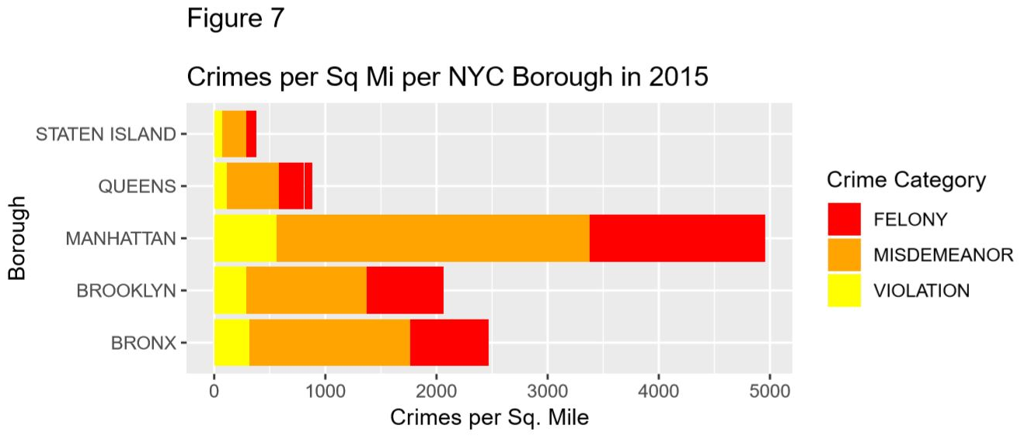
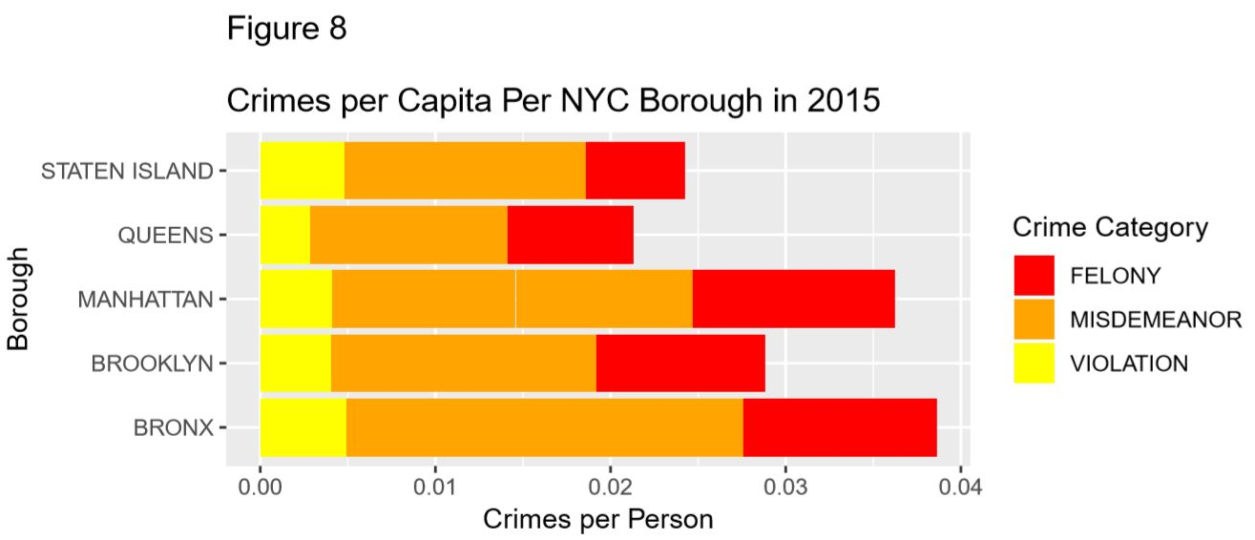
Our Findings: Square Mile vs. Per Capita
Manhattan is the most crime dense borough
Crimes per capita is more evenly distributed for the boroughs
Note the change in Staten Island, this is because its large size and smaller population

Slide 14
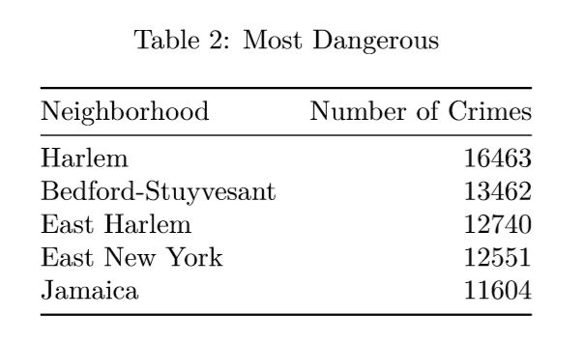
Our Findings: Most Dangerous

Slide 15
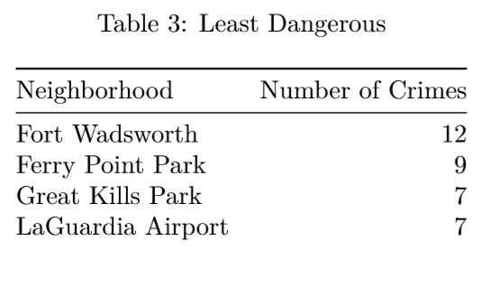
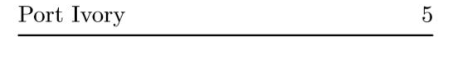
Our Findings: Least Dangerous
* Great Kills Park only had 2 Murders in 2015

Slide 16
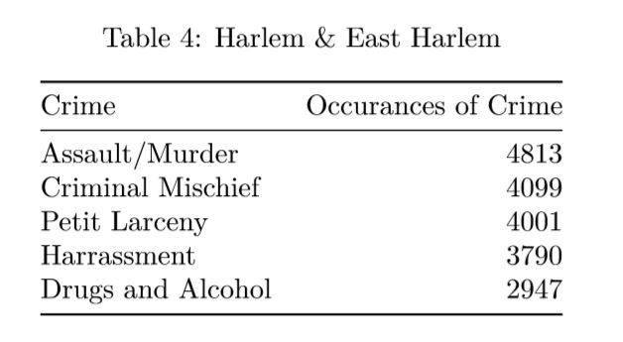
Our Findings: Harlem and East Harlem

Slide 17
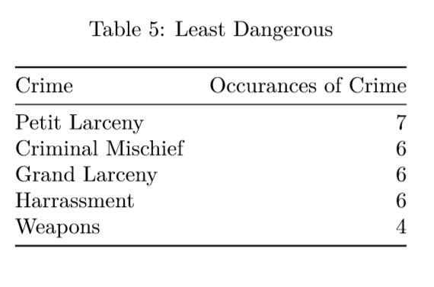
Our Findings: Least Dangerous Crimes

Slide 18
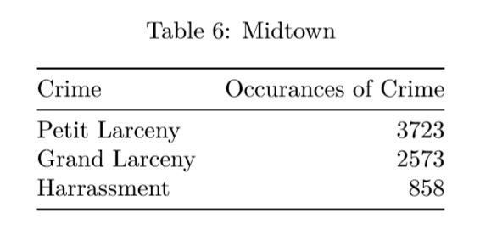
Our Findings: Times Square (Midtown)

Slide 19
Conclusions
Crime areas have no pattern, no ‘bad-side’ of town
Temperature and seasons have a noticeable effect on crime rates
Individual neighborhoods paint a much clearer picture than boroughs
Boroughs are not as dangerous as they may seem, only a few neighborhoods to always avoid

Slide 20
Future Goals
Work more with Google API and Google Map routes and get a faster API
Route suggestion based on safest neighborhoods
Become a mobile app and expand to new cities
Real-time updates, safe spaces, and police alerts

Slide 21
Shiny App Demonstration Thank you

