Slide 1
Project

Slide 2
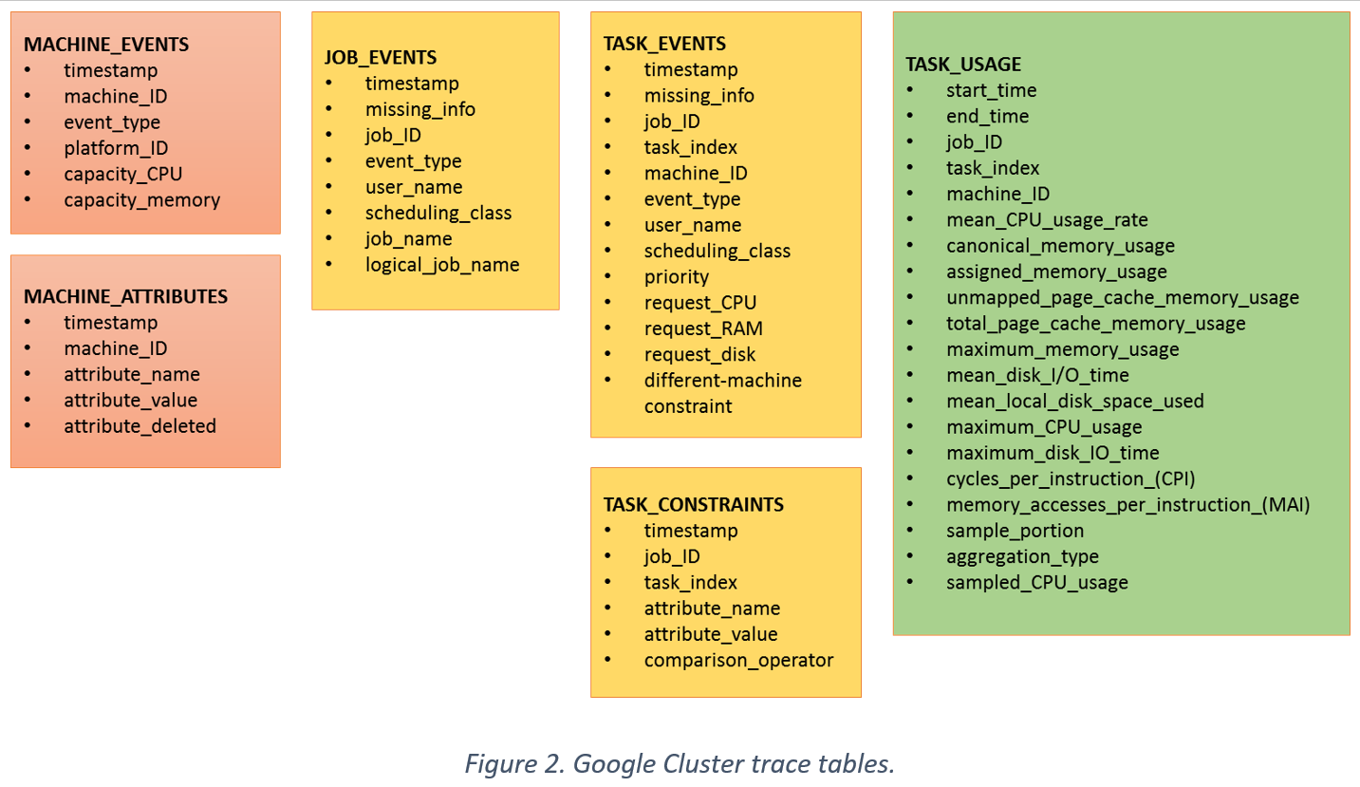

Slide 3
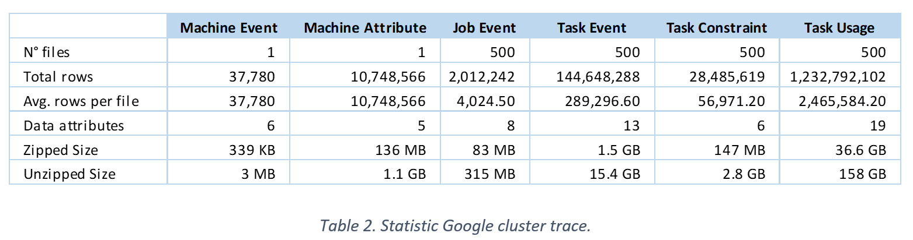
Google cluster trace

Slide 4
Operations
Functions:
Insert
Delete
Select
Update

Slide 5
Topics
Indices
Transactions
Multiuser (concurrency)
Distributed (*)

Slide 6
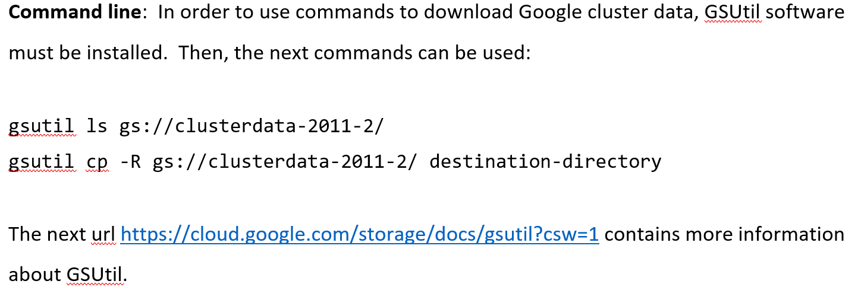

Slide 7
Team
4 personas
Git hub

