Slide 1


Hack the Uterus !:
el repte NEST
NSMP Endometrial Stratification Tool
Grup de Recerca en Patologies Ginecològiques i de la Mama
Alba Farrés, Ramon Rovira, Silvia Martorell, Andrea Amadeo, Miguel Ángel Rios, Nicolás Martínez, Elisa Llurba, Silvia Cabrera.
#BitsxlaMarató
12 Desembre 2024

Slide 2
Endometrial cancer: the molecular era
Most common gynecologic cancer in developed countries; incidence rising
Typical age: 60–65 years
Key symptom: postmenopausal abnormal uterine bleeding
Risk factors: obesity, nulliparity, metabolic syndrome/diabetes
Histology: mainly endometrioid; serous/clear cell less common but more aggressive
Primary treatment: surgery; adjuvant therapy per risk stratification
Prognosis: ~75% diagnosed at stage I–II; 5-year OS in stage I >80–90%
Notes:
Canc. Ginecologic + freq. En països desenvolupats
Perfil edat: 60-65a
FR: obesitat, nul·liparitat, sd.metabòlic (diabetis) -🡪 incidència i prevalencia en ascens
Pronostic

Slide 3
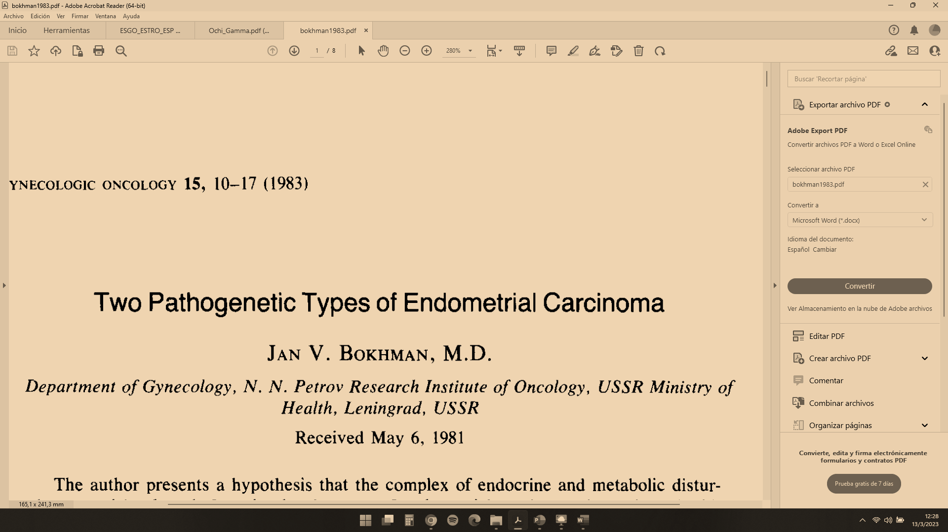
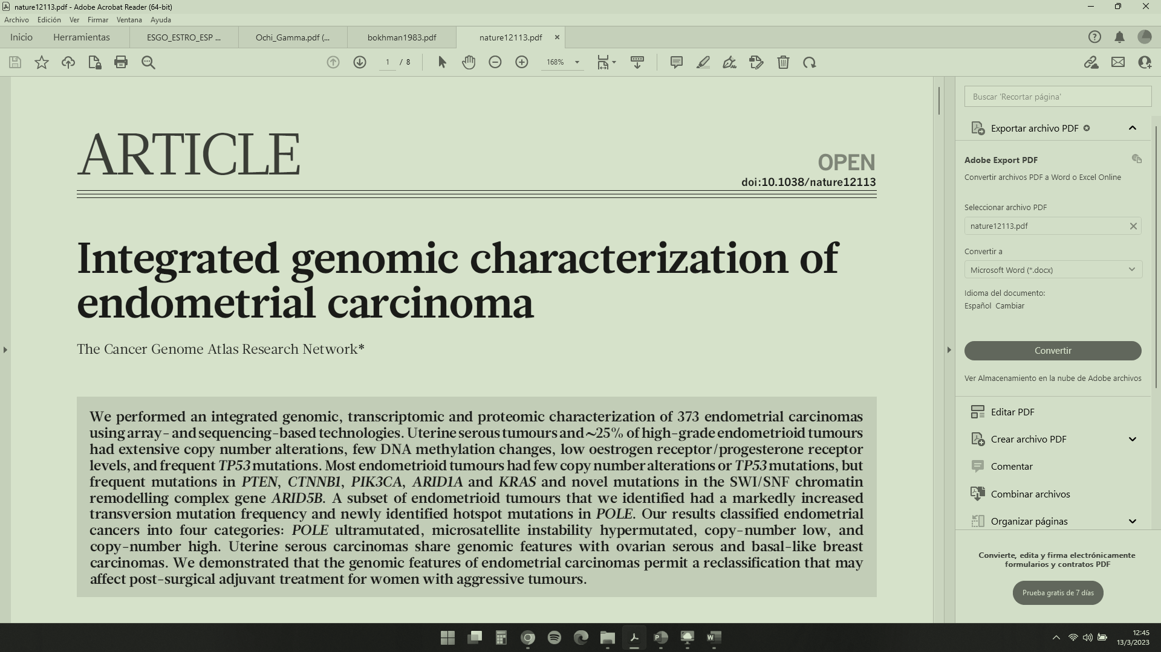

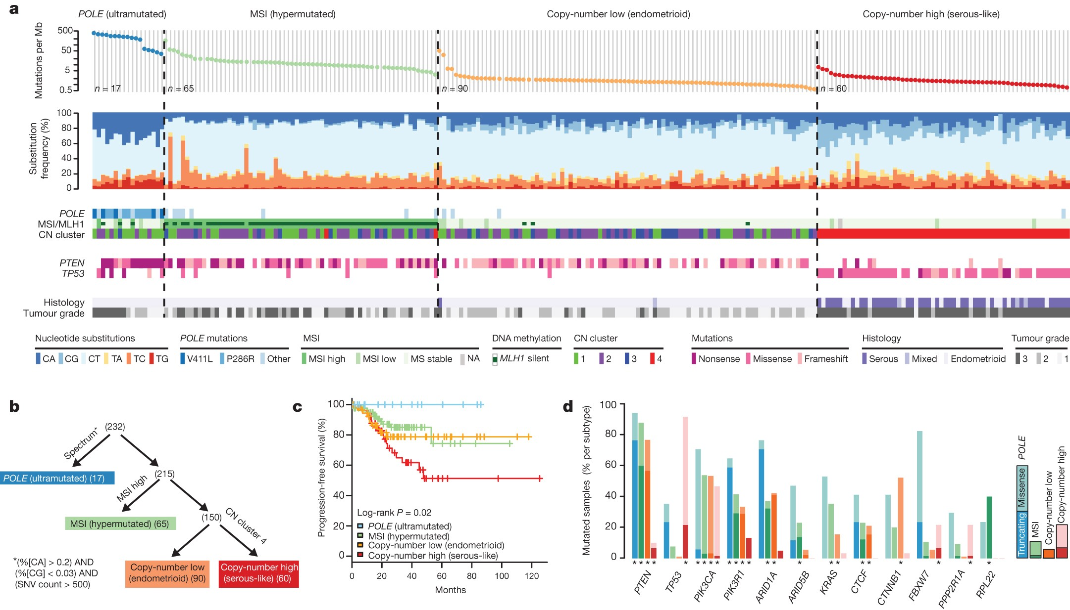
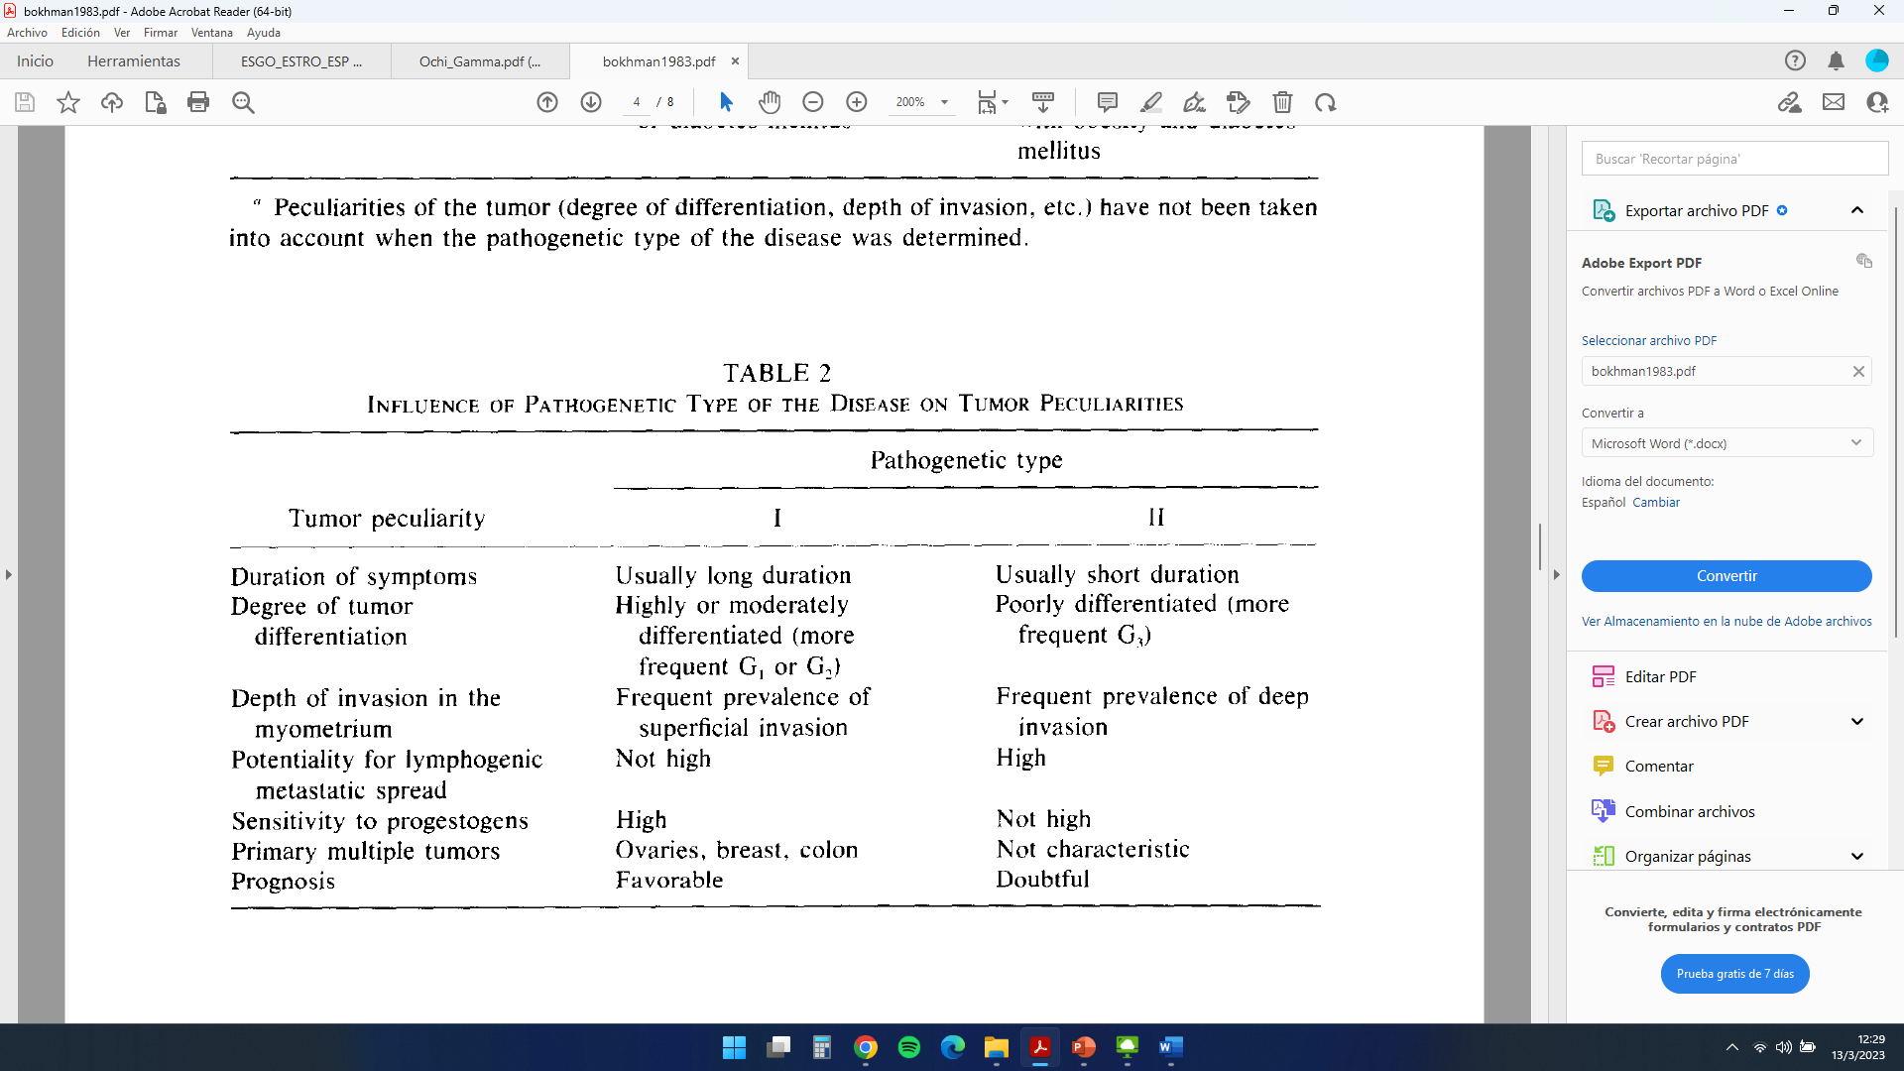
Endometrial cancer: the molecular era
Gynecol Oncol. 1983 Feb;15(1):10-7. doi: 10.1016/0090-8258(83)90111-7
Nature 497, 67–73 (2013). https://doi.org/10.1038/nature12113

Slide 4
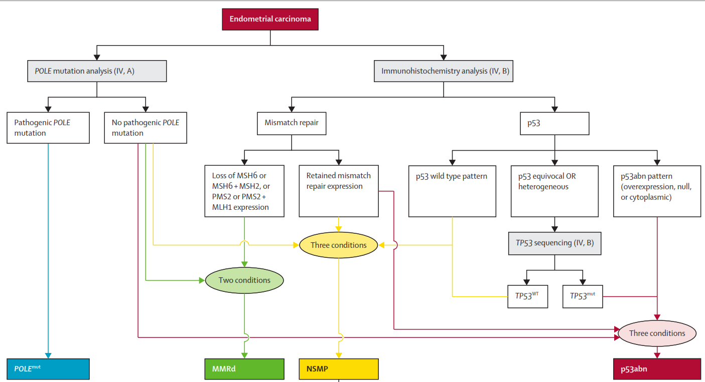
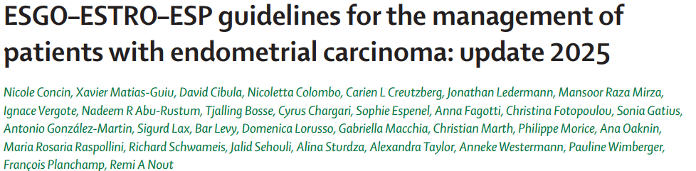
Endometrial cancer: the molecular era
≈ 50% EC
Diagnosis by exclusion
Uncertain prognosis
≈ 7 - 10%
≈ 25 - 30%
≈ 20%
Algorithm for assessment of molecular classification of endometrial carcinoma

Slide 5
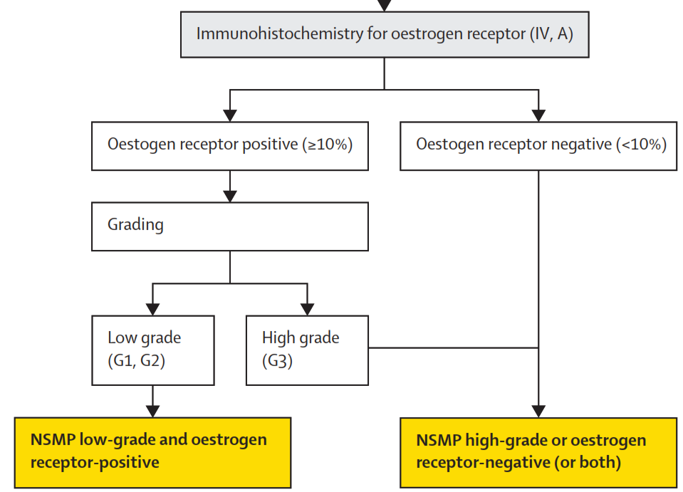
Endometrial cancer: the molecular era
Algorithm for assessment of molecular classification of endometrial carcinoma

Slide 6
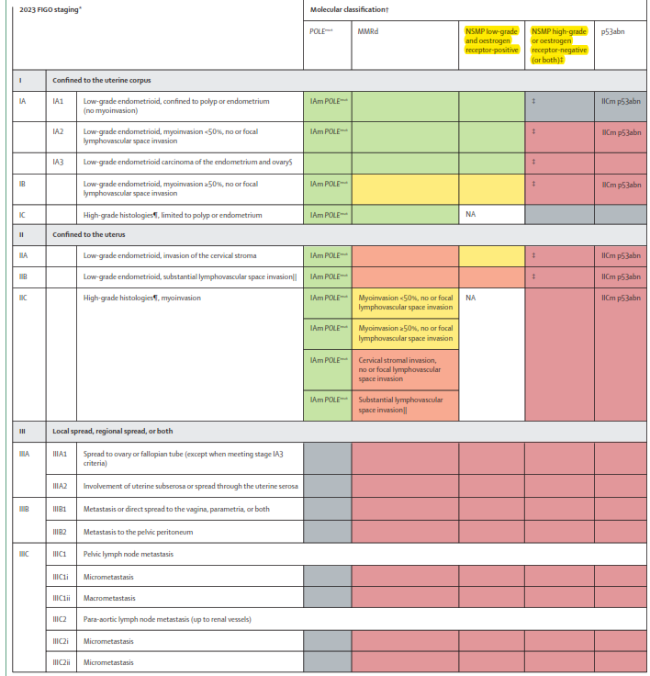

Endometrial cancer: the molecular era
NSMP
Low-grade
Rc Es +
High-grade
Rc Es -
Notes:
Downstaging: Pacientes con POLEmut en estadios I-II se reclasifican como IAm POLEmut (71.4% de casos)
Upstaging: Pacientes con p53abn se reclasifican como IICm p53abn (37.5% de casos) K. Han et al., 2024
Key differences from 2009 include:
Molecular classification now impacts staging
More granular subdivision of advanced stages
Downstaging of low-grade endometrioid tumors with isolated adnexal metastasis
Detailed lymph node metastasis classification (micro vs. macrometastasis)
Refined stage IV categorization based on metastasis location
The evidence is robust, analyzing over 5,000 patients across different stage cohorts. The new system provides more precise prognostic stratification, with statistically significant mortality differences between subgroups. For instance, patients with single distant metastases had notably different 5-year survival rates compared to those with multiple metastases

Slide 7
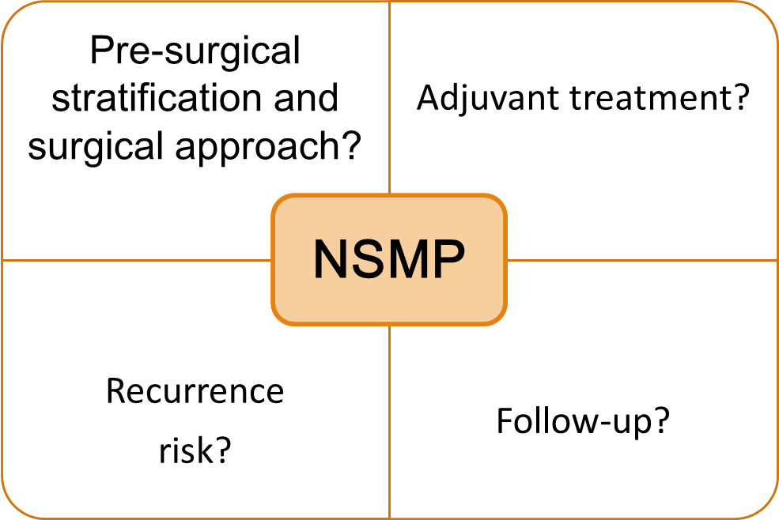
Why We Need a Prognostic Tool for NSMP
≈ 50% EC
Diagnosis by exclusion
Uncertain prognosis

Slide 8
Our Proposal: Developing a Prognostic Model
We aim to improve risk stratification for NSMP endometrial cancer through a robust and validated prognostic model

Slide 9

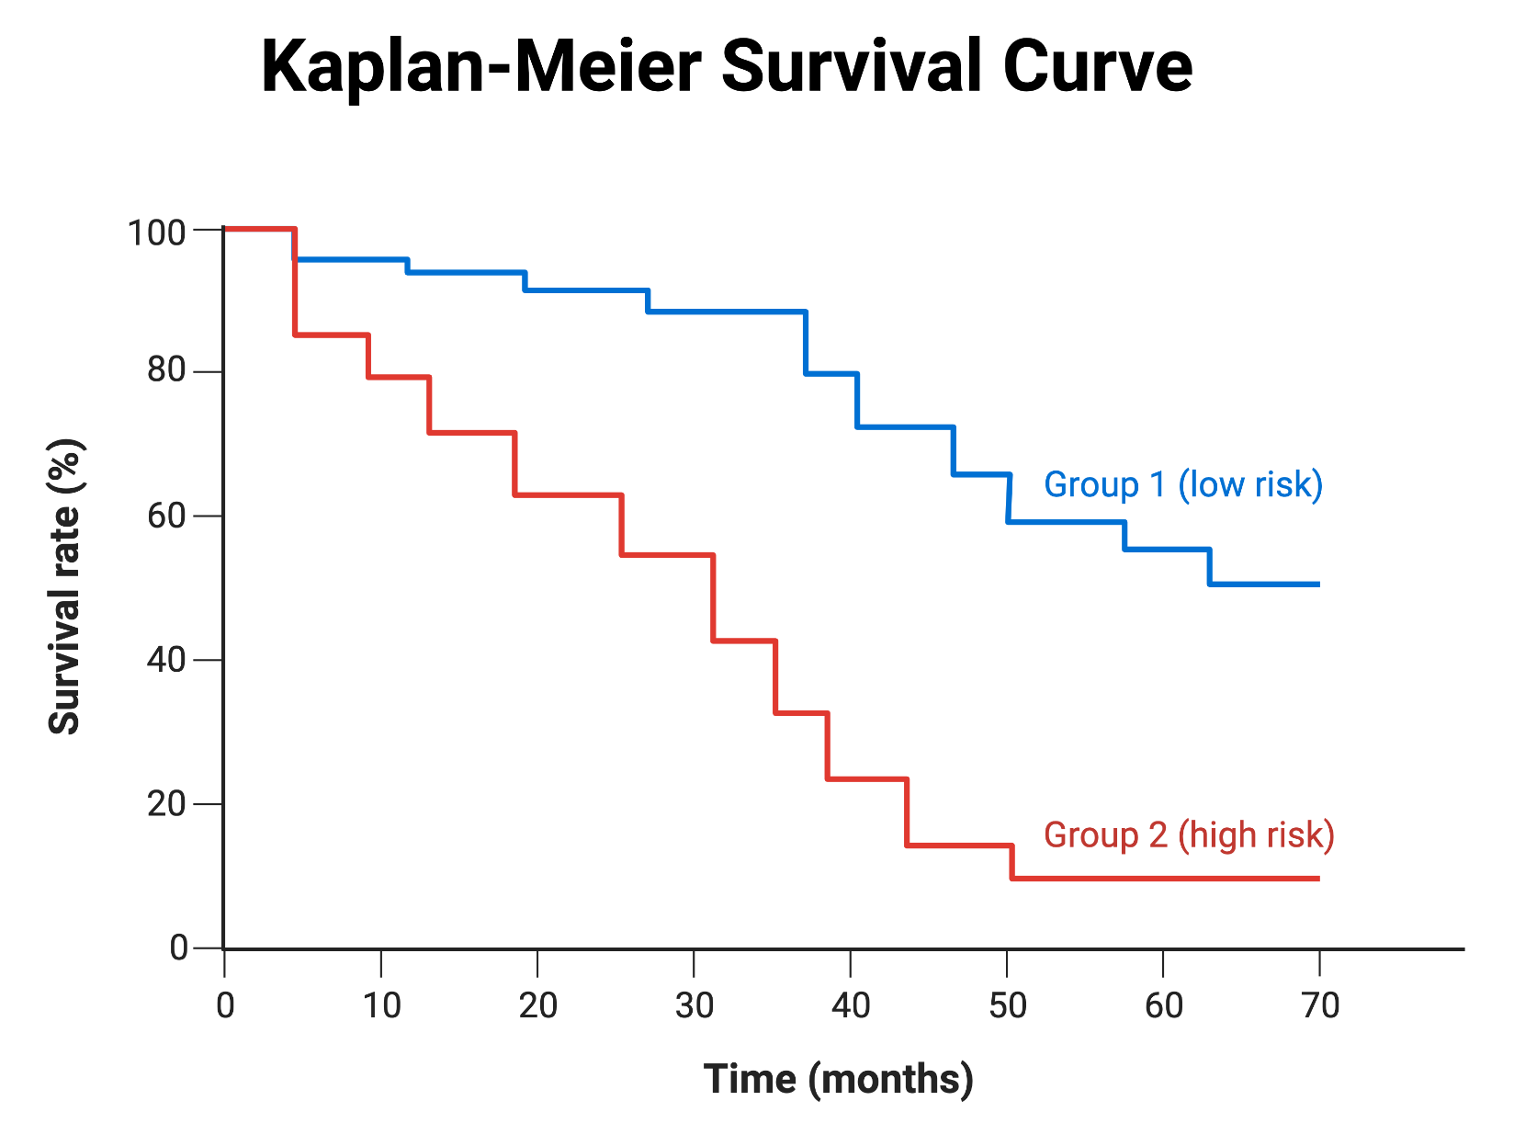
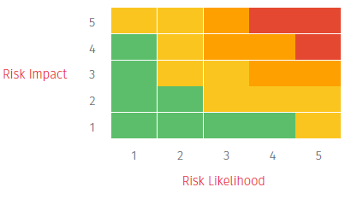
Developing a Prognostic Model:
Clinico – pathological and Molecular Tool
Integrate clinicopathological and molecular factors
Build a risk prediction model
Transform results into a user-friendly digital calculator

Slide 10

Developing a Prognostic Model:
Clinico – pathological and Molecular Tool
Integrate clinicopathological and molecular factors
Build a risk prediction model
Transform results into a user-friendly digital calculator
Support personalized treatment decisions
Improve accuracy of risk stratification
Provide a practical tool for clinicians

Slide 11
Study Design and Potential Digital Health Integration
Study design
Retrospective observational cohort study
Development cohort: N≈150
Validation: internal (testing the model) + external (multicenter cohort)
Outcomes: recurrence-free survival, overall survival
Digital Health
Goal: translate the model into a practical tool
Potential forms: web-based calculator, Mobile interface, Integration into clinical workflow
Notes:
1rst question:
Is better to use the bigger cohort for development and the little for validation?

Slide 12
Variables of interest
Fecha nacimiento
Edad
IMC
Fecha diagnóstico (AP)
Tipo histológico
Grado
Infiltración miometrial
Metástasis a distancia
Riesgo preIQ ?? Estadiaje preIQ ??
Tratamiento neoadyuvante
Tratamiento 1o quirurgico
ASA
Tipo histológico definitivo
Grado histológico
Tamaño tumoral
Afectación linfovascular
AP centinela pélvico
AP ganglios pélvicos
AP ganglios paraórticos
Receptores Estrogenos
Receptores Progesterona
Estudio genético
Estadio Quirurgico FIGO 2018 / 2023
Grupo de riesgo definitivo (???)
Tributaria a radioterapia / braquiterapia / sistémico
Fecha ultima visita
Recidiva
Estado actual paciente
Causa muerte
Fecha muerte
Libre enfermedad
Numero recidiva
Fecha recidiva
Diagnostico, numero, lugar
Tratamiento recibido para la recidiva
Tratamiento quirúrgic recidiva
Reseccion macroscopica completa
Tratamiento RT / sistémico

Slide 13



Expected Impact: Towards Personalized Care
More personalized treatment decisions
First NSMP-specific prognostic model externally validated
Clinical impact
Scientific impact
Technological impact
Digital tool ready for clinical use

Slide 14
Thank you for your attention

