Slide 1
Summary of Project Architecture and Objectives

Slide 2
Background Arguments
5G architecture, network slices
Federated Learning
Application of FL models to enhance 5G capabilities
Kubernetes

Slide 3
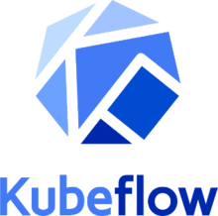
Kubeflow Platform
Kubeflow is an open-source platform that aims to easily manage and deploy End-to-End ML procedures.
It was born with the idea of being:
COMPOSABLE:
it is compatible with the most used ML platform in the Data Science and ML community
( Tensorflow,PyTorch..)
PORTABLE:
Since under the hood it is supported by a K8s cluster it can be runned anywhere K8s is present
( Onprem, GCP , AWS)
SCALABLE:
Exploiting Kubernetes ‘s orchestration abilities it is possible to design scalable ML procedures
with different type of resources (CPUs,GPUs,TPUs) and augment and reduce theyr number by
need.

Slide 4
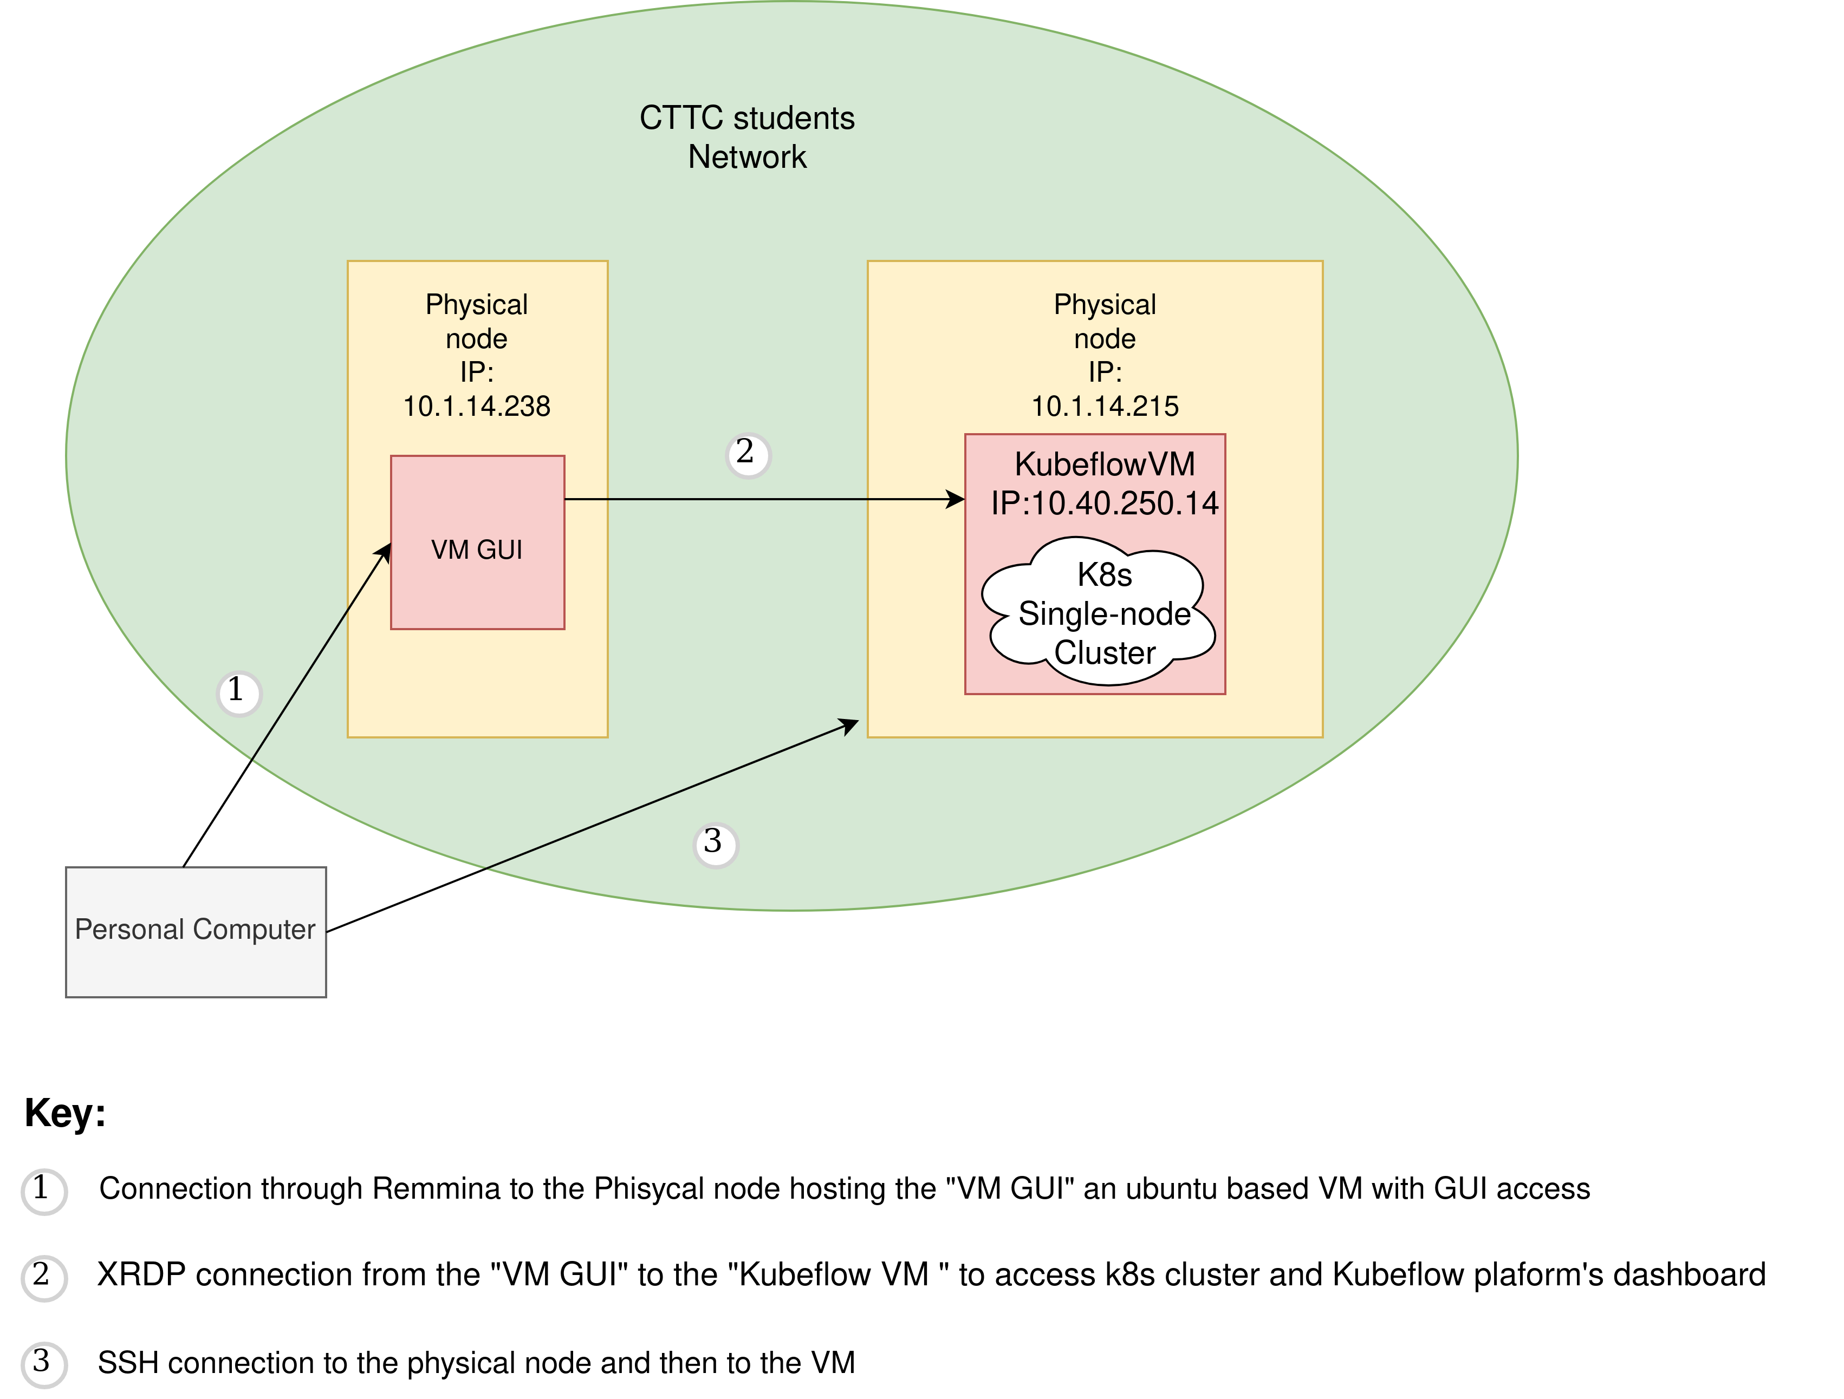
ACTUAL PROJECT ARCHITECTURE

Slide 5
Kubeflow Installation
Altough it comes in many ready to use distribution exploiting third part companies expecially in the GCP and AWS we have decided to deploy it manually on an On-prem K8s cluster hosted in the CTTC network.
The installed version is the 1.4 following the Kubeflow manifests WG at https://github.com/kubeflow/manifests.
The tool used for the installation are :
Kubeadm, Kubelet v1.20 : needed to set up the K8s single-node cluster
Kustomize v 3.2.0 : needed to deploy manifests from the cloned directory piped with kubectl
Kubectl v1.20 : needed to connect to k8s cluster from “VM GUI” and “Kubeflow VM” and to use kustomize

Slide 6
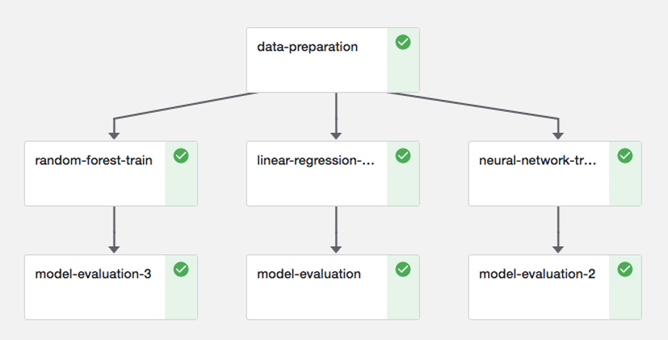
Kubeflow Pipelines
Is a powerful tool to deploy ML procedures as a whole KF pipeline composed by the ML algorithm’s fundamental steps
managed as single pipeline components with precise input and outputs ( forming a graph) and containerized so that kubernetes can orchestrate them correctly.
The main advantages in using KF pipelines are :
Simplify the Hyperparameters tuning and Serving workflows using an intuitive UI
Accelerate the time to production by reducing the needed time for training and from training to serving
Collaborate faster within the team especially between Data scientists and the MLOps team.

Slide 7
Objectives and Next Steps
The actual architecture is composed by a single-node K8s cluster.
After select the right FL algorithm candidate the idea is to apply the whole ML cycle :
Transorm the ML algorithm ( ex notebook) in a KFPipeline
Deploy the pipeline
Perform parallel Training rounds using Kubeflow
Get the best HyperParameters and some other Metric to be decided using Katib
Add some worker node to the cluster so it will be multi-node
Repeat the steps before with the new k8s cluster to test the scalability and robustness of the platform

