Slide 1
Data Science Flex Program
Midterm Project
Abahk, Paul
Forensca, Leonardo (Leo)
San Pedro, Nico

Slide 2
Agenda
Introduction
Part I – Key Insights
Part II – Anatomy of the Dashboard
Part III – Dashboard Demo

Slide 3
Introduction
Dataset: 2018 – 2020 Traffic Incident
Goal: Create an interactive dashboard to review recent data for future planning and decision making.

Slide 4
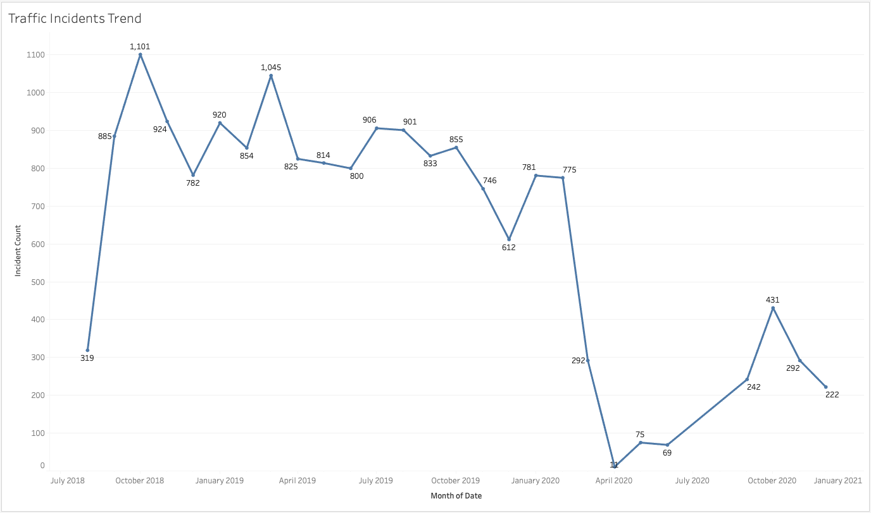
Part I – Key Insights

Slide 5
Pre-Pandemic Traffic Incidents

Slide 6
During Pandemic
Traffic Incidents

Slide 7
Lockdown Started

Slide 9
Over 2/3 of the incidents were caused by Vehicular Accidents

Slide 10
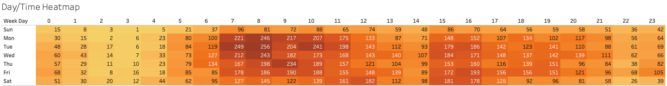
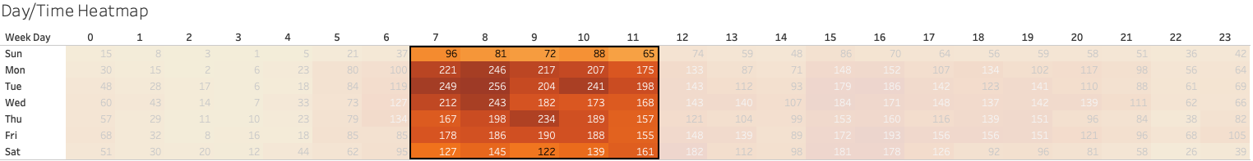

Slide 11
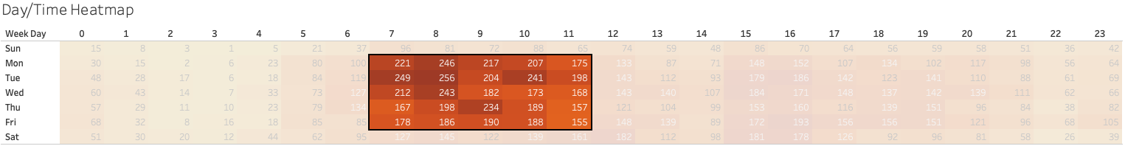
The traffic incidents mostly occurred early in the morning.

Slide 12
Especially weekdays morning

Slide 13
Part I Summary
- The traffic incident was significantly affected by the COVID-19 restrictions starting March/April 2020.
- Majority of the reported traffic incidents were caused by vehicular accidents.
- Most of the incidents took place during weekday morning.

Slide 14
Part I Recommendations
- Look into developing an administrative method to limit the volume of vehicles on the road such as enhanced plate coding schemes, express lanes or alternate routes.
- Consider taking public transportation such as busses and trains to reduce the volume of private vehicles on the road.
- Stay focused on driving and avoid distractions especially during weekday morning.

Slide 15
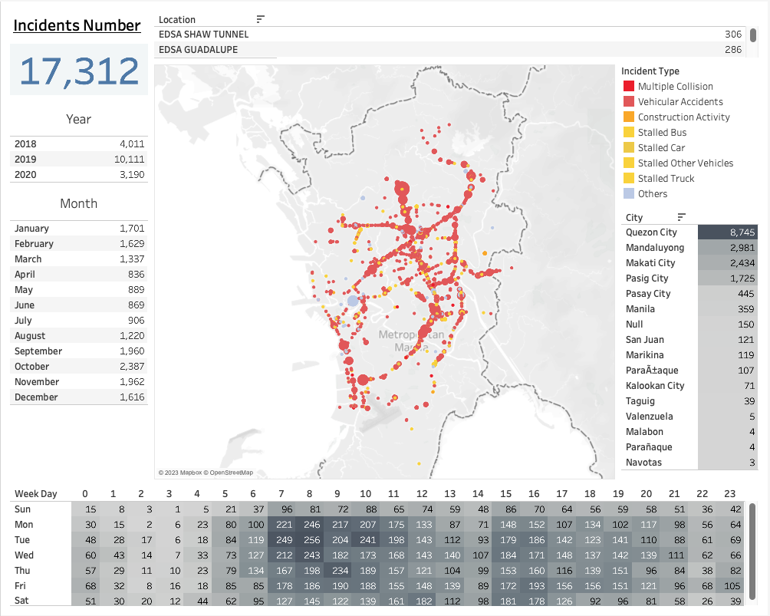
Part II – Anatomy of the Dashboard

Slide 17
Incident Number Card
- shows the incident number based on the current selection.
-by default, it shows all incidents count.

Slide 18
Year/Month Card
- shows the incident count per year and month.
-serves as a filter.

Slide 19
Hours/Weekday Heat Map Card
- shows the incident count as a heat map depending on the current selection./s

Slide 20
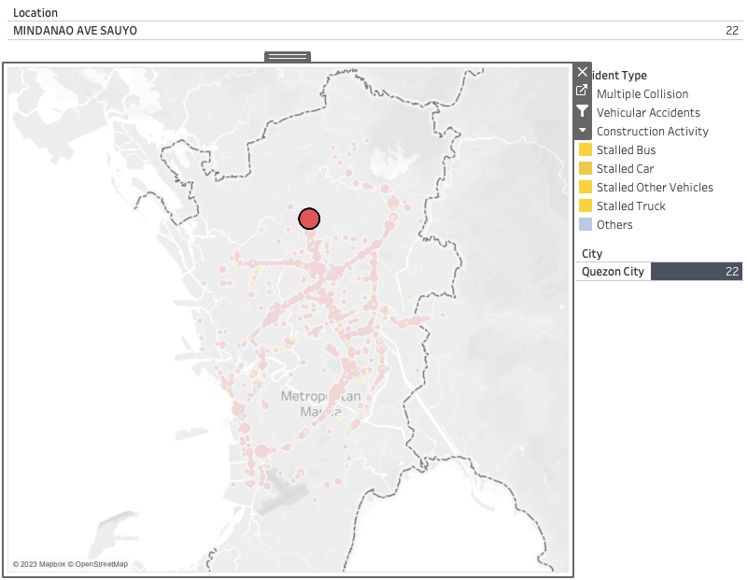
Location/Map Card
- shows the map where the incident have happened.
-

Slide 21
Location/Map Card
- shows the incident types

Slide 22
Location/Map Card
- shows the exact location of the street where the incident have happened.

Slide 23
Location/Map Card
- shows the jurisdiction of which city the incident have happened.

Slide 25
Part II Summary
The dashboard has 4 major parts:
Incident Count Card
Month/Year Card
Week/Hour Card
Location/Map Card

Slide 26
End of Presentation

