Slide 1
Data Visualization and Dashboards with Tableau
Nico San Pedro

Slide 2
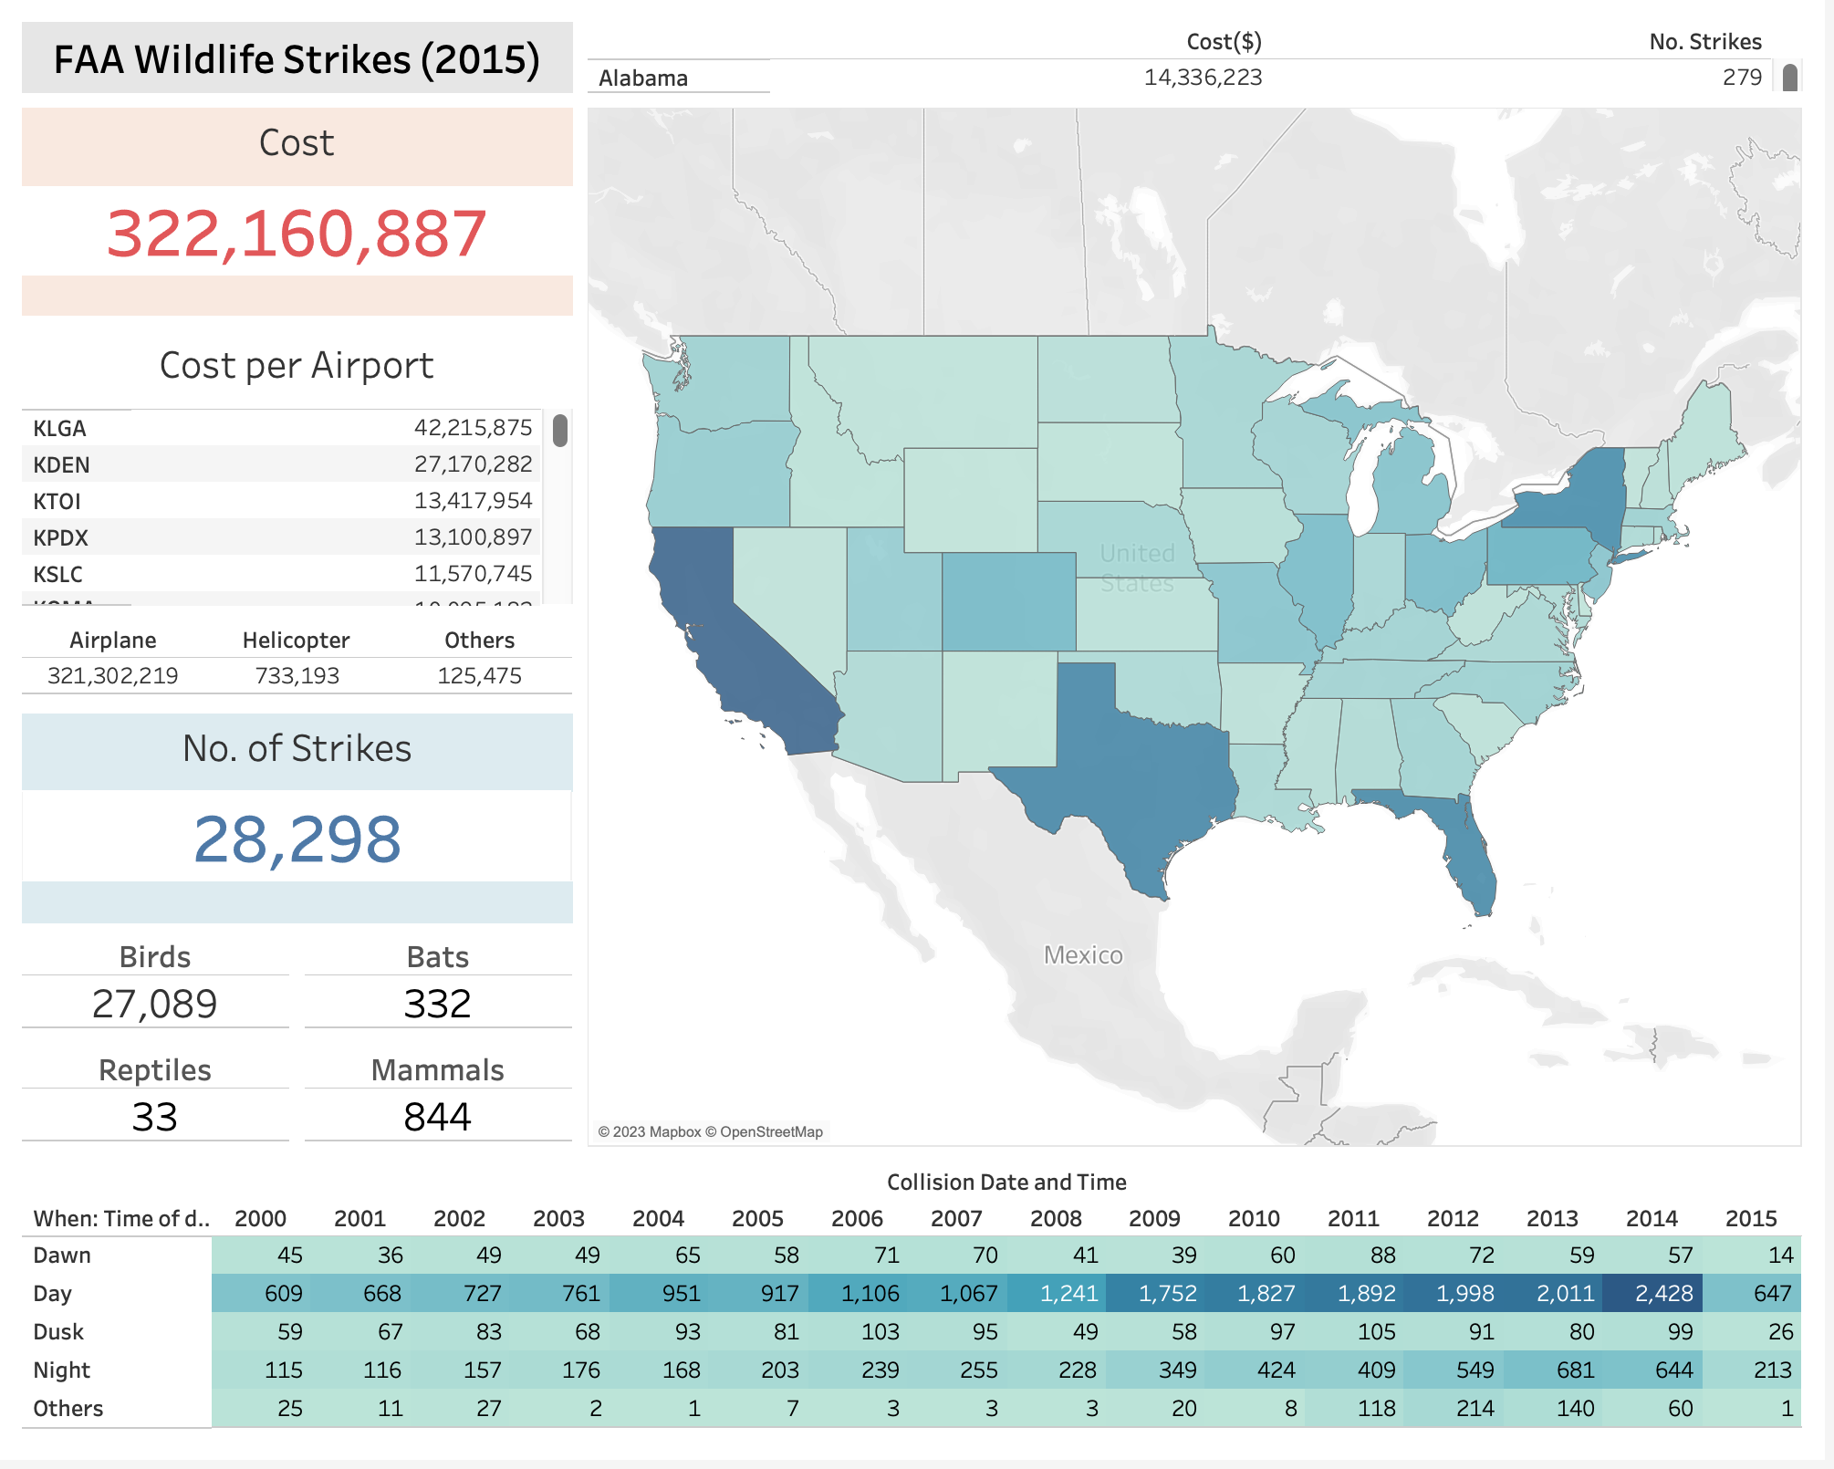

Slide 3
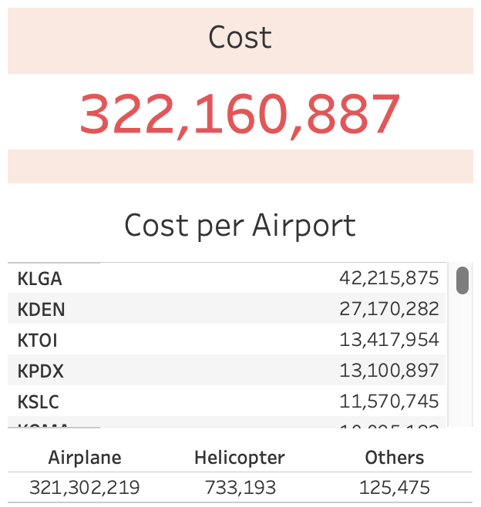

Slide 5
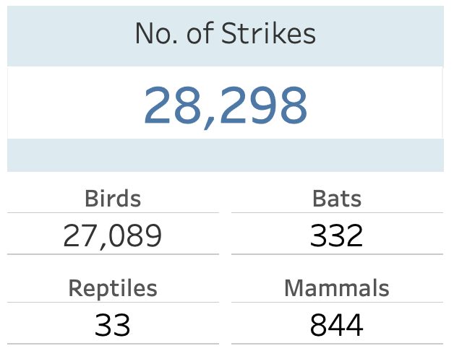

Slide 7
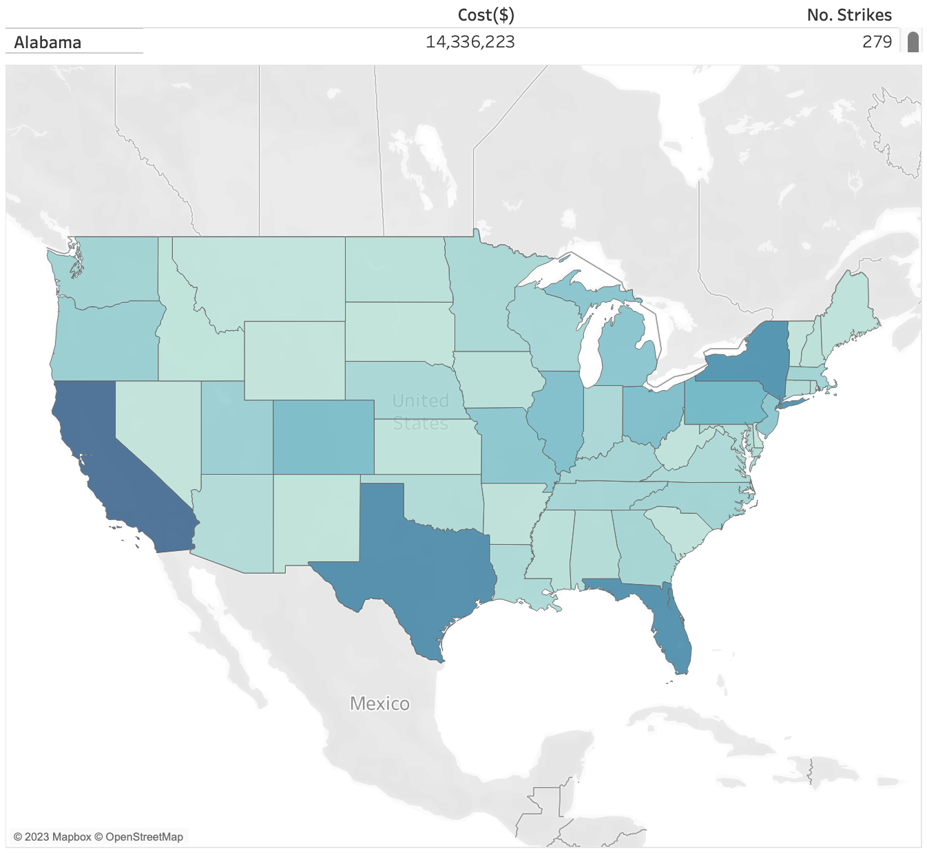

Slide 9


