Slide 1
Data Visualization and Dashboards with Tableau
Nico San Pedro

Slide 2
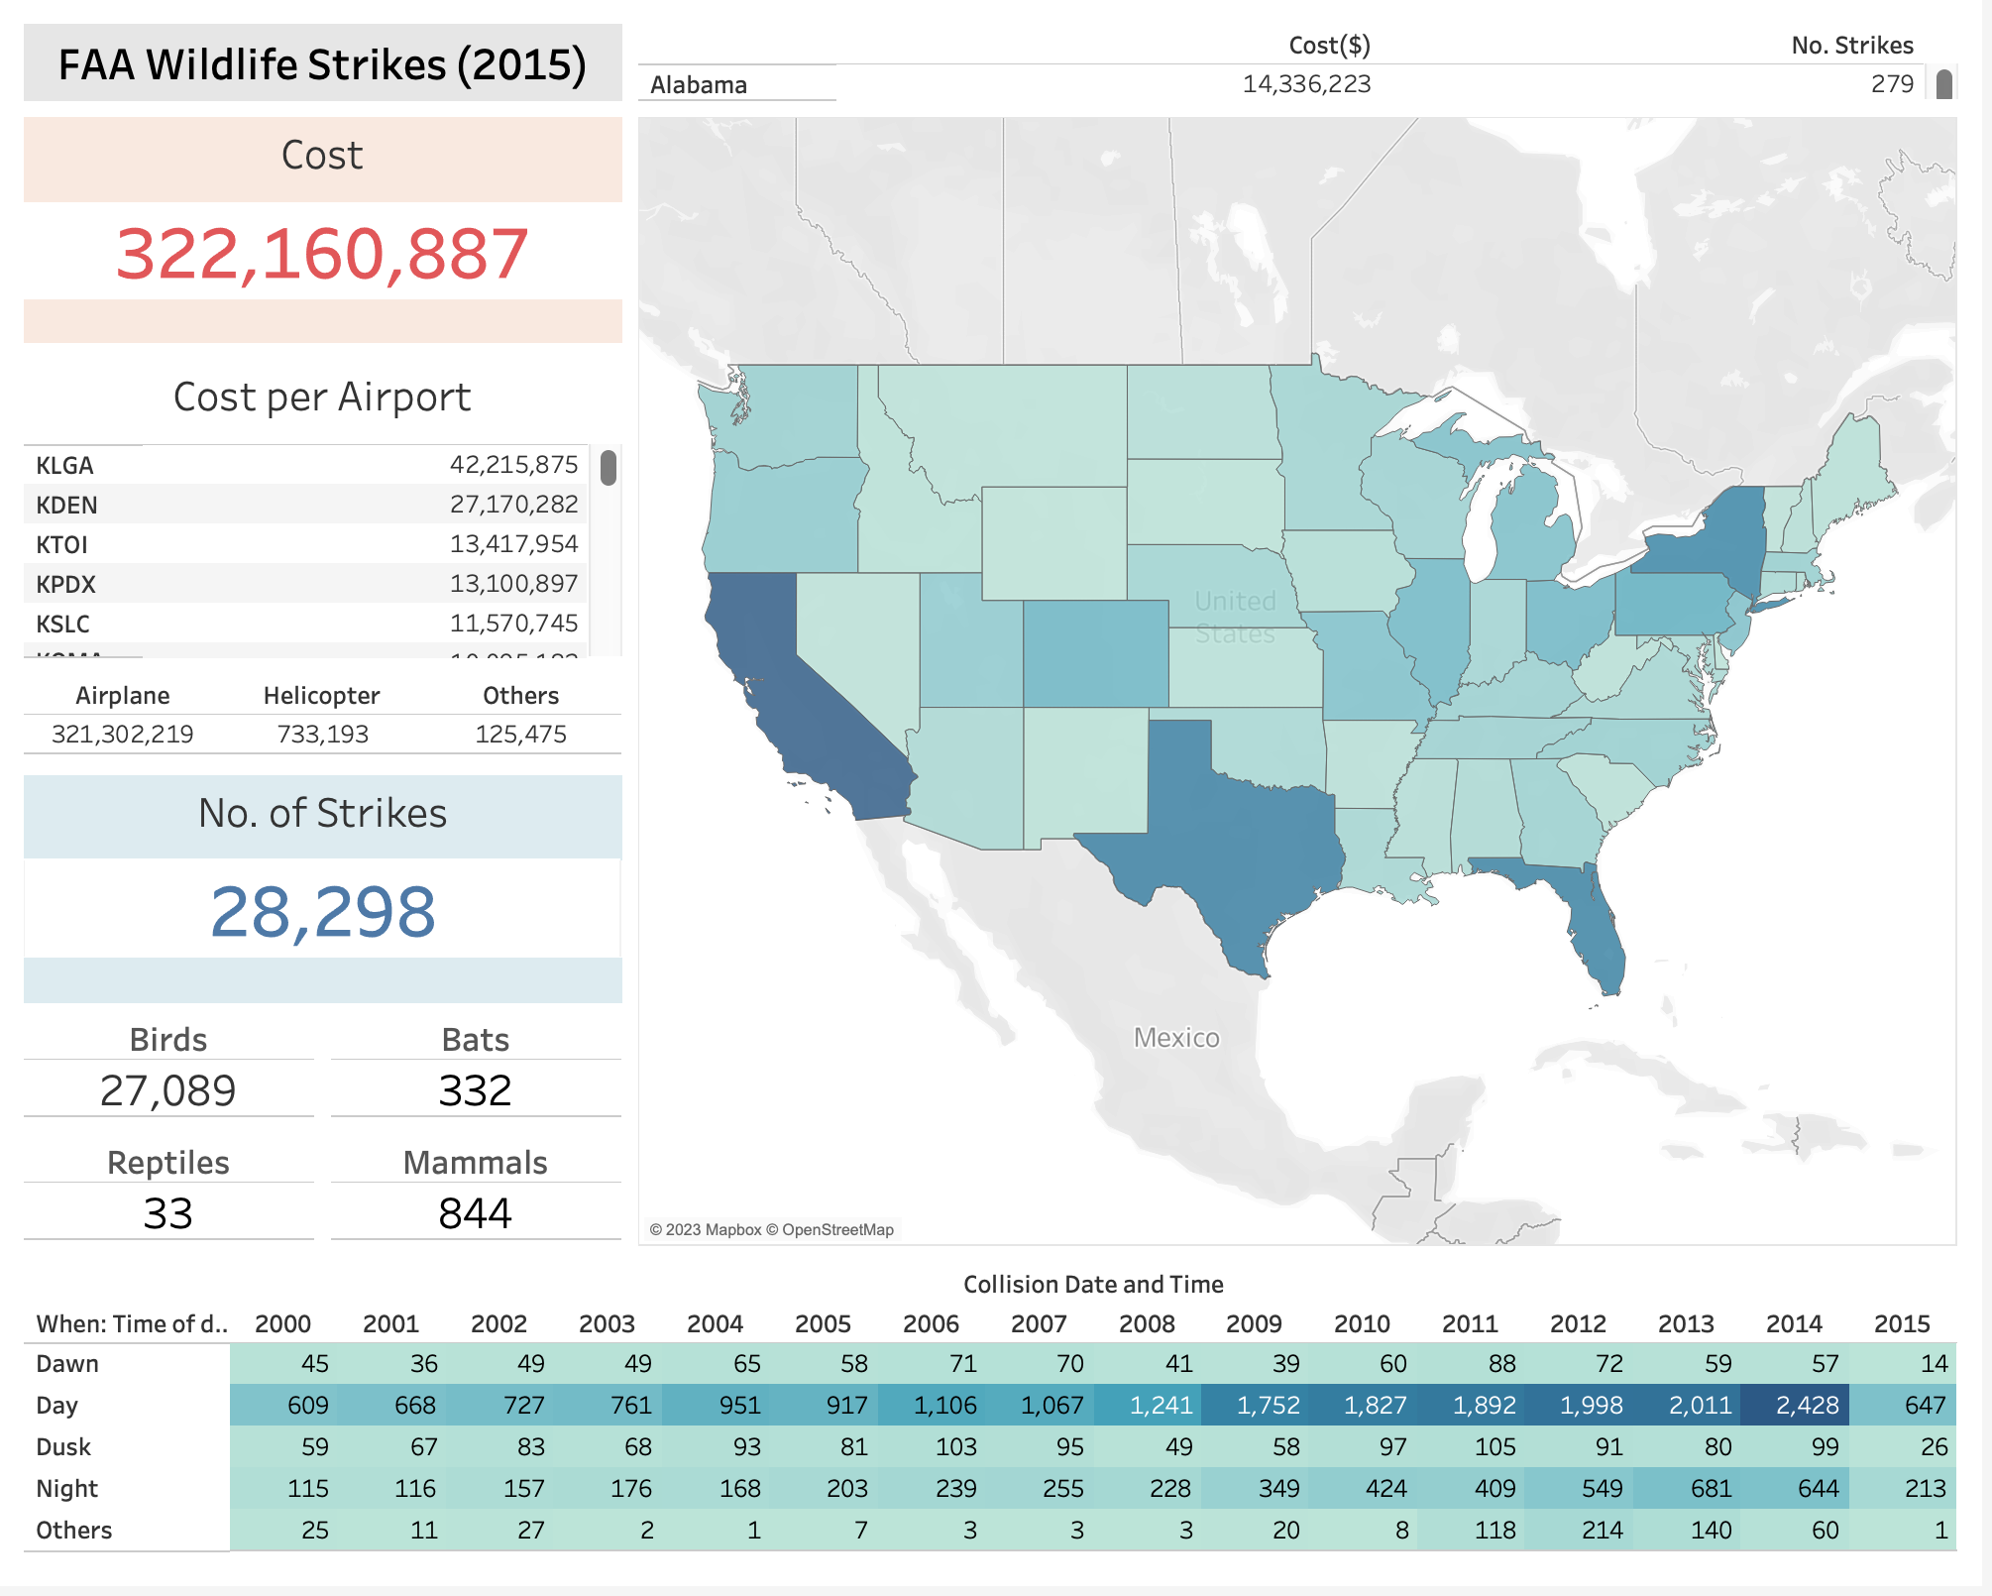
A simple to use and interactive dashboard that shows the significant data about the FAA dataset.
The dashboard has four main parts.

Slide 3
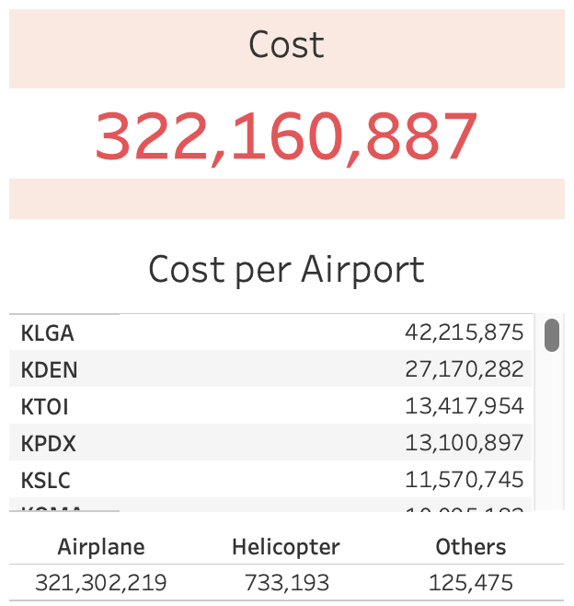
1. Cost Section
- this section updates the overall cost, airport cost and aircraft cost depending on which part of the dashboard is highlighted.

Slide 5
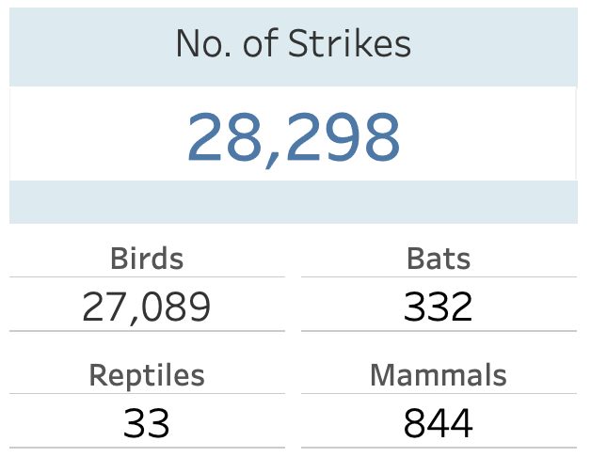
2. Strikes Section
- this section updates the overall strikes and the cause of strike depending on which part of the dashboard is highlighted.

Slide 7
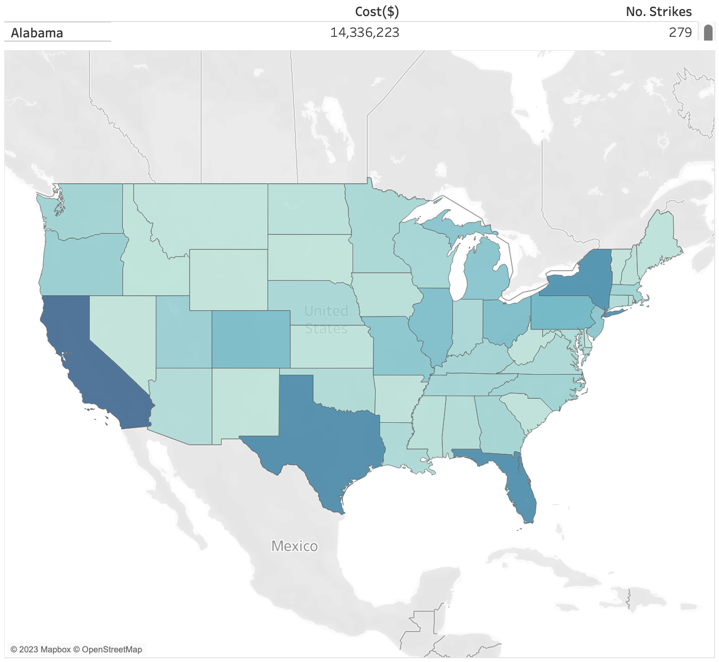
3. Map Section
- this section displays the distribution of strikes, the cost and number of strikes based on the current selected filter.

Slide 9
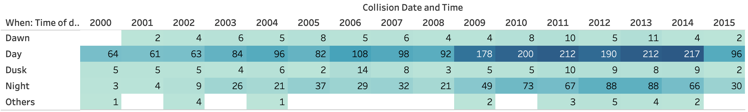
4. Heat Map Section
- this section displays the distribution of the strikes depending on the time of the day and year. It also responds to the current filter selected.

Slide 12
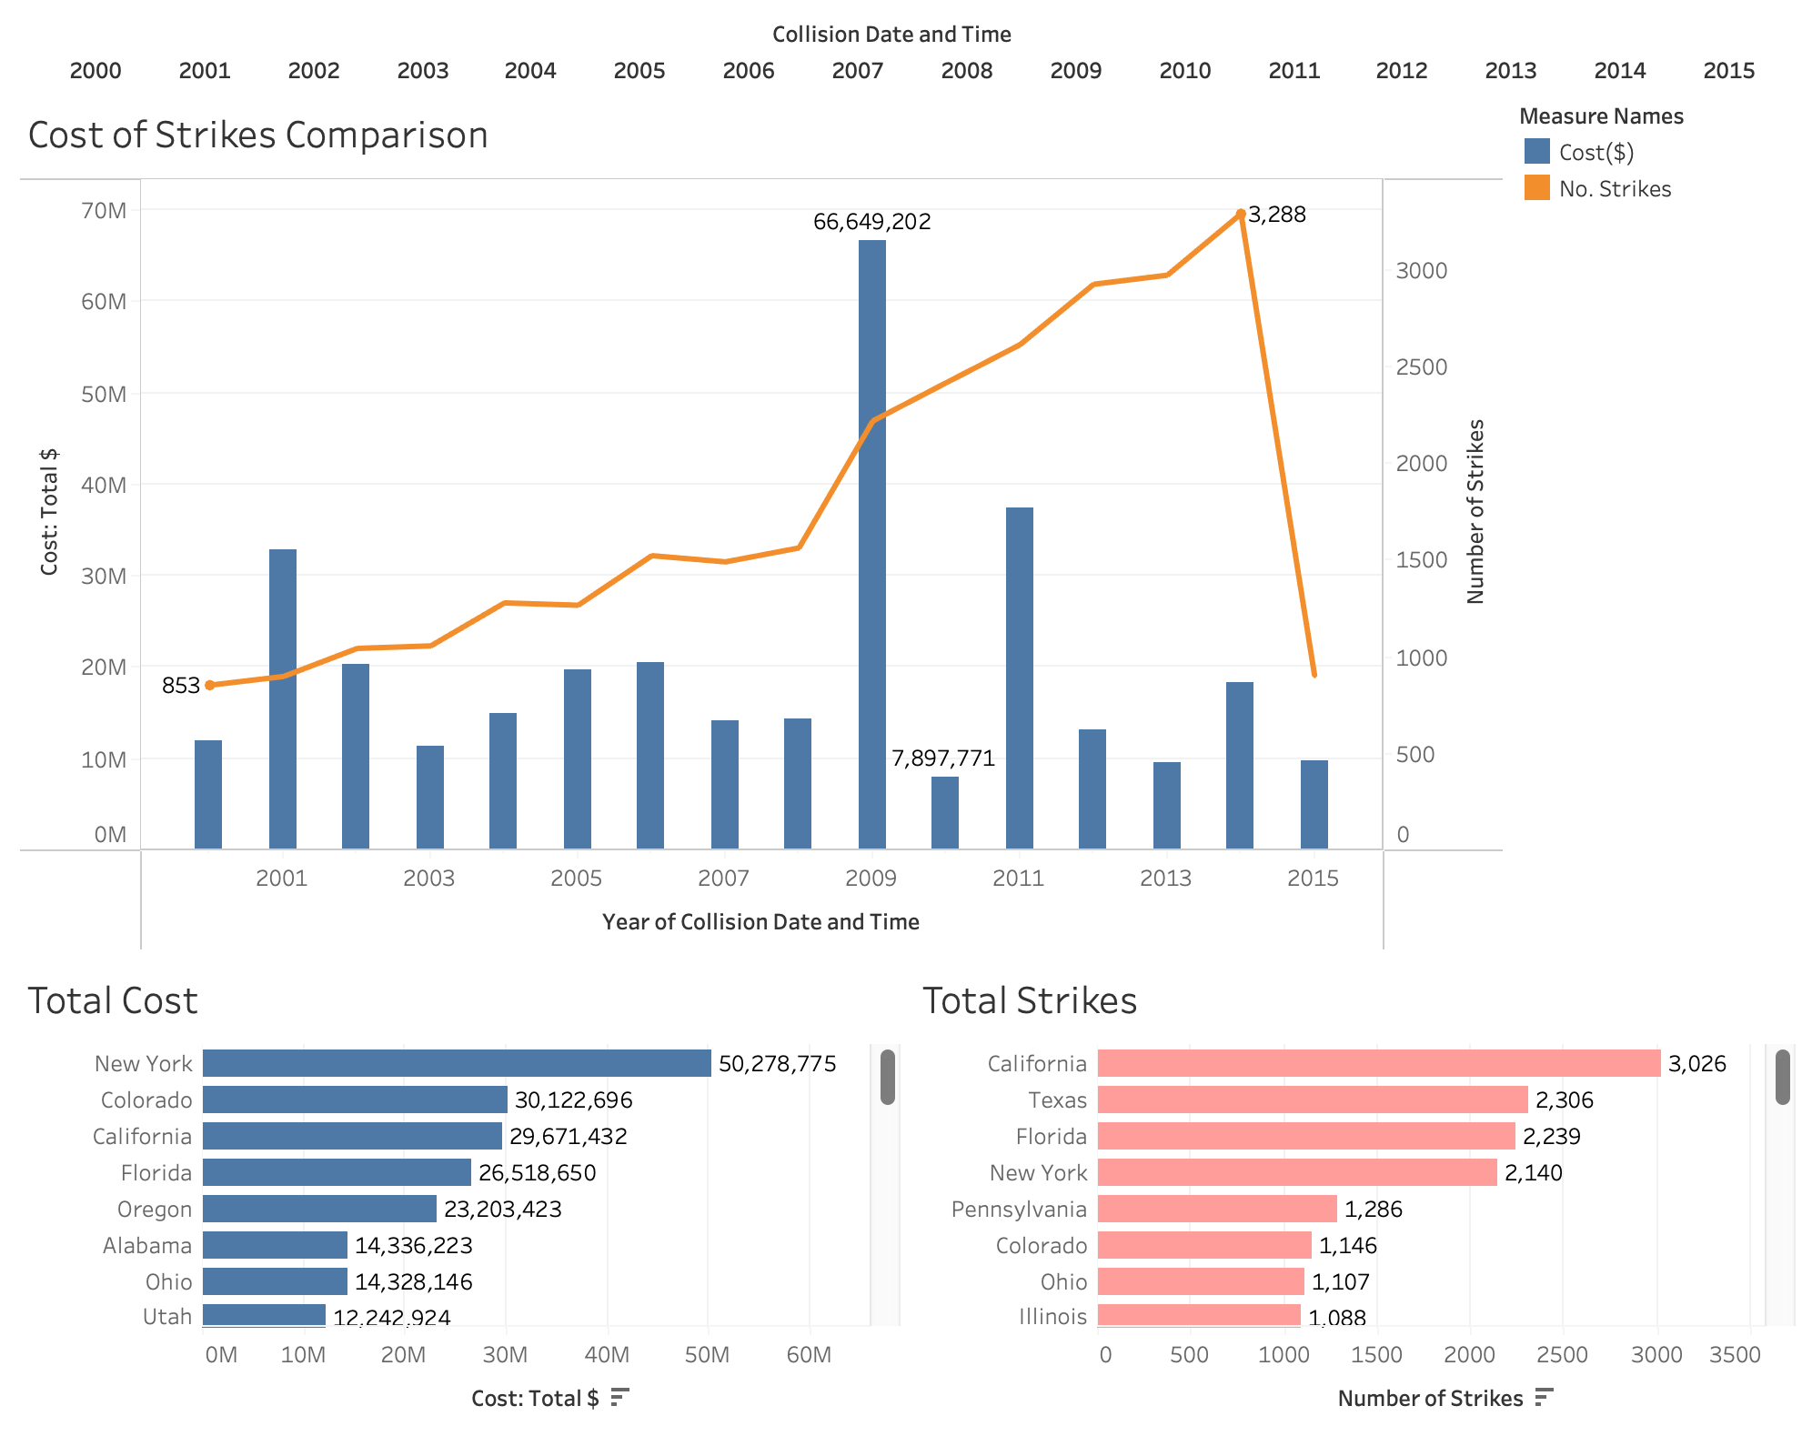
Cost and Strikes Dashboard

Slide 13
Depicted by the blue bar, 2009 has the highest reported aircraft cost inflicted by engine strikes.

Slide 14
Although with less than $20M cost of aircraft damages, 2014 has the highest reported number of engine strikes.

Slide 15
Comparing the two states, New York has the highest overall total cost in aircraft damages inflicted by engine strikes.
However, it is the state of California which have the most number of reported aircraft engine strikes.

Slide 16
Key Insights
California has

