Slide 1
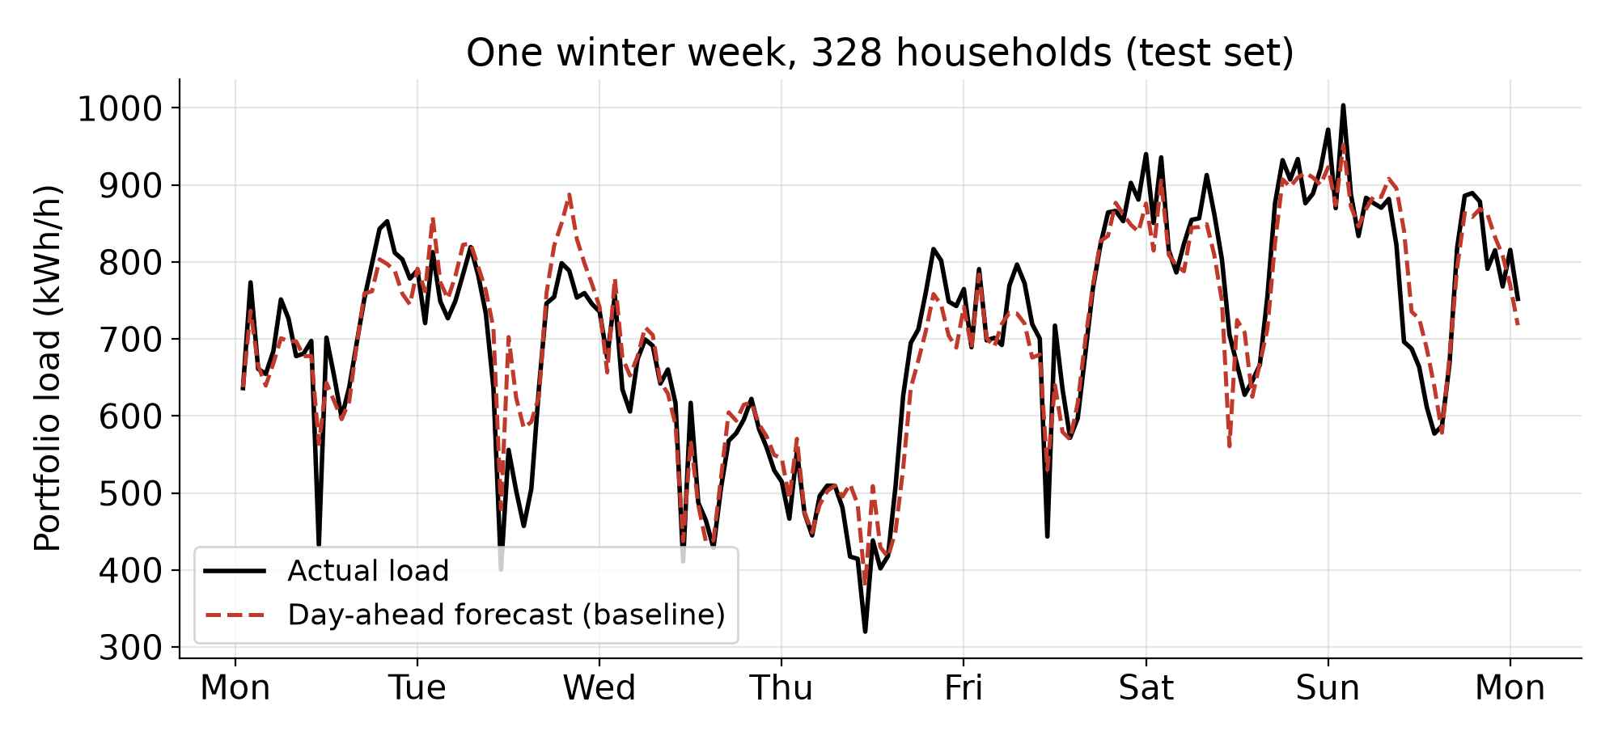
LEVEL 0 - BASELINE
Forecasting tomorrow's load for 328 heat-pump households
Task: hourly portfolio forecast for E.ON's day-ahead purchase
Baseline: one gradient-boosting model; only data known by midnight D-1
Test-year error: nMAE 6.3%
Strict time split: train → validation → test (80/20); the test year decides nothing
Question: does clustering households first make it better?
RWTH Hackathon × E.ON — Bringing the Heat
Notes:
We forecast tomorrow's hourly electricity demand of 328 heat-pump households - the quantity E.ON has to buy on the day-ahead market. Our baseline is a single gradient-boosting model that only uses information available at midnight before the delivery day. On a full, unseen test year it is already accurate: about 6.3 percent normalized error. We split the data strictly in time into training, validation and test, so the test year never influences any decision. Our question: if we first group similar households, does the forecast - and the procurement cost - get better?

Slide 2
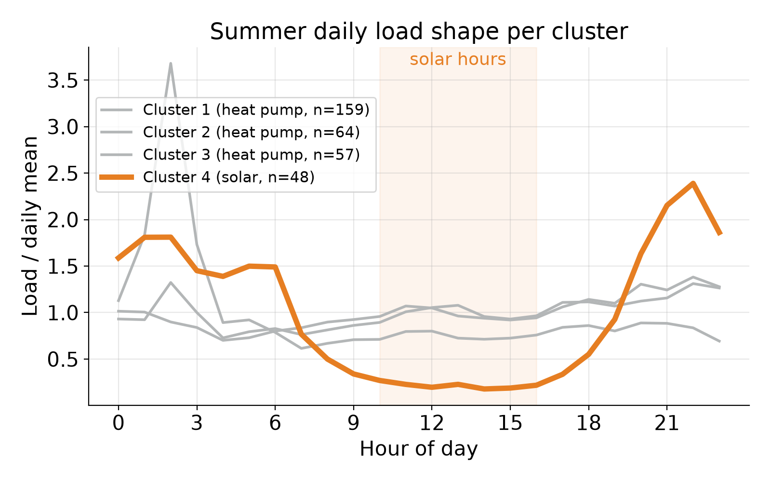
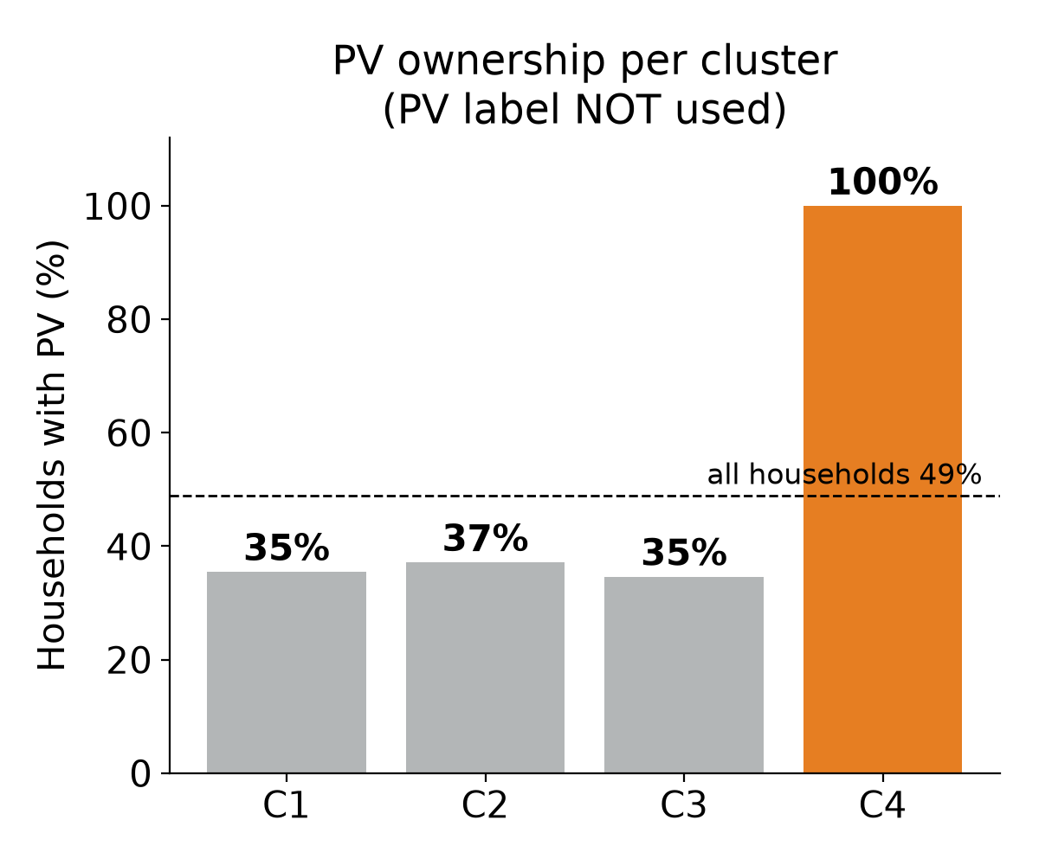
LEVEL 1 - CLUSTERING
Clustering finds the solar owners — without being told
9 load-shape features (temperature sensitivity, solar signature, time-of-day shares), k-means. 48 households, 40/40 known = PV; summer midday load only ~1/4 of morning/evening.
RWTH Hackathon × E.ON — Bringing the Heat
Notes:
We cluster households only on how they use electricity: how strongly they react to temperature, whether their midday load drops when the sun shines, and when during the day they consume. We never give the model the PV label. Still, one cluster of 48 households contains only solar owners - all 40 with a known label - while the other clusters are around 35 percent. In summer their grid demand almost disappears at noon. So clustering works very well as customer insight. The next question is: does it save E.ON money?

Slide 3
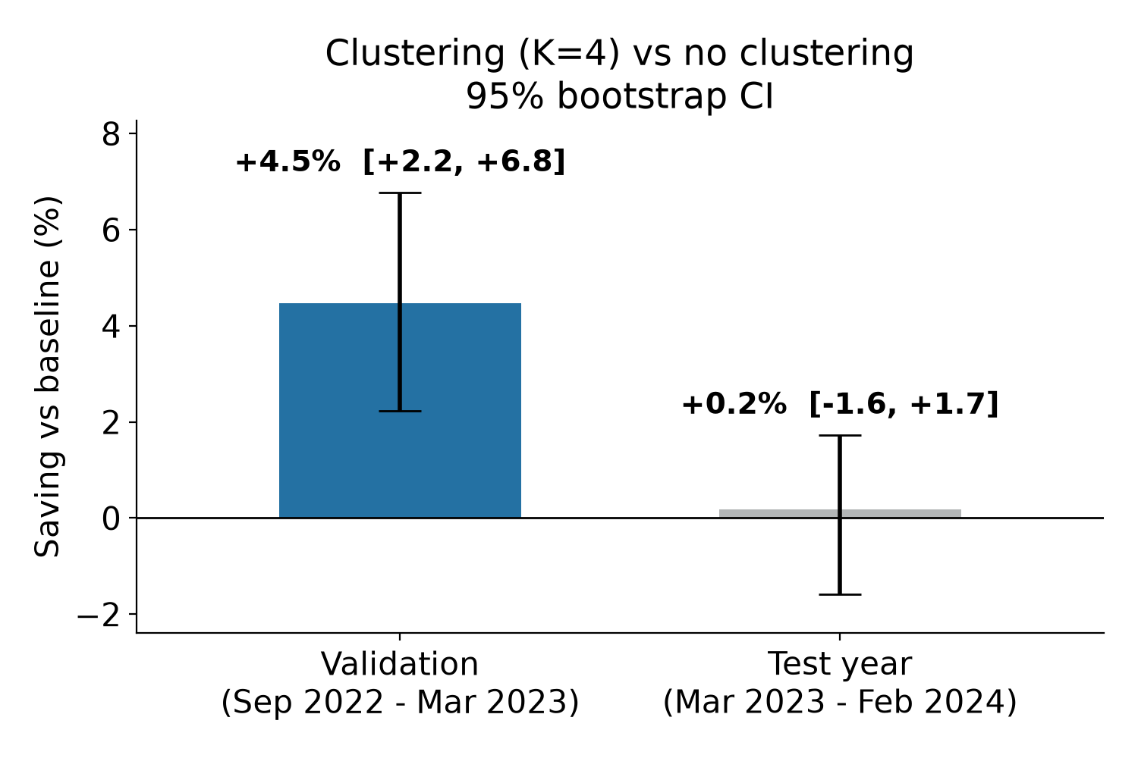
LEVEL 2 - BUSINESS METRIC
4.5% saving on validation — 0.2% on the test year
Real German day-ahead prices (SMARD) + intraday penalty for every forecast error
Baseline imbalance cost: 32 €/household/year (≈4% of the day-ahead bill)
K = 4 chosen on validation: +4.5% [+2.2, +6.8]
Same model on the test year: +0.2% [-1.6, +1.7] → not significant
Picking K on the test set would have claimed +1.7% (K = 5) — a selection-bias trap we avoided
RWTH Hackathon × E.ON — Bringing the Heat
Notes:
To measure what matters for procurement we price every forecast error with real German day-ahead prices plus an intraday penalty. For the baseline that is about 32 euros per household and year. On the validation period clustering looked great: 4.5 percent cheaper, clearly significant. But on the untouched test year the saving shrinks to 0.2 percent, with a confidence interval around zero. Why? Aggregating 328 households already averages out individual behaviour, and the validation period was the 2022 energy-crisis winter. Had we picked the number of clusters on the test set, we would have reported 1.7 percent - our strict split protects E.ON from that kind of over-promise.

Slide 4
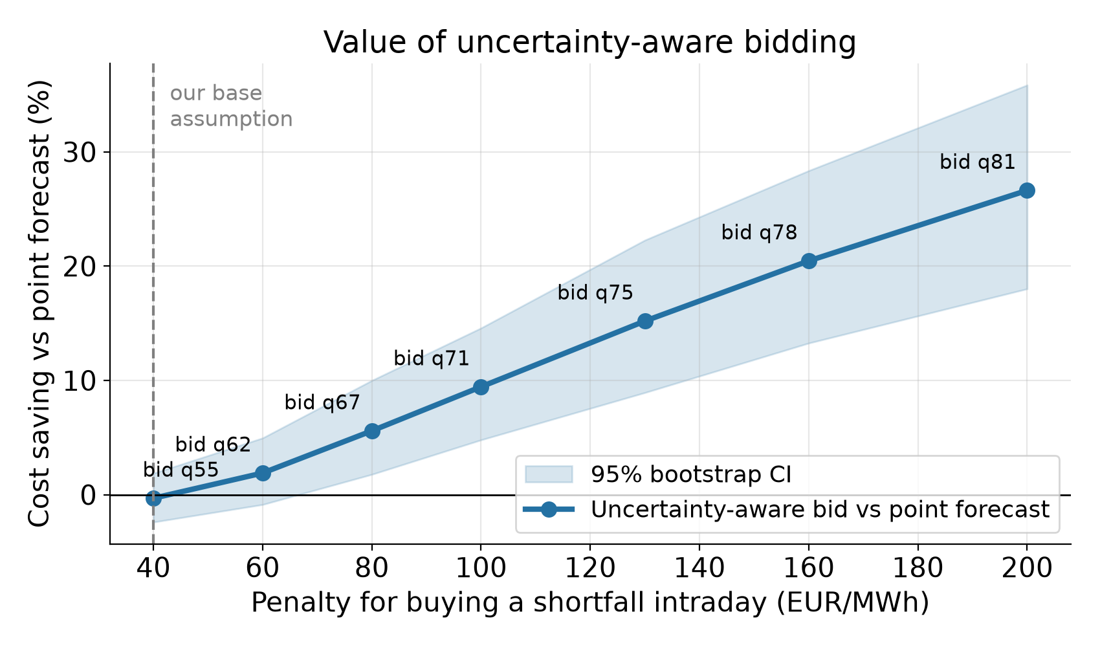
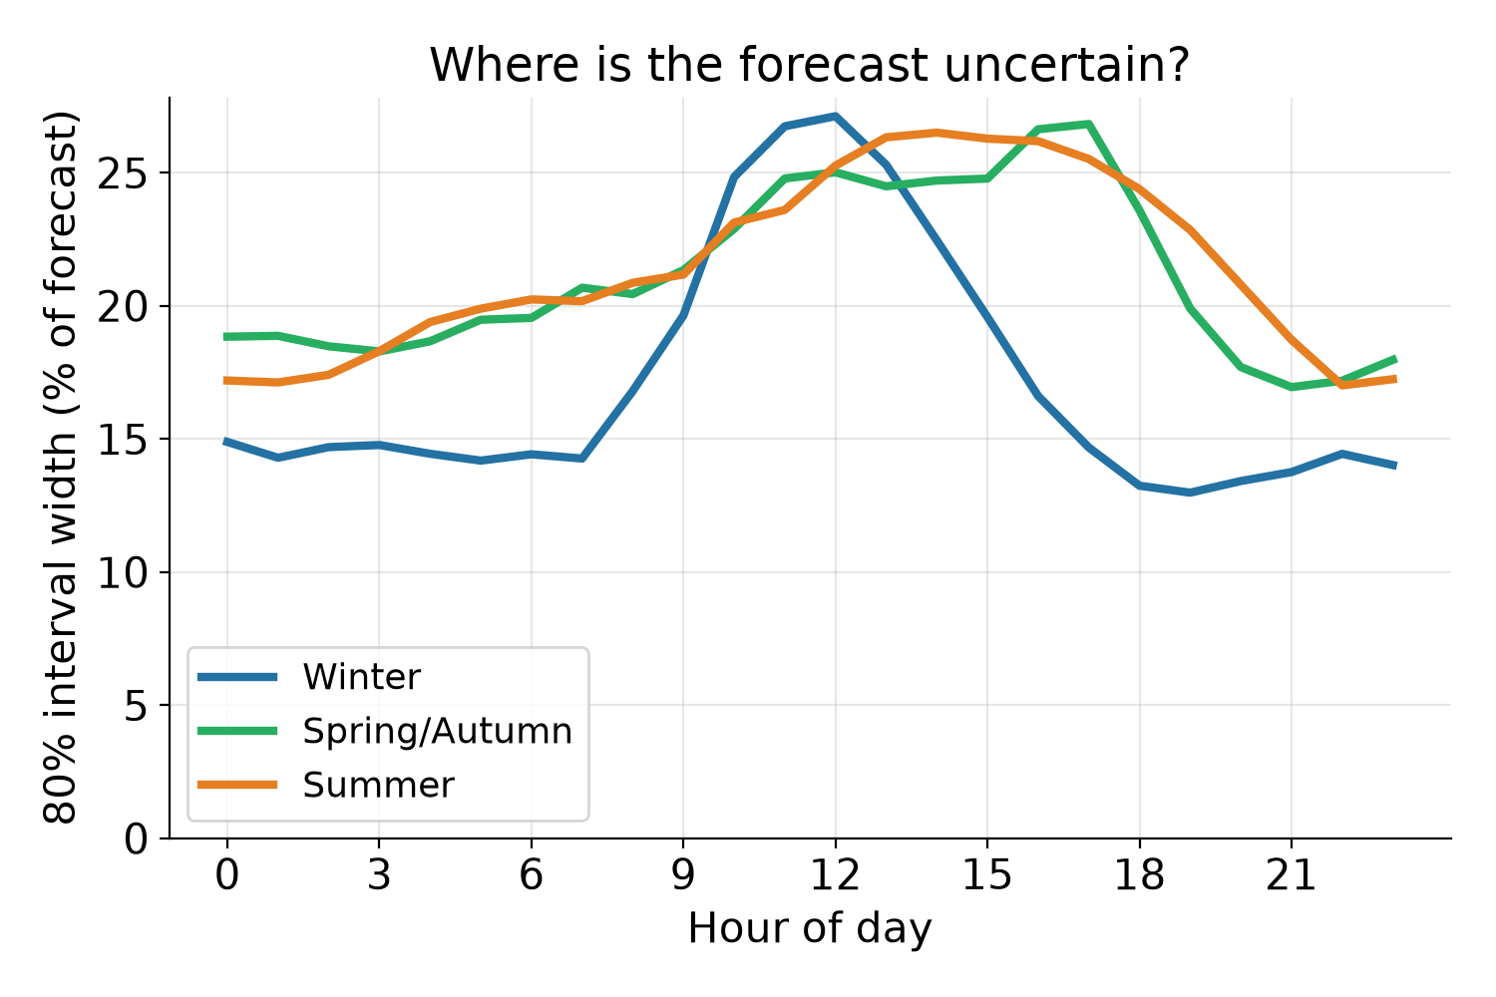
LEVEL 3 - UNCERTAINTY
The money is in the uncertainty, not in the clusters
Intervals are calibrated: 79% in 80%, 89% in 90% interval
Bid the cost-optimal quantile τ* = c_short / (c_short + c_surplus). Symmetric penalty: no gain. Shortfall penalty ≥ 80 €/MWh: 6–27% cheaper (significant).
RWTH Hackathon × E.ON — Bringing the Heat
Notes:
Instead of one number, we forecast a full distribution from the recent forecast errors. It is well calibrated: 79% of actual values fall in our 80 percent interval. The forecast is most uncertain around midday - solar and heat pumps switching - and most certain at night in winter. We then bid the cost-optimal quantile, the classic newsvendor rule. If being short costs about as much as being long, the point forecast is already optimal. But real imbalance prices are asymmetric: as soon as a shortfall costs 80 euros per megawatt-hour or more, uncertainty-aware bidding is 6 to 27 percent cheaper - far more than clustering ever gave us.

Slide 5
CONCLUSION
What E.ON should take away
1
Use clustering for customer insight
It reliably finds PV owners and customer segments — but does not significantly cut day-ahead cost for a large portfolio.
2
Invest in probabilistic forecasts
Calibrated intervals + quantile bidding pay off as soon as imbalance penalties are asymmetric.
3
Validate like it is real money
Three-way time split, real prices and bootstrap confidence intervals prevent over-promising.
Next: real imbalance prices (reBAP) · 15-minute products (SDAC since Oct 2025) · weather forecasts instead of observed weather
RWTH Hackathon × E.ON — Bringing the Heat
Notes:
Three take-aways. First, clustering is valuable for understanding customers - it finds PV owners without labels - but it is not a forecasting trick for a large portfolio. Second, the real lever is probabilistic forecasting combined with cost-aware bidding. Third, validate as if it were real money. Next steps: real imbalance prices, the new 15-minute day-ahead products, and real weather forecasts. Thank you.

