Slide 1



Connect your Metamask wallet / Connected to …
Switch to ropsten network
Your $QUIZ balance:
500
Today’s survey:
Music
START SURVEY

Slide 2
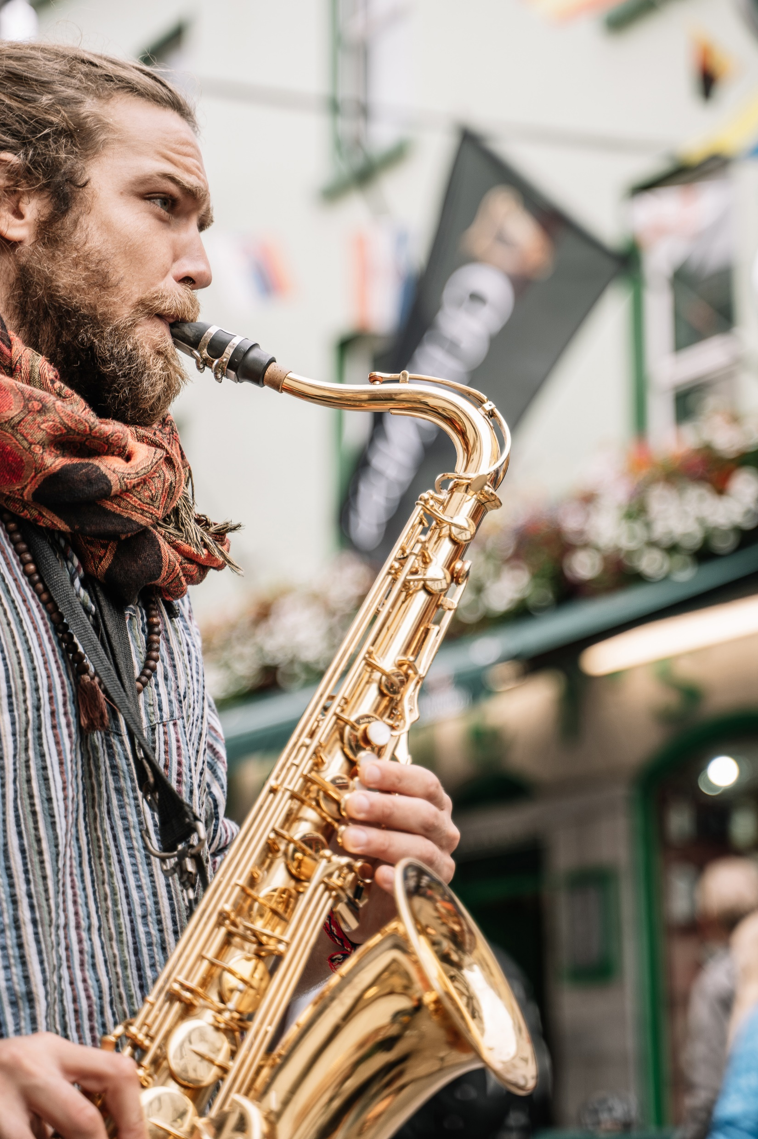

Which is your favorite genre?
JAZZ
ROCK
CLASSICAL
5’’

Slide 3
Your answers
Which is your favorite genre? Rock
…? …
…? …
…? …
…? …
…? …
SUBMIT

