Slide 1
Detecting Anxiety and Health Anxiety in Reddit Text
Weak supervision · clinical-feature architecture surgery · LLM baselines
MSc Dissertation — 2026
743,879 Reddit posts · 38 subreddits · 12 experiments · 171 tests

Slide 2
The problem
• Health anxiety (illness anxiety disorder): persistent, excessive worry about having a serious illness — clinically distinct from, and far less studied than, general anxiety or depression.
• Reddit is a large-scale, naturalistic source of mental-health language: people describe symptoms, fears and help-seeking in their own words.
• Research question: can we detect anxiety — and specifically HEALTH anxiety — from text, rigorously, with clinical grounding, and honest about what actually works?
• Constraint that shapes everything: no clinician-labelled health-anxiety data exists, so we must build from weak / self-reported signals.
2 / 20

Slide 3
What the field has done — and the gap we target
• Only published health-anxiety baseline: Low et al. 2020 (Reddit Mental Health Dataset) — linear SGD-L1, weighted-F1 = 0.851. Strong encoders (MentalBERT/RoBERTa, MentaLLaMA) and LLMs exist.
• The gaps: (1) no public CLINICIAN-labelled health-anxiety dataset; (2) subreddit-as-label is circular; (3) cross-corpus F1 collapse is the field norm (Harrigian et al.).
• Unclaimed territory we target:
– Fuse clinical-instrument (SHAI) features directly INTO a transformer.
– Hierarchical user-level modelling of a person's post stream.
– Generative-LLM baselines (zero-shot + QLoRA) for health anxiety.
3 / 20

Slide 4
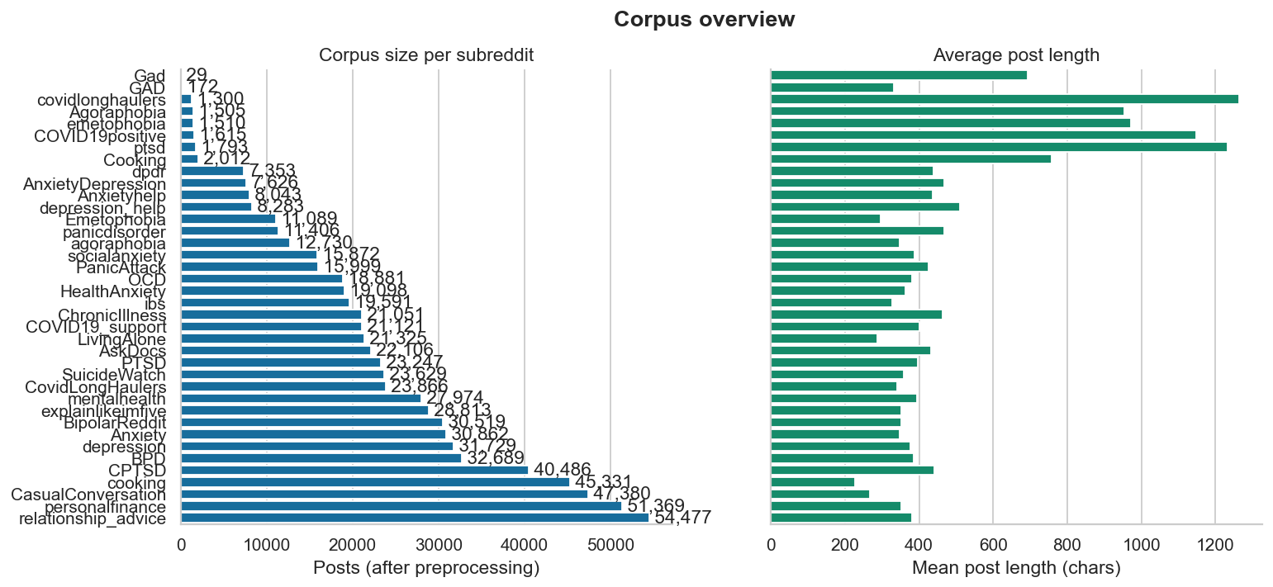
Data & evaluation protocol
• 743,879 posts across 38 subreddits: anxiety / health-anxiety / comorbid / depression / suicidality + subreddit-matched neutral controls.
• Weak-label positives are severely imbalanced: 69,010 anxiety · 10,659 depression · 2,544 health-anxiety · 458 suicidality.
• Author-disjoint splits throughout — no user appears in both train and test. This is the rigorous protocol that exposes proxy-label leakage (and many papers skip it).
4 / 20

Slide 5
Labelling: weak supervision + self-disclosure
• Tier-1 WEAK labels = subreddit-as-proxy prior ⊕ clinical lexicons (50/50). Lexicons grounded in GAD-7, SHAI / HAI, PHQ-9 and Columbia C-SSRS instruments.
• Self-disclosure TEST set: regex-verified “I was diagnosed with…” users (with negation/third-party filters) + subreddit-matched never-disclosed controls.
• eRisk protocol: the disclosure post is MASKED at test time; we score the user's remaining posts — no trivial keyword leakage.
• Honest framing: these are weak / proxy labels, NOT clinician annotations — every claim is bounded by that.
5 / 20

Slide 6
Methodology — model zoo & evaluation
• Models: TF-IDF+LogReg · XGBoost (26 linguistic features) · MentalRoBERTa (single + multi-task) · DANN · Fusion (novel) · Hierarchical user model · LLMs (Qwen / MentaLLaMA zero-shot + QLoRA).
• Evaluation goes well beyond a single F1:
– Author-disjoint F1 / AUROC / AUPRC with bootstrap CIs.
– Cross-corpus zero-shot transfer (RMHD, expert-labelled ANGST).
– Calibration · per-subreddit thresholds · McNemar & paired-bootstrap significance.
– SHAP interpretability · eRisk early-detection · adversarial robustness · fairness audit.
• 12 experiments + supporting analyses; 171 automated tests.
6 / 20

Slide 7
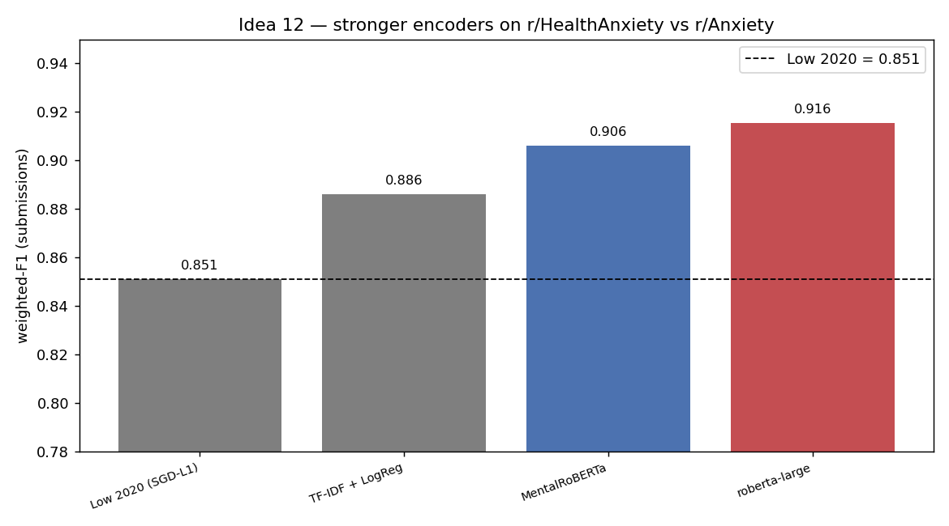
Headline: beating the only health-anxiety baseline
• Task: r/HealthAnxiety vs r/Anxiety (submissions, author-disjoint) — is health-anxiety language separable from general anxiety?
• Weighted-F1: TF-IDF 0.886 · MentalRoBERTa 0.906 · RoBERTa-large 0.916.
• All beat Low et al. 2020 (0.851) — a +0.035 to +0.065 improvement over the only published baseline. This is our primary contribution.
7 / 20

Slide 8
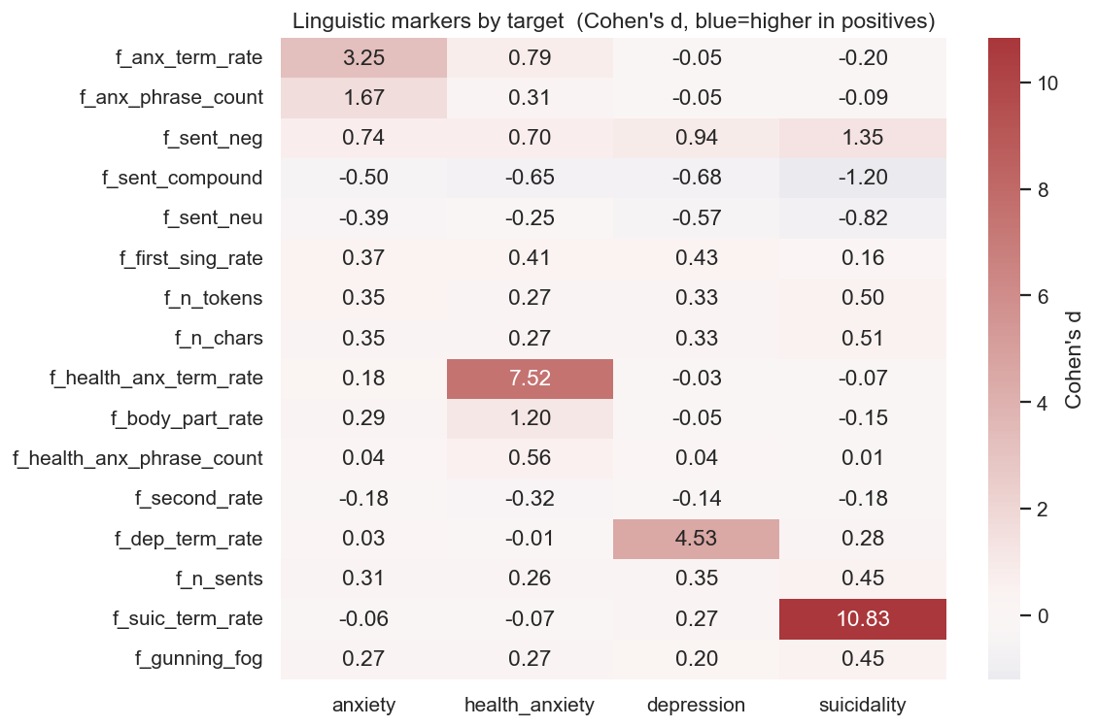
What separates health anxiety from general anxiety?
• Health-anxiety markers have large effect sizes: illness/bodily terms (Cohen's d ≈ +7.5), symptom-googling, reassurance-seeking — all SHAI-consistent.
• Discriminative n-grams: “my health”, “google”, “symptoms”, “results”, “disease”, “spiral” (HA) vs “work”, “job”, “medication”, “sleep” (anxiety).
• Negative sentiment rises monotonically with severity (anxiety → HA → depression → suicidality).
8 / 20

Slide 9
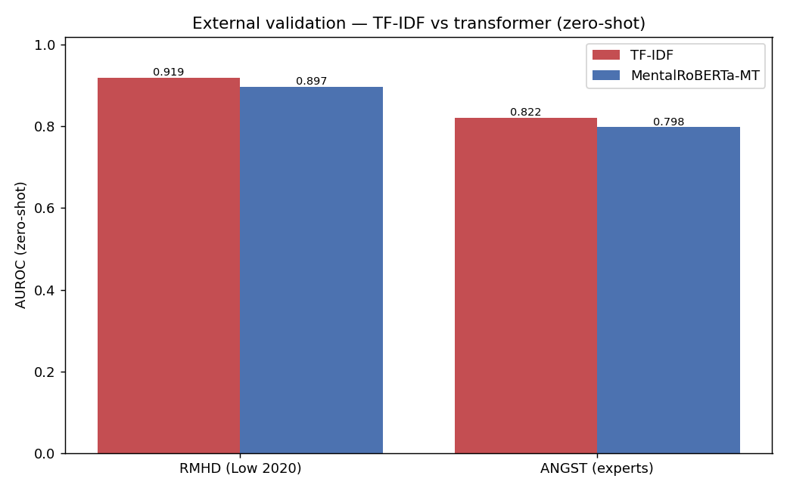
External validity — and a transfer puzzle
• Zero-shot transfer: RMHD (Low 2020) AUROC 0.92; ANGST (3 expert psychologists) AUROC 0.82 — genuine external validity, rare in this field.
• Puzzle: cheap TF-IDF OUT-transferred the transformer (RMHD 0.920 vs 0.897) — this motivates the architecture surgery on the next slide.
• The classic F1-collapse under shift (in-dist 0.93 → cross 0.31) is a thresholding artifact: AUROC stays ~0.99 → fixed by per-subreddit calibration.
9 / 20

Slide 10
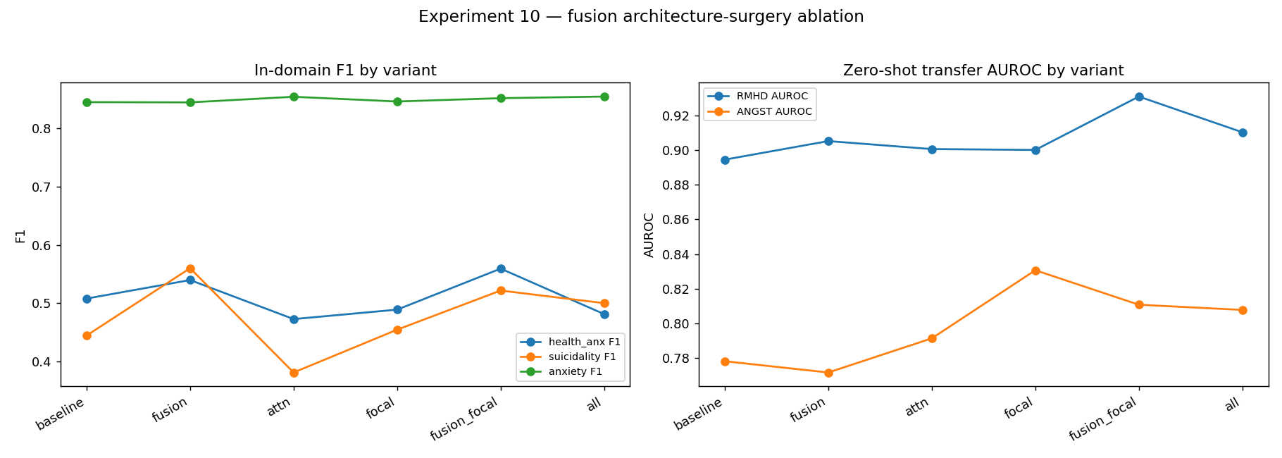
Contribution 1: clinical-feature architecture surgery
• FusionMultiTaskModel: encoder embedding (768-d) ⊕ 26 linguistic + 7 SHAI features → fusion MLP; + focal loss; + attention pooling (all independently ablatable).
• WIN — fusion+focal lifts the imbalance-limited rare classes: health-anx F1 0.508→0.559, suicidality 0.444→0.522.
• WIN — and cross-corpus transfer: RMHD AUROC 0.894→0.931 (now BEATS TF-IDF 0.920); ANGST →0.811.
• NOVEL: fusing SHAI clinical-instrument features into a transformer closes the documented transfer gap — not previously done in this domain.
10 / 20

Slide 11
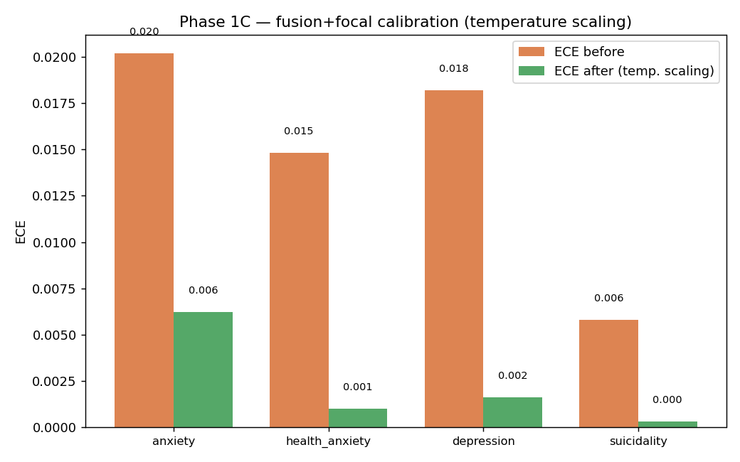
Contribution 1 (cont.): calibrating the new model
• Focal loss makes the model UNDER-confident — every learned temperature < 1 (0.47–0.62).
• Temperature scaling restores excellent calibration: anxiety ECE 0.020→0.006; rarer classes ≤0.002 (a 69–95% reduction).
• Per-subreddit thresholds lift anxiety macro-F1 0.852→0.888.
• Both calibration tools transfer cleanly to the fused architecture — the trade focal makes (calibration for recall/ranking) is fully recoverable post-hoc.
11 / 20

Slide 12
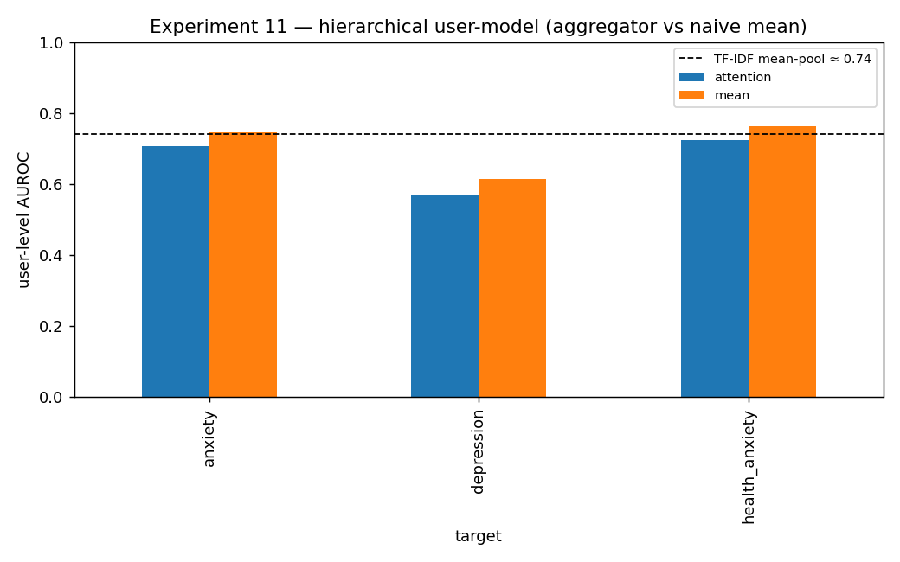
Contribution 2: hierarchical user model (honest negative)
• Frozen MentalRoBERTa post-encoder → learned attention aggregation over a user's post stream → user head; evaluated user-level on the disclosure test set.
• Result: learned attention ≤ naive mean-pooling on all three targets; both only TIE cheap TF-IDF (~0.74 user-AUROC).
• The bottleneck is the noisy proxy label + subreddit-matched hard negatives — NOT the aggregation mechanism. A clean null (and a useful one).
12 / 20

Slide 13
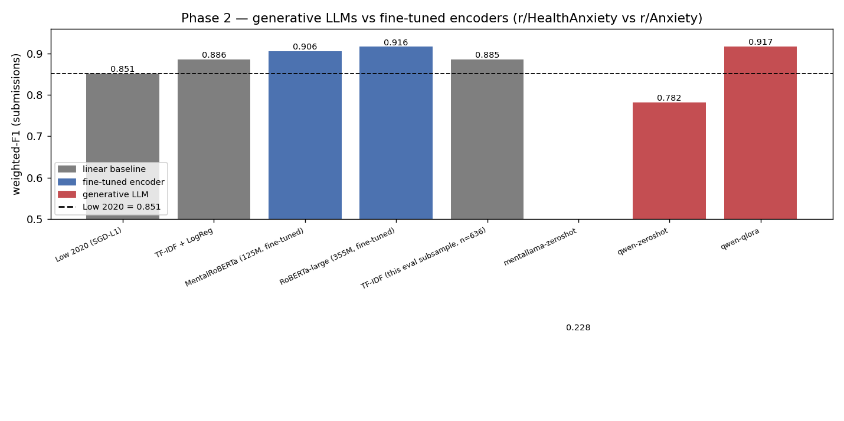
Contribution 3: generative-LLM baselines
• Qwen2.5-7B ZERO-SHOT: weighted-F1 0.782 — loses to TF-IDF (0.886) and to the encoders.
• Qwen2.5-7B QLoRA (1 epoch, 4-bit): 0.917 — statistically TIED with RoBERTa-large (0.916), at 20–55× the parameters.
• Lesson: fine-tuning — not prompting — closes the gap; the small fine-tuned encoder stays the efficient choice.
• MentaLLaMA verbalizer-unsuitable (chance, both prompt formats); Llama-3.1-8B gated → deferred.
13 / 20

Slide 14
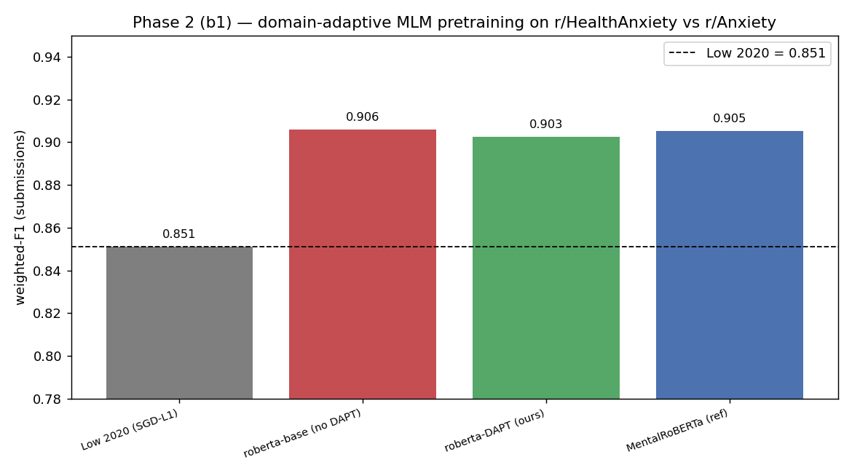
Contribution 4: domain-adaptive pretraining (null)
• Continue masked-LM pretraining of roberta-base on 200k in-domain posts, then fine-tune on the HA task.
• No benefit: vanilla roberta-base already MATCHES MentalRoBERTa (0.906 ≈ 0.905); light DAPT slightly hurts (0.903).
• Consistent lesson (DAPT + LLM): at the ~0.92 Reddit-binary ceiling, fine-tuning dominates — pretraining provenance and model scale barely matter.
14 / 20

Slide 15
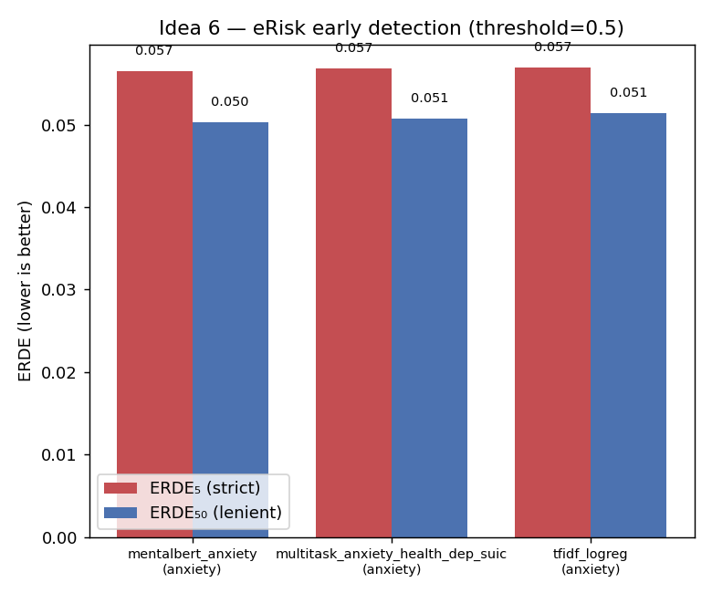
Supporting rigour (the full evaluation menu)
• Calibration — TF-IDF was badly under-confident (ECE 0.200→0.035, −82%); transformers already well-calibrated.
• Per-subreddit thresholds — anxiety macro-F1 0.719→0.781.
• Significance — McNemar + paired bootstrap: model differences are NOT significant (honestly, tied).
• eRisk early detection — anxiety flagged at a median of 1 post (recall 0.78).
• Plus: SHAP interpretability · robustness (<5% flips under perturbation) · fairness (TPR gaps ≤0.06) · weak-label filtering (null).
15 / 20

Slide 16
What is new / better than the literature
• ✔ Beat the only published health-anxiety baseline (Low 2020 0.851 → 0.916 weighted-F1).
• ✔ NOVEL: SHAI clinical-feature fusion into a transformer → closes the cross-corpus transfer gap (no prior work does this for health anxiety).
• ✔ First DANN application to Reddit mental-health + genuine external validation on RMHD and expert-labelled ANGST.
• ✔ Full calibration / significance / fairness / robustness / eRisk suite — beyond typical single-metric papers.
• ✔ Scientific honesty: documented, reproducible NEGATIVE results (hierarchical, DANN, DAPT) — rare and valuable.
16 / 20

Slide 17
What is NOT better — honest limitations
• ✘ At/near the ~0.92 Reddit-binary ceiling → limited headroom; absolute gains are modest.
• ✘ Weak / proxy labels (subreddit-as-label); no clinician-annotated health-anxiety gold set.
• ✘ User-level detection only TIES cheap TF-IDF (~0.74) — deep models give no advantage there.
• ✘ LLMs do NOT beat fine-tuned encoders: zero-shot loses, QLoRA only reaches parity (at huge cost).
• ✘ DAPT adds nothing here; most headline runs are single-seed (no multi-seed CI averaging yet).
17 / 20

Slide 18
Summary of contributions
Contribution | New? | vs literature
HA-vs-Anxiety classifier | extends Low 2020 | ✔ +0.065 F1
SHAI clinical-feature fusion model | NOVEL | ✔ closes transfer gap
Calibrating the focal model | novel application | ✔ ECE → ≤0.006
Hierarchical user model | novel attempt | ✘ null (ties TF-IDF)
DANN on Reddit mental-health | first application | ✘ null
LLM zero-shot / QLoRA baselines | new for HA | ≈ parity, not better
Domain-adaptive MLM (DAPT) | completeness | ✘ null
Calibration/significance/fairness/robustness/eRisk | thorough | ✔ exceeds norm
18 / 20

Slide 19
Future work
• Llama-3.1-8B baselines (zero-shot + QLoRA) — pipeline ready; pending HF gated access.
• MentaLLaMA via generate-and-parse decoding (the verbalizer probe is unsuitable for a long-form domain LLM).
• Ordinal severity head (CORAL / CORN) on the fusion model — grade severity, not just presence.
• The field's biggest gap: clinician-annotated health-anxiety labels + multi-seed confidence intervals.
• Live user-history enrichment for user-level modelling (currently blocked by Reddit IP limits).
19 / 20

Slide 20
Conclusion
• The winning recipe: fine-tune a compact encoder + fuse clinical (SHAI) features + focal loss → beats the published baseline AND closes the cross-corpus transfer gap.
• LLMs match but do not beat small fine-tuned encoders; pretraining provenance and scale barely matter at the ceiling — fine-tuning on the task does.
• Equal weight to honest negatives (hierarchical, DANN, DAPT) and full evaluation rigour → a credible, reproducible health-anxiety NLP study.
• Take-away: clinically-grounded, parameter-efficient, and honest beats big-and-vague.
20 / 20

