Slide 1
Foundation of Data Science
Group 4
University of Southampton
Yelp Challenge
Nicola Vitale
Antonios Andronis
Adisorn J.
Hujiang Lin
Nikolaos Perrakis
Supervisor:
prof. Elena Simperl

Slide 2

The Challenge
What is Yelp?
Why Yelp?
Site: http://www.yelp.com/dataset_challenge

Slide 3
The Yelp dataset
Yelp provides 5 datasets. We used 3 of them.
User 366,715 records
Review 1,569,264 records
Business 61,184 records

Slide 4
Our Objectives
Use Yelp reviews to identify and predict business issues
Identify strong negative reviews based on significance of the sentiment score
Quantify user contribution
Identify significant negative review keyword sentiments
Identify current issues that will generate strong negative reviews

Slide 5
The Pipeline
NLP - AlchemyAPI Popular Businesses
Cleaning
Storing
Explore
Python scripts
Data Storage in MongoDB
Visualization
Analyze
Significance Tests
Visualization with matplotlib

Slide 6
The Pipeline
NLP - AlchemyAPI Popular Businesses
Cleaning
Storing
Explore
Python scripts
Data Storage in MongoDB
Visualization
Analyze
Significance Tests
Visualization with matplotlib

Slide 7
Data Cleaning
The dataset from Yelp is quite clean. However, we found some problematic values that affect NLP analysis.
Having new line character(‘\n’) in some review texts:
These strings are hard to handle and can not work well with NLP analysis,
so we remove these.
Having dashes in some review texts or even worse that the text contains only dashes like “----------------”:
It causes unsupported-text-language error when sending it to NLP.
When the text has some dashes, we remove them out of the text.
If the text itself is only dashes, we ignore the text.

Slide 8
The Pipeline
NLP - AlchemyAPI Popular Businesses
Cleaning
Storing
Explore
Python scripts
Data Storage in MongoDB
Visualization
Analyze
Significance Tests
Visualization with matplotlib

Slide 9
Data Storage
Dataset’s size ~ 2.5GB, 5 datasets in JSON format
mongoDB version 3.0.x
- Schema-less database -> data structure is quite flexible
- Can contain large volume dataset BUT still has good performance
-> NO significant variation of execution time
- Easy to import and export, which is good for team’s collaboration
- Get started using it with just a few settings

Slide 10
The Pipeline
NLP - AlchemyAPI Popular Businesses
Cleaning
Storing
Explore
Python scripts
Data Storage in MongoDB
Visualization
Analyze
Significance Tests
Visualization with matplotlib

Slide 11
Alchemy API
AchelmyAPI is a part of IBM Watson.
IBM Watson is a technology platform that uses Natural Language Processing and Machine Laerning to reveal insights from large amounts of unstructured data.
Why choosing it?
It provides deeper information such as keyword entity, taxonomy, keyword sentiment. It has many versions of API language like Python, Java, etc.
Alternative NLP candidates
Data Calais, CoreNLP(Stanford), NLTK(Python)

Slide 12
The Pipeline
NLP - AlchemyAPI Popular Businesses
Cleaning
Storing
Explore
Python scripts
Data Storage in MongoDB
Visualization
Analyze
Significance Tests
Visualization with matplotlib

Slide 13
Exploratory Data Analysis
Tools Python version 2.7 including build-in libraries: Pymongo, NumPy, Matplotlib. Achelmy API as a NLP.
Techniques
Query the database to see the data strucure: Time Range: December 2009 - January 2015 Business categories popularity. Business Popularity Reviews sentiment score Run Chart.

Slide 14
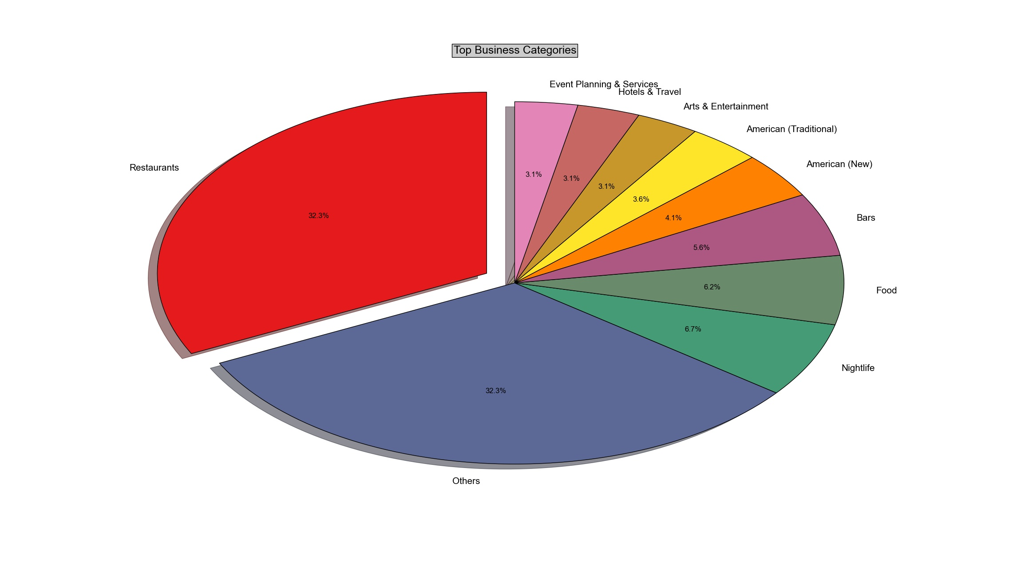
Samples (cont.)
Top business categories

Slide 15
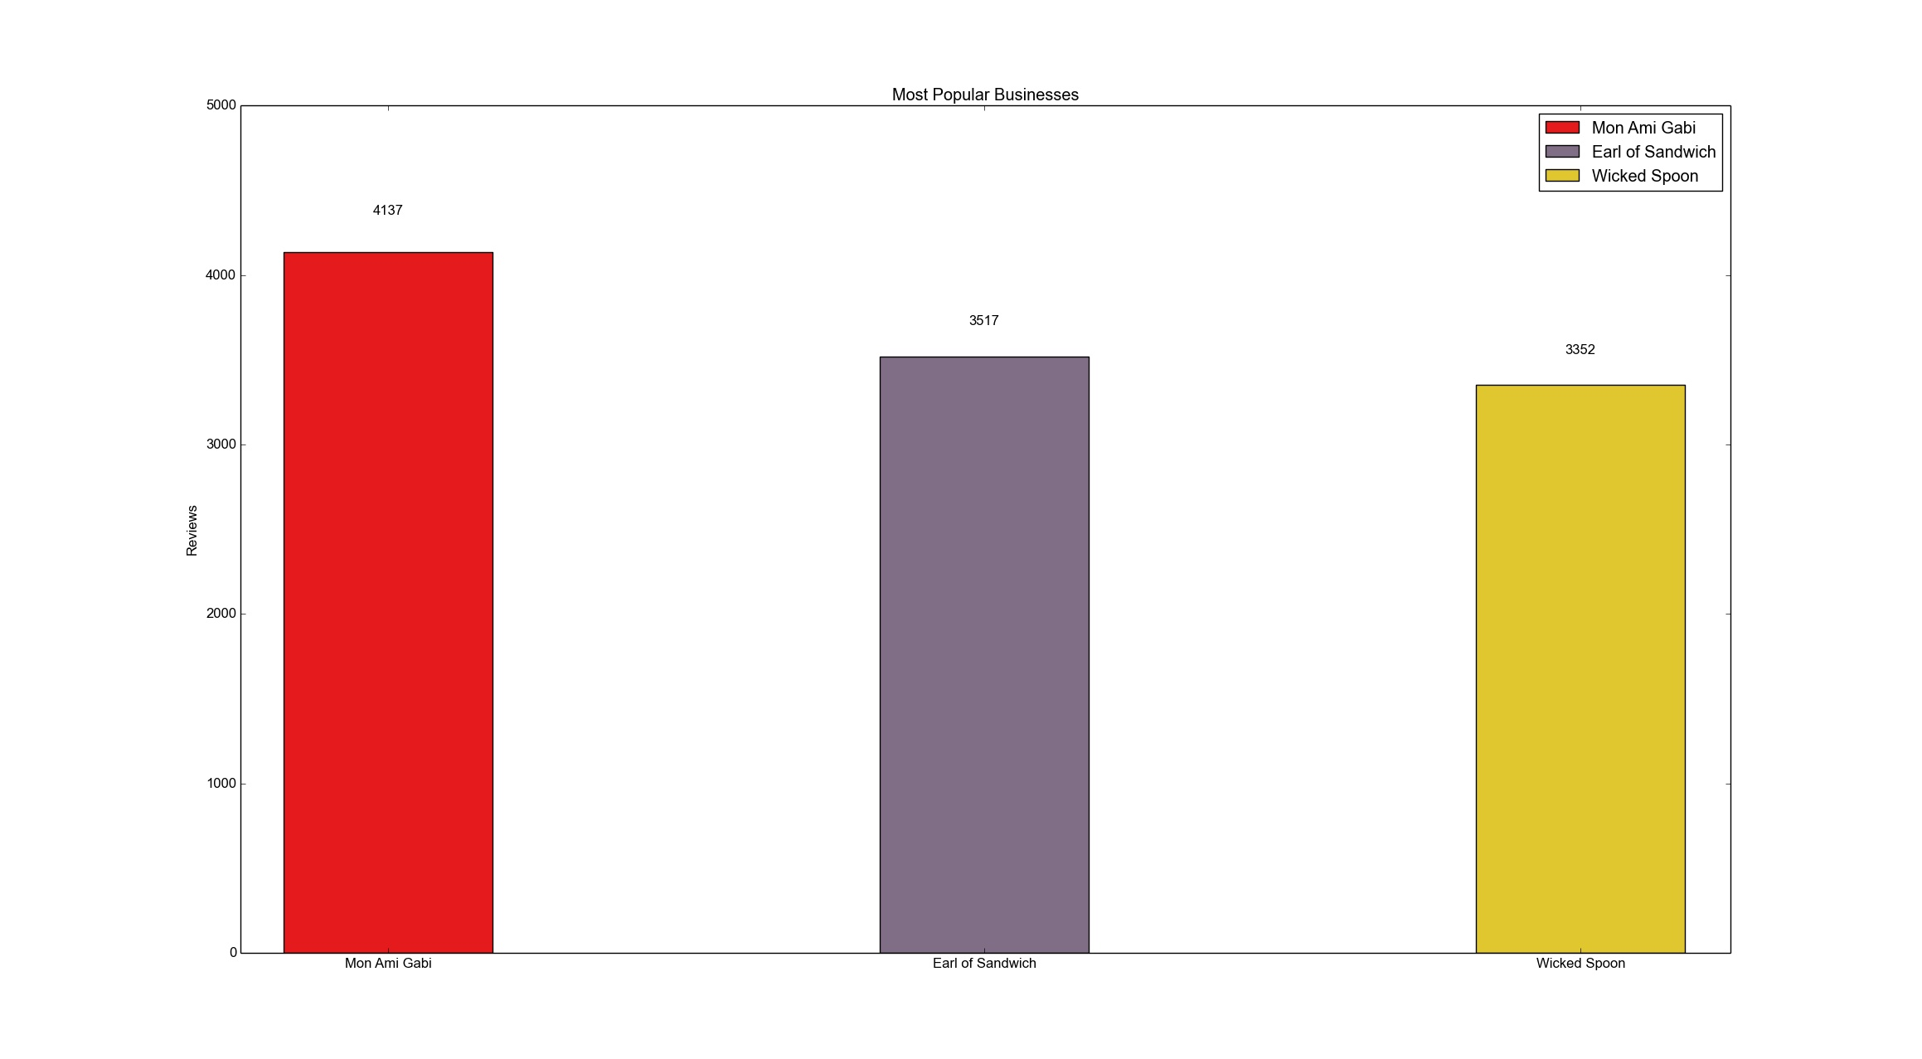
Samples (cont.)
Most popular business

Slide 16
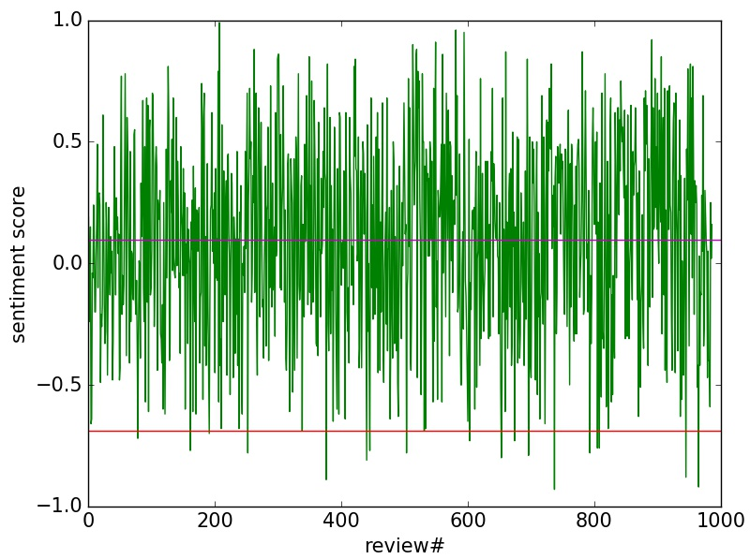
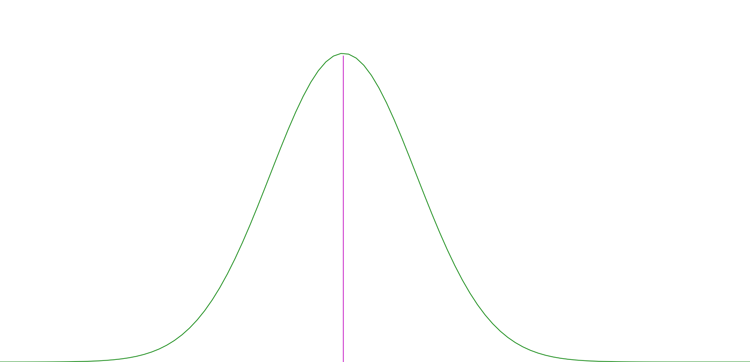
Statistical Analysis
Sentiment Score Time Series for a business.
Normally Distributed Sentiment Score.

Slide 17
Significance Testing
Use Normality test to identify non random review cluster that correspond to business problems
Check Significance of their keyword sentiment scores against overall mean and standard deviation.
Keep only negative significant keywords

Slide 18
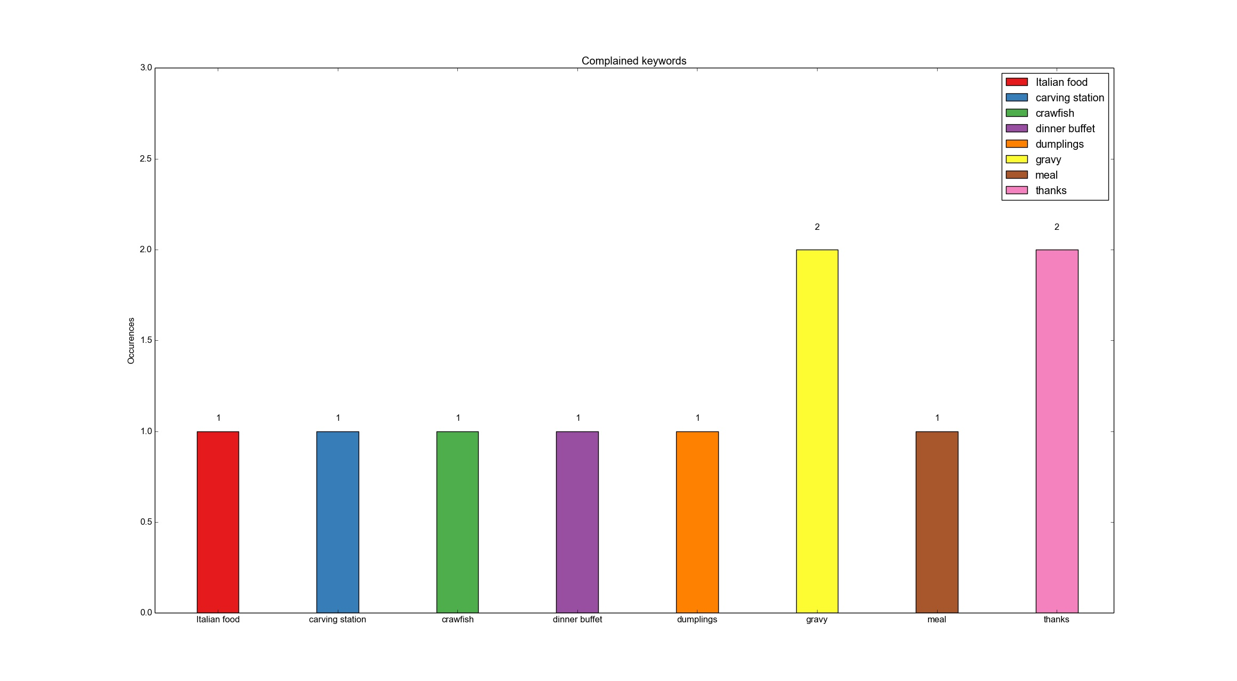
Samples
Complaint Keywords

Slide 19
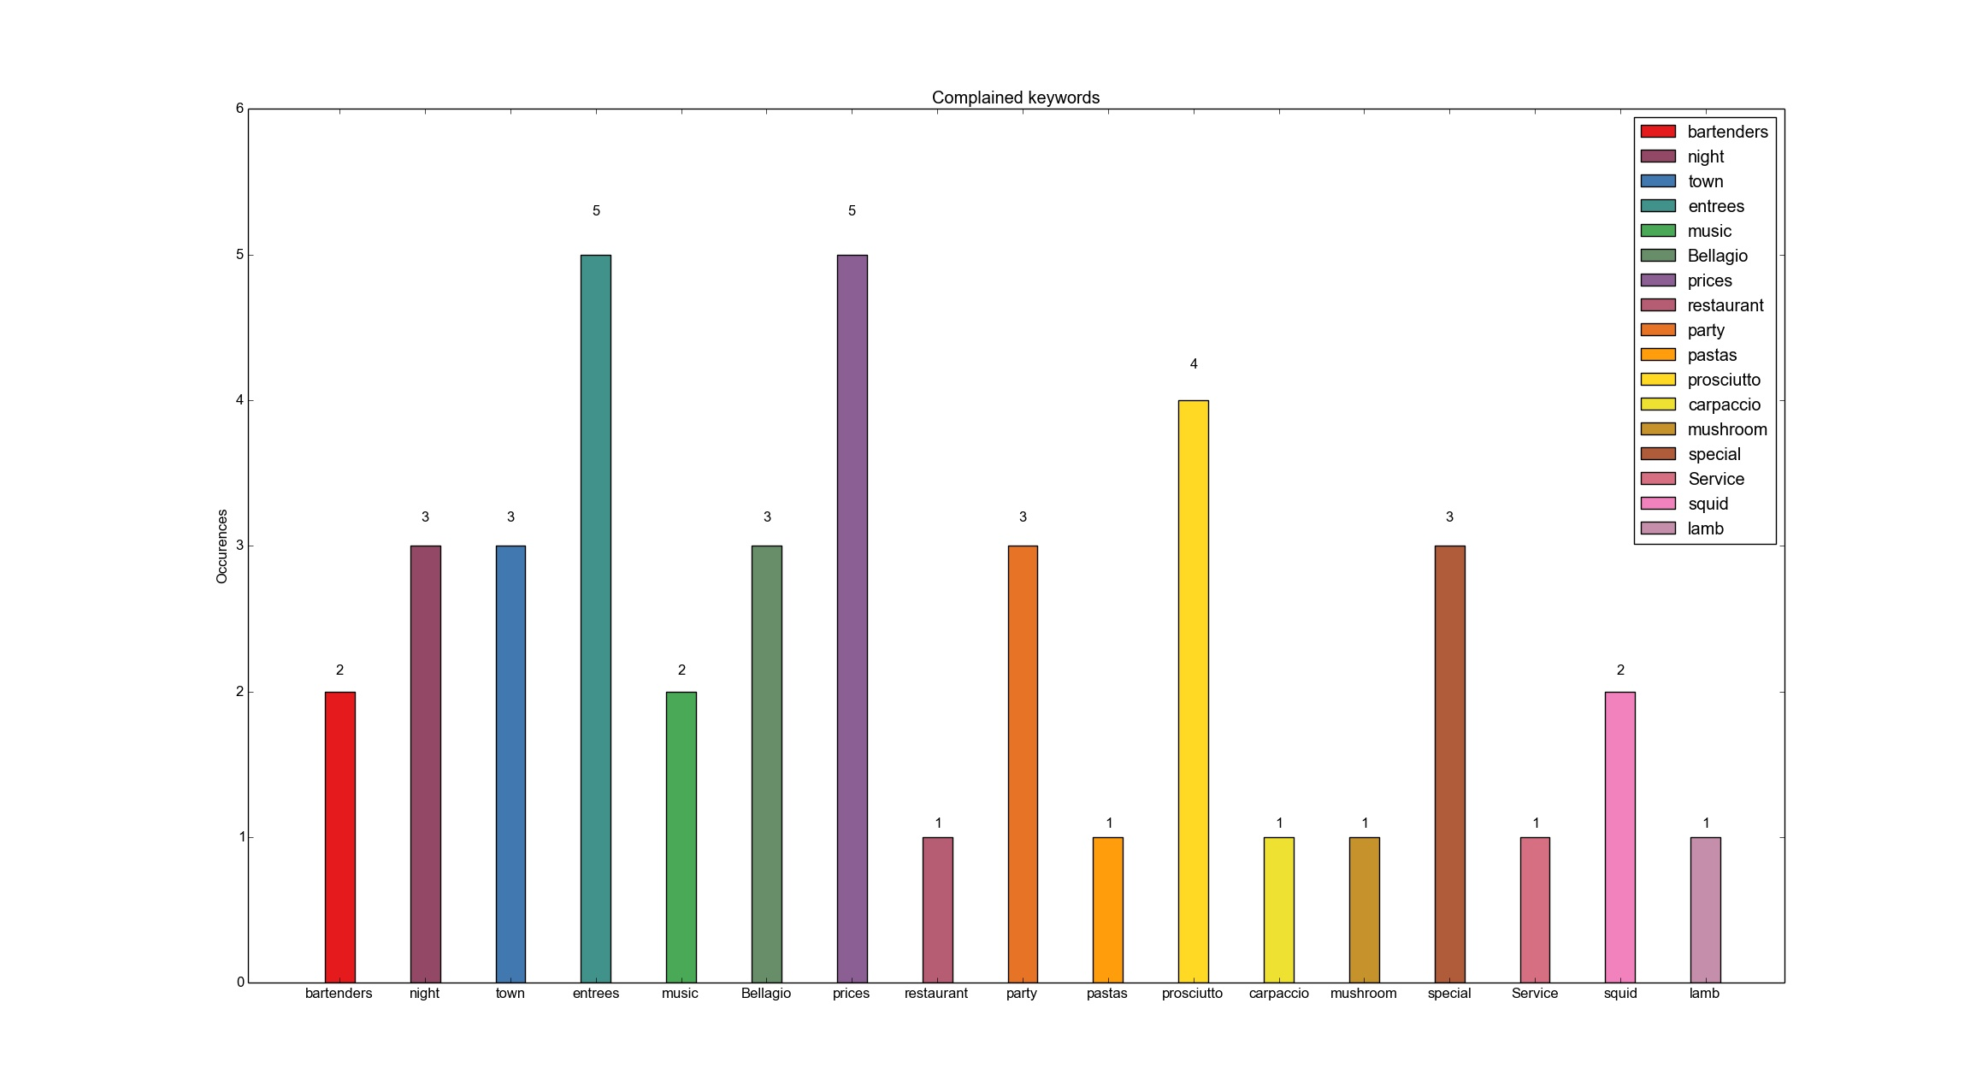
Samples (cont.)
Complaint Keywords

Slide 20
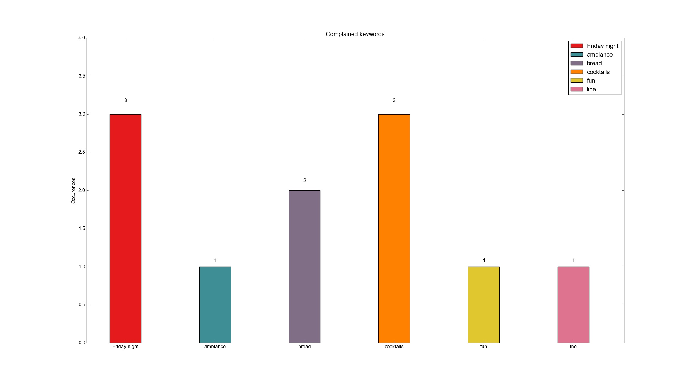
Samples (cont.)
Complaint Keywords

Slide 21
Conclusions
We can succesfully identify business issues
We can describe them
We can use the last 20 reviews to point out current issues

