Slide 1
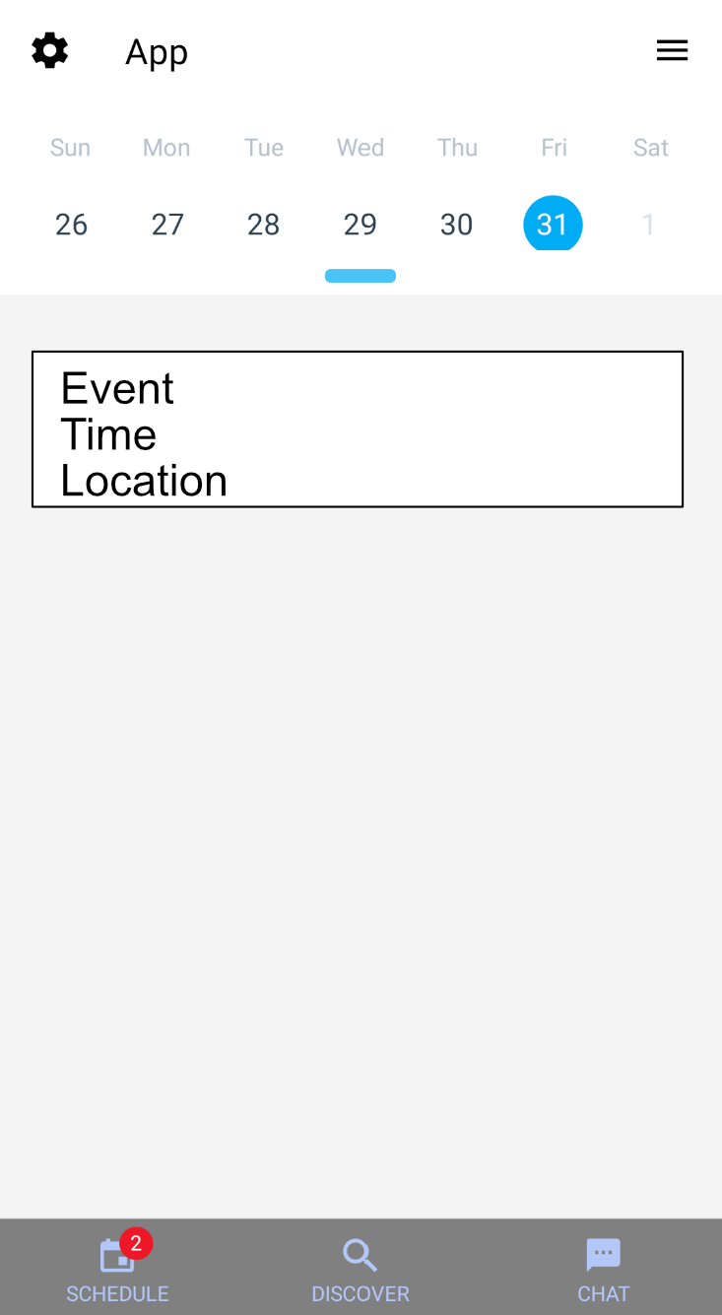
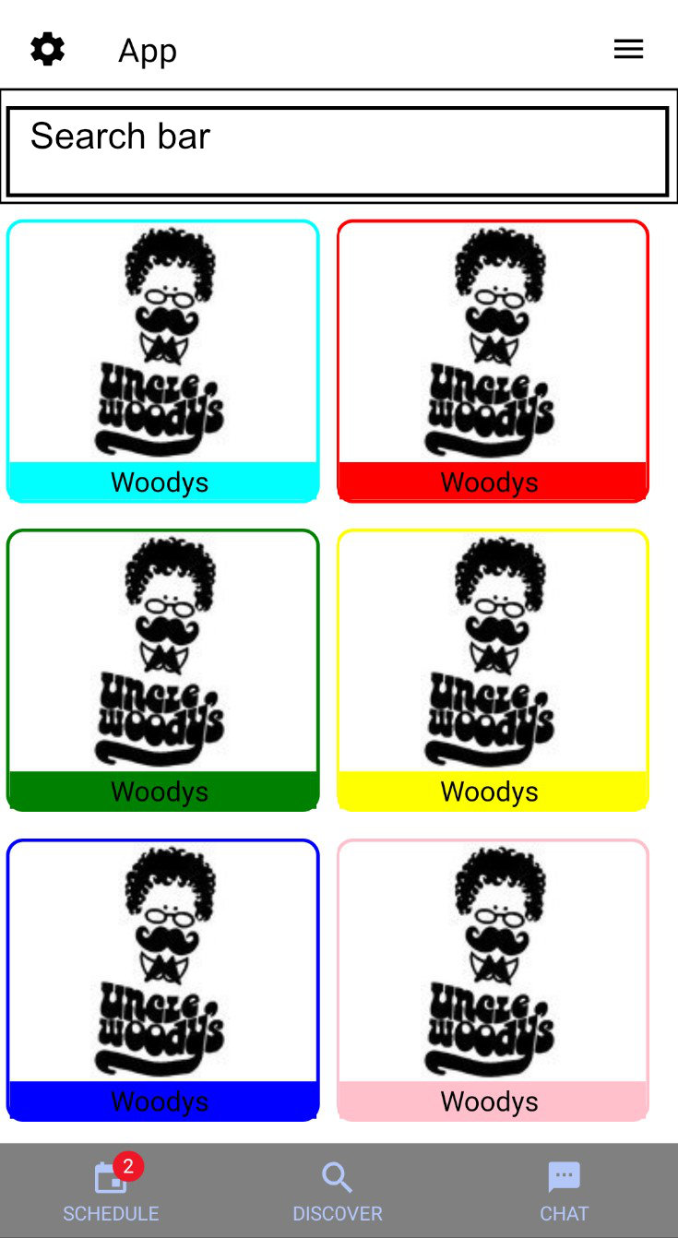




Socialendar
Who We Are
Design
Challenges
By far the biggest challenge is keeping testing up to date. Nothing gets added into the code without thorough testing.
Other commitments, such as school, and homework take a lot of time away from the project.
Agreement between group on API routes was another challenge.
Django Rest Framework makes writing the API easier, but there is a lot to know in order to do everything properly.
Nick Chonko
Tim Walsh
Advised by Nan Niu
Background
Socialendar is a social media calendar mobile application. Users are able to make and share events with their friends. The app includes the option to dynamically schedule events in a user’s calendar around their existing events. Socialendar also will pull events from online to suggest to users.
Achievements
The calendar view allows users to view and create events.
The discover tab(WIP) allows users to view community created events, and events pulled from online.
Fully planned out API ahead of time. This allows each member in the group to work independently without constantly stopping to consult other members.
RESTful API
Very well tested front end and back end code
Well thought out database schema
We want our application to have 3 main tabs, the calendar tab, the discover tab, and the messaging tab. The calendar tab allows the user to view their calendar and any events they have. The discover tab is used for finding public events, such as a concert. The messaging tab (WIP) is used to communicate with friends with the intent on planning events to attend.

