Slide 1
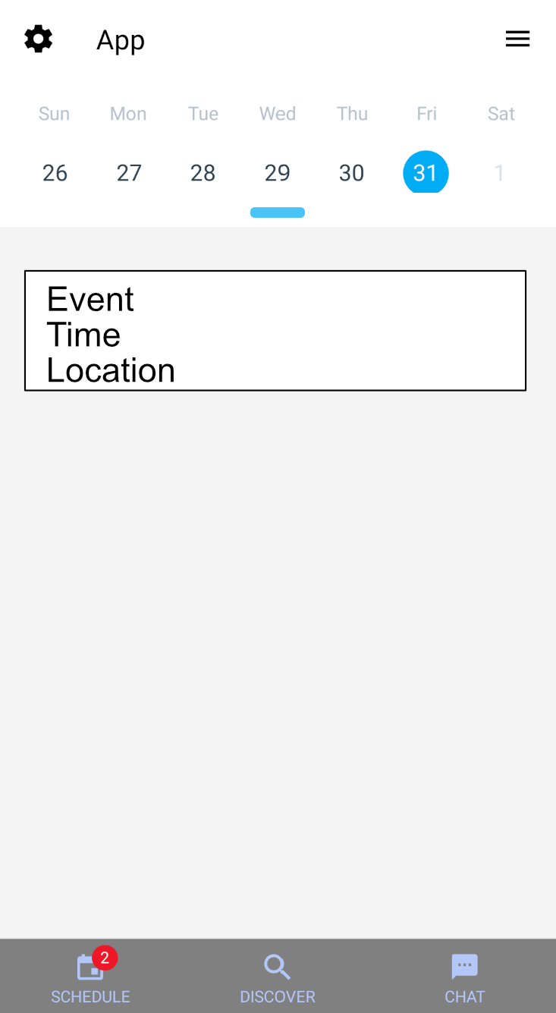
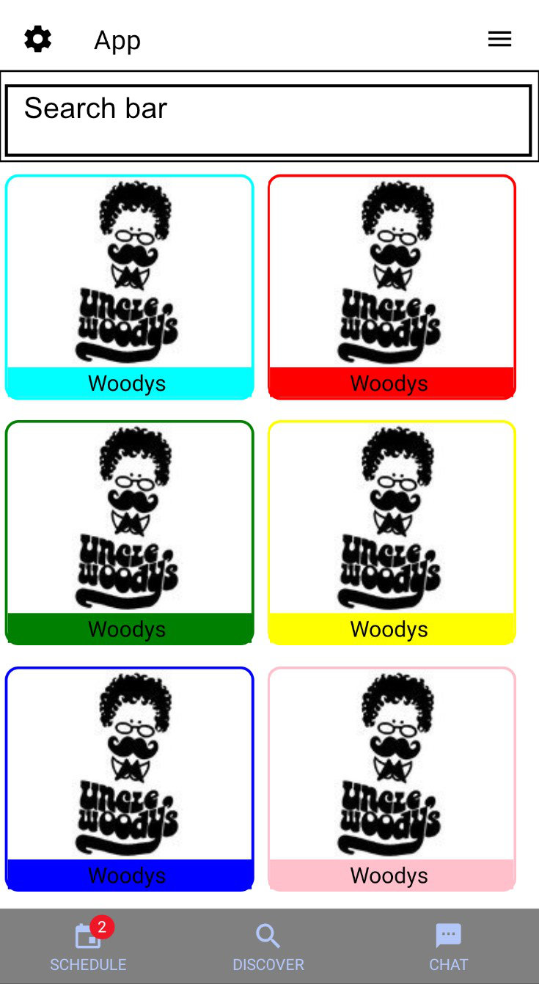



Socialendar
Who We Are
Design
Challenges
Nick Chonko
Tim Walsh
Advised by Nan Niu
Background
Socialendar is a social media calendar mobile application. Users are able to make and share events with their friends. The app includes the option to dynamically schedule events in a user’s calendar around their existing events. Socialendar also will pull events from online to suggest to users.
The calendar view allows users to view and create events.
The discover tab(WIP) allows users to view community created events, and events pulled from online.

