Slide 1


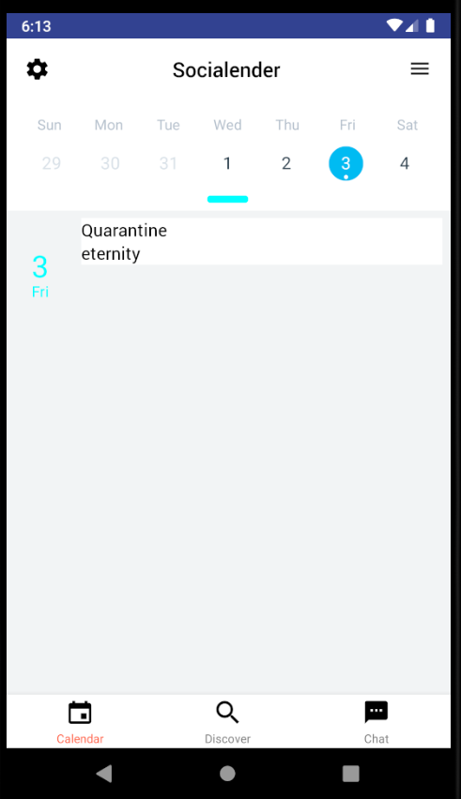
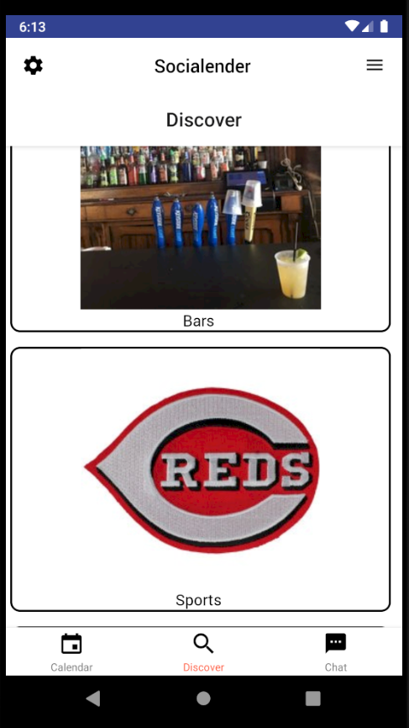
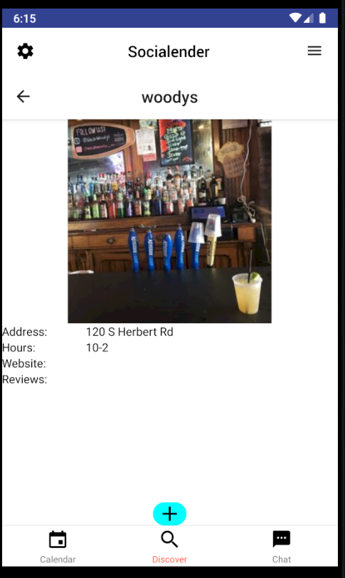
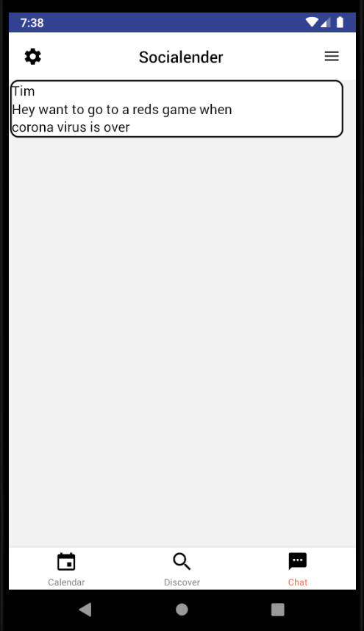
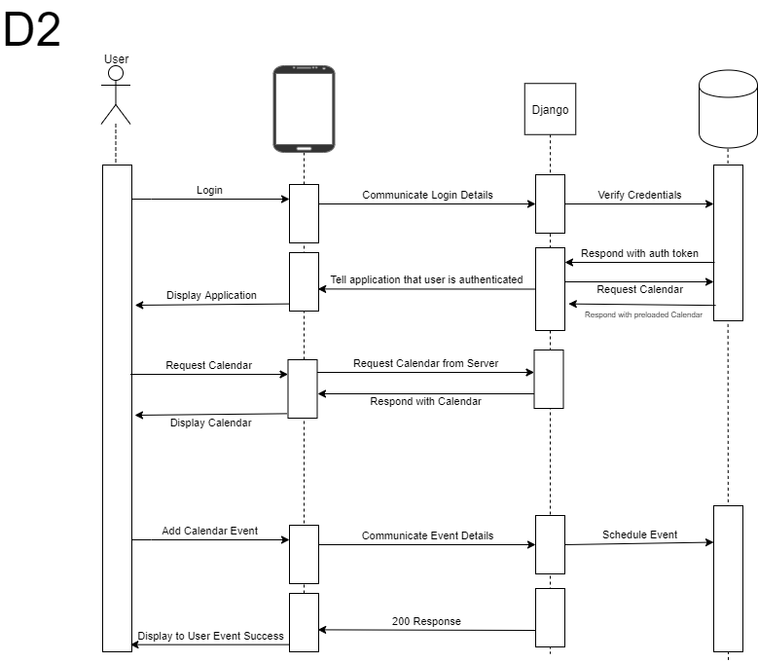







SoCalendar
Background
Nick Chonko
Advised By Nan Niu
Tim Walsh
Challenges
SoCalendar is a social media application based on a user’s schedule. A user inputs his or her scheduled events and/or tasks. SoCalendar provides the user an interface to discover fun activities and add them to his or her schedule. The user can chat with friends within the application to easily make plans. SoCalendar will then schedule the user’s upcoming tasks freeing the user’s valuable time.
Design
By far the biggest challenge for the developers is keeping testing up-to-date. Nothing is added into the code before thorough testing. Other commitments, such as school and homework, take time away from the project. Django Rest Framework makes writing the API easier, but it is a complex framework. Moving off campus created remote work across multiple time zones.
EASY USER-FRIENDLY DESIGN ALLOWS THE USER TO MAKE PLANS EASILY
Plan and Schedule:
At its core, SoCalendar is designed to help a user organize his or her schedule. SoCalendar intuitively schedules events and tasks at the times a user needs to attend or complete them.
Search and discover:
SoCalendar is designed to help a user maximize his or her schedule. Through the Discovery page, a user may simply browse things to do by category.
Add it to the Calendar:
Worried there is no time to do something fun? Fear not! SoCalendar will rework a user’s schedule to fit his or her needs.
Squad Up:
Messaging capability within the app. Users have no excuses to miss out on fun with friends because SoCalendar will free up their calendars.
Goals
Achievements
Well maintained and tested code
Intuitive UI and UX
User sign up and login capabilities
Working Calendar
Automatic Event Scheduling
Discover page with recommended events
Messaging capabilities
Cloud deployed backend
Google Play Store front end application
Improved planning, time management, architecture and development skills
Developed a phone application and docker container
Used React Native and Django to create a client-server architecture
Utilized several open source libraries
Researched many technologies and chose the most effective one to meet the constraints of our solution
Worked as a team to effectively communicate and develop a solution on time
Design Decisions
Our lowest level Design Diagram
Frontend:
For the frontend we are using the React Native framework with several additional libraries in order to expand functionality. The main reason we are using React Native is that it supports Android and IOS platforms; this significantly reduces the development time necessary to support both platforms. We utilize react-native-calendars (an open source library developed by WIX) to complete the Calendar rendering quickly. React-navigation is the library available to support our navigation needs. We were able to quickly focus on the custom needs of our application, such as the discovery page, because of its pre-built functionality.
Backend:
For the backend, we are running a Django server with Django Rest Framework to implement our API. We use Celery to run some of our automated processes asynchronously. We use a PostgreSQL database to handle all of our data storage.
Our backend runs within Docker Containers which allow for easy deployment to AWS. We use pytest to test our backend to make sure that all of our functionality works properly. Finally, we use Flake8 to lint our code and to ensure that the entire backend follows the same quality standards.

