Slide 1
Unnamed Social Media Application

Slide 2
Who We Are
Tim Walsh - walshtt@mail.uc.edu
Nick Chonko – chonkona@mail.uc.edu
Nan Niu – nan.niu@uc.edu

Slide 3
Goal Statement and Purpose
Today’s youth have a hard time juggling many things going on including scheduling classes, assignments, activities, and social gatherings. We would like to make an application that makes this simple and easy.

Slide 4
Project Description - Abstract
Our application is for a user to be able to put scheduled events into a calendar as well as times when they would like to do social activities. The user then can add tasks that need to be completed during daily life and the user’s tasks will be added to the calendar during available time slots. Finally, the social aspect is that the user will be recommended things to do during their social times, such as concerts, restaurant deals, and fitness classes. In addition, the user will be able to add friends and recommend that they participate in activities with them.

Slide 5
Project Description - Constraints
Economical – We want to cloud host a server + IOS developer license
Ethical – Data could be used to track people and we want to avoid that
Security – We need to make all emails and schedules secured from other users and attackers
Social – We want this to be for the benefit of people meeting up in person

Slide 6
Project Description – Stories
1 Create Month display
Description:
As a user, I want to view my calendar for the current month or a selected upcoming month, so that I can plan ahead.
2 Create Day display
Description:
As a user, I want to view my calendar for the current day or a selected upcoming day, so that I can know what I am going to be doing on a specific day.
3 User Login
Description:
As a user, I want to login via google calendar, so that I can load all of my events from google.
4 Create Scheduling Algorithm
Description:
As a user, I want to be able to put in the deadline of task, so that have my calendar schedule the task
5 Bulk Load Data From Google
Description:
As a developer, I want to be able to bulk load a users calendar data for the coming 6 months, so we do not make continuous calls to google calendar

Slide 7
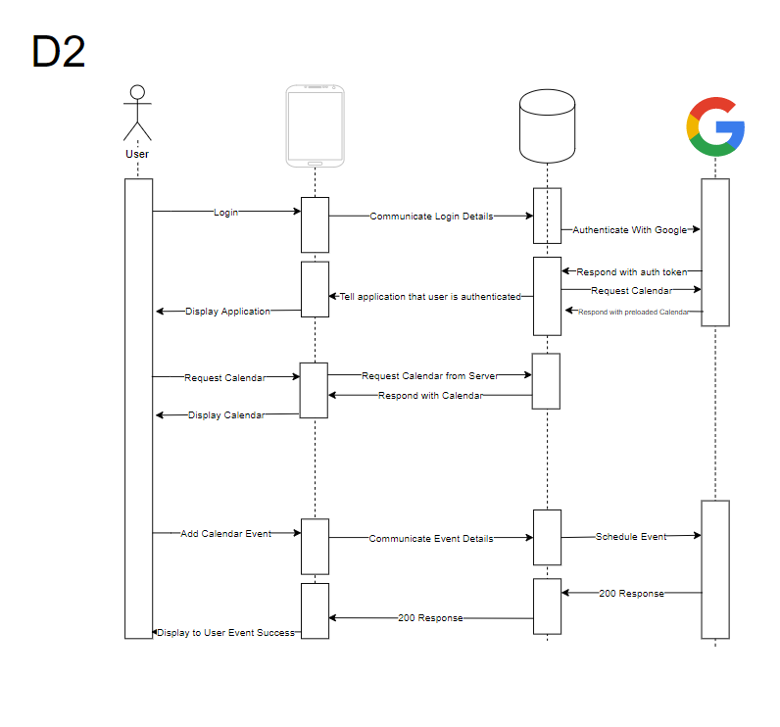
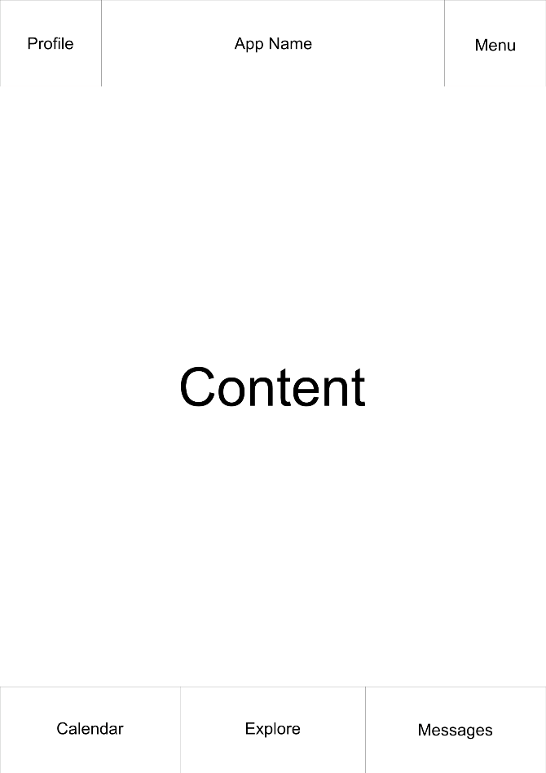
Project Description - Diagrams

Slide 8
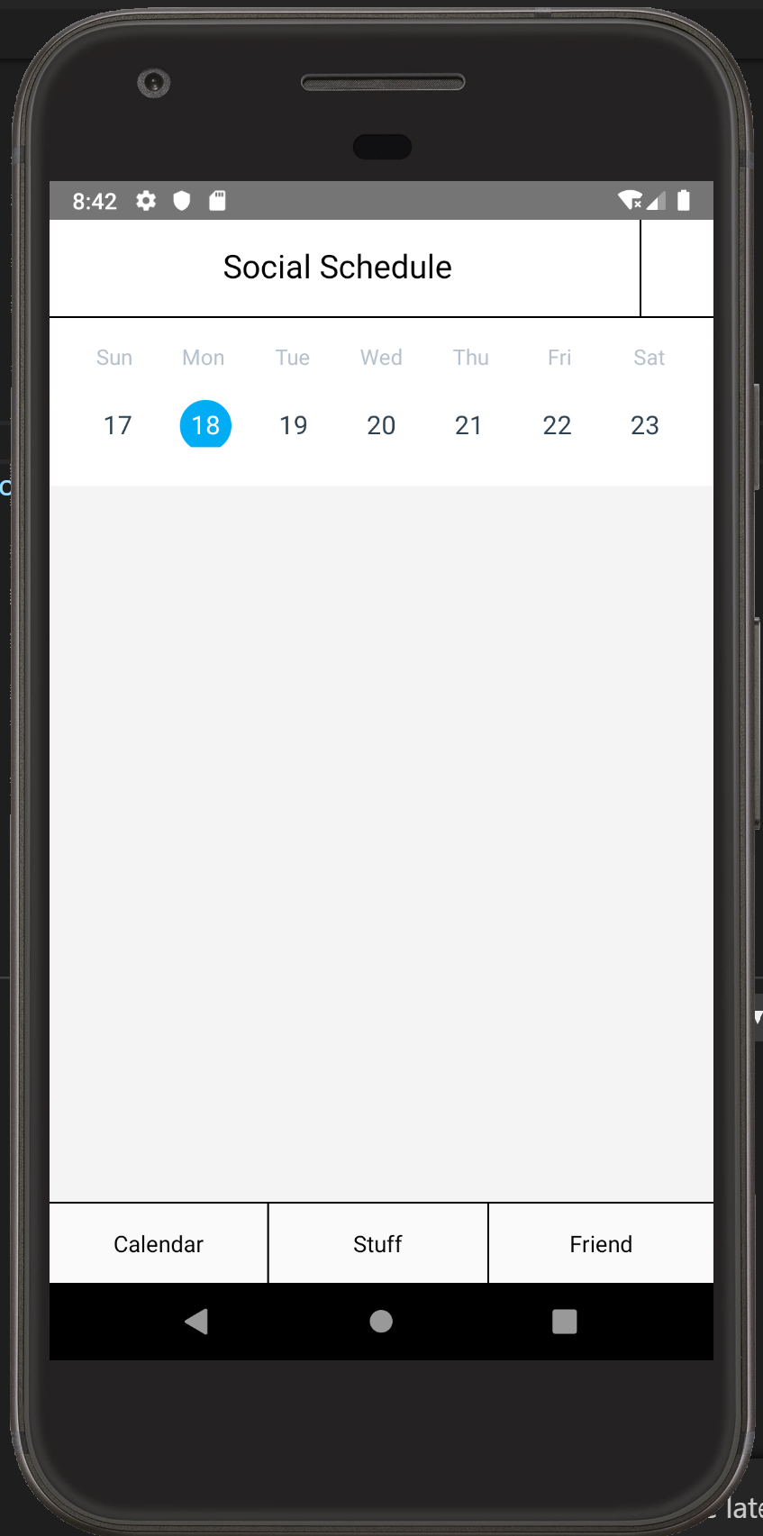
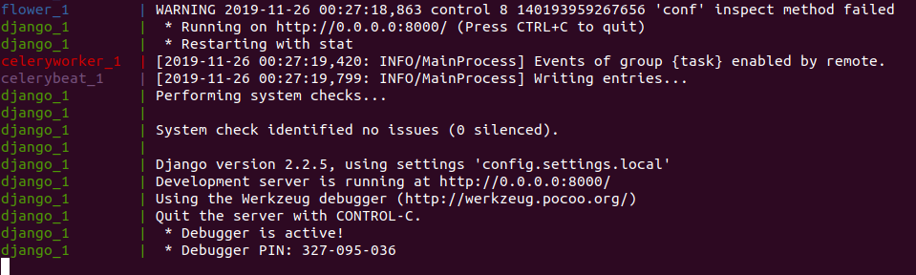
Current State of the Project

Slide 9
End of Term Accomplishments
Functional UI
Ability to connect to Google Calendar
Mapped out back end architecture

Slide 10
Project Milestones
Milestone | Description
Get back end running | The initial Django server should run
Rough UI/UX | Not necessarily fleshed out. Just bare minimum needed
API planning | Thorough planning of our API in RAML so that both of us know exactly what
Hookup front end to back end | Make sure the front end and backend are communicating properly using the details from the API planning
Messaging Capabilities | Add the ability for users to message each other
Location Services | Add location services for location events
Google Play Store | Our app should be on the app store available for download

Slide 11
Project Timeline
Tasks/Milestones | Start Date | Completion Date
Get back end running | 11/1/19 | 11/24/19
Rough UI | 11/1/19 | 12/6/19
Rough UX | 12/6/19 | 12/25/19
Google Calendar API | 11/24/19 | 12/6/19
Custom Users | 11/24/19 | 12/6/19
API Planning | 12/6/19 | 12/25/19
Hookup front end to back end | 12/25/19 | 1/13/20
Scheduling Algorithm | 12/25/19 | 1/13/20
Messaging Capabilities | 1/13/20 | 2/16/20
Location Services | 1/13/20 | 2/1/20
Yelp Services | 2/1/20 | 2/15/20
Concert Services | 2/16/20 | 3/1/20
Twitter Services | 3/1/20 | 3/16/20
Facebook Services | 3/1/20 | 3/16/20
Google Play Store | 3/16/20 | 4/1/20
Refining and Refactoring | 4/1/20 | Expo

Slide 12
Who is Doing What
Tim
Rough UI - Not necessarily fleshed out. Just bare minimum needed
Rough UX - Not necessarily fleshed out. Just bare minimum needed
Messaging Capabilities - Add the ability for users to message each other
Location Services - Add location services for location events
Concert Services - Add ways to automatically show nearby concerts available
Facebook - Ability to post to Facebook about events
Nick
Get back end running - The initial Django server should run
Google Calendar API - Ability for our backend to use Google Calendar API
Custom Users - Allow the creation of users in our DB
Scheduling Algorithm - the algorithm used to schedule users’ events around other events, within their free time
Yelp Services - Add yelp reviews of businesses in which events are taking place
Twitter - Ability to tweet about events

Slide 13
Expected Demo at Expo
Available app on Google Play Store and Apple App Store
Actual user feedback and response
Cloud deployed server

