Slide 1
Socialendar
Nick Chonko, Tim Walsh
Advisor – Nan Niu

Slide 2
Goals
Create a mobile application which users can use to keep track of events in their lives, and communicate with others.
Allow for dynamic planning of events to fit around the rest of a user’s schedule.
Automatically pull events from online that users may be interested in.

Slide 3
Intellectual Merits
Dynamic Scheduling – Automatically plan certain events around a user’s existing schedule
Ability to view and attend public events
Ability to share events with friends

Slide 4
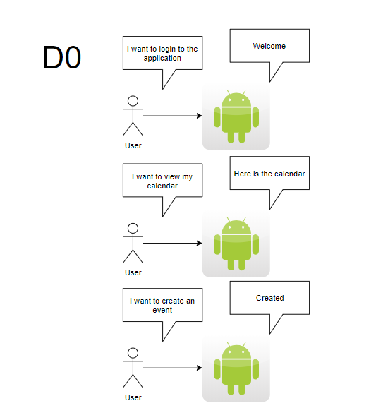
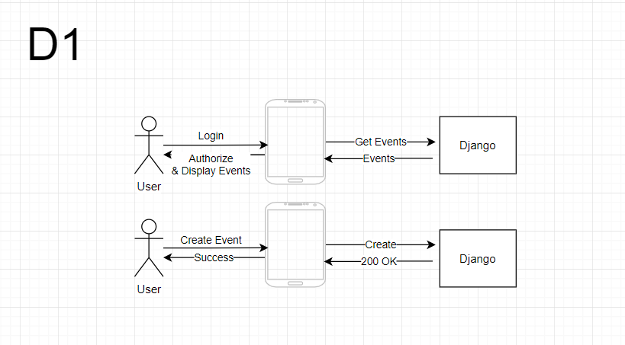
Design Specifications

Slide 5
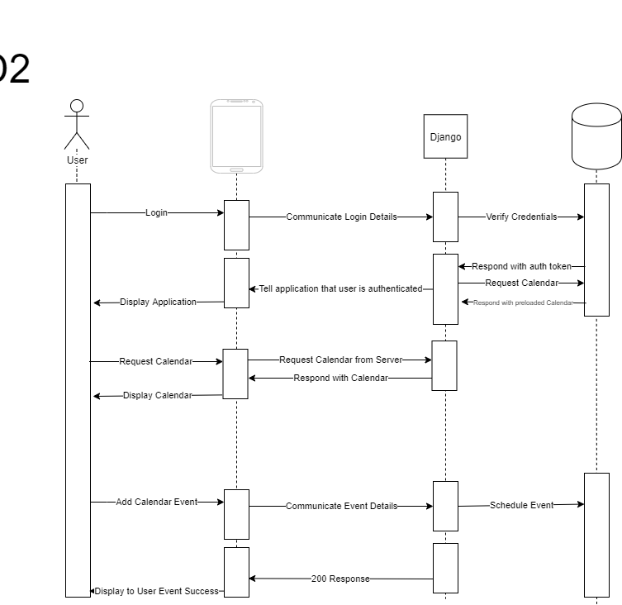
Design Specifications
D
Our application consists of a React Front end, a Django server, and a Postgres database
The Django server, and Postgres are run in Docker containers that are deployed to AWS.

Slide 6
Technologies
Front End
React –
React Native Calendars -
Back End
Django – The server for our application
Django Rest Framework – Library used with Django to write API
Docker – Used for easy deployment
PostgreSQL – Database used for the application
Cloud
AWS EC2 – Used to run our Django Server
AWS RDS – Used to operate our Postgres Database

Slide 7
Milestones
Tasks/Milestones | Start Date | Completion Date
Get back end running | 11/1/19 | 11/24/19
Rough UI | 11/1/19 | 12/6/19
Rough UX | 12/6/19 | 12/25/19
Custom Users | 11/24/19 | 12/6/19
API Planning | 12/6/19 | 12/25/19
Hookup front end to back end | 12/25/19 | 1/13/20
Scheduling Algorithm | 12/25/19 | 1/13/20
Messaging Capabilities | 1/13/20 | 2/16/20
Location Services | 1/13/20 | 2/1/20
Yelp Services | 2/1/20 | 2/15/20
Concert Services | 2/16/20 | 3/1/20
Twitter Services | 3/1/20 | 3/16/20
Facebook Services | 3/1/20 | 3/16/20
Google Play Store | 3/16/20 | 4/1/20
Refining and Refactoring | 4/1/20 | Expo

Slide 8
Results
Ability to schedule events
Working front end and back end
Messaging capabilities are a work in progress
Final design of front end is a work in progress

Slide 9
Challenges
By far the biggest challenge is keeping testing up to date. Nothing gets added into the code without thorough testing.
Other commitments, such as school, and homework take a lot of time away from the project.
Agreement between group on API routes was another challenge.
Django Rest Framework makes writing the API easier, but there is a lot to know in order to do everything properly.

