Slide 1

Task-1
E-commerce Website
By
Nicy Job

Slide 2
Contents
Task-1
Requirements
Analysis
Design
Task-2
Estimated time for an e-commerce website

Slide 3
Requirements
User Registration and Login
Users must be able to create accounts, log in, and reset passwords.
Product Catalog
Display products with images, descriptions, prices, and categories.
Shopping Cart
Allow users to add, remove, and update items in their cart.
Checkout Process
Users can review their cart, enter shipping information(Address),and make payment
Payment
Users can be able to pay through multiple methods
Order Management
Users are able to view their order history and track the status of their orders.

Slide 4
6.User Profiles
Users can manage their profiles, including addresses and payment methods
7.Product Reviews and Ratings
Users can reviews and ratings for products.
8.Admin Panel
Create an interface for administrators to manage products, users, and orders.

Slide 5
Analysis
Feasibility Study
Technical Feasibility:
Assessment of technologies
Economic Feasibility:
Cost analysis (development, hosting, maintenance).
Operational Feasibility:
Evaluate if the current team has the necessary skills (e.g., web development, digital marketing, customer support).

Slide 6
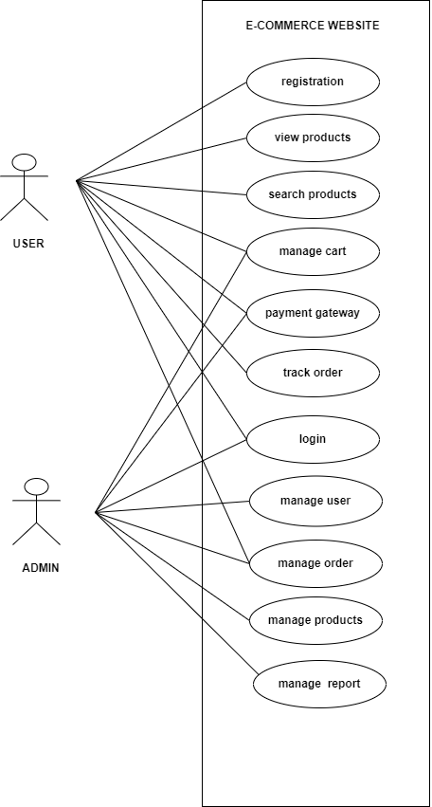
Use Case Diagram

Slide 7
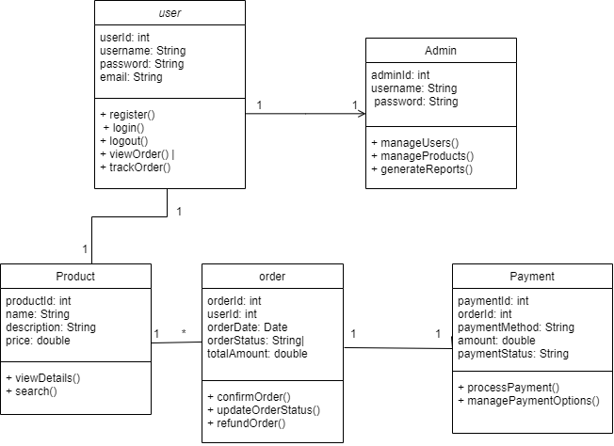
Class Diagram

Slide 8
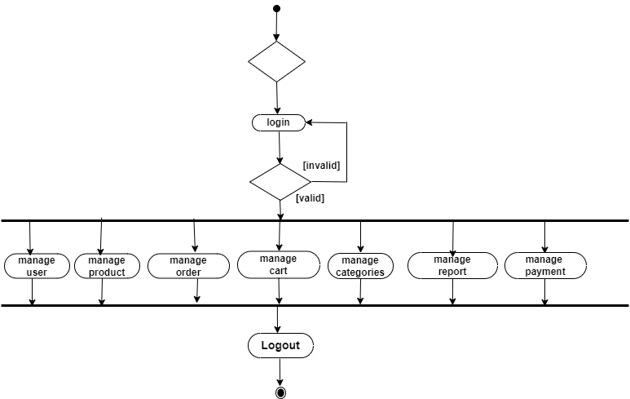
Admin Activity Diagram

Slide 9
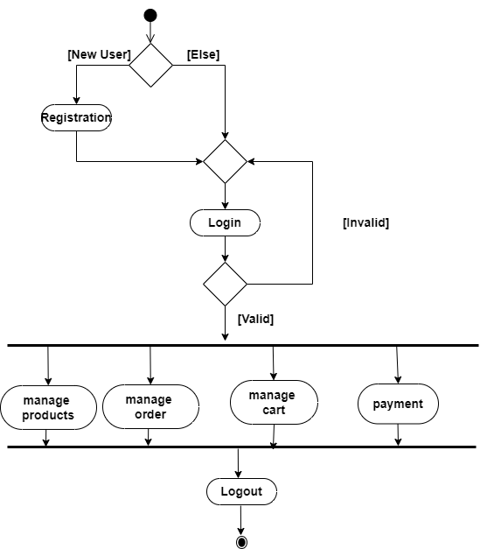
User Activity Diagram

Slide 10
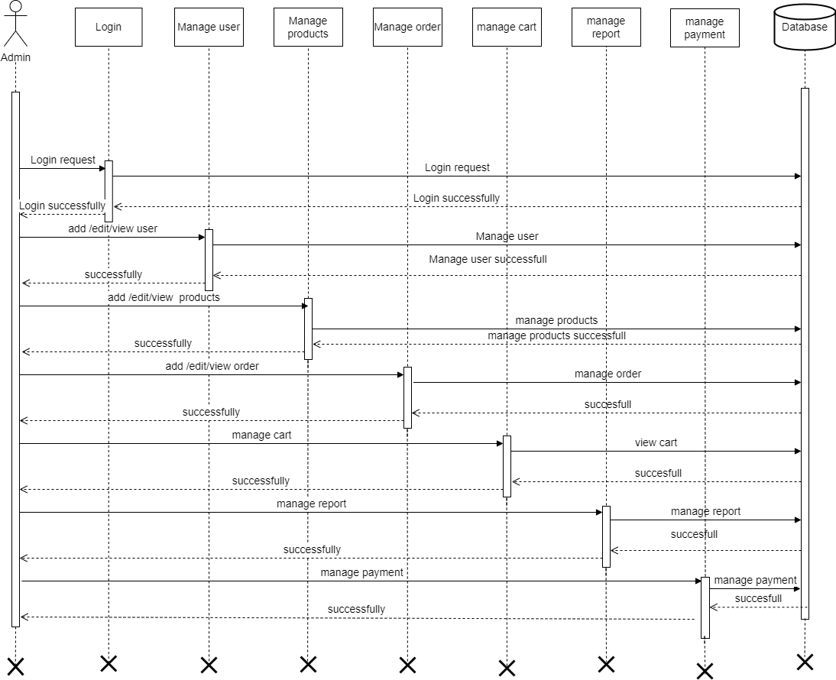
Admin Sequence Diagram

Slide 11
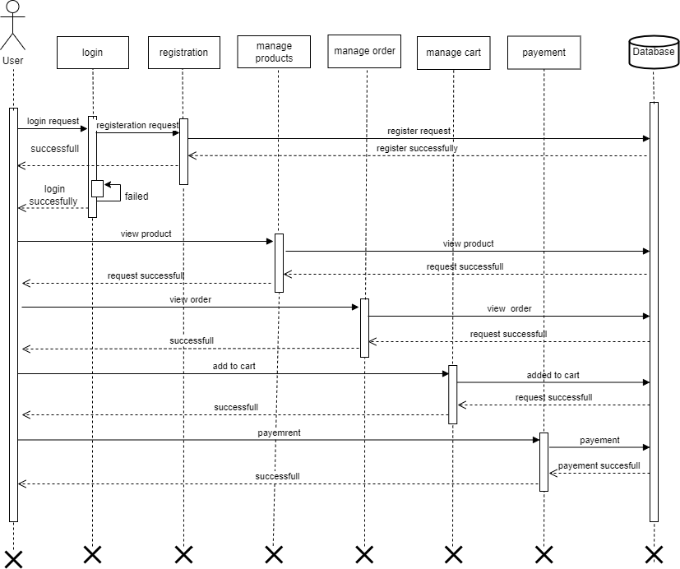
User Sequence Diagram

Slide 12
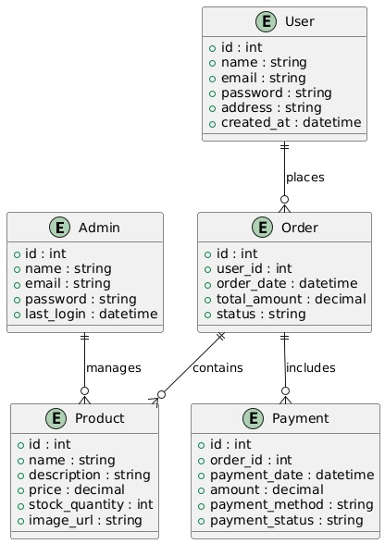
ER Diagram

Slide 13
THANK YOU

