Slide 1
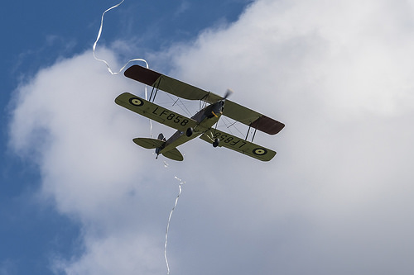
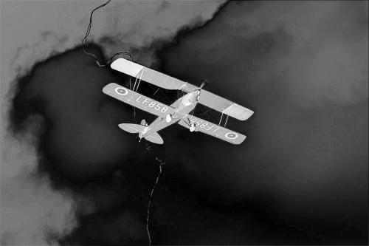




Image average
$$I_{μ}=[L_{μ},a_{μ},b_{μ}]$$
$$S\left(x,y\right)=||I_{μ}−I_{whc}(x,y)||$$
Gaussian blur
$$I_{whc}(x,y)=[L_{whc},a_{whc},b_{whc}]$$

