Slide 1
APB and AXI Interfaces

Slide 2
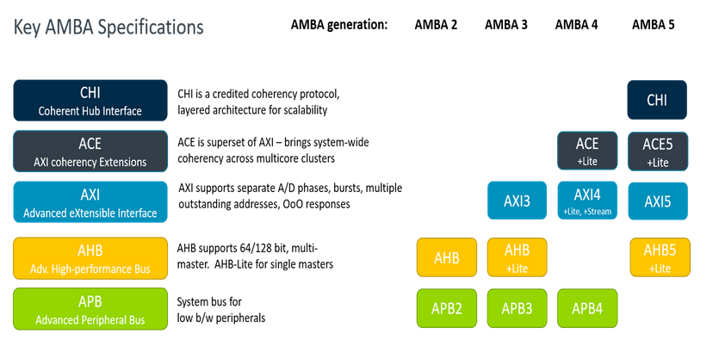
Amba Protocol List
Protocols we will be dealing with today

Slide 3
APB (Advanced Peripheral Bus)
The APB protocol is a low-cost interface, optimized for minimal power consumption and reduced interface complexity. The APB interface is not pipelined and is a simple, synchronous protocol. Every transfer takes at least two cycles to complete.
APB transfers are initiated by an APB bridge. APB bridges can also be referred to as a Requester. A peripheral interface responds to requests. APB peripherals can also be referred to as a Completer. This specification will use Requester and Completer.

Slide 4
Data Buses
The APB protocol has two independent data buses, one for read data and one for write data. The buses can be 8, 16, or 32 bits wide. The read and write data buses must have the same width.
Data transfers cannot occur concurrently because the read data and write data buses do not have their own individual handshake signals.

Slide 5
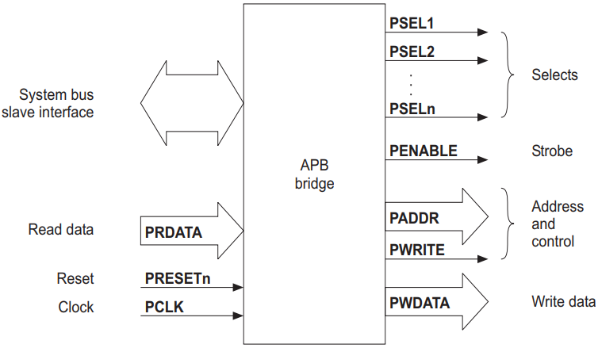
APB SIGNALS DESCRIPTION
PCLK (Peripheral Clock): PCLK is the clock signal for the APB bus. It provides the timing reference for the data transfers on the bus.
nRESET (Active-Low Reset): This signal is used to reset the peripheral devices connected to the APB bus. When the nRESET signal is asserted (pulled low), it resets the peripherals.
PADDR (Peripheral Address): PADDR is the address bus used to specify the address of the peripheral device with which data transfer is to take place.
PWDATA (Peripheral Write Data): PWDATA is the bus used to transfer data from the CPU to the peripheral during write operations.

Slide 6
APB SIGNALS DESCRIPTION
PRDATA (Peripheral Read Data): PRDATA is the bus used to transfer data from the peripheral to the CPU during read operations.
PSEL (Peripheral Select): PSEL is the bus that indicates which peripheral is currently selected for communication. It is a chip select signal that enables a specific peripheral device.
PENABLE (Peripheral Enable): PENABLE is a signal that indicates whether the current transfer is an active phase of the bus cycle. It is used to enable the peripheral for data transfer
PWRITE (Peripheral Write Control): PWRITE is a control signal that indicates whether the current transfer is a write operation (data is being written from the CPU to the peripheral).
PREADY (Peripheral Ready): PREADY is a signal indicating whether the peripheral is ready to complete the current data transfer. It is often used in a handshaking mechanism.

Slide 7
Data Transfers
Write Transfer
There is 2 types of write transfer in APB protocol:
With no wait states
With wait states

Slide 8
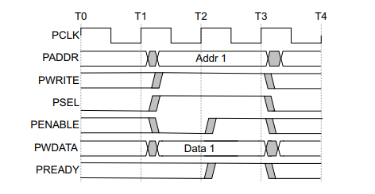
With No Wait States
Figure 1.1 shows a basic write transfer with no wait states.
There are 3 phases in write state:
Setup Phase: Setup phase of the write transfer occurs T1 in Figure 1.1. The select signal,PSEL, is asserted, which means that PADDR,PWRITE and PWDATA must be valid.
Figure 1.1 – Write Transfer

Slide 9
With No Wait States
Access Phase: Access phase of the write transfer is shown at T2 in Figure 1.1 where PENABLE is asserted.PREADY is asserted by the Completer at the rising edge of PCLK to indicate that the write data will be accepted at T3. PADDR,PWDATA, and any other control signals, must be stable until the transfer completes.
At the end of the transfer, PENABLE is deasserted. PSEL is also deasserted, unless there is another transfer to the same peripheral.
Figure 1.1 – Write Transfer

Slide 10
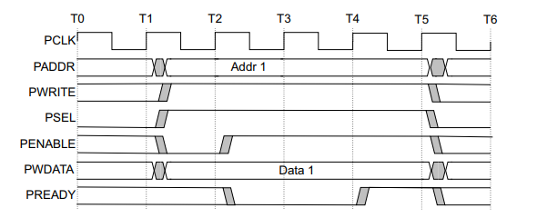
With Wait States
Figure 1.2 shows how the Completer can use PREADY to extend the transfer.
During the Access phase, when PENABLE is HIGH, the completer extends the transfer by driving PREADY LOW. The following signals remaing unchanged while PREADY remains LOW
Figure 1.2 – Write Transfer
Note: PREADY can take any value when PENABLE is low. This ensures that peripherals that have a fixed two cycle access can tie PREADY HIGH

Slide 11
Read Transfer
Two types of read transfer are described in this section:
With no wait states.
With wait states.

Slide 12
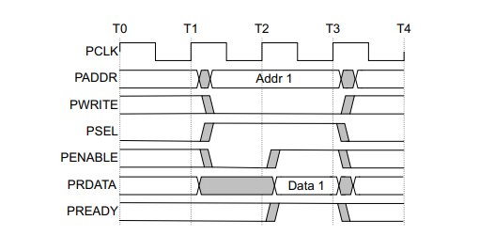
With No Wait States
Figure 2.1 shows a read transfer. The timing of the PADDR,PWRITE,PSELECT,PENABLE signals are the same as described in Write No Transfer section. The Completer must provide the data before end of the read transfer.
Figure 2.1 – Read Transfer With No Wait State

Slide 13
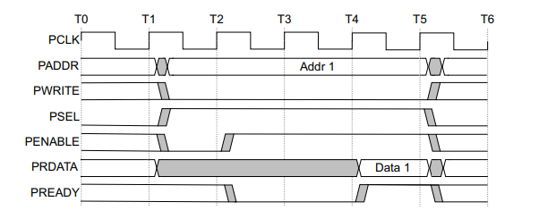
With Wait States
Figure 1.4 shows how the PREADY signal can extend the transfer.
The transfer extended if PREADY is driven LOW during an Access phase. PADDR,PWRITE,PSEL,PENABLE,PPROT,PAUSER signals remains same while PREADY remains LOW.
Figure 2.2 – Read Transfer With Wait State

