Slide 1
APB and AXI Interfaces

Slide 2
AXI Protocol
The Advanced eXtensible Interface (AXI) is an on-chip communication bus protocol developed by ARM. It is part of the AXI3 and AXI4 specifications. The AMBA specificaitons defines 3 AXI4 protocols.
AXI4: A high performance memory mapped data and adress interface. Capable of Burst access to memory mapped devices.
AXI4-Lite: A subset of AXI, lacking burst access capability. Has a simpler interface than the full AXI4 interface.
AXI4-Stream: A fast unidirectional protocl for transfering data from master to slave.

Slide 3
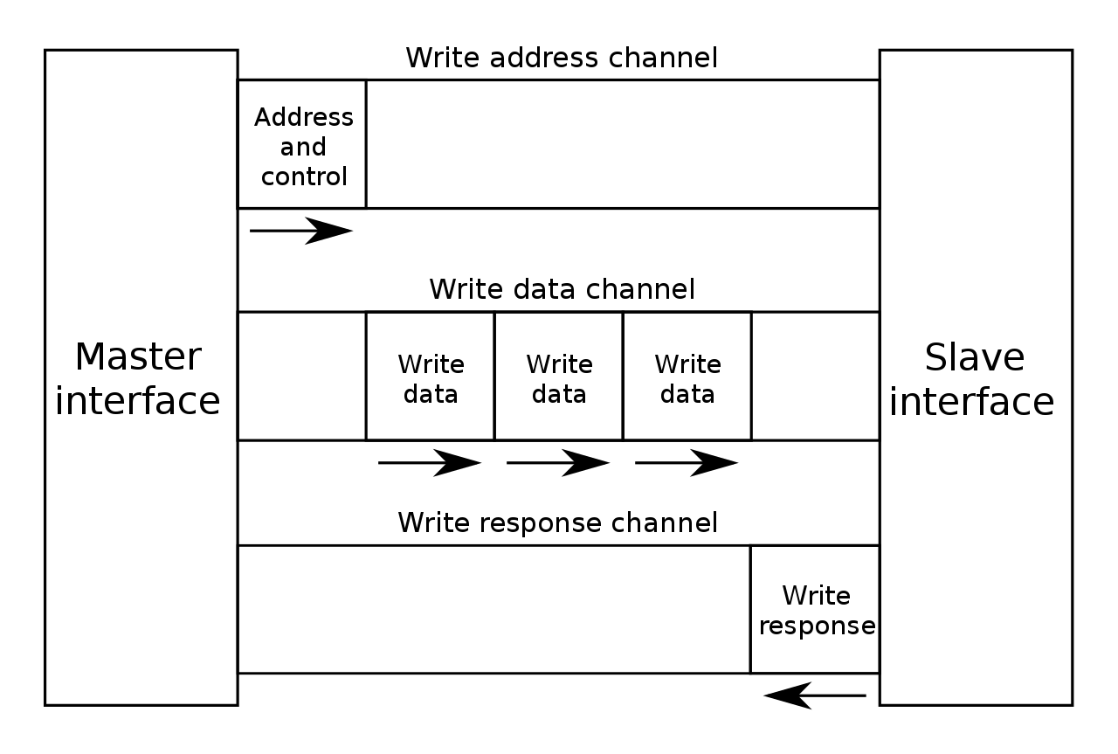
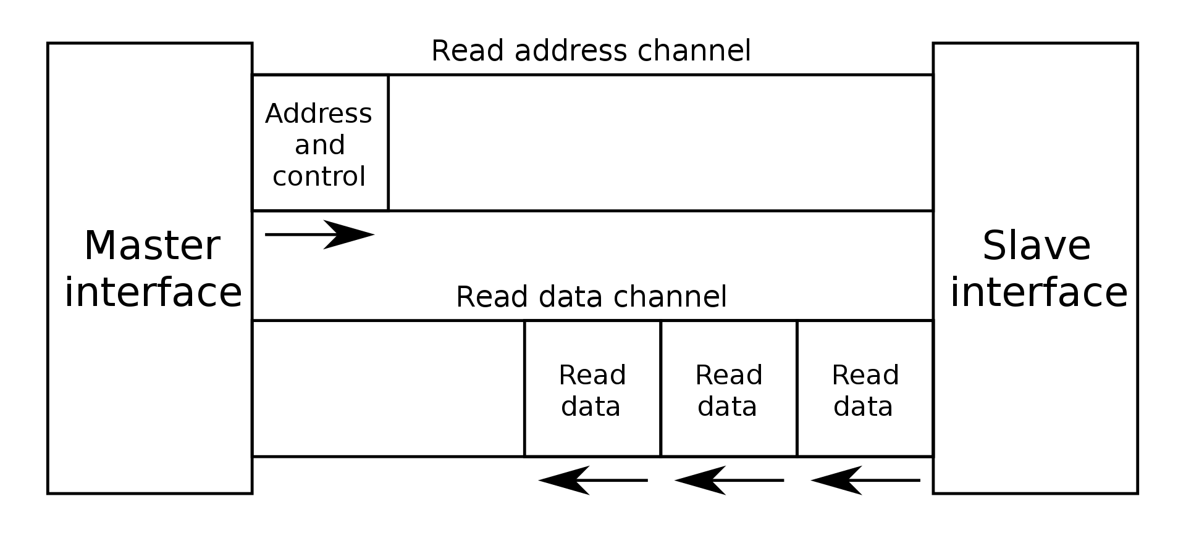
Basic AXI Signaling
In Figure 1 and Figure 2, there are 5 basic channels for write and read operations.
For Write Channel:
Write Address Channel
Write Data Channel
Write Response Channel
For Read Channel:
Read Address Channel
Read Data Channel
Figure 1 – Write Transaction
Figure 2 – Read Transaction

Slide 4
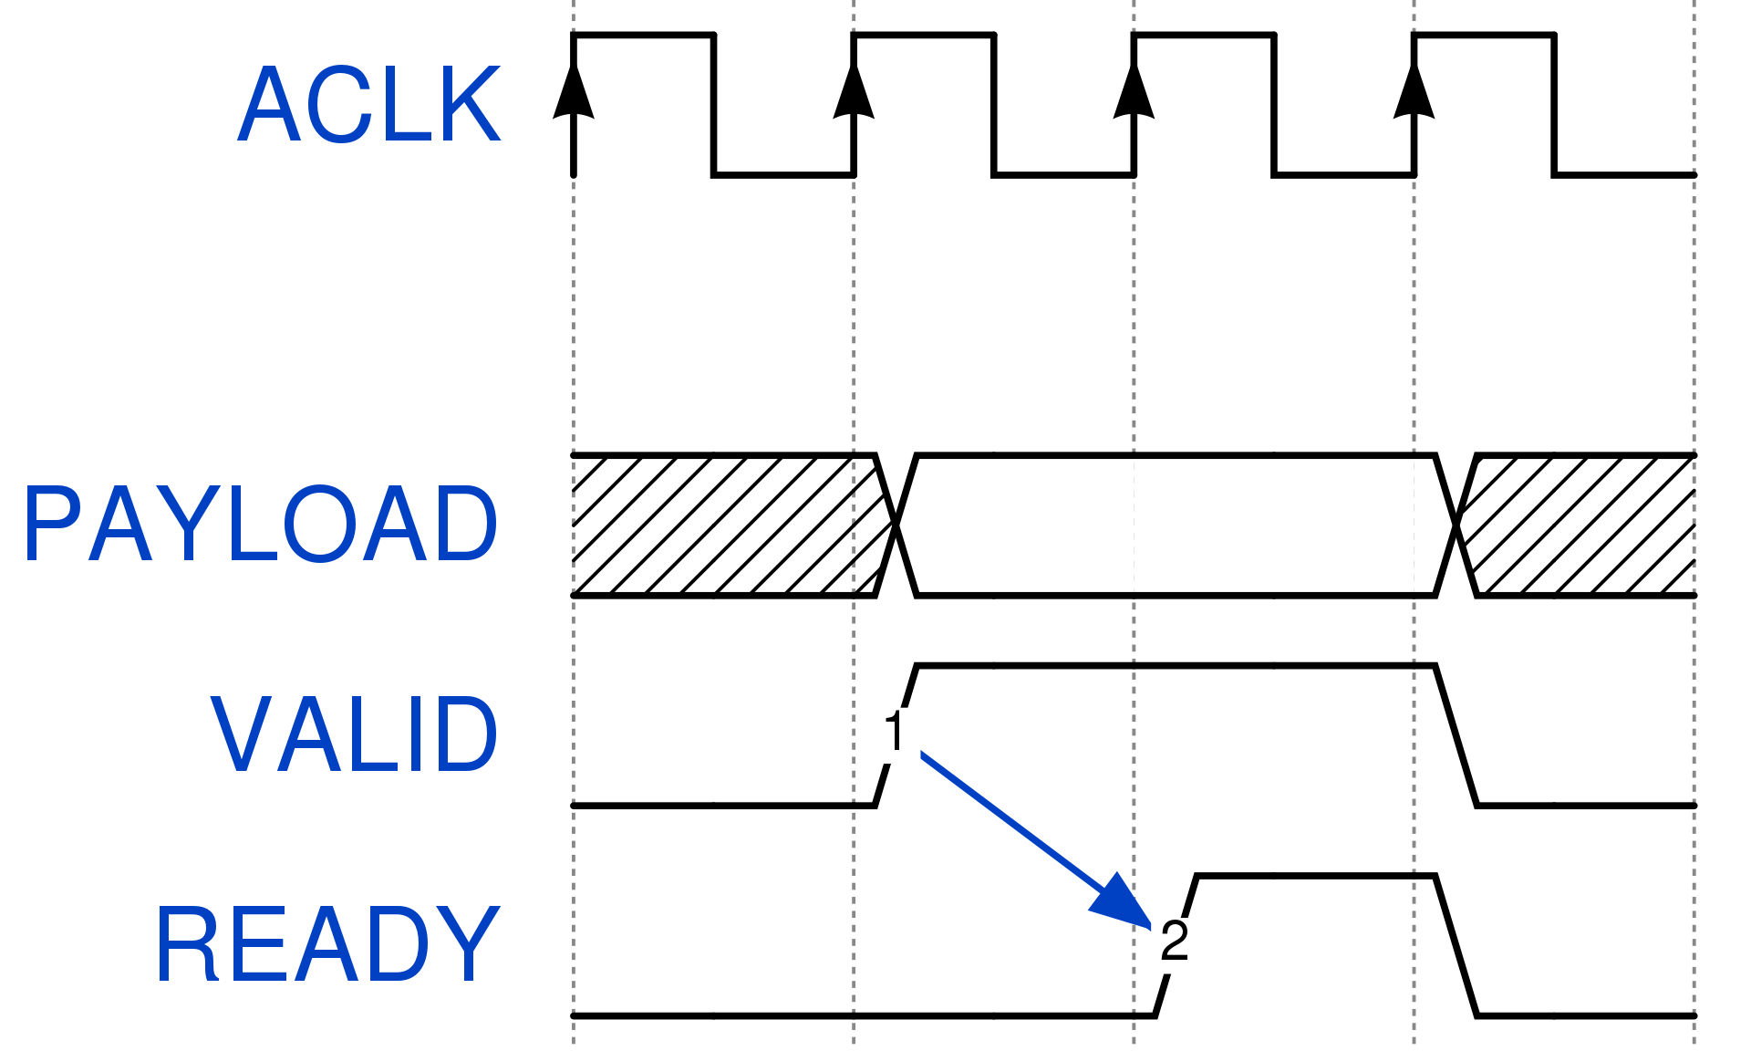
Handshake Process
AXI defines a basic handshake mechanism, composed by and VALID and READY signal. The VALID signal is driven by the Master to inform the destination there is an valid data on the bus and can be read from that clock cycle onworads. Similarly, the Slave device asserts the READY signal for say it is ready to take data to Master.
When both VALID and READY signals are high at the same clock cycle, the handshake occurs and then, payload is considered «transfered» and the source can eitehr provide a new data payload by keeping VALID logical 1 or terminate the transmission by de-asserting VALID. An individiual data transfer, so a clock cycle when both VALID and READY are high, is called beat. AXI4, AXI4-Lite and AXI4-Stream are use handsake mechanism to transfer or read data.
Figure 3 Handshake

Slide 5
AXI4 Full – Write Transaction
To start a write operation, the initator has to provide both the address information and the data.
The address information are provided over the Write address channel, in a similar manner as a read operation.
The burst type and burst length on AWLEN and if present, all the option signals.
An initiator has also provide the data related to the specified address(es) on the write channel: WDATA, WSTRB.
NOTE: On the last data word, WLAST signal must be asserted by the initiator.

Slide 6
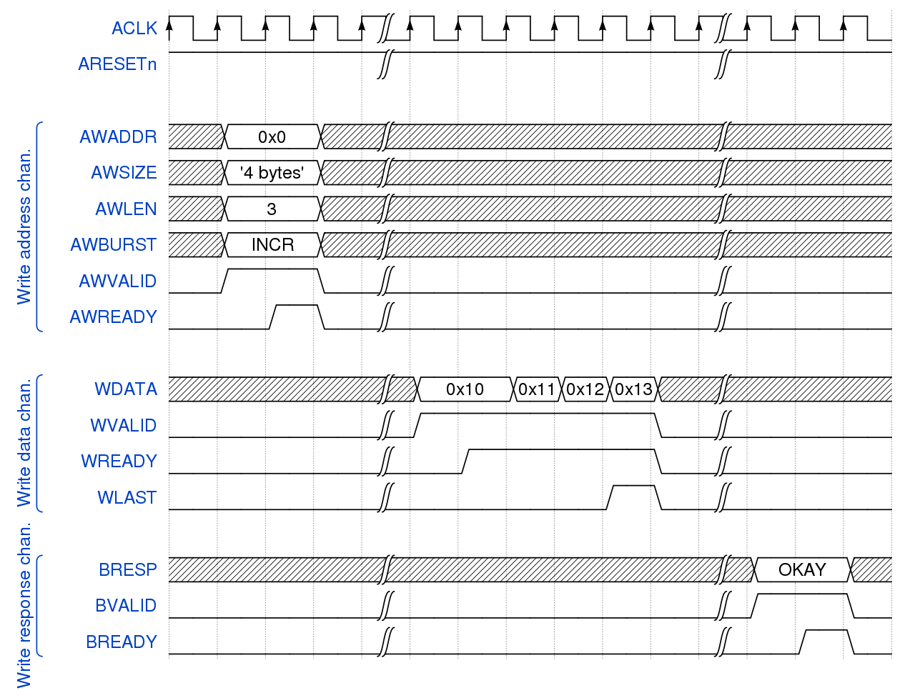
Figure 4 Write Transaction
In Figure 4, the initiator drives 4 beats (AWLEN + 1) of 4 bytes each starting from address 0x0 with INCR type.(It is incremented by 0x4) In this example, Master writes the 0x10 -> Address 0x4, 0x11 -> Address 0x8, 0x12 -> Address 0x12, 0x13 -> Address 0xC. Notice that in the writ address channel, there is a VALID & READY handshake and write data channel also. Notice that, when 0x13 which is last signal is going to slave, WLAST signal is asserted and then slave makes response OKAY with Write Response Channel

Slide 7
AXI4 Full – Read Transaction
To start a read transaction, the initator has to provide on the Read Address Channel.
The start address on ARADDR.
The burst type and burst length on ARLEN.
Additionally the other auxiliary signals, if present, are used to define more specific transfers. After the usual VALID & READY handshake, the target has to provide on the Read data channel.

Slide 8
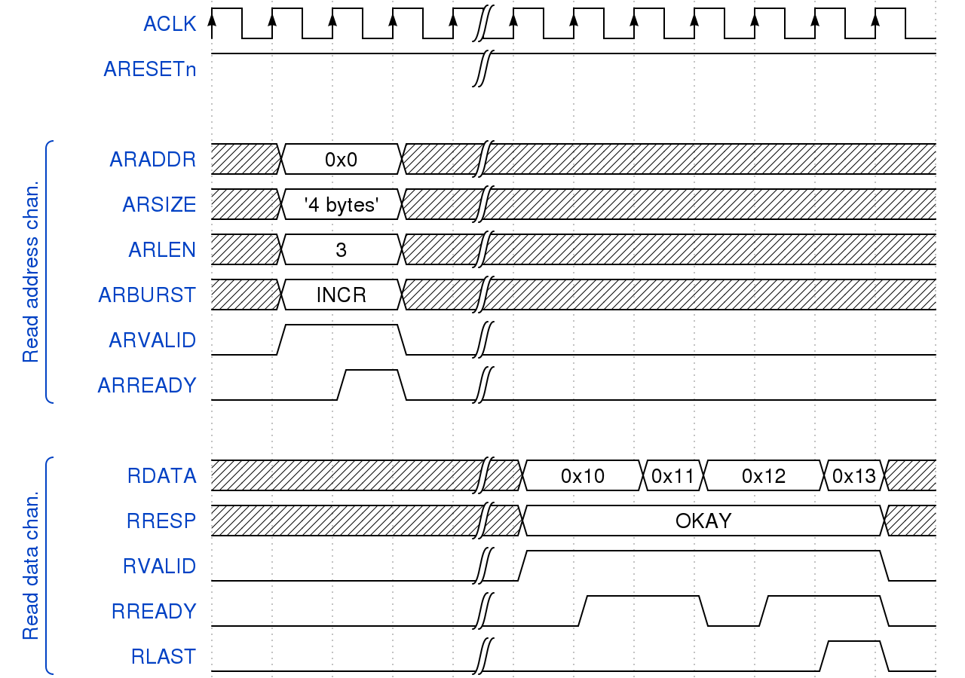
Exampe read transaction is given in Figure 5. In read transaction, the initiator requests 4 beats (ARLEN + 1) of 4 bytes each starting from address 0x00 and incremented with 0x04 in Read Address Channel. Slave device is returning back with 0x10 for address 0x00, 0x11 for address 0x4, 0x12 for address 0x8 and 0x13 for address 0xC and when the last data signal is reading from the line, (which is 0x13 in this example) notice that RLAST signal is asserted and also notice that when reading 1 byte, the Master sends OKAY message in RRESP channel
Figure 5 – Read Transaction

Slide 9
AXI-4 Lite
AXI4-Lite is a subset of AXI4. There is several different things between the two.
All transactions are of burst length 1. So there is no burst option.
All data accesses use the full width of the data bus. AXI4 Lite supports 32 bit and 64 bit bus width.
All accesses are non-modifable, non-bufferable.
Exclusive acceses are not supported.

Slide 10
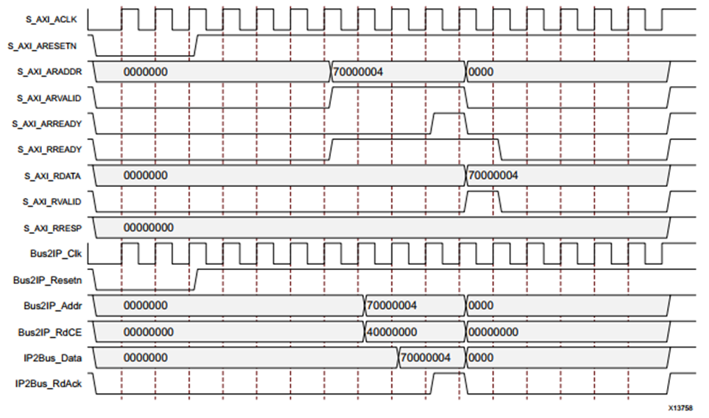
AXI4 – Lite Write Transaction
An AXI4-Lite write transaction example given in Figure 6.
The master puts an address on the Write Address Channel and data on the Write Data Channel. At the same time it asserts AWVALID and WVALID indicating the address and data on the respective channels is valid. BREADY is also asserted by the master, indicating it is ready to receive a response.
Figure 6 – AXI4 Lite Write Transaction

Slide 11
AXI4 – Lite Write Transaction
The slave asserts AWREADY and WREADY on the Write Address and Write Data Channels, the handshakes on those channels occur and the associated valid and ready signals can be deasserted.
The slave asserts BVALID indicating there is a valid response on the Write response channel.
The next rising edge clock edge completes the transaction, with both Ready and Valid signals on the write response channel high.
Figure 6 – AXI4 Lite Write Transaction

Slide 12
AXI4 – Lite Read Transaction
An AXI4-Lite Read Transaction example given in Figure 7.
The Master puts an address on the Read Address Channel as well as asserting ARVALID, indicating the address is valid, and RREADY, indicating the master is ready to receive data from the slave.
The Slave asserts ARREADY, indicating that it is ready to receive the address on the bus.
Figure 7 – AXI4 Lite Read Transaction

Slide 13
AXI4 – Lite Read Transaction
Since both ARVALID and ARREADY are asserted, on the next rising clock edge the handshake occurs, after this the master and slave deassert ARVALID and the ARREADY, respectively. (At this point, the slave has received the requested address).
The Slave puts the requested data on the Read Data Channel and asserts RVALID, indicating the data in the channel is valid. The slave can also put a response on RRESP, though this does not occur here
Since both RREADY and RVALID are asserted, the next rising clock edge completes the transaction. RREADY and RVALID can now be deasserted..
Figure 8 – AXI4 Lite Read Transaction

