Slide 1
Lab5 Intro LED Control with via AXI4-LITE Bus

Slide 2
Introduction
This lab guides you through the process of using Efinity and IP Integrator to create a complete RISC-V Sapphire SoC based processor system targeting the KuanTek Tri-Pi Board.
You will use Led Module and AXI4-LITE Bus IP Design to build an application to build the system and validate the design functionality in the Efinity RISC-V IDE.

Slide 3
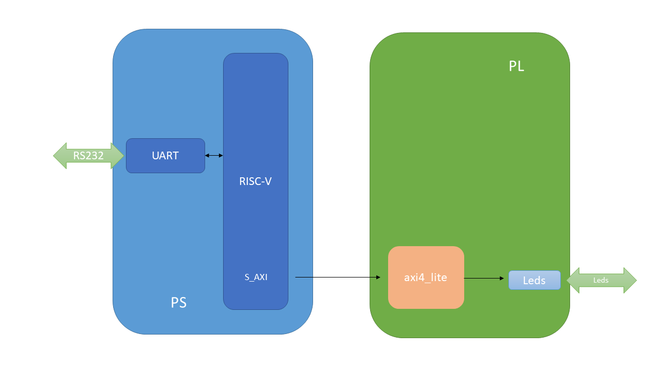
RISC-V Sapphire Based Embedded System Design

Slide 4
Prodecure
Create a project using Efinity Software
Create the Sapphire SoC IP from IP Editor
Add the top module and AXI4-LITE IP Bus
Designing the pins what we used leds design on the chip from Interface Designer
Validate the design
Generate the bitstream
Create workspace on the Efinity RISC-V IDE
Create an LED application, write register ofset for leds contol in the Efinity RISC-V IDE
Verify the design functionality in hardware

Slide 5
Summary
In this lab, you created an RISC-V SapphireSoC processor based embedded system in the Tri-Pi device.
You designed Resource the Efinix standard GPIO IP to provide input and output functionality. You will use AXI4-LITE BUS.
You created the project in Efinity, created the hardware system using IP Integrator, synthesized and implemented the design and exported the generated bitstream to the RISC-V IDE, created a AXI4-LITE Led software application in the RISC-V IDE, controlled the leds with writing register in the main program and verified the functionality after programming the PL section and running the application from the BRAM memory.

