Slide 1
Lab6 Intro LED Control with Button via AXI4-LITE Bus

Slide 2
Introduction
This lab guides you through the process of using Efinity and IP Integrator to create a complete RISC-V Sapphire SoC based processor system targeting the KuanTek Tri-Pi Board.
You will use Led-Button Module and AXI4-LITE IP BUS Design to build an application, read and write registers for build the system and validate the design functionality in the Efinity RISC-V IDE.

Slide 3
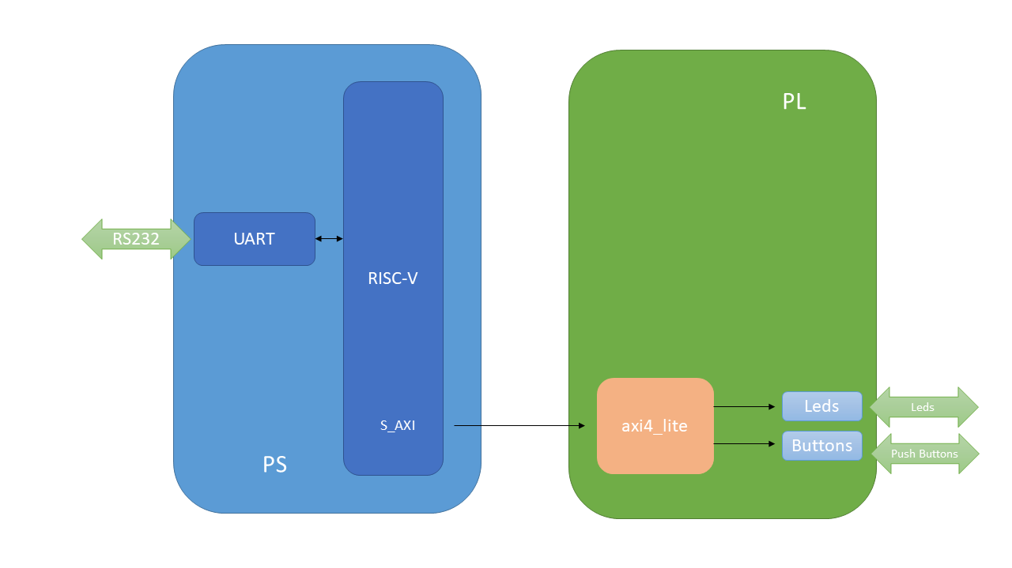
RISC-V Sapphire Based Embedded System Design

Slide 4
Prodecure
Create a project using Efinity Software
Create the Sapphire SoC IP from IP Editor
Add the top module and AXI4-LITE IP Bus
Designing the pins what we used for buttons and leds design on the chip from Interface Designer
Validate the design
Generate the bitstream
Create workspace on the Efinity RISC-V IDE
Create an led-button application in the Efinity RISC-V IDE
Verify the design functionality in hardware

Slide 5
Summary
In this lab, you created an RISC-V SapphireSoC processor based embedded system in the Tri-Pi device.
You designed Resource the Efinix standard GPIO IP to provide input and output functionality. You will use AXI4-LITE BUS.
You created the project in Efinity, created the hardware system using IP Integrator, synthesized and implemented the design and exported the generated bitstream to the RISC-V IDE, created a ABP3 Led-Button software application in the RISC-V IDE, writed data to registers and read a data from registers , verified the functionality after programming the PL section and running the application from the BRAM memory.

