Slide 1
Lab7 Intro Debugging Using ILA and VIO with Math IP

Slide 2
Introduction
Software and hardware interact with each other in an embedded system.
The Efinity Software includes System Debugger as software debugging tool.
The Efinix integrated logic analyzer tool allows for hardware debugging by providing access to the internal signals, using number of cores, without necessarily bringing them out via the package pins using several types of cores.
These cores may reside in the programmable logic (PL) portion of the device and can be configured with several modes that can monitor signals within the design.

Slide 3
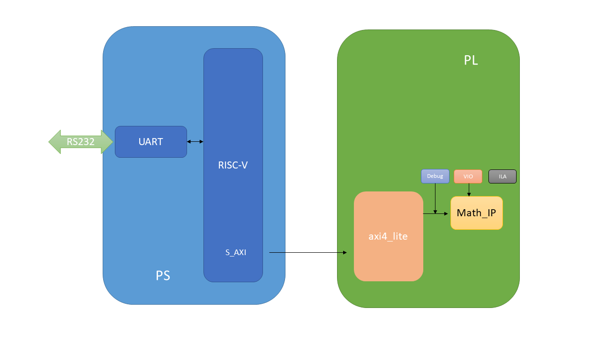
RISC-V Sapphire Based Embedded System Design

Slide 4
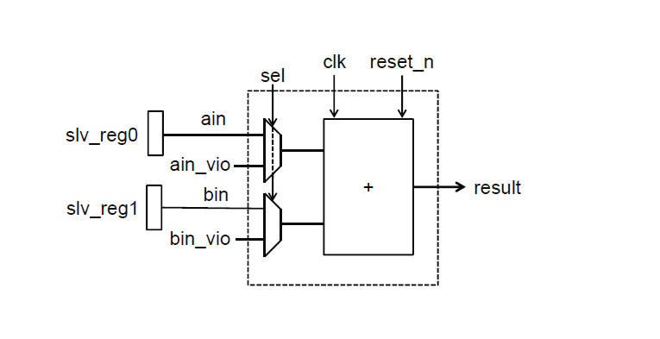
Custom MATH-IP Design

Slide 5
Prodecure
Create a project using Efinity Software
Create the Sapphire SoC IP from IP Editor
Add the top module , math-ip and AXI4-LITE IP Bus
Customize AXI4-LITE ip
Set debug settings, create ila ports and vio ports
Add debug ip to top module
Validate the design
Generate the bitstream
Create workspace on the Efinity RISC-V IDE
Verify the design functionality in hardware

Slide 6
Summary
In this lab, you created an RISC-V SapphireSoC processor based embedded system in the Tri-Pi device.
You designed Resource the Efinix standard GPIO IP to provide input and output functionality. You will use AXI4-LITE BUS. You designed debug cores for debugging.
You instantiated the ILA and the VIO cores into the top module design.
You used Mark Debug feature of Efinity to debug the AXI transactions on the custom peripheral.
Finally, you carried out cross triggering between hardware and software.

