Slide 1
Introduction to OpenCL
A Collaboration Between
David Kaeli, Northeastern University
Benedict R. Gaster, AMD
© 2011

Slide 2
Instructor Notes
This is a straight-forward lecture. It introduces the OpenCL specification while building a simple vector addition program
The Mona Lisa images in the slides may be misleading in that we are not actually using OpenCL images, but they were nicer to look at than diagrams of buffers
It would probably be a good idea to open up the example code and walk through it along with the lecture

Slide 3
OpenCL Architecture
OpenCL allows parallel computing on heterogeneous devices
CPUs, GPUs, other processors (Cell, DSPs, etc)
Provides portable accelerated code
Defined in four parts
Platform Model
Execution Model
Memory Model
Programming Model
(We’re going to diverge from this structure a bit)

Slide 4
Platform Model
Each OpenCL implementation (i.e. an OpenCL library from AMD, NVIDIA, etc.) defines platforms which enable the host system to interact with OpenCL-capable devices
Currently each vendor supplies only a single platform per implementation
OpenCL uses an “Installable Client Driver” model
The goal is to allow platforms from different vendors to co-exist
Current systems’ device driver model will not allow different vendors’ GPUs to run at the same time

Slide 5
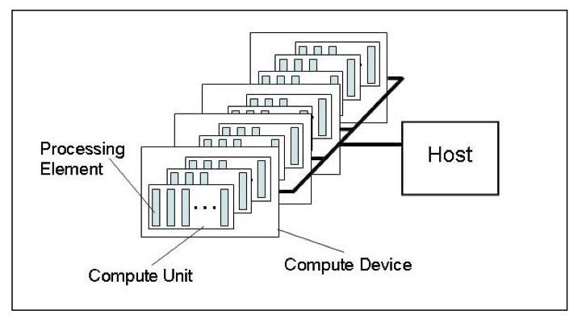
Platform Model
The model consists of a host connected to one or more OpenCL devices
A device is divided into one or more compute units
Compute units are divided into one or more processing elements
Each processing element maintains its own program counter

Slide 6
Host/Devices
The host is whatever the OpenCL library runs on
x86 CPUs for both NVIDIA and AMD
Devices are processors that the library can talk to
CPUs, GPUs, and generic accelerators
For AMD
All CPUs are combined into a single device (each core is a compute unit and processing element)
Each GPU is a separate device

Slide 7

Selecting a Platform
This function is usually called twice
The first call is used to get the number of platforms available to the implementation
Space is then allocated for the platform objects
The second call is used to retrieve the platform objects

Slide 8
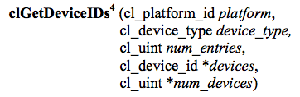
Selecting Devices
Once a platform is selected, we can then query for the devices that it knows how to interact with
We can specify which types of devices we are interested in (e.g. all devices, CPUs only, GPUs only)
This call is performed twice as with clGetPlatformIDs
The first call is to determine the number of devices, the second retrieves the device objects

Slide 9
Contexts
A context refers to the environment for managing OpenCL objects and resources
To manage OpenCL programs, the following are associated with a context
Devices: the things doing the execution
Program objects: the program source that implements the kernels
Kernels: functions that run on OpenCL devices
Memory objects: data that are operated on by the device
Command queues: mechanisms for interaction with the devices
Memory commands (data transfers)
Kernel execution
Synchronization

Slide 10
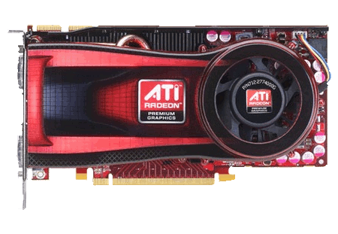
Contexts
When you create a context, you will provide a list of devices to associate with it
For the rest of the OpenCL resources, you will associate them with the context as they are created
Context
Empty context
Notes:
Devices can be associated with multiple contexts if desired

Slide 11
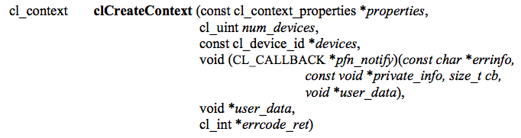
Contexts
This function creates a context given a list of devices
The properties argument specifies which platform to use (if NULL, the default chosen by the vendor will be used)
The function also provides a callback mechanism for reporting errors to the user
Notes:
There is another function called clCreateContextFromType(), which will create a context using all the GPUs, CPUs, etc.

Slide 12
Command Queues
A command queue is the mechanism for the host to request that an action be performed by the device
Perform a memory transfer, begin executing, etc.
A separate command queue is required for each device
Commands within the queue can be synchronous or asynchronous
Commands can execute in-order or out-of-order

Slide 13
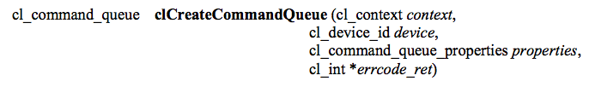
Command Queues
A command queue establishes a relationship between a context and a device
The command queue properties specify:
If out-of-order execution of commands is allowed
If profiling is enabled
Profiling is done using events (discussed in a later lecture) and will create some overhead

Slide 14
Command Queues
Command queues associate a context with a device
Despite the figure below, they are not a physical connection
Context
Command queues

Slide 15
Memory Objects
Memory objects are OpenCL data that can be moved on and off devices
Objects are classified as either buffers or images
Buffers
Contiguous chunks of memory – stored sequentially and can be accessed directly (arrays, pointers, structs)
Read/write capable
Images
Opaque objects (2D or 3D)
Can only be accessed via read_image() and write_image()
Can either be read or written in a kernel, but not both

Slide 16
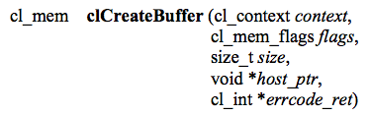
Creating buffers
This function creates a buffer (cl_mem object) for the given context
Images are more complex and will be covered in a later lecture
The flags specify:
the combination of reading and writing allowed on the data
if the host pointer itself should be used to store the data
if the data should be copied from the host pointer

Slide 17

Memory Objects
Memory objects are associated with a context
They must be explicitly transferred to devices prior to execution (covered later)
Uninitialized OpenCL memory objects—the original
data will be transferred later to/from these objects
Context
Original input/output
data
(not OpenCL
memory objects)
Notes:
Even though we show images here, the example will really be working with buffers

Slide 18
Transferring Data
OpenCL provides commands to transfer data to and from devices
clEnqueue{Read|Write}{Buffer|Image}
Copying from the host to a device is considered writing
Copying from a device to the host is reading
The write command both initializes the memory object with data and places it on a device
The validity of memory objects that are present on multiple devices is undefined by the OpenCL spec (i.e. are vendor specific)
OpenCL calls also exist to directly map part of a memory object to a host pointer

Slide 19
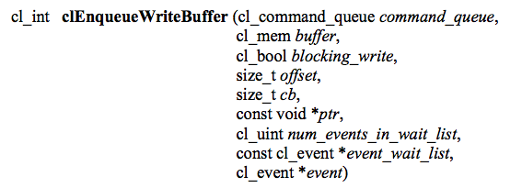
Transferring Data
This command initializes the OpenCL memory object and writes data to the device associated with the command queue
The command will write data from a host pointer (ptr) to the device
The blocking_write parameter specifies whether or not the command should return before the data transfer is complete
Events (discussed in another lecture) can specify which commands should be completed before this one runs

Slide 20
Transferring Data
Memory objects are transferred to devices by specifying an action (read or write) and a command queue
The validity of memory objects that are present on multiple devices is undefined by the OpenCL spec (i.e. is vendor specific)
The images are
redundant here to
show that they are
both part of the
context (on the
host) and
physically on the
device
Context
Images are written to a device
Notes:
If the device were a CPU, it could execute on the memory object in-place.

Slide 21
Programs
A program object is basically a collection of OpenCL kernels
Can be source code (text) or precompiled binary
Can also contain constant data and auxiliary functions
Creating a program object requires either reading in a string (source code) or a precompiled binary
To compile the program
Specify which devices are targeted
Program is compiled for each device
Pass in compiler flags (optional)
Check for compilation errors (optional, output to screen)

Slide 22
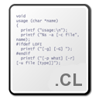
Programs
A program object is created and compiled by providing source code or a binary file and selecting which devices to target
Program
Context

Slide 23
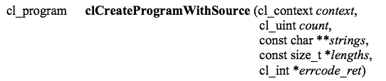
Creating Programs
This function creates a program object from strings of source code
count specifies the number of strings
The user must create a function to read in the source code to a string
If the strings are not NULL-terminated, the lengths fields are used to specify the string lengths

Slide 24
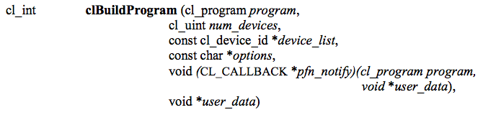
Compiling Programs
This function compiles and links an executable from the program object for each device in the context
If device_list is supplied, then only those devices are targeted
Optional preprocessor, optimization, and other options can be supplied by the options argument

Slide 25
Reporting Compile Errors
If a program fails to compile, OpenCL requires the programmer to explicitly ask for compiler output
A compilation failure is determined by an error value returned from clBuildProgram()
Calling clGetProgramBuildInfo() with the program object and the parameter CL_PROGRAM_BUILD_STATUS returns a string with the compiler output

Slide 26
Kernels
A kernel is a function declared in a program that is executed on an OpenCL device
A kernel object is a kernel function along with its associated arguments
A kernel object is created from a compiled program
Must explicitly associate arguments (memory objects, primitives, etc) with the kernel object

Slide 27

Kernels
Kernel objects are created from a program object by specifying the name of the kernel function
Kernels
Context

Slide 28

Kernels
Creates a kernel from the given program
The kernel that is created is specified by a string that matches the name of the function within the program

Slide 29
Runtime Compilation
There is a high overhead for compiling programs and creating kernels
Each operation only has to be performed once (at the beginning of the program)
The kernel objects can be reused any number of times by setting different arguments
Read source code into an array
clCreateProgramWithSource
clBuildProgram
clCreateKernel
clCreateProgramWithBinary

Slide 30
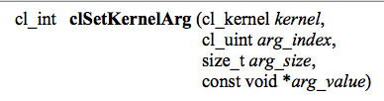
Setting Kernel Arguments
Kernel arguments are set by repeated calls to clSetKernelArgs
Each call must specify:
The index of the argument as it appears in the function signature, the size, and a pointer to the data
Examples:
clSetKernelArg(kernel, 0, sizeof(cl_mem), (void*)&d_iImage);
clSetKernelArg(kernel, 1, sizeof(int), (void*)&a);

Slide 31
Kernel Arguments
Memory objects and individual data values can be set as kernel arguments
Context
Data (e.g. images) are set as kernel arguments

Slide 32
Thread Structure
Massively parallel programs are usually written so that each thread computes one part of a problem
For vector addition, we will add corresponding elements from two arrays, so each thread will perform one addition
If we think about the thread structure visually, the threads will usually be arranged in the same shape as the data

Slide 33
Thread Structure
Consider a simple vector addition of 16 elements
2 input buffers (A, B) and 1 output buffer (C) are required
Array Indices
Vector Addition:
0 | 1 | 2 | 3 | 4 | 5 | 6 | 7 | 8 | 9 | 10 | 11 | 12 | 13 | 14 | 15
A
+
B
=
C

Slide 34
Thread Structure
Create thread structure to match the problem
1-dimensional problem in this case
Thread IDs
Thread structure:
0
1
2
3
4
5
6
7
8
9
10
11
12
13
14
15
Vector Addition:
0 | 1 | 2 | 3 | 4 | 5 | 6 | 7 | 8 | 9 | 10 | 11 | 12 | 13 | 14 | 15
A
+
B
=
C

Slide 35
Thread Structure
Each thread is responsible for adding the indices corresponding to its ID
Thread structure:
0
1
2
3
4
5
6
7
8
9
10
11
12
13
14
15
Vector Addition:
0 | 1 | 2 | 3 | 4 | 5 | 6 | 7 | 8 | 9 | 10 | 11 | 12 | 13 | 14 | 15
A
+
B
=
C

Slide 36
Thread Structure
OpenCL’s thread structure is designed to be scalable
Each instance of a kernel is called a work-item (though “thread” is commonly used as well)
Work-items are organized as work-groups
Work-groups are independent from one-another (this is where scalability comes from)
An index space defines a hierarchy of work-groups and work-items

Slide 37
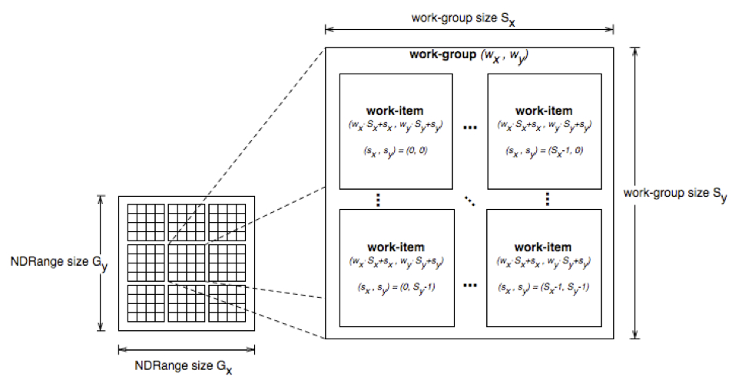
Thread Structure
Work-items can uniquely identify themselves based on:
A global id (unique within the index space)
A work-group ID and a local ID within the work-group

Slide 38
Thread Structure
API calls allow threads to identify themselves and their data
Threads can determine their global ID in each dimension
get_global_id(dim)
get_global_size(dim)
Or they can determine their work-group ID and ID within the workgroup
get_group_id(dim)
get_num_groups(dim)
get_local_id(dim)
get_local_size(dim)
get_global_id(0) = column, get_global_id(1) = row
get_num_groups(0) * get_local_size(0) == get_global_size(0)

Slide 39
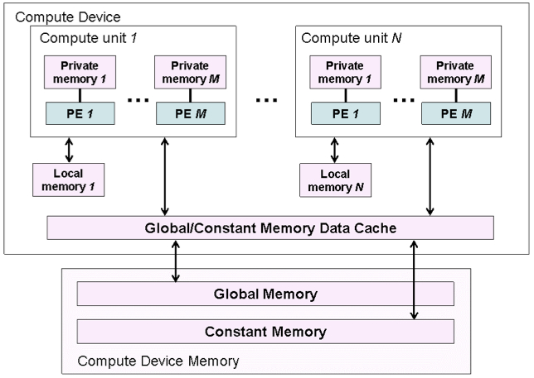
Memory Model
The OpenCL memory model defines the various types of memories (closely related to GPU memory hierarchy)
Memory | Description
Global | Accessible by all work-items
Constant | Read-only, global
Local | Local to a work-group
Private | Private to a work-item

Slide 40
Memory Model
Memory management is explicit
Must move data from host memory to device global memory, from global memory to local memory, and back
Work-groups are assigned to execute on compute-units
No guaranteed communication/coherency between different work-groups (no software mechanism in the OpenCL specification)

Slide 41
Writing a Kernel
One instance of the kernel is created for each thread
Kernels:
Must begin with keyword __kernel
Must have return type void
Must declare the address space of each argument that is a memory object (next slide)
Use API calls (such as get_global_id()) to determine which data a thread will work on

Slide 42
Address Space Identifiers
__global – memory allocated from global address space
__constant – a special type of read-only memory
__local – memory shared by a work-group
__private – private per work-item memory
__read_only/__write_only – used for images
Kernel arguments that are memory objects must be global, local, or constant

Slide 43
Example Kernel
Simple vector addition kernel:
__kernel
void vecadd(__global int* A,
__global int* B,
__global int* C) {
int tid = get_global_id(0);
C[tid] = A[tid] + B[tid];
}

Slide 44
Executing the Kernel
Need to set the dimensions of the index space, and (optionally) of the work-group sizes
Kernels execute asynchronously from the host
clEnqueueNDRangeKernel just adds is to the queue, but doesn’t guarantee that it will start executing

Slide 45
Executing the Kernel
A thread structure defined by the index-space that is created
Each thread executes the same kernel on different data
Context
An index space of
threads is created
(dimensions match
the data)

Slide 46

Executing the Kernel
A thread structure defined by the index-space that is created
Each thread executes the same kernel on different data
Context
Each thread
executes
the kernel

Slide 47
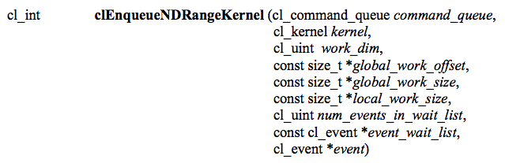
Executing the Kernel
Tells the device associated with a command queue to begin executing the specified kernel
The global (index space) must be specified and the local (work-group) sizes are optionally specified
A list of events can be used to specify prerequisite operations that must be complete before executing

Slide 48
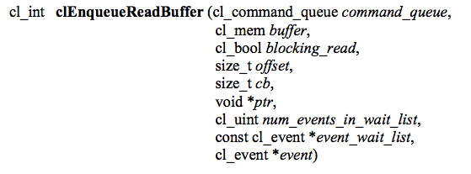
Copying Data Back
The last step is to copy the data back from the device to the host
Similar call as writing a buffer to a device, but data will be transferred back to the host

Slide 49
Copying Data Back
The output data is read from the device back to the host
Context
Copied back
from GPU

Slide 50
Releasing Resources
Most OpenCL resources/objects are pointers that should be freed after they are done being used
There is a clRelase{Resource} command for most OpenCL types
Ex: clReleaseProgram(), clReleaseMemObject()

Slide 51
Error Checking
OpenCL commands return error codes as negative integer values
Return value of 0 indicates CL_SUCCESS
Negative values indicates an error
cl.h defines meaning of each return value
Note: Errors are sometimes reported asynchronously
CL_DEVICE_NOT_FOUND -1
CL_DEVICE_NOT_AVAILABLE -2
CL_COMPILER_NOT_AVAILABLE -3
CL_MEM_OBJECT_ALLOCATION_FAILURE -4
CL_OUT_OF_RESOURCES -5
Notes:
Since kernels are executed asynchronously but return an error value immediately, runtime errors will likely be reported later.

Slide 52
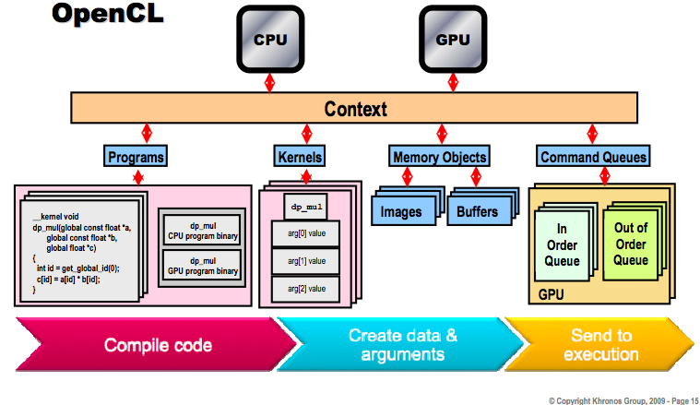
Big Picture

Slide 53
Programming Model
Data parallel
One-to-one mapping between work-items and elements in a memory object
Work-groups can be defined explicitly (like CUDA) or implicitly (specify the number of work-items and OpenCL creates the work-groups)
Task parallel
Kernel is executed independent of an index space
Other ways to express parallelism: enqueueing multiple tasks, using device-specific vector types, etc.
Synchronization
Possible between items in a work-group
Possible between commands in a context command queue

Slide 54
Running the Example Code
A simple vector addition OpenCL program that goes along with this lecture was provided
Before running, the following should appear in your .bashrc file:
export LD_LIBRARY_PATH=<path to stream sdk>/lib/x86_64
To compile:
Make sure that vecadd.c and vecadd.cl are in the current working directory
gcc -o vecadd vecadd.c -I<path to stream sdk>/include -L<path to stream sdk>/lib/x86_64 -lOpenCL

Slide 55
Summary
OpenCL provides an interface for the interaction of hosts with accelerator devices
A context is created that contains all of the information and data required to execute an OpenCL program
Memory objects are created that can be moved on and off devices
Command queues allow the host to request operations to be performed by the device
Programs and kernels contain the code that devices need to execute

