Slide 1
GPU Architecture
A Collaboration Between
David Kaeli, Northeastern University
Benedict R. Gaster, AMD
© 2011

Slide 2
Instructor Notes
We describe motivation for talking about underlying device architecture because device architecture is often avoided in conventional programming courses
Contrast conventional multicore CPU architecture with high level view of AMD and Nvidia GPU Architecture
This lecture starts with a high level architectural view of all GPUs, discusses each vendor’s architecture and then converges back to the OpenCL spec
Stress on the difference between the AMD VLIW architecture and Nvidia scalar architecture
Also discuss the different memory architecture
Brief discussion of ICD and compilation flow of OpenCL provides a lead to Lecture 5 where the first complete OpenCL program is written

Slide 3
Topics
Mapping the OpenCL spec to many-core hardware
AMD GPU Architecture
Nvidia GPU Architecture
Cell Broadband Engine
OpenCL Specific Topics
OpenCL Compilation System
Installable Client Driver (ICD)

Slide 4
Motivation
Why are we discussing vendor specific hardware if OpenCL is platform independent ?
Gain intuition of how a program’s loops and data need to map to OpenCL kernels in order to obtain performance
Observe similarities and differences between Nvidia and AMD hardware
Understanding hardware will allow for platform specific tuning of code in later lectures
Notes:
This point is important because this would be a common question while teaching an open platform agnostic programming

Slide 5
Conventional CPU Architecture
Space devoted to control logic instead of ALU
CPUs are optimized to minimize the latency of a single thread
Can efficiently handle control flow intensive workloads
Multi level caches used to hide latency
Limited number of registers due to smaller number of active threads
Control logic to reorder execution, provide ILP and minimize pipeline stalls
Conventional CPU Block Diagram
Control Logic
L2 Cache
L3 Cache
ALU
L1 Cache
~ 25GBPS
System Memory
A present day multicore CPU could have more than one ALU ( typically < 32) and some of the cache hierarchy is usually shared across cores
Notes:
Basic computer architecture points for multicore CPUs

Slide 6
Modern GPGPU Architecture
Generic many core GPU
Less space devoted to control logic and caches
Large register files to support multiple thread contexts
Low latency hardware managed thread switching
Large number of ALU per “core” with small user managed cache per core
Memory bus optimized for bandwidth
~150 GBPS bandwidth allows us to service a large number of ALUs simultaneously
High Bandwidth
bus to ALUs
On Board System Memory
Simple ALUs
Cache
Notes:
High level 10,000 feet view of what a GPU looks like, irrespective of whether its AMD’s or Nvidia’s

Slide 7
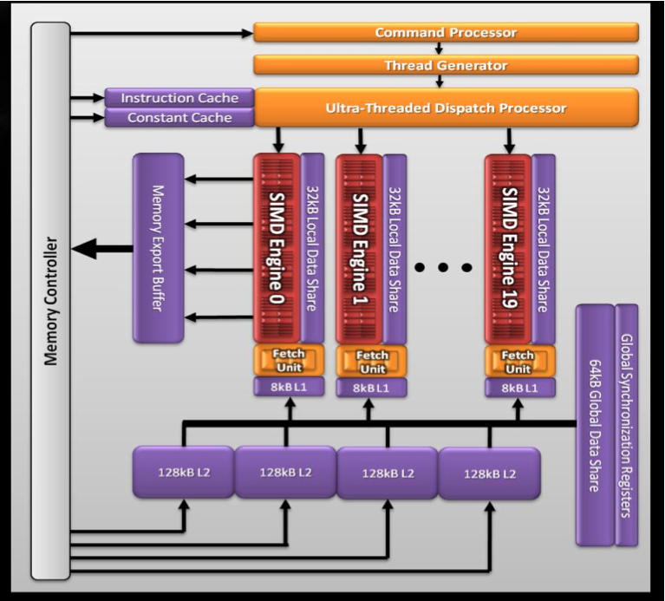
AMD GPU Hardware Architecture
AMD 5870 – Cypress
20 SIMD engines
16 SIMD units per core
5 multiply-adds per functional unit (VLIW processing)
2.72 Teraflops Single Precision
544 Gigaflops Double Precision
Source: Introductory OpenCL SAAHPC2010, Benedict R. Gaster
Notes:
Very AMD specific discussion of low-level GPU architecture

Slide 8

SIMD Engine
One SIMD Engine
A SIMD engine consists of a set of “Stream Cores”
Stream cores arranged as a five way Very Long Instruction Word (VLIW) processor
Up to five scalar operations can be issued in a VLIW instruction
Scalar operations executed on each processing element
Stream cores within compute unit execute same VLIW instruction
The block of work-items that are executed together is called a wavefront.
64 work items for 5870
One Stream Core
Instruction and Control Flow
T-Processing
Element
Branch
Execution Unit
Processing
Elements
General Purpose Registers
Source: AMD Accelerated Parallel Processing OpenCL Programming Guide
Notes:
Very AMD specific discussion of low-level GPU architecture
Discusses a single SIMD engine and the stream cores

Slide 9
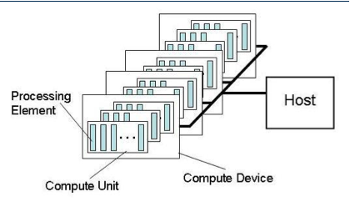
AMD Platform as seen in OpenCL
Individual work-items execute on a single processing element
Processing element refers to a single VLIW core
Multiple work-groups execute on a compute unit
A compute unit refers to a SIMD Engine
Notes:
We converge back to the OpenCL terminology to understand how the AMD GPU maps onto the OpenCL processing elements

Slide 10
AMD GPU Memory Architecture
Memory per compute unit
Local data store (on-chip)
Registers
L1 cache (8KB for 5870) per compute unit
L2 Cache shared between compute units (512KB for 5870)
Fast path for only 32 bit operations
Complete path for atomics and < 32bit operations
SIMD Engine
LDS, Registers
L1 Cache
Compute Unit to Memory X-bar
L2 Cache
Write Cache
Atomic Path
LDS
Notes:
A brief overview of the AMD GPU memory architecture (As per Evergreen Series)

Slide 11
AMD Memory Model in OpenCL
Subset of hardware memory exposed in OpenCL
Local Data Share (LDS) exposed as local memory
Share data between items of a work group designed to increase performance
High Bandwidth access per SIMD Engine
Private memory utilizes registers per work item
Constant Memory
__constant tags utilize L1 cache.
Private
Memory
Private
Memory
Private
Memory
Private
Memory
Workitem 1
Workitem 1
Workitem 1
Workitem 1
Compute Unit 1
Compute Unit N
Local Memory
Local Memory
Global / Constant Memory Data Cache
Compute Device
Global Memory
Compute Device Memory
Notes:
The mapping of the AMD GPU memory components to the OpenCL terminology.
Architecturally this is similar for AMD and Nvidia except that each ones have their own vendor specific names
Similar types of memory are mapped to local memory for both AMD and Nvidia

Slide 12
AMD Constant Memory Usage
Constant Memory declarations for AMD GPUs only beneficial for following access patterns
Direct-Addressing Patterns: For non array constant values where the address is known initially
Same Index Patterns: When all work-items reference the same constant address
Globally scoped constant arrays: Arrays that are initialized, globally scoped can use the cache if less than 16KB
Cases where each work item accesses different indices, are not cached and deliver the same performance as a global memory read
Source: AMD Accelerated Parallel Processing OpenCL Programming Guide
Notes:
Summary of the usage of constant memory.
Important because there are a restricted set of cases where there is a hardware provided performance boost while using constant memory
This will have greater context with a complete example which would have to be later.
This slide is added in case some one is reading this while optimizing some application and needs device specific details

Slide 13
Nvidia GPUs - Fermi Architecture
Instruction Cache
GTX 480 - Compute 2.0 capability
15 cores or Streaming Multiprocessors (SMs)
Each SM features 32 CUDA processors
480 CUDA processors
Global memory with ECC
Warp Scheduler
Warp Scheduler
Dispatch Unit
Dispatch Unit
Register File 32768 x 32bit
Core
Core
Core
Core
LDST
SFU
LDST
Core
Core
Core
Core
LDST
LDST
Core
Core
Core
Core
LDST
SFU
LDST
Core
Core
Core
Core
LDST
LDST
Core
Core
Core
Core
LDST
LDST
SFU
CUDA Core
Core
Core
Core
Core
LDST
LDST
Dispatch Port
Core
Core
Core
Core
LDST
Operand Collector
LDST
SFU
Core
Core
Core
Core
LDST
LDST
Source: NVIDIA’s Next Generation CUDA Architecture Whitepaper
FP Unit
Int Unit
Interconnect Memory
L1 Cache / 64kB Shared Memory
Result Queue
L2 Cache
Notes:
Nvidia “Fermi” Architecture, High level overview.

Slide 14
Nvidia GPUs – Fermi Architecture
SM executes threads in groups of 32 called warps.
Two warp issue units per SM
Concurrent kernel execution
Execute multiple kernels simultaneously to improve efficiency
CUDA core consists of a single ALU and floating point unit FPU
Instruction Cache
Warp Scheduler
Warp Scheduler
Dispatch Unit
Dispatch Unit
Register File 32768 x 32bit
Core
Core
Core
Core
LDST
SFU
LDST
Core
Core
Core
Core
LDST
LDST
Core
Core
Core
Core
LDST
SFU
LDST
Core
Core
Core
Core
LDST
LDST
Core
Core
Core
Core
LDST
LDST
SFU
CUDA Core
Core
Core
Core
Core
LDST
LDST
Dispatch Port
Core
Core
Core
Core
LDST
LDST
SFU
Operand Collector
Core
Core
Core
Core
LDST
Source: NVIDIA’s Next Generation CUDA Compute Architecture Whitepaper
LDST
FP Unit
Int Unit
Interconnect Memory
Result Queue
L1 Cache / 64kB Shared Memory
L2 Cache
Notes:
Architectural highlights of a SM in a Fermi GPU
Mention scalar nature of a CUDA core unlike AMD’s VLIW architecture

Slide 15
SIMT and SIMD
SIMT denotes scalar instructions and multiple threads sharing an instruction stream
HW determines instruction stream sharing across ALUs
E.g. NVIDIA GeForce (“SIMT” warps), AMD Radeon architectures (“wavefronts”) where all the threads in a warp /wavefront proceed in lockstep
Divergence between threads handled using predication
SIMT instructions specify the execution and branching behavior of a single thread
SIMD instructions exposes vector width,
E.g. of SIMD: explicit vector instructions like x86 SSE
Notes:
The SIMT execution model of GPU threads. SIMD specifies vector width as in SSE.
However the SIMT execution model doesn’t necessarily need to know the number of threads in a warp for a OpenCL program.
The concept of a warp / wavefront is not within OpenCL.

Slide 16
SIMT Execution Model
SIMD execution can be combined with pipelining
ALUs all execute the same instruction
Pipelining is used to break instruction into phases
When first instruction completes (4 cycles here), the next instruction is ready to execute
SIMD Width
Add
Mul
Add
Mul
Add
Mul
Add
Mul
Add
Mul
Add
Mul
Add
Mul
Add
Mul
…
Add
Mul
Add
Mul
Add
Mul
Add
Mul
Add
Mul
Add
Mul
Add
Mul
Add
Mul
Add
Mul
Add
Mul
Add
Mul
Wavefront
Add
Mul
Add
Mul
Add
Mul
Add
Mul
Add
Mul
Add
Mul
Add
Mul
Add
Mul
Add
Mul
Add
Mul
Add
Mul
Add
Mul
Add
Mul
Cycle
1 | 2 | 3 | 4 | 5 | 6 | 7 | 8 | 9
…
Notes:
The SIMT Execution mode which shows how different threads execute the same instruction

Slide 17
Nvidia Memory Hierarchy
L1 cache per SM configurable to support shared memory and caching of global memory
48 KB Shared / 16 KB of L1 cache
16 KB Shared / 48 KB of L1 cache
Data shared between work items of a group using shared memory
Each SM has a 32K register bank
L2 cache (768KB) that services all operations (load, store and texture)
Unified path to global for loads and stores
Registers
Thread Block
Shared Memory
L1 Cache
L2 Cache
Global Memory
Notes:
Nvidia specific GPU memory architecture.
Main highlight is the configurable L1 : Shared size ratio
L2 is not exposed in the OpenCL specification

Slide 18
Nvidia Memory Model in OpenCL
Like AMD, a subset of hardware memory exposed in OpenCL
Configurable shared memory is usable as local memory
Local memory used to share data between items of a work group at lower latency than global memory
Private memory utilizes registers per work item
Private
Memory
Private
Memory
Private
Memory
Private
Memory
Workitem 1
Workitem 1
Workitem 1
Workitem 1
Compute Unit 1
Compute Unit N
Local Memory
Local Memory
Global / Constant Memory Data Cache
Compute Device
Global Memory
Compute Device Memory
Notes:
Similar to AMD in the sense that low latency memory which is the shared memory becomes OpenCL local memory

Slide 19
Cell Broadband Engine
Developed by Sony, Toshiba, IBM
Transitioned from embedded platforms into HPC via the Playstation 3
OpenCL drivers available for Cell Bladecenter servers
Consists of a Power Processing Element (PPE) and multiple Synergistic Processing Elements (SPE)
Uses the IBM XL C for OpenCL compiler
SPE 0
SPE 1
SPE 2
SPE 3
SPU
SPU
SPU
SPU
LS
LS
LS
LS
25 GBPS
25 GBPS
25 GBPS
Element Interconnect ~ 200GBPS
LS = Local store per SPE of 256KB
Memory & Interrupt Controller
L1 and L2 Cache
POWER PC
Source: http://www.alphaworks.ibm.com/tech/opencl
PPE
Notes:
Brief introduction on the Cell

Slide 20
Cell BE and OpenCL
Cell Power/VMX CPU used as a CL_DEVICE_TYPE_CPU
Cell SPU (CL_DEVICE_TYPE_ACCELERATOR)
No. of compute units on a SPU accelerator device is <=16
Local memory size <= 256KB
256K of local storage divided among OpenCL kernel, 8KB global data cache, local, constant and private variables
OpenCL accelerator devices, and OpenCL CPU device share a common memory bus
Provides extensions like “Device Fission” and “Migrate Objects” to specify where an object resides (discussed in Lecture 10)
No support for OpenCL images, sampler objects, atomics and byte addressable memory
Source: http://www.alphaworks.ibm.com/tech/opencl
Notes:
Brief overview of how the Cell’s memory architecture maps to OpenCL
For usage of the Cell in specific applications a high level view is given and Lec 10 discusses its special extensions
Optimizations in Lec 6-8 do not apply to the Cell because of its very different architecture

Slide 21
An Optimal GPGPU Kernel
From the discussion on hardware we see that an ideal kernel for a GPU:
Has thousands of independent pieces of work
Uses all available compute units
Allows interleaving for latency hiding
Is amenable to instruction stream sharing
Maps to SIMD execution by preventing divergence between work items
Has high arithmetic intensity
Ratio of math operations to memory access is high
Not limited by memory bandwidth
Note that these caveats apply to all GPUs
Notes:
Discusses an optimal kernel to show how irrespective of the different underlying architecture, an optimum program for both AMD and Nvidia would have similar characteristics

Slide 22
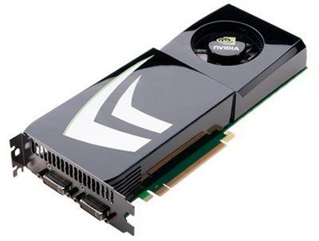
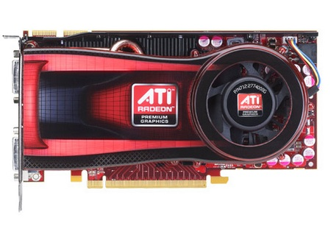
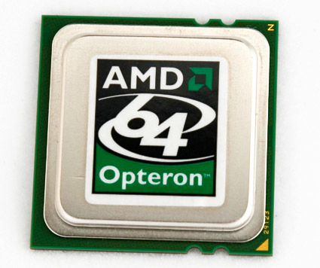
OpenCL Compilation System
LLVM - Low Level Virtual Machine
Kernels compiled to LLVM IR
Open Source Compiler
Platform, OS independent
Multiple back ends
http://llvm.org
OpenCL Compute Program
LLVM Front-end
LLVM IR
Nvidia PTX
AMD CAL IL
x86
Notes:
Explains how platform agnostic OpenCL code is mapped to a device specific Instruction Set Architecture.

Slide 23
Installable Client Driver
ICD allows multiple implementations to co-exist
Code only links to libOpenCL.so
Application selects implementation at runtime
Current GPU driver model does not easily allow multiple devices across manufacturers
clGetPlatformIDs() and clGetPlatformInfo() examine the list of available implementations and select a suitable one
Application
libOpenCL.so
Nvidia-opencl
atiocl.so
Notes:
The ICD is added in order to explain how we can interface different OpenCL implementations with a similar compilation tool-chain

Slide 24
Summary
We have examined different many-core platforms and how they map onto the OpenCL spec
An important take-away is that even though vendors have implemented the spec differently the underlying ideas for obtaining performance by a programmer remain consistent
We have looked at the runtime compilation model for OpenCL to understand how programs and kernels for compute devices are created at runtime
We have looked at the ICD to understand how an OpenCL application can choose an implementation at runtime
Next Lecture
Cover moving of data to a compute device and some simple but complete OpenCL examples

