Slide 1
OpenCL Buffers and Complete Examples
A Collaboration Between
David Kaeli, Northeastern University
Benedict R. Gaster, AMD
© 2011

Slide 2
Instructor Notes
This is a brief lecture which goes into some more details on OpenCL memory objects
Describes various flags that can be used to change how data is handled between host and device, like page-locked I/O and so on
The aim of this lecture is to cover required OpenCL host code for buffer management and provide simple examples
Code for context and buffer management discussed in examples in this lecture serves as templates for more complicated kernels
This allows the next 3 lectures to be focused solely on kernel optimizations like blocking, thread grouping and so on
Examples covered
Simple image rotation example
Simple non-blocking matrix-matrix multiplication

Slide 3
Topics
Using OpenCL buffers
Declaring buffers
Enqueue reading and writing of buffers
Simple but complete examples
Image Rotation
Non-blocking Matrix Multiplication

Slide 4
Creating OpenCL Buffers
Data used by OpenCL devices is stored in a “buffer” on the device
An OpenCL buffer object is created using the following function
Data can implicitly be copied to the device using a host pointer parameter
In this case copy to device is invoked when kernel is enqueued
cl_mem bufferobj = clCreateBuffer (
cl_context context, //Context name
cl_mem_flags flags, //Memory flags
size_t size, //Memory size allocated in buffer
void *host_ptr, //Host data
cl_int *errcode) //Returned error code
Notes:
OpenCL allows specifying a host pointer when we declare a object. In this case copy to device is invoked when kernel is enqueued.

Slide 5
Memory Flags
Memory flag field in clCreateBuffer() allows us to define characteristics of the buffer object
Memory Flag | Behavior
CL_MEM_READ_WRITE | Specifies memory read / write behavior
CL_MEM_WRITE_ONLY
CL_MEM_READ_ONLY
CL_MEM_USE_HOST_PTR | Implementations can cache the contents pointed to by host_ptr in device memory. This cached copy can be used when kernels are executed on a device.
CL_MEM_ALLOC_HOST_PTR | Specifies to the implementation to allocate memory from host accessible memory.
CL_MEM_COPY_HOST_PTR | Specifies to allocate memory for the object and copy the data from memory referenced by host_ptr.
Notes:
These memory flags are used to specify how a buffer is allocated

Slide 6
Copying Buffers to Device
clEnqueueWriteBuffer() is used to write a buffer object to device memory (from the host)
Provides more control over copy process than using host pointer functionality of clCreateBuffer()
Allows waiting for events and blocking
cl_int clEnqueueWriteBuffer (
cl_command_queue queue, //Command queue to device
cl_mem buffer, //OpenCL Buffer Object
cl_bool blocking_read, //Blocking/Non-Blocking Flag
size_t offset, //Offset into buffer to write to
size_t cb, //Size of data
void *ptr, //Host pointer
cl_uint num_in_wait_list, //Number of events in wait list
const cl_event * event_wait_list, //Array of events to wait for
cl_event *event) //Event handler for this function
Notes:
Point to mention here is that OpenCL event handling capabilities are not available when we do copying using the host pointer parameter of clcreatebuffer because the copy is done implicitly.
So if profiling is going to be used, this function call is necessary instead of passing host pointers

Slide 7
Copying Buffers to Host
clEnqueueReadBuffer() is used to read from a buffer object from device to host memory
Similar to clEnqueueWriteBuffer()
The vector addition example discussed in Lecture 2 and 3 provide simple code snipped for moving data to and from devices
cl_int clEnqueueReadBuffer (
cl_command_queue queue, //Command queue to device
cl_mem buffer, //OpenCL Buffer Object
cl_bool blocking_read, //Blocking/Non-Blocking Flag
size_t offset, //Offset to copy from
size_t cb, //Size of data
void *ptr, //Host pointer
cl_uint num_in_wait_list, //Number of events in wait list
const cl_event * event_wait_list, //Array of events to wait for
cl_event *event) //Event handler for this function
Notes:
Similar to clEnqueueWriteBuffer

Slide 8
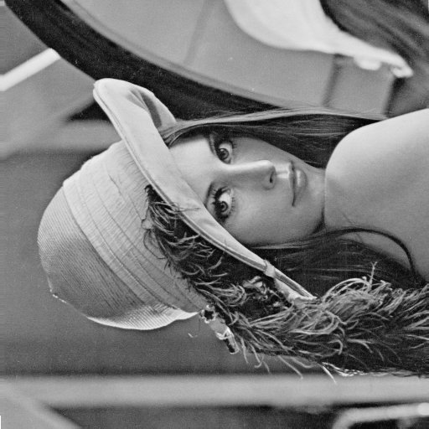
Example 1 - Image Rotation
A common image processing routine
Applications in matching, alignment, etc.
New coordinates of point (x₁,y₁) when rotated by an angle Θ around (x₀,y₀)
By rotating the image about the origin (0,0) we get
Each coordinate for every point in the image can be calculated independently
Original Image
Rotated Image (90º)

Slide 9
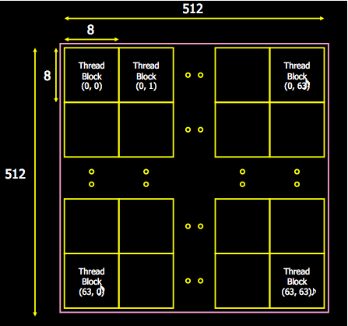
Image Rotation
Input: To copy to device
Image (2D Matrix of floats)
Rotation parameters
Image dimensions
Output: From device
Rotated Image
Main Steps
Copy image to device by enqueueing a write to a buffer on the device from the host
Run the Image rotation kernel on input image
Copy output image to host by enqueueing a read from a buffer on the device
Notes:
Simple data parallel algorithm and example
Each work item handles one pixel.

Slide 10
The OpenCL Kernel
Parallel portion of the algorithm off-loaded to device
Most thought provoking part of coding process
Steps to be done in Image Rotation kernel
Obtain coordinates of work item in work group
Read rotation parameters
Calculate destination coordinates
Read input and write rotated output at calculated coordinates
Parallel kernel is not always this obvious.
Profiling of an application is often necessary to find the bottlenecks and locate the data parallelism
In this example grid of output image decomposed into work items
Not all parts of the input image copied to the output image after rotation, corners of I/P image could be lost after rotation
Notes:
Pseudo-code for OpenCL kernels

Slide 11
OpenCL Kernel
__kernel void image_rotate(
__global float * src_data, __global float * dest_data, //Data in global memory
int W, int H, //Image Dimensions
float sinTheta, float cosTheta ) //Rotation Parameters
{
//Thread gets its index within index space
const int ix = get_global_id(0);
const int iy = get_global_id(1);
//Calculate location of data to move into ix and iy– Output decomposition as mentioned
float xpos = ( ((float) ix)*cosTheta + ((float)iy )*sinTheta);
float ypos = ( ((float) iy)*cosTheta - ((float)ix)*sinTheta);
if (( ((int)xpos>=0) && ((int)xpos< W))) //Bound Checking
&& (((int)ypos>=0) && ((int)ypos< H)))
{
//Read (xpos,ypos) src_data and store at (ix,iy) in dest_data
dest_data[iy*W+ix]=
src_data[(int)(floor(ypos*W+xpos))];
}
}
Notes:
This is a simple example and improvements are possible in the accessing of memory because reads will not be perfectly aligned.
However the aim of this example is to show how a data – space like a image can be mapped to a grid of work items and how each work item can process its piece of data independently of other work items.

Slide 12
Step0: Initialize Device
Declare context
Choose a device from context
Using device and context create a command queue
Query Platform
Platform Layer
Query Devices
Command Queue
cl_context myctx = clCreateContextFromType ( 0, CL_DEVICE_TYPE_GPU,
NULL, NULL, &ciErrNum);
Create Buffers
Compile Program
ciErrNum = clGetDeviceIDs (0,
CL_DEVICE_TYPE_GPU,
1, &device, cl_uint *num_devices)
Compiler
Compile Kernel
cl_commandqueue myqueue ;
myqueue = clCreateCommandQueue(
myctx, device, 0, &ciErrNum);
Runtime Layer
Set Arguments
Execute Kernel
Notes:
This is the essential boiler plate code that can be reused for any OpenCL program.
This creates the context, command queue and picks a device

Slide 13
Step1: Create Buffers
Create buffers on device
Input data is read-only
Output data is write-only
Transfer input data to the device
Query Platform
Platform Layer
Query Devices
cl_mem d_ip = clCreateBuffer(
myctx, CL_MEM_READ_ONLY,
mem_size,
NULL, &ciErrNum);
Command Queue
Create Buffers
cl_mem d_op = clCreateBuffer(
myctx, CL_MEM_WRITE_ONLY,
mem_size,
NULL, &ciErrNum);
Compile Program
Compiler
Compile Kernel
ciErrNum = clEnqueueWriteBuffer (
myqueue , d_ip, CL_TRUE,
0, mem_size, (void *)src_image,
0, NULL, NULL)
Runtime Layer
Set Arguments
Execute Kernel
Notes:
IP and OP buffers

Slide 14
Step2: Build Program, Select Kernel
Query Platform
// create the program
cl_program myprog = clCreateProgramWithSource ( myctx,1, (const char **)&source,
&program_length, &ciErrNum);
Platform Layer
Query Devices
Command Queue
// build the program
ciErrNum = clBuildProgram( myprog, 0,
NULL, NULL, NULL, NULL);
Create Buffers
Compile Program
//Use the “image_rotate” function as the kernel
cl_kernel mykernel = clCreateKernel (
myprog , “image_rotate” ,
error_code)
Compiler
Compile Kernel
Runtime Layer
Set Arguments
Execute Kernel
Notes:
These steps can be reused for all OpenCL functions.

Slide 15
Step3: Set Arguments, Enqueue Kernel
// Set Arguments
clSetKernelArg(mykernel, 0, sizeof(cl_mem),
(void *)&d_ip);
clSetKernelArg(mykernel, 1, sizeof(cl_mem),
(void *)&d_op);
clSetKernelArg(mykernel, 2, sizeof(cl_int),
(void *)&W);
...
//Set local and global workgroup sizes
size_t localws[2] = {16,16} ;
size_t globalws[2] = {W, H};//Assume divisible by 16
// execute kernel
clEnqueueNDRangeKernel(
myqueue , myKernel,
2, 0, globalws, localws,
0, NULL, NULL);
Query Platform
Platform Layer
Query Devices
Command Queue
Create Buffers
Compile Program
Compiler
Compile Kernel
Runtime Layer
Set Arguments
Execute Kernel
Notes:
Execute kernel on GPU

Slide 16
Step4: Read Back Result
Only necessary for data required on the host
Data output from one kernel can be reused for another kernel
Avoid redundant host-device IO
Query Platform
Platform Layer
Query Devices
Command Queue
Create Buffers
Compile Program
// copy results from device back to host
clEnqueueReadBuffer(
myctx, d_op,
CL_TRUE, //Blocking Read Back
0, mem_size, (void *) op_data,
NULL, NULL, NULL);
Compiler
Compile Kernel
Runtime Layer
Set Arguments
Execute Kernel
Notes:
Read back output

Slide 17
OpenCL Timing
OpenCL provides “events” which can be used for timing kernels
Events will be discussed in detail in Lecture 11
We pass an event to the OpenCL enqueue kernel function to capture timestamps
Code snippet provided can be used to time a kernel
Add profiling enable flag to create command queue
By taking differences of the start and end timestamps we discount overheads like time spent in the command queue
cl_event event_timer;
clEnqueueNDRangeKernel(
myqueue , myKernel,
2, 0, globalws, localws,
0, NULL, &event_timer);
unsigned long starttime, endtime;
clGetEventProfilingInfo( event_time,
CL_PROFILING_COMMAND_START,
sizeof(cl_ulong), &starttime, NULL);
clGetEventProfilingInfo(event_time, CL_PROFILING_COMMAND_END,
sizeof(cl_ulong), &endtime, NULL);
unsigned long elapsed =
(unsigned long)(endtime - starttime);
Notes:
By taking the difference between start and end times, we can check execution duration of kernels without overhead as gettimeofday would have

Slide 18
Example 2 Matrix Multiplication

Slide 19
Basic Matrix Multiplication
Non-blocking matrix multiplication
Doesn’t use local memory
Each element of matrix reads its own data independently
Serial matrix multiplication
Reuse code from image rotation
Create context, command queues and compile program
Only need one more input memory object for 2nd matrix
for(int i = 0; i < Ha; i++)
for(int j = 0; j < Wb; j++){
c[i][j] = 0;
for(int k = 0; k < Wa; k++)
c[i][j] += a[i][k] + b[k][j]
}
Notes:
Simple serial 3-loop matrix multiplication

Slide 20
Simple Matrix Multiplication
Wb
__kernel void simpleMultiply(
__global float* c, int Wa, int Wb,
__global float* a, __global float* b) {
//Get global position in Y direction
int row = get_global_id(1);
//Get global position in X direction
int col = get_global_id(0);
float sum = 0.0f;
//Calculate result of one element
for (int i = 0; i < Wa; i++) {
sum +=
a[row*Wa+i] * b[i*Wb+col];
}
c[row*Wb+col] = sum;
}
B
Hb
col
A
C
row
Ha
Wa
Wb
Notes:
OpenCL getting started guide example.
This example also shows how each work item can use its own section of input data (Matrix A and B ) to calculate the result for its own position in Matrix C

Slide 21
Summary
We have studied the use of OpenCL buffer objects
A complete program in OpenCL has been written
We have understood how an OpenCL work-item can be used to work on a single output element (seen with rotation and matrix multiplication)
While the previously discussed examples are correct data parallel programs their performance can be drastically improved
Next Lecture
Study the GPU memory subsystem to understand how data must be managed to obtain performance for data parallel programs
Understand possible optimizations for programs running on data parallel hardware like GPUs

