Slide 1
Optimizing Performance
A Collaboration Between
David Kaeli, Northeastern University
Benedict R. Gaster, AMD
© 2011

Slide 2
Instructor Notes
This lecture discusses three important optimizations
The performance impact of mapping threads to data on the GPU is subtle but extremely important. Examples are shown (including a detailed matrix transpose) along with actual empirical results
The number of threads that are active on the GPU can also play a large part in achieving good performance, and so the subtleties of GPU occupancy are discussed
Vectorization is particularly important for AMD GPUs and is briefly discussed as well

Slide 3
Topics
Thread mapping
Choosing a proper mapping
Optimizing with local memory
Device occupancy
Vectorization

Slide 4
Thread Mapping
Thread mapping determines which threads will access which data
Proper mappings can align with hardware and provide large performance benefits
Improper mappings can be disastrous to performance
The paper Static Memory Access Pattern Analysis on a Massively Parallel GPU by Jang, et. al focuses on the task of effectively mapping threads to the data access patterns of an algorithm

Slide 5
Thread Mapping
By using different mappings, the same thread can be assigned to access different data elements
The examples below show three different possible mappings of threads to data (assuming the thread id is used to access an element)
int group_size =
get_local_size(0) *
get_local_size(1);
int tid =
get_group_id(1) * get_num_groups(0) *
group_size +
get_group_id(0) *
group_size +
get_local_id(1) *
get_local_size(0) +
get_local_id(0)
Mapping
int tid =
get_global_id(1) *
get_global_size(0) +
get_global_id(0);
int tid =
get_global_id(0) *
get_global_size(1) +
get_global_id(1);
0
1
2
3
0
4
8
12
0
1
4
5
Thread IDs
4
5
6
7
1
5
9
13
2
3
6
7
8
9
10
11
2
6
10
14
8
9
12
13
12
13
14
15
3
7
11
15
10
11
14
15
*assuming 2x2 groups

Slide 6
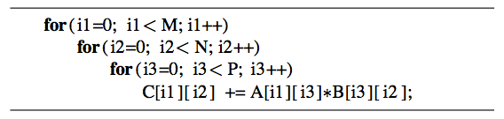
Thread Mapping
Consider a serial matrix multiplication algorithm
This algorithm is suited for output data decomposition
We will create NM threads
Effectively removing the outer two loops
Each thread will perform P calculations
The inner loop will remain as part of the kernel
Should the index space be MxN or NxM?
Notes:
Assuming that our thread structure will match the dimensions of our output matrix, the question here is whether the outer loop of the algorithm should be mapped to the X or the Y dimension of the thread structure. Same for the middle loop. The next slide will help clarify.

Slide 7
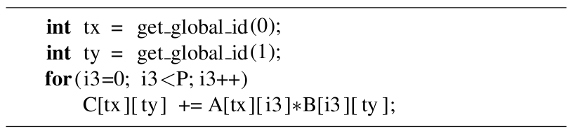
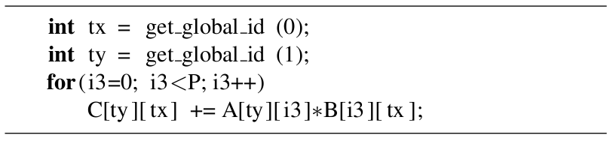
Thread Mapping
Thread mapping 1: with an MxN index space, the kernel would be:
Thread mapping 2: with an NxM index space, the kernel would be:
Both mappings produce functionally equivalent versions of the program

Slide 8
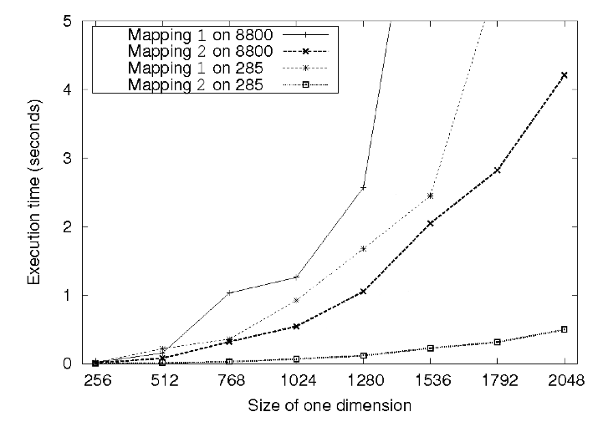
Thread Mapping
This figure shows the execution of the two thread mappings on NVIDIA GeForce 285 and 8800 GPUs
Notice that mapping 2 is far superior in performance for both GPUs
Notes:
These are results from Jang, et al.

Slide 9
Thread Mapping
The discrepancy in execution times between the mappings is due to data accesses on the global memory bus
Assuming row-major data, data in a row (i.e., elements in adjacent columns) are stored sequentially in memory
To ensure coalesced accesses, consecutive threads in the same wavefront should be mapped to columns (the second dimension) of the matrices
This will give coalesced accesses in Matrices B and C
For Matrix A, the iterator i3 determines the access pattern for row-major data, so thread mapping does not affect it

Slide 10
Thread Mapping
In mapping 1, consecutive threads (tx) are mapped to different rows of Matrix C, and non-consecutive threads (ty) are mapped to columns of Matrix B
The mapping causes inefficient memory accesses

Slide 11
Thread Mapping
In mapping 2, consecutive threads (tx) are mapped to consecutive elements in Matrices B and C
Accesses to both of these matrices will be coalesced
Degree of coalescence depends on the workgroup and data sizes

Slide 12
Thread Mapping
In general, threads can be created and mapped to any data element by manipulating the values returned by the thread identifier functions
The following matrix transpose example will show how thread IDs can be modified to achieve efficient memory accesses

Slide 13
Matrix Transpose
A matrix transpose is a straightforward technique
Out(x,y) = In(y,x)
No matter which thread mapping is chosen, one operation (read/write) will produce coalesced accesses while the other (write/read) produces uncoalesced accesses
Note that data must be read to a temporary location (such as a register) before being written to a new location
In
Out
In
Out
coalesced
uncoalesced
uncoalesced
coalesced
Threads
0
1
2
3
0
1
2
3
Notes:
Either approach causes horrible performance on the GPU.

Slide 14
Matrix Transpose
If local memory is used to buffer the data between reading and writing, we can rearrange the thread mapping to provide coalesced accesses in both directions
Note that the work group must be square
In
Out
coalesced
coalesced
0
1
2
3
Local memory
4
5
6
7
8
9
10
11
12
13
14
15
Threads
0
1
2
3
0
1
2
3
global mem index
0
1
2
3
0
1
2
3
local mem index
0
1
2
3
0
4
8
12
Notes:
After reading the data to local memory, new indexes are computed that allow consecutive threads to write to consecutive memory locations.

Slide 15

Matrix Transpose
The following figure shows a performance comparison of the two transpose kernels for matrices of size NxM on an AMD 5870 GPU
“Optimized” uses local memory and thread remapping

Slide 16
Occupancy
On current GPUs, work groups get mapped to compute units
When a work group is mapped to a compute unit, it cannot be swapped off until all of its threads complete their execution
If there are enough resources available, multiple work groups can be mapped to the same compute unit at the same time
Wavefronts from another work group can be swapped in to hide latency
Resources are fixed per compute unit (number of registers, local memory size, maximum number of threads)
Any one of these resource constraints may limit the number of work groups on a compute unit
The term occupancy is used to describe how well the resources of the compute unit are being utilized

Slide 17
Occupancy – Registers
The availability of registers is one of the major limiting factor for larger kernels
The maximum number of registers required by a kernel must be available for all threads of a workgroup
Example: Consider a GPU with 16384 registers per compute unit running a kernel that requires 35 registers per thread
Each compute unit can execute at most 468 threads
This affects the choice of workgroup size
A workgroup of 512 is not possible
Only 1 workgroup of 256 threads is allowed at a time, even though 212 more threads could be running
3 workgroups of 128 threads are allowed, providing 384 threads to be scheduled, etc.
Notes:
Because of the hardware schedulable unit of threads (i.e. wavefronts or warps), we usually try to create workgroups that are a power of two in size, or at least a multiple of the schedulable unit

Slide 18
Occupancy – Registers
Consider another example:
A GPU has 16384 registers per compute unit
The work group size of a kernel is fixed at 256 threads
The kernel currently requires 17 registers per thread
Given the information, each work group requires 4352 registers
This allows for 3 active work groups if registers are the only limiting factor
If the code can be restructured to only use 16 registers, then 4 active work groups would be possible
Notes:
Since workgroups are units that must be scheduled all at once, reducing register pressure by a small amount could allow many more threads to be active.

Slide 19
Occupancy – Local Memory
GPUs have a limited amount of local memory on each compute unit
32KB of local memory on AMD GPUs
32-48KB of local memory on NVIDIA GPUs
Local memory limits the number of active work groups per compute unit
Depending on the kernel, the data per workgroup may be fixed regardless of number of threads (e.g., histograms), or may vary based on the number of threads (e.g., matrix multiplication, convolution)

Slide 20
Occupancy – Threads
GPUs have hardware limitations on the maximum number of threads per work group
256 threads per WG on AMD GPUs
512 threads per WG on NVIDIA GPUs
NVIDIA GPUs have per-compute-unit limits on the number of active threads and work groups (depending on the GPU model)
768 or 1024 threads per compute unit
8 or 16 warps per compute unit
AMD GPUs have GPU-wide limits on the number of wavefronts
496 wavefronts on the 5870 GPU (~25 wavefronts or ~1600 threads per compute unit)

Slide 21
Occupancy – Limiting Factors
The minimum of these three factors is what limits the active number of threads (or occupancy) of a compute unit
The interactions between the factors are complex
The limiting factor may have either thread or wavefront granularity
Changing work group size may affect register or shared memory usage
Reducing any factor (such as register usage) slightly may have allow another work group to be active
The CUDA occupancy calculator from NVIDIA plots these factors visually allowing the tradeoffs to be visualized
Notes:
The impact of occupancy is latency hiding, so the real benefit of having as many active threads possible is completely dependent on the degree of memory latency present in the program (compute-bound kernels will see minimal benefit from more active threads).

Slide 22
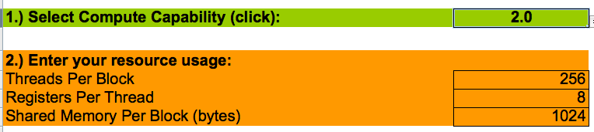
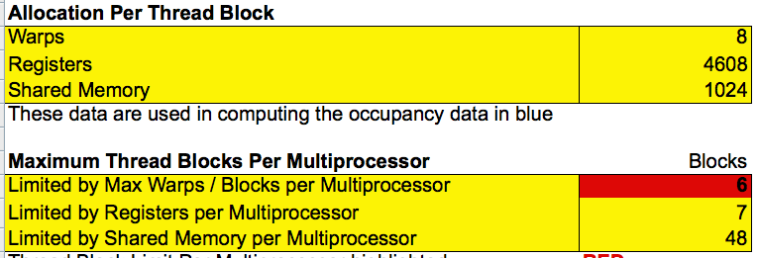
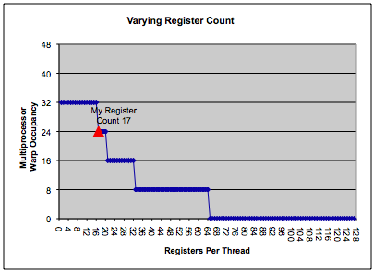
CUDA Occupancy Calculator
CUDA occupancy calculator:
1. Enter hardware model and kernel requirements
2. Resource usage and limiting factors are displayed
3. Graphs are shown to visualize limiting factors

Slide 23
Vectorization
On AMD GPUs, each processing element executes a 5-way VLIW instruction
5 scalar operations or
4 scalar operations + 1 transcendental operation
Compute Unit
...
PE₀
PE₁
PE₂
PE_{n-1}
Registers
ALU + T-unit
Incoming
Instruction
Branch Unit
ALU
Notes:
NVIDIA GPUs do not have vector-based PEs

Slide 24
Vectorization
Vectorization allows a single thread to perform multiple operations at once
Explicit vectorization is achieved by using vector datatypes (such as float4) in the source program
When a number is appended to a datatype, the datatype becomes an array of that length
Operations can be performed on vector datatypes just like regular datatypes
Each ALU will operate on different element of the float4 data
Notes:
The compiler will attempt to pack the VLIW instruction if vector data types are not used.

Slide 25
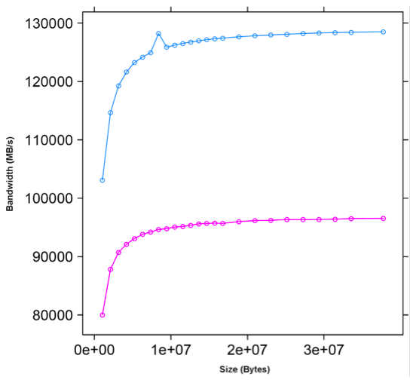
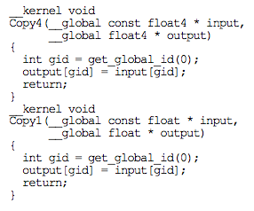
Vectorization
Vectorization improves memory performance on AMD GPUs
The AMD Accelerated Parallel Processing OpenCL Programming Guide compares float to float4 memory bandwidth

Slide 26
Summary
Although writing a simple OpenCL program is relatively easy, optimizing code can be very difficult
Improperly mapping loop iterations to OpenCL threads can significantly degrade performance
When creating work groups, hardware limitations (number of registers, size of local memory, etc.) need to be considered
Work groups must be sized appropriately to maximize the number of active threads and properly hide latencies
Vectorization is an important optimization for AMD GPU hardware
Though not covered here, vectorization may also help performance when targeting CPUs

