Slide 1
OpenCL Programming & Optimization Case Study
A Collaboration Between
David Kaeli, Northeastern University
Benedict R. Gaster, AMD
© 2011

Slide 2
Instructor Notes
Lecture discusses parallel implementation of a simple embarrassingly parallel nbody algorithm
We aim to provide some correspondence between the architectural techniques discussed in the optimization lectures and a real scientific computation algorithm
We implement a N-body formulation of gravitational attraction between bodies
Two possible optimizations on a naïve nbody implementation
Data reuse vs. non data reuse
Unrolling of inner loop
Simple example based on the AMD Nbody SDK example
Example provided allows user to:
Change data size to study scaling
Switch data reuse on or off
Change unrolling factor of n-body loop
Run example without parameters for help on how to run the example and define optimizations to be applied to OpenCL kernel

Slide 3
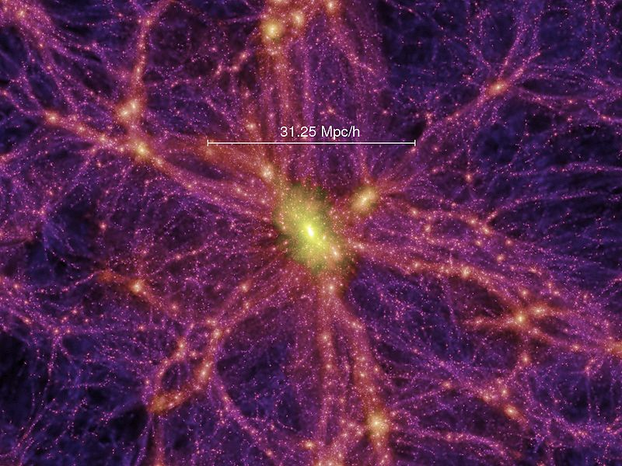
Topics
N-body simulation algorithm on GPUs in OpenCL
Algorithm, implementation
Optimization Spaces
Performance
The Millennium Run simulates the universe until the present state, where structures are abundant, manifesting themselves as stars, galaxies and clusters
Source: http://en.wikipedia.org/wiki/N-body_simulation

Slide 4
Motivation
We know how to optimize a program in OpenCL by taking advantage of the underlying architecture
We have seen how to utilize threads to hide latency
We have also seen how to take advantage of the different memory spaces available in today’s GPUs.
How do we apply this to an real world useful scientific computing algorithm?
Our aim is to use the architecture specific optimizations discussed in previous lectures

Slide 5
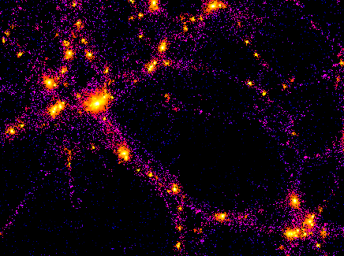
N-body Simulation
An n-body simulation is a simulation of a system of particles under the influence of physical forces like gravity
E.g.: An astrophysical system where a particle represents a galaxy or an individual star
N² particle-particle interactions
Simple, highly data parallel algorithm
Allows us to explore optimizations of both the algorithm and its implementation on a platform
Source: THE GALAXY-CLUSTER-SUPERCLUSTER CONNECTION
http://www.casca.ca/ecass/issues/1997-DS/West/west-bil.html

Slide 6
Algorithm
The gravitational attraction between two bodies in space is an example of an N-body problem
Each body represents a galaxy or an individual star, and bodies attract each other through gravitational force
Any two bodies attract each other through gravitational forces (F)
An O(N²) algorithm since N*N interactions need to be calculated
This method is known as an all-pairs N-body simulation
Notes:
Well known formulation which says force between bodies is proportional to their mass and inversely proportional to square of the distance.

Slide 7
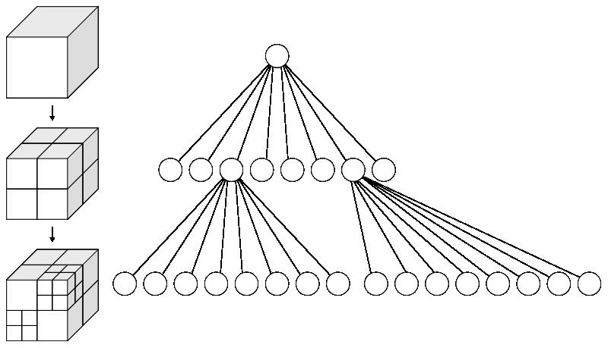
N-body Algorithms
For large counts, the previous method calculates of force contribution of distant particles
Distant particles hardly affect resultant force
Algorithms like Barnes Hut reduce number of particle interactions calculated
Volume divided into cubic cells in an octree
Only particles from nearby cells need to be treated individually
Particles in distant cells treated as a single large particle
In this lecture we restrict ourselves to a simple all pair simulation of particles with gravitational forces
A octree is a tree where a node has exactly 8 children
Used to subdivide a 3D space
Notes:
There are better ways to calculate interactions rather than the naïve n2 method.
Barnes Hutt allows us to divide the space, this reduces number of particles to be calculated.
The number of particles reduces because multiple far field objects are combined into one

Slide 8
Basic Implementation – All pairs
All-pairs technique is used to calculate close-field forces
Why bother, if infeasible for large particle counts ?
Algorithms like Barnes Hut calculate far field forces using near-field results
Near field still uses all pairs
So, implementing all pairs improves performance of both near and far field calculations
Easy serial algorithm
Calculate force by each particle
Accumulate of force and displacement in result vector
for(i=0; i<n; i++)
{
ax = ay = az = 0;
// Loop over all particles "j”
for (j=0; j<n; j++) {
//Calculate Displacement
dx=x[j]-x[i];
dy=y[j]-y[i];
dz=z[j]-z[i];
// small eps is delta added for dx,dy,dz = 0
invr= 1.0/sqrt(dx*dx+dy*dy+dz*dz +eps);
invr3 = invr*invr*invr;
f=m[ j ]*invr3;
// Accumulate acceleration
ax += f*dx;
ay += f*dy;
az += f*dx;
}
// Use ax, ay, az to update particle positions
}
Notes:
Basic C code O(n²)

Slide 9
Parallel Implementation
Forces of each particle can be computed independently
Accumulate results in local memory
Add accumulated results to previous position of particles
New position used as input to the next time step to calculate new forces acting between particles
N = No. of particles in system
N
N
Force between all particles
Resultant force – per particle
Next Iteration
Notes:
Parallelization of the outer loop of the program.
Each particle calculates all its interactions independent of every other particle

Slide 10
Naïve Parallel Implementation
Disadvantages of implementation where each work item reads data independently
No reuse since redundant reads of parameters for multiple work-items
Memory access= N reads*N threads= N²
Similar to naïve non blocking matrix multiplication in Lecture 5
__kernel void nbody(
__global float4 * initial_pos,
__global float4 * final_pos,
Int N, __local float4 * result) {
int localid = get_local_id(0);
int globalid = get_global_id(0);
result [localid] = 0;
for( int i=0 ; i<N;i++) {
//! Calculate interaction between
//! particle globalid and particle i
GetForce(
globalid, i,
initial_pos, final_pos,
&result [localid]) ;
}
finalpos[ globalid] = result[ localid];
}
p items /workgroup
N = No. of particles
All N particles read in by each work item
Notes:
Naïve implementation where all threads work independently

Slide 11
Local Memory Optimizations
p forces read into local memory
Data Reuse
Any particle read into compute unit can be used by all p bodies
Computational tile:
Square region of the grid of forces consisting of size p
2p descriptions required to evaluate all p² interactions in tile
p work items (in vertical direction) read in p forces
Interactions on p bodies captured as an update to p acceleration vectors
Intra-work group synchronization shown in orange required since all work items use data read by each work item
p
p items per workgroup
p
tile₀
tile₁
tile _{N/p}
p
tile₀
tile₁
tile _{N/p}
N/p work groups
p
p
Notes:
Since each work item needs to calculate interactions with all particles we can introduce data reuse by tiling the grid space.
The reuse is enabled such that when a work item reads in some data, all the other work items calculate the interaction too.

Slide 12
OpenCL Implementation
Kernel Code
Data reuse using local memory
Without reuse N*p items read per work group
With reuse p*(N/p) = N items read per work group
All work items use data read in by each work item
SIGNIFICANT improvement: p is work group size (at least 128 in OpenCL, discussed in occupancy)
Loop nest shows how a work item traverses all tiles
Inner loop accumulates contribution of all particles within tile
for (int i = 0; i < numTiles; ++i)
{
// load one tile into local memory
int idx = i * localSize + tid;
localPos[tid] = pos[idx];
barrier(CLK_LOCAL_MEM_FENCE);
// calculate acceleration effect due to each body
for( int j = 0; j < localSize; ++j ) {
// Calculate acceleration caused by particle j on i
float4 r = localPos[j] – myPos;
float distSqr = r.x * r.x + r.y * r.y + r.z * r.z;
float invDist = 1.0f / sqrt(distSqr + epsSqr);
float s = localPos[j].w * invDistCube;
// accumulate effect of all particles
acc += s * r;
}
// Synchronize so that next tile can be loaded
barrier(CLK_LOCAL_MEM_FENCE);
}
}
Notes:
Data reuse based implementation.
Synchronize call is needed in order to allow for each work item to read in its data before being used by other work items

Slide 13
Performance
Effect of optimizations compared for two GPU platforms
Exactly same code, only recompiled for platform
Devices Compared
AMD GPU = 5870 Stream SDK 2.2
Nvidia GPU = GTX 480 with CUDA 3.1
Time measured for OpenCL kernel using OpenCL event counters (covered in in Lecture 11)
Device IO and other overheads like compilation time are not relevant to our discussion of optimizing a compute kernel
Events are provided in the OpenCL spec to query obtain timestamps for different state of OpenCL commands

Slide 14
Effect of Reuse on Kernel Performance
Notes:
Scaling for larger particle sizes for two different implementations for AMD and Nvidia GPUs.
Note: These have not been unrolled yet

Slide 15
Thread Mapping and Vectorization
As discussed in Lecture 8
Vectorization allows a single thread to perform multiple operations in one instruction
Explicit vectorization is achieved by using vector data-types (such as float4) in the source
Vectorization using float4 enables efficient usage of memory bus for AMD GPUs
Easy in this case due to the vector nature of the data which are simply spatial coordinates
Vectorization of memory accesses implemented using float4 to store coordinates
__kernel void nbody(
__global float4 * pos,
__global float4 * vel,
//float4 types enables improved
//usage of memory bus
) {
}
// Loop Nest Calculating per tile interaction
// Same loop nest as in previous slide
for (int i=0 ; i< numTiles; i++)
{
for( int j=0; j<localsize; j ++)
}

Slide 16
Performance - Loop Unrolling
We also attempt loop unrolling of the reuse local memory implementation
We unroll the innermost loop within the thread
Loop unrolling can be used to improve performance by removing overhead of branching
However this is very beneficial only for tight loops where the branching overhead is comparable to the size of the loop body
Experiment on optimized local memory implementation
Executable size is not a concern for GPU kernels
We implement unrolling by factors of 2 and 4 and we see substantial performance gains across platforms
Decreasing returns for larger unrolling factors seen
Notes:
Unrolling of the inner loop to increase the computational intensity of the inner loop

Slide 17
Effect of Unroll on Kernel Performance
U# in legend denotes unroll factor

Slide 18
Performance Conclusions
From the performance data we see:
Unrolling greatly benefits the AMD GPU for our algorithm
This can be attributed to better packing of the VLIW instructions within the loop
Better packing is enabled by the increased amount of computation uninterrupted by a conditional statement when we unroll a loop
The Nvidia Fermi performance doesn’t benefit as much from the reuse and tiling
This can be attributed to the caching which is possible in the Fermi GPUs. The caching could enable data reuse.
As seen the Fermi performance is very close for both with and without reuse
Note: You can even run this example on the CPU to see performance differences
Notes:
General conclusions and benefits of optimizations on different platforms

Slide 19
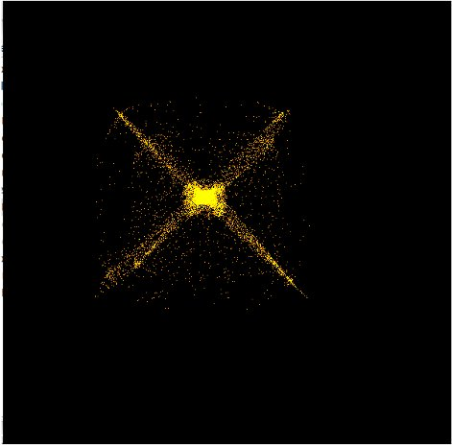
Provided Nbody Example
A N-body example is provided for experimentation and explore GPU optimization spaces
Stand-alone application based on simpler on AMD SDK formulation
Runs correctly on AMD and Nvidia hardware
Three kernels provided
Simplistic formulation
Using local memory tiling
Using local memory tiling with unrolling
Note: Code is not meant to be a high performance N-body implementation in OpenCL
The aim is to serve as an optimization base for a data parallel algorithm
Screenshot of provided N-body demo running 10k particles on a AMD 5870
Notes:
Details of provided example

Slide 20
References for Nbody Simulation
AMD Stream Computing SDK and the Nvidia GPU Computing SDK provide example implementations of N-body simulations
Our implementation extends the AMD SDK example. The Nvidia implementation implementation is a different version of the N-body algorithm
Other references
Nvidia GPU Gems
http://http.developer.nvidia.com/GPUGems3/gpugems3_ch31.html
Brown Deer Technology
http://www.browndeertechnology.com/docs/BDT_OpenCL_Tutorial_NBody.html

Slide 21
Summary
We have studied a application as an optimization case study for OpenCL programming
We have understood how architecture aware optimizations to data and code improve performance
Optimizations discussed do not use device specific features like Warp size, so our implementation yields performance improvement while maintaining correctness on both AMD and Nvidia GPUs

Slide 22
Other Resources
Well known optimization case studies for GPU programming
CUDPP and Thrust provide CUDA implementations of parallel prefix sum, reductions and parallel sorting
The parallelization strategies and GPU specific optimizations in CUDA implementations can usually be applied to OpenCL as well
CUDPP http://code.google.com/p/cudpp/
Thrust http://code.google.com/p/thrust/
Histogram on GPUs
The Nvidia and AMD GPU computing SDK provide different implementations for 64 and 256 bin Histograms
Diagonal Sparse Matrix Vector Multiplication - OpenCL Optimization example on AMD GPUs and multi-core CPUs
http://developer.amd.com/documentation/articles/Pages/OpenCL-Optimization-Case-Study.aspx
GPU Gems which provides a wide range of CUDA optimization studies

