Slide 1
Events Timing and Profiling
A Collaboration Between
David Kaeli, Northeastern University
Benedict R. Gaster, AMD
© 2011

Slide 2
Instructor Notes
Discusses synchronization, timing and profiling in OpenCL
Coarse grain synchronization covered which discusses synchronizing on a command queue granularity
Discuss different types of command queues (in order and out of order)
Fine grained synchronization which covers synchronization at a per function call granularity using OpenCL events
Improved event handling capabilities like user defined events have been added in the OpenCL 1.1 specification
Synchronization across multiple function calls and scheduling actions on the command queue discussed using wait lists
The main applications of OpenCL events have been discussed here including timing, profiling and using events for managing asynchronous IO with a device
Potential performance benefits with asynchronous IO explained using a asymptotic calculation and a real world medical imaging application

Slide 3
Topics
OpenCL command queues
Events and synchronization
OpenCL 1.1 and event callbacks
Using OpenCL events for timing and profiling
Using OpenCL events for asynchronous host-device communication with image reconstruction example

Slide 4
Command Queues
We need to measure the performance of an application as a whole and not just our optimized kernels to understand bottlenecks
This necessitates understanding of OpenCL synchronization techniques and events
Command queues are used to submit work to a device
Two main types of command queues
In Order Queue
Out of Order Queue
Notes:
Motivation and recap of command queues

Slide 5
In-Order Execution
In an in-order command queue, each command executes after the previous one has finished
For the set of commands shown, the read from the device would start after the kernel call has finished
Memory transactions have consistent view
Commands To Submit
clEnqueueWriteBuffer (queue , d_ip, CL_TRUE, 0, mem_size, (void *)ip, 0, NULL, NULL)
clEnqueueNDRangeKernel (queue, kernel0, 2,0, global_work_size, local_work_size, 0,NULL,NULL)
clEnqueueReadBuffer( context, d_op, CL_TRUE, 0, mem_size, (void *) op, NULL, NULL,NULL);
Time
Mem
clEnqWrite
EnqNDRange
clEnqRead
Device 0
Command Queue
Notes:
In-Order Execution of a command queue

Slide 6
Out-of-Order Execution
In an out-of-order command queue, commands are executed as soon as possible, without any ordering guarantees
All memory operations occur in single memory pool
Out-of-order queues result in memory transactions that will overlap and clobber data without some form of synchronization
The commands discussed in the previous slide could execute in any order on device
Time
EnqWrite
Mem
EnqRead
Device 0
Command Queue
EnqNDRange
Notes:
Out of order execution provides no guarantee of a command completing before another starting execution

Slide 7
Synchronization in OpenCL
Synchronization is required if we use an out-of-order command queue or multiple command queues
Coarse synchronization granularity
Per command queue basis
Finer synchronization granularity
Per OpenCL operation basis using events
Synchronization in OpenCL is restricted to within a context
This is similar to the fact that it is not possible to share data between multiple contexts without explicit copying
The proceeding discussion of synchronization is applicable to any OpenCL device (CPU or GPU)

Slide 8
OpenCL Command Queue Control
Command queue synchronization methods work on a per-queue basis
Flush: clFlush(cl_commandqueue)
Send all commands in the queue to the compute device
No guarantee that they will be complete when clFlush returns
Finish: clFinish(cl_commandqueue)
Waits for all commands in the command queue to complete before proceeding (host blocks on this call)
Barrier: clEnqueueBarrier(cl_commandqueue)
Enqueue a synchronization point that ensures all prior commands in a queue have completed before any further commands execute
Notes:
Coarse grained synchronization in OpenCL, Limited use case
For eg can be used to be sure a kernel is done executing before we read back data
This function call blocks the host.

Slide 9
Synchronization for clEnqueue Functions
Functions like clEnqueueReadBuffer and clEnqueueWriteBuffer have a boolean parameter to determine if the function is blocking
This provides a blocking construct that can be invoked to block the host
If blocking is TRUE, OpenCL enqueues the operation using the host pointer in the command-queue
Host pointer can be reused by the application after the enqueue call returns
If blocking is FALSE, OpenCL will use the host pointer parameter to perform a non-blocking read/write and returns immediately
Host pointer cannot be reused safely by the application after the call returns
Event handle returned by clEnqueue* operations can be used to check if the non-blocking operation has completed
Notes:
Blocking parameter provided by clEnqueue functions, dictates usage of host pointer associated with clEnqueue function

Slide 10
OpenCL Events
Previous OpenCL synchronization functions only operated on a per-command-queue granularity
OpenCL events are needed to synchronize at a function granularity
Explicit synchronization is required for
Out-of-order command queues
Multiple command queues
OpenCL events are data-types defined by the specification for storing timing information returned by the device
Notes:
Fine grained synchronization which is used for Out-of-order command queues or multiple command queues

Slide 11
OpenCL Events
Profiling of OpenCL programs using events has to be enabled explicitly when creating a command queue
CL_QUEUE_PROFILING_ENABLE flag must be set
Keeping track of events may slow down execution
A handle to store event information can be passed for all clEnqueue* commands
When commands such as clEnqueueNDRangeKernel and clEnqueueReadBuffer are invoked timing information is recorded at the passed address
Notes:
Enabling recording OpenCL events has to be done while creating the command queue

Slide 12
Uses of OpenCL Events
Using OpenCL Events we can:
time execution of clEnqueue* calls like kernel execution or explicit data transfers
use the events from OpenCL to schedule asynchronous data transfers between host and device
profile an application to understand an execution flow
observe overhead and time consumed by a kernel in the command queue versus actually executing
Note: OpenCL event handling can be done in a consistent manner on both CPU and GPU for AMD and NVIDIA’s implementations
Notes:
Example use cases of events

Slide 13
Capturing Event Information
cl_int clGetEventProfilingInfo (
cl_event event, //event object
cl_profiling_info param_name, //Type of data of event
size_t param_value_size, //size of memory pointed to by param_value void * param_value, //Pointer to returned timestamp
size_t * param_value_size_ret) //size of data copied to param_value
clGetEventProfilingInfo allows us to query cl_event to get required counter values
Timing information returned as cl_ulong data types
Returns device time counter in nanoseconds
Notes:
Syntax for event capture

Slide 14
Event Profiling Information
cl_int clGetEventProfilingInfo (
cl_event event, //event object
cl_profiling_info param_name, //Type of data of event
size_t param_value_size, //size of memory pointed to by param_value
void * param_value, //Pointer to returned timestamp
size_t * param_value_size_ret) //size of data copied to param_value
Table shows event types described using cl_profiling_info enumerated type
Event Type | Description
CL_PROFILING_COMMAND_QUEUED | Command is enqueued in a command-queue by the host.
CL_PROFILING_COMMAND_SUBMIT | Command is submitted by the host to the device associated with the command queue.
CL_PROFILING_COMMAND_START | Command starts execution on device.
CL_PROFILING_COMMAND_END | Command has finished execution on device.
Notes:
Possible event states

Slide 15
Capturing Event Information
cl_int clGetEventInfo (
cl_event event, //event object
cl_event_info param_name, //Specifies the information to query.
void * param_value, //Pointer to memory where result queried is returned
size_t * param_value_size_ret) //size in bytes of memory pointed to by param_value
clGetEventInfo can be used to return information about the event object
It can return details about the command queue, context, type of command associated with events, execution status
This command can be used by along with timing provided by clGetEventProfilingInfo as part of a high level profiling framework to keep track of commands
Notes:
Syntax for event capture

Slide 16
User Events in OpenCL 1.1
OpenCL 1.1 defines a user event object. Unlike clEnqueue* commands, user events can be set by the user
When we create a user event, status is set to CL_SUBMITTED
clSetUserEventStatus is used to set the execution status of a user event object. The status needs to be set to CL_COMPLETE
A user event can only be set to CL_COMPLETE once
cl_event clCreateUserEvent (
cl_context context, //OpenCL Context
cl_int *errcode_ret ) //Returned Error Code
cl_mem clSetUserEventStatus (
cl_event event, //User event
cl_int execution_status) //Execution Status
Notes:
OpenCL 1.1 provides a user event which can be set by a program and not by OpenCL functions like the clEnqueue* functions

Slide 17
Using User Events
A simple example of user events being triggered and used in a command queue
//Create user event which will start the write of buf1
user_event = clCreateUserEvent(ctx, NULL);
clEnqueueWriteBuffer( cq, buf1, CL_FALSE, ..., 1, &user_event , NULL);
//The write of buf1 is now enqued and waiting on user_event
X = foo(); //Lots of complicated host processing code
clSetUserEventStatus(user_event, CL_COMPLETE);
//The clEnqueueWriteBuffer to buf1 can now proceed as per OP of foo()
Notes:
Simple usage scenario for OpenCL events which can be scheduled by the user.
For example, set up a write to a device on a queue after some complicated host computation on the data is finished

Slide 18
Wait Lists
All clEnqueue* methods also accept event wait lists
Waitlists are arrays of cl_event type
OpenCL defines waitlists to provide precedence rules
Enqueue a list of events to wait for such that all events need to complete before this particular command can be executed
Enqueue a command to mark this location in the queue with a unique event object that can be used for synchronization
err = clWaitOnEvents(1, &read_event);
clEnqueueWaitListForEvents( cl_command_queue , int, cl_event *)
clEnqueueMarker( cl_command_queue, cl_event *)
Notes:
Wait lists are simply arrays of events

Slide 19
Example of Event CallBacks
cl_int clSetEventCallback (
cl_event event, //Event Name
cl_int command_exec_type , //Status on which callback is invoked
void (CL_CALLBACK *pfn_event_notify) //Callback Name
(cl_event event, cl_int event_command_exec_status, void *user_data),
void * user_data) //User Data Passed to callback
OpenCL 1.1 allows registration of a user callback function for a specific command execution status
Event callbacks can be used to enqueue new commands based on event state changes in a non-blocking manner
Using blocking versions of clEnqueue* OpenCL functions in callback leads to undefined behavior
The callback takes an cl_event, status and a pointer to user data as its parameters
Notes:
Callback allows launching of functions on events in OpenCL

Slide 20
AMD Events Extension
OpenCL event callbacks are valid only for the CL_COMPLETE state
The cl_amd_event_callback extension provides the ability to register event callbacks for states other than CL_COMPLETE
Lecture 10 discusses how to use vendor specific extensions in OpenCL
The event states allowed are cl_queued, cl_submitted, and cl_running
Notes:
AMD extension allows for defining multiple states even in user events, The specification only provides cl_complete.

Slide 21
Using Events for Timing
OpenCL events can easily be used for timing durations of kernels.
This method is reliable for performance optimizations since it uses counters from the device
By taking differences of the start and end timestamps we are discounting overheads like time spent in the command queue
clGetEventProfilingInfo( event_time,
CL_PROFILING_COMMAND_START,
sizeof(cl_ulong), &starttime, NULL);
clGetEventProfilingInfo(event_time, CL_PROFILING_COMMAND_END,
sizeof(cl_ulong), &endtime, NULL);
unsigned long elapsed =
(unsigned long)(endtime - starttime);
Notes:
By taking the difference between start and end times, we can check execution duration of kernels without overhead as gettimeofday would have

Slide 22
Profiling Using Events
OpenCL calls occur asynchronously within a heterogeneous application
A clFinish to capture events after each function introduces interference
Obtaining a pipeline view of commands in an OpenCL context
Declare a large array of events in beginning of application
Assign an event from within this array to each clEnqueue* call
Query all events at one time after the critical path of the application
Application Function 1
Application Function 2
clEnqueueNDRangeKernel(
kernel1,
&event_list[i] );
clEnqueueNDRangeKernel(
kernel2,
&event_list [i+1] );
&event_list [i]
&event_list [i+1]
Event Logging Framework
N = estimated no. of events in application
cl_event event_list[N]
Event logging framework can query and format data stored in event_list
Notes:
Simple profiling technique to understand flow of OpenCL kernels in a command queue

Slide 23
Profiling with Event Information
Before getting timing information, we must make sure that the events we are interested in have completed
There are different ways of waiting for events:
clWaitForEvents(numEvents, eventlist)
clFinish(commandQueue)
Timer resolution can be obtained from the flag CL_DEVICE_PROFILING_TIMER_RESOLUTION when calling clGetDeviceInfo()
Notes:
Using waitlists while profiling

Slide 24
Example of Profiling
A heterogeneous application can have multiple kernels and a large amount of host device IO
Questions that can be answered by profiling using OpenCL events
We need to know which kernel to optimize when multiple kernels take similar time ?
Small kernels that may be called multiple times vs. large slow complicated kernel ?
Are the kernels spending too much time in queues ?
Understand proportion between execution time and setup time for an application
How much does host device IO matter ?
By profiling an application with minimum overhead and no extra synchronization, most of the above questions can be answered
Notes:
Profiling use cases

Slide 25
Asynchronous IO
Overlapping host-device I/O can lead to substantial application level performance improvements
How much can we benefit from asynchronous IO
Can prove to be a non-trivial coding effort, Is it worth it ?
Useful for streaming workloads that can stall the GPU like medical imaging where new data is generated and processed in a continuous loop
Other uses include workloads like linear algebra where the results of previous time steps can be transferred asynchronously to the host
We need two command queues with a balanced amount of work on each queue
Notes:
Asynchronous IO which can be used to overlap kernel computation with host device communication

Slide 26
Asynchronous I/O
Asymptotic Approximation of benefit of asynchronous IO in OpenCL
Tc = Time for computation
Ti = Time to write I/P to device To = Time to read OP for device
(Assume host to device and device to host I/O is same)
Case 1: 1 Queue
Ti
Tc
To
Ti
Tc
To
Total Time = 2Tc + 2Ti + 2To
Case 2: 2 Queues – One device for compute
Ti
Tc
To
Ti
idle
Tc
To
Total Time for 2 kernels and their I/O
= 2Tc + Ti + To
Note: Idle time denotes time when no IO occurs. The compute units of the GPU are busy
Notes:
A theoretical and asymptotic style calculation can be used to estimate potential benefits by using device.
As seen from Case 1 and 2 the benefits of asynchronous IO can be seen by comparing kernel and IO time, We can at most save 2Ti or 2Tc because we would have some idle time if Ti and Tc are not equal

Slide 27
Asynchronous I/O
Time with 1 Queue = 2Tc + 2Ti + 2To
No asynchronous behavior
Time with 2 Queues = 2Tc + Ti + To
Overlap computation and communication
Maximum benefit achievable with similar input and output data is approximately 30% of overlap when Tc = Ti = To since that would remove the idle time shown in the previous diagram
Host-device I/O is limited by PCI bandwidth, so it's often not quite as big a win
Notes:
Performance benefit for one balanced command queue (no idle time)

Slide 28
Dual DMA Engine Case
In the Nvidia Fermi GPUs, dual DMA engines allow simultaneous bidirectional IO.
Possible Improvement with dual DMA Engines
Baseline with one queue = 3*5 = 15T
Overlap Case = 7T
Potential Performance Benefit ~ 50%
Case 3: One device for compute but dual DMA Engines Tc ~ Ti ~ To = T
Ti
Tc
To
Ti
Tc
To
Dual DMA active
Ti
Tc
To
Ti
Tc
To
Ti
Tc
To
Total Time = 7T
Notes:
Fermi GPUs can allow more overlap because of dual dma engines which increases the amount of hiding as shown

Slide 29
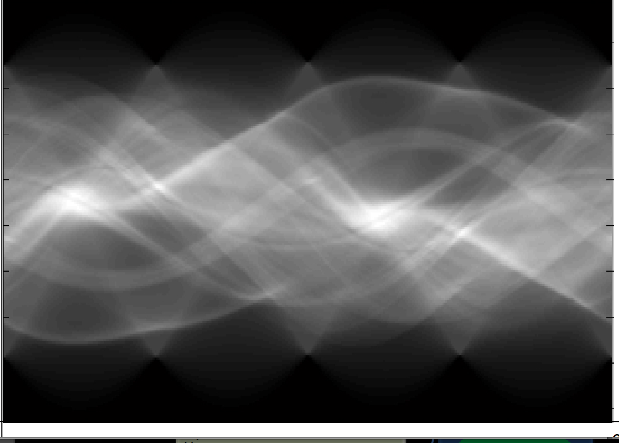
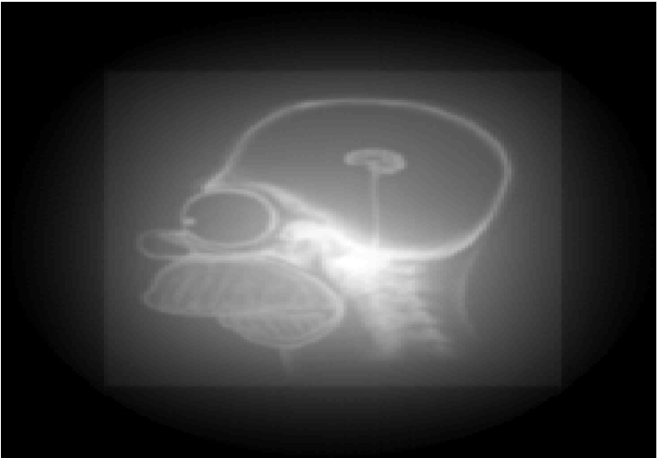
Example: Image Reconstruction
Filtered Back-projection Application
Multiple sinogram images processed to build a reconstructed image
Images continuously fed in from scanner to iteratively improve resultant output
Streaming style data flow
Input Image Stack
Image Source: hem.bredband.net/luciadbb/Reconstruction_presentation.pdf
Reconstructed OP Image
Notes:
Example streaming application which can benefit from overlapped computation and communication

Slide 30
Without Asynchronous I/O
Single Command Queue: N images = N( tcompute + transfer)
Inefficient for medical imaging applications like reconstruction where large numbers of input images are used in a streaming fashion to incrementally reconstruct an image.
Performance improvement by asynchronous IO is better than previously discussed case since no IO from device to host after each kernel call. This would reduce total IO time per kernel by ½
Total time per image = Ti + Tc = 2T
Overlapped Time = T (if Ti = Tc) shows ~ 50% improvement scope
ComputeKernel(Image0)
Copy(Image1)
ComputeKernel(Image1)
Copy(Image1)
Notes:
In this application the device to host IO only occurs at end of the reconstruction

Slide 31
Events for Asynchronous I/O
Two command queues created on the same device
Different from asymptotic analysis case of dividing computation between queues
In this case we use different queues for IO and compute
We have no output data moving from Host to device for each image, so using separate command queues will also allow for latency hiding
Compute Queue
ComputeKernel(Image0)
ComputeKernel(Image1)
ComputeKernel(Image2)
I/O Queue
Copy(Image0
Copy(Image1)
Copy(Image2)
Notes:
In this application the device to host IO only occurs at end of the reconstruction

Slide 32
Backprojection
The Backprojection kernel isn’t relevant to this discussion
We simply wish to show how kernels and buffer writes can be enqueued to different queues to overlap IO and computation
More optimizations possible like buffering strategies and memory management to avoid declaring N buffers on device
//N is the number of images we wish to use
cl_event event_list[N];
//Start First Copy to device
clEnqueueWriteBuffer (queue1 , d_ip[0], CL_FALSE,
(void *)ip, 0, NULL, &event_list[0] ) ;
for ( int i = 1 ; i <N ; i++)
{ //Wait till IO is finished by specifying a wait list of one element which denotes the previous I/O
clEnqueueNDRange(queue0, Kernel, …
1,&event_list[i-1], NULL); //clEnqueueND will return asynchronously and begin IO
//Enque a Non Blocking Write using other command queue
clEnqueueWriteBuffer (queue1
, d_ip [i-1], CL_FALSE,
(void *)ip, 0, NULL, &event_list[i])
}
Notes:
Kernel call and event list which can allow moving data asynchronously

Slide 33
Summary
OpenCL events allow us to use the execution model and synchronization to benefit application performance
Use command queue synchronization constructs for coarse grained control
Use events for fine grained control over an application
OpenCL 1.1 allows more complicated event handling and adds callbacks. OpenCL 1.1 also provides for events that can be triggered by the user
Specification provides events to understand an application performance.
Per kernel analysis requires vendor specific tools
Nvidia OpenCL Profiler
AMD Accelerated Parallel Processing (APP) Profiler and Kernel Analyzer

