Slide 1
Debugging
A Collaboration Between
David Kaeli, Northeastern University
Benedict R. Gaster, AMD
© 2011

Slide 2
Instructor Notes
GPU debugging is still immature, but being improved daily. You should definitely check to see the latest options available before giving this lecture.

Slide 3
Debugging Techniques
Compiling for x86 CPU
Debugging with GDB
GPU printf
Live debuggers
Parallel Nsight
gDEBugger

Slide 4
CPU Debugging
OpenCL allows the same code to run on different types of devices
Compiling to run on a CPU provides some extra facilities for debugging
Additional forms of IO (such as writing to disk) are still not available from the kernel
AMD’s OpenCL implementation recognizes any x86 processor as a target device
Simply select the CPU as the target device when executing the program
NVIDIA’s OpenCL implementation can support compiling to x86 CPUs if AMD’s installable client driver is installed

Slide 5
CPU Debugging with GDB
Setting up for GDB
Pass the compiler the “-g” flag
Pass “-g” to clBuildProgram()
Set an environment variable CPU_COMPILER_OPTIONS=“-g”
Avoid non-deterministic execution by setting an environment variable CPU_MAX_COMPUTE_UNITS=1

Slide 6
CPU Debugging with GDB
Run gdb with the OpenCL executable
> gdb a.out
Breakpoints can be set by line number, function name, or kernel name
To break at the kernel hello within gdb, enter:
(gdb) b __OpenCL_hello_kernel
The prefix and suffix are required for kernel names
OpenCL kernel symbols are not known until the kernel is loaded, so setting a breakpoint at clEnqueueNDRangeKernel() is helpful
(gdb) b clEnqueueNDRangeKernel

Slide 7
CPU Debugging with GDB
To break on a certain thread, introduce a conditional statement in the kernel and set the breakpoint inside the conditional body
Can use gdb commands to view thread state at this point
...
if(get_global_id(1) == 20 &&
get_global_id(0) == 34) {
; // Set breakpoint on this line
}
Notes:
AMD’s OpenCL programming guide has a section dedicated to debugging with GDB

Slide 8
GPU Printf
AMD GPUs support printing during execution using printf()
NVIDIA does not currently support printing for OpenCL kernels (though they do with CUDA/C)
AMD requires the OpenCL extension cl_amd_printf to be enabled in the kernel
printf() closely matches the definition found in the C99 standard

Slide 9
GPU Printf
printf() can be used to print information about threads or check help track down bugs
The following example prints information about threads trying to perform an improper memory access
int myIdx = ... // index for addressing a matrix
if(myIdx < 0 || myIdx >= rows || myIdx >= cols) {
printf(“Thread %d,%d: bad index (%d)\n”,
get_global_id(1), get_global_id(0), myIdx));
}

Slide 10
GPU Printf
printf() works by buffering output until the end of execution and transferring the output back to the host
It is important that a kernel completes in order to retrieve printed information
Commenting out code following printf() is a good technique if the kernel is crashing

Slide 11
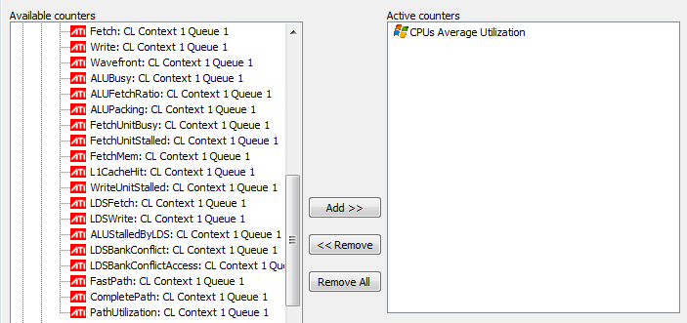
gDEBugger
Developed by Graphic Remedy
Cost: not free
Debugger, profiler, memory analyzer
Integrated with AMD/ATI and NVIDIA performance counters

Slide 12
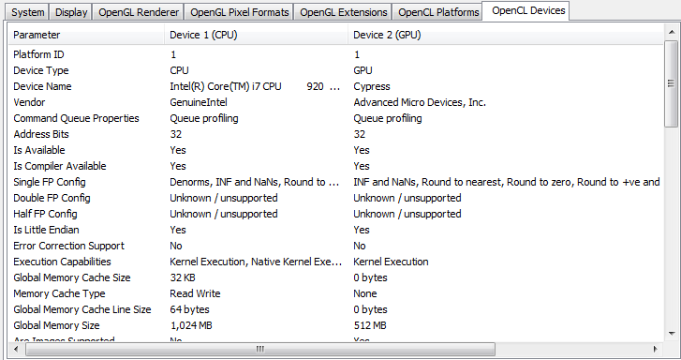
gDEBugger
Displays information about OpenCL platforms and devices present in the system

Slide 13
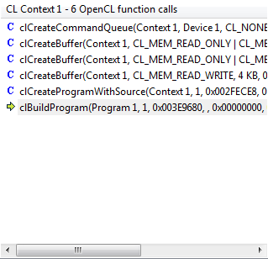
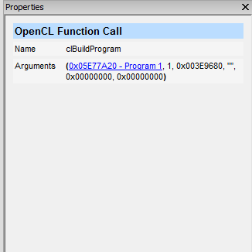
gDEBugger
Can step through OpenCL calls, and view arguments
Links to programs, kernels, etc. when possible in the function call view

Slide 14
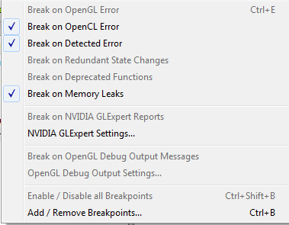
gDEBugger
Automatically detects OpenCL errors and memory leaks

Slide 15
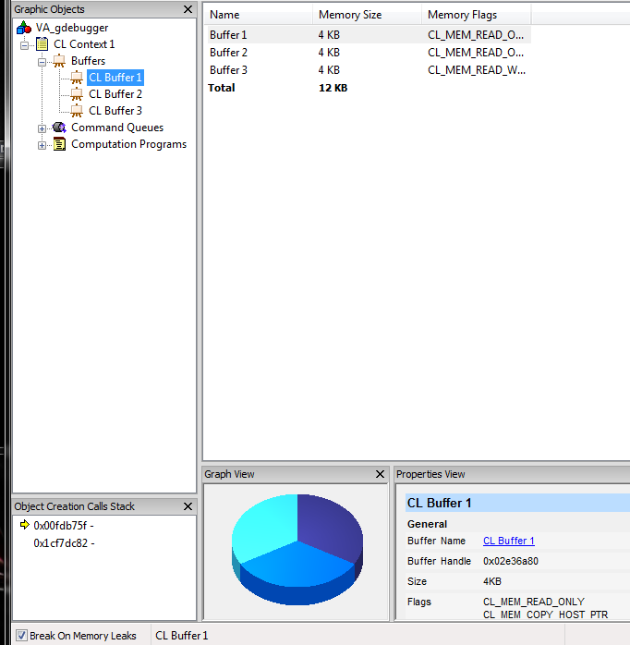
gDEBugger
Displays contents of buffers and images present on OpenCL devices
View live
Export to disk

Slide 16
Summary
GPU debugging is still immature
NVIDIA has a live debugger for Windows only
AMD and NVIDIA allow restrictive printing from the GPU
AMD allows code to be compiled and run with gdb on the CPU
Graphic Remedy (gDEBugger) provides online memory analysis and is integrated with performance counters, but cannot debug on a thread-by-thread basis

