Slide 1
Programming Multiple Devices
A Collaboration Between
David Kaeli, Northeastern University
Benedict R. Gaster, AMD
© 2011

Slide 2
Instructor Notes
This lecture describes the different ways to work with multiple devices in OpenCL (i.e., within a single context and using multiple contexts), and the tradeoffs associated with each approach
The lecture concludes with a quick discussion of heterogeneous load-balancing issues when working with multiple devices

Slide 3
Approaches to Multiple Devices
Single context, multiple devices
Standard way to work with multiple devices in OpenCL
Multiple contexts, multiple devices
Computing on a cluster, multiple systems, etc.
Considerations for CPU-GPU heterogeneous computing

Slide 4
Single Context, Multiple Devices
Nomenclature:
“clEnqueue*” is used to describe any of the clEnqueue commands (i.e., those that interact with a device)
E.g. clEnqueueNDRangeKernel(), clEnqueueReadImage()
“clEnqueueRead*” and “clEnqueueWrite*” are used to describe reading/writing to either buffers or images
E.g. clEnqueueReadBuffer(), clEnqueueWriteImage()

Slide 5
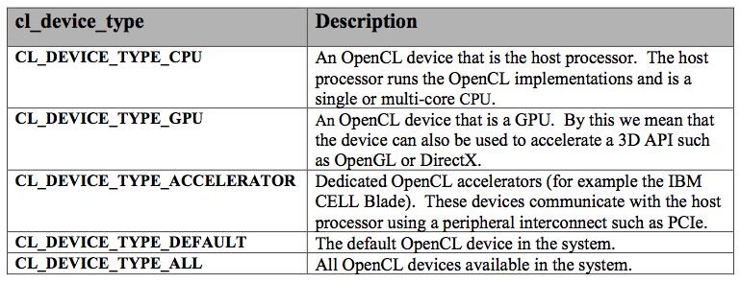
Single Context, Multiple Devices
Associating specific devices with a context is done by passing a list of the desired devices to clCreateContext()
The call clCreateContextFromType() takes a device type (or combination of types) as a parameter and creates a context with all devices of that type:

Slide 6
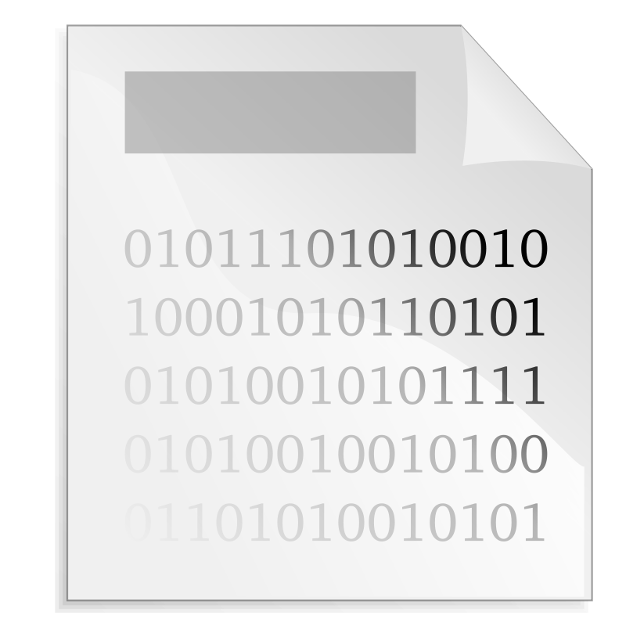
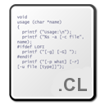

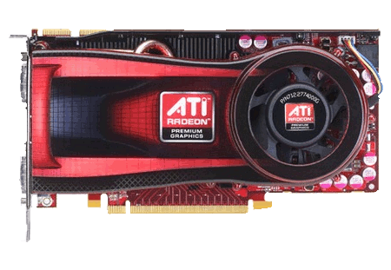
Single Context, Multiple Devices
When multiple devices are part of the same context, most OpenCL objects are shared
Memory objects, programs, kernels, etc.
One command queue must exist per device and is supplied in OpenCL when the target GPU needs to be specified
Any clEnqueue* function takes a command queue as an argument
Context

Slide 7
Single Context, Multiple Devices
While memory objects are common to a context, they must be explicitly written to a device before being used
Whether or not the same object can be valid on multiple devices is vendor specific
OpenCL does not assume that data can be transferred directly between devices, so commands only exists to move from a host to device, or device to host
Copying from one device to another requires an intermediate transfer to the host
Context
2) Object now valid on host
1) clEnqueueRead*(cq0, ...) copies object to host
3) clEnqueueWrite*(cq1, ...) copies object to device 1
0) Object starts on device 0
4) Object ends up on device 1
TWO PCIe DATA TRANSFERS ARE REQUIRED
Notes:
If CPUs were being used and operating on data in-place, the commands to transfer data would likely not actually do any copying.

Slide 8
Single Context, Multiple Devices
The behavior of a memory object written to multiple devices is vendor-specific
OpenCL does not define if a copy of the object is made or whether the object remains valid once written to a device
We can imagine that a CPU would operate on a memory object in-place, while a GPU would make a copy (so the original would still be valid until it is explicitly written over)
Fusion GPUs from AMD could potentially operate on data in-place as well
Currently AMD/NVIDIA implementations allow an object to be copied to multiple devices (even if the object will be written to)
When data is read back, separate host pointers must be supplied or one set of results will be clobbered
Context
When writing data to a GPU, a copy is made, so multiple writes are valid
clEnqueueWrite*(cq0, ...)
clEnqueueWrite*(cq1, ...)

Slide 9
Single Context, Multiple Devices
Just like writing a multi-threaded CPU program, we have two choices for designing multi-GPU programs
Redundantly copy all data and index using global offsets
Split the data into subsets and index into the subset
GPU 0
GPU 1
A
A
Threads
0
1
2
3
4
5
6
7
GPU 0
GPU 1
A₀
A₁
Threads
0
1
2
3
0
1
2
3

Slide 10
Single Context, Multiple Devices
OpenCL provides mechanisms to help with both multi-device techniques
clEnqueueNDRangeKernel() optionally takes offsets that are used when computing the global ID of a thread
Note that for this technique to work, any objects that are written to will have to be synchronized manually
SubBuffers were introduced in OpenCL 1.1 to allow a buffer to be split into multiple objects
This allows reading/writing to offsets within a buffer to avoid manually splitting and recombining data

Slide 11
Single Context, Multiple Devices
OpenCL events are used to synchronize execution on different devices within a context
Each clEnqueue* function generates an event that identifies the operation
Each clEnqueue* function also takes an optional list of events that must complete before that operation should occur
clEnqueueWaitForEvents() is the specific call to wait for a list of events to complete
Events are also used for profiling and were covered in more detail in Lecture 11

Slide 12
Multiple Contexts, Multiple Devices
An alternative approach is to create a redundant OpenCL context (with associated objects) per device
Perhaps is an easier way to split data (based on the algorithm)
Would not have to worry about coding for a variable number of devices
Could use CPU-based synchronization primitives (such as locks, barriers, etc.)
Communicate using host-based libraries
Context
Context
Notes:
If the contexts were on the same physical machine, pthreads could be used to communicate and synchronize. In a distributed setting, MPI could be used.

Slide 13
Multiple Contexts, Multiple Devices
Follows SPMD model more closely
CUDA/C’s runtime-API approach to multi-device code
No code required to consider explicitly moving data between a variable number of devices
Using functions such as scatter/gather, broadcast, etc. may be easier than creating subbuffers, etc. for a variable number of devices
Supports distributed programming
If a distributed framework such as MPI is used for communication, programs can be ran on multi-device machines or in distributed environments

Slide 14
Multiple Contexts, Multiple Devices
In addition to PCI-Express transfers required to move data between host and device, extra memory and network communication may be required
Host libraries (e.g., pthreads, MPI) must be used for synchronization and communication

Slide 15
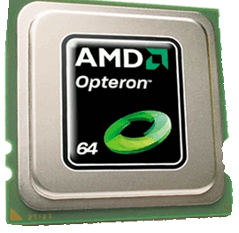
Heterogeneous Computing
Targeting heterogeneous devices (e.g., CPUs and GPUs at the same time) requires awareness of their different performance characteristics for an application
To generalize:
Context
 | CPUs | GPUs
Overhead | Low | High (depending on data)
Performance | Variable | High*
*otherwise application wouldn’t use OpenCL

Slide 16
Heterogeneous Computing
Factors to consider
Scheduling overhead
What is the startup time of each device?
Location of data
Which device is the data currently resident on?
Data must be transferred across the PCI-Express bus
Granularity of workloads
How should the problem be divided?
What is the ratio of startup time to actual work
Execution performance relative to other devices
How should the work be distributed?

Slide 17
Heterogeneous Computing
Granularity of scheduling units must be weighed
Workload sizes that are too large may execute slowly on a device, stalling overall completion
Workload sizes that are too small may be dominated by startup overhead
Approach to load-balancing #1:
Begin scheduling small workload sizes
Profile execution times on each device
Extrapolate execution profiles for larger workload sizes
Schedule with larger workload sizes to avoid unnecessary overhead
Approach to load-balancing #2:
If one device is much faster than anything else in the system, just run on that device

Slide 18
Summary
There are different approaches to multi-device programming
Single context, multiple devices
Can only communicate with devices recognized by one vendor
Code must be written for a general number of devices
Multiple contexts, multiple devices
More like distributed programming
Code can be written for a single device (or multiple devices), with explicit movement of data between contexts

