Slide 1

Data Stream Mining
Lesson 2
Bernhard Pfahringer
University of Waikato, New Zealand
1
Notes:
1

Slide 2
Overview
Drift and adaption
Change detection
CUSUM / Page-Hinkley
DDM
Adwin
Evaluation
Holdout
Prequential
Multiple runs: Cross-validation, …
Pitfalls

Slide 3
Many dimensions for Model Management
Data: fixed sized window, adaptive window, weighting
Detection:
monitor some performance measure
Compare distributions over time windows
Adaptation:
Implicit/blind (e.g. based on windows)
Explicit: use change detector
Model: restart from scratch, or replace parts (tree-branch, ensemble member)
3 Props: true detection rate, false alarm rate, detection delay

Slide 4

CUSUM: cumulative sum
Monitor residuals, raise alarm when the mean is significantly different from 0
(Page-Hinkley is a more sophisticated variant.)

Slide 5

DDM [Gama etal ‘04]
Drift detection method: monitors prediction based on estimated standard deviation
Normal state
Warning state
Alarm/Change state

Slide 6
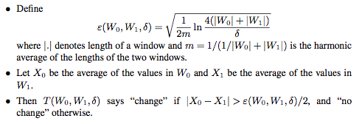
Adwin [Bifet&Gavalda ‘07]
Invariant: maximal size window with same mean (distribution)
[uses exponential histogram idea to save space and time]

Slide 7
Evaluation: Holdout
Have a separate test (or Holdout) set
Evaluate current model after every k examples
Where does the Holdout set come from?
What about drift/change?

Slide 8
Prequential
Also called “test than train”:
Use every new example to test current model
Then train the current model with the new example
Simple and elegant, also tracks change and drift naturally
But can suffer from initial bad performance of a model
Use fading factors (e.g. alpha = 0.99)
Or a sliding window

Slide 9
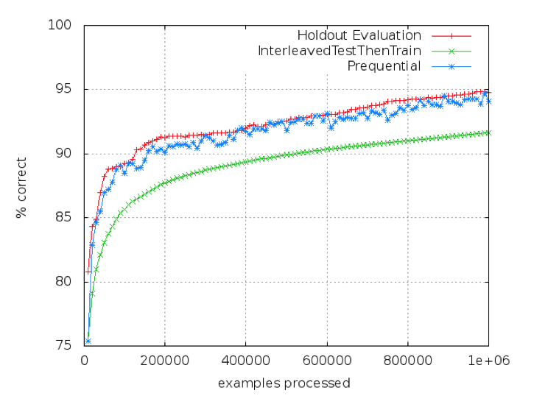
Comparison (no drift)

Slide 10
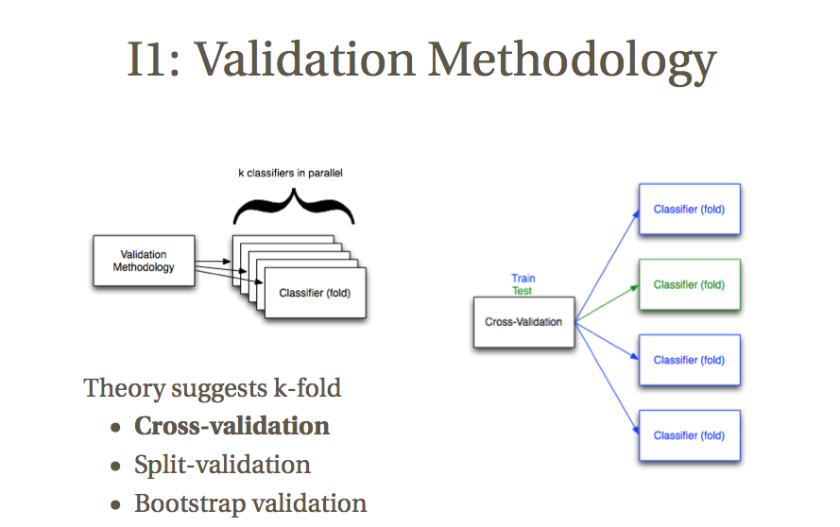
K-fold: Cross-validation

Slide 11
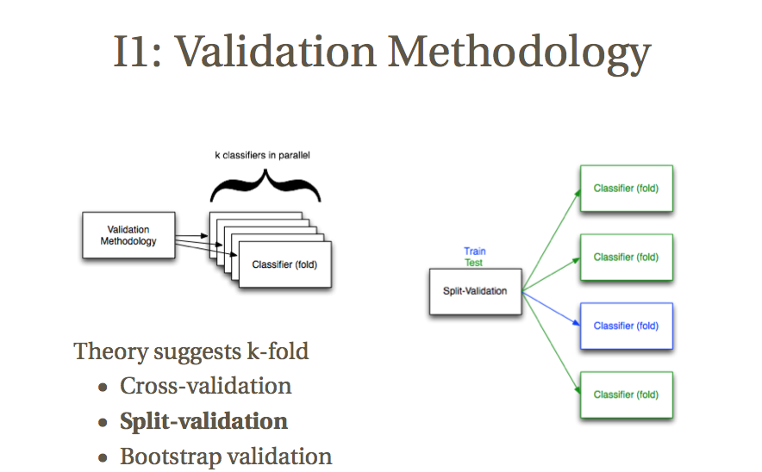
K-fold: split-validation

Slide 12
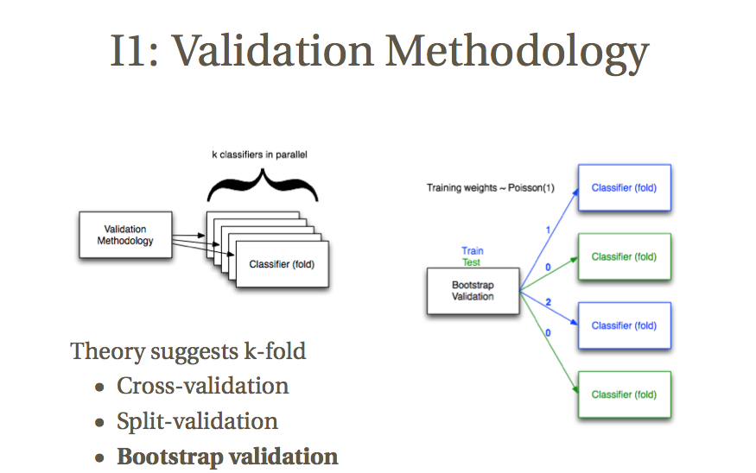
K-fold: bootstrap validation

Slide 13
K-fold: who wins? [Bifet etal 2015]
Cross-validation strongest, but most expensive
Split-validation weakest, but cheapest
Bootstrap: in between, but closer to cross-validation

Slide 14
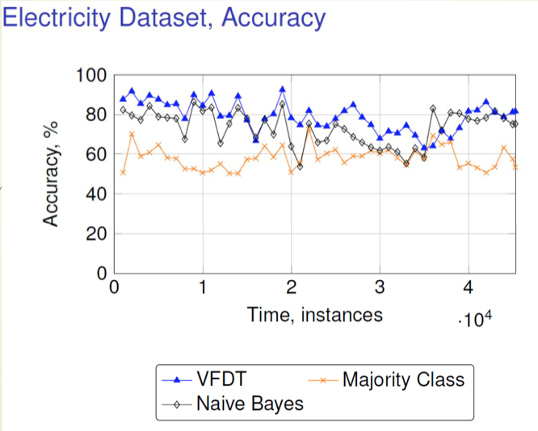
Evaluation can be misleading

Slide 15
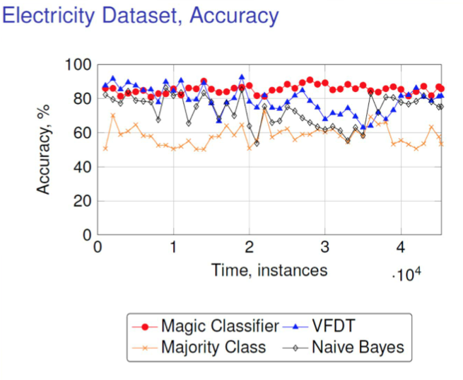
“Magic” classifier

Slide 16
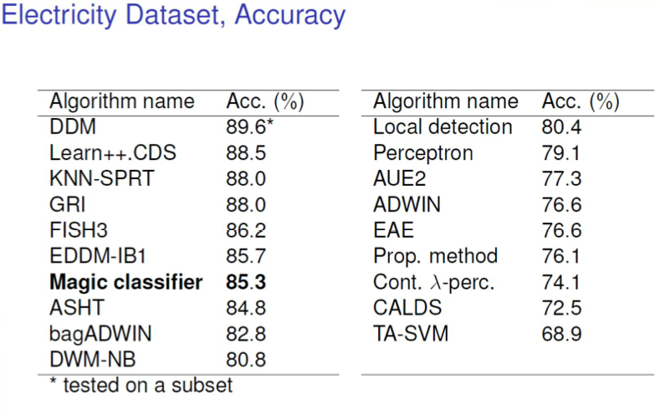
Published results

Slide 17
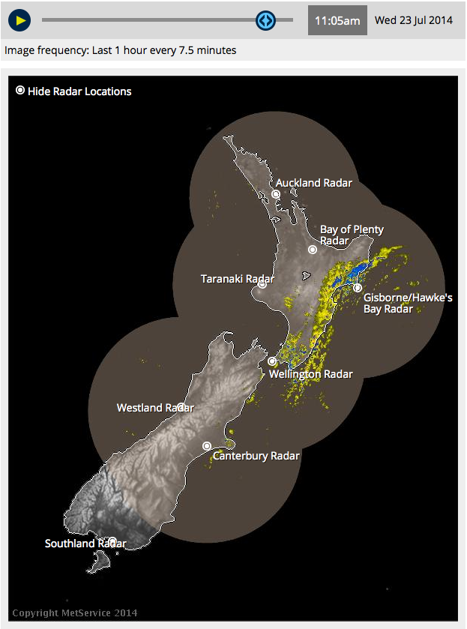
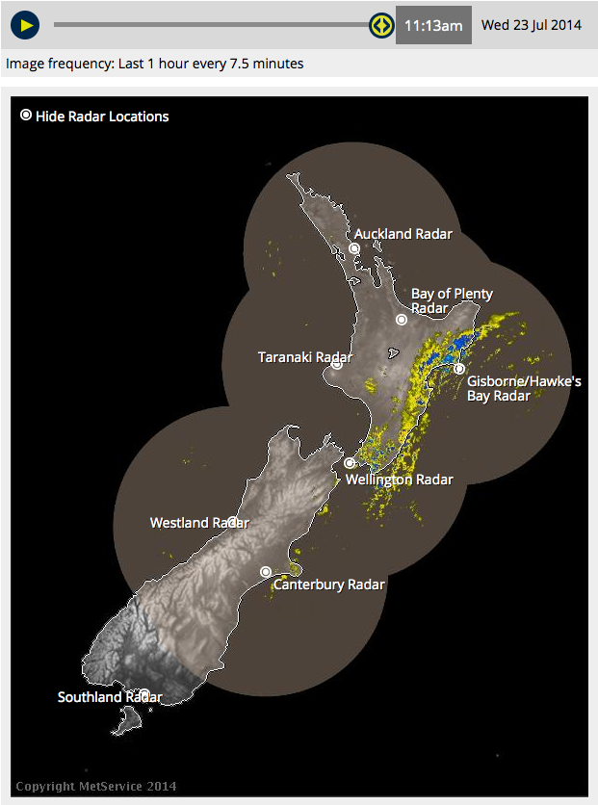
“Magic” = no-change classifier
Problem is Auto-correlation
Use for evaluation: Kappa-plus
Exploit for better prediction

Slide 18
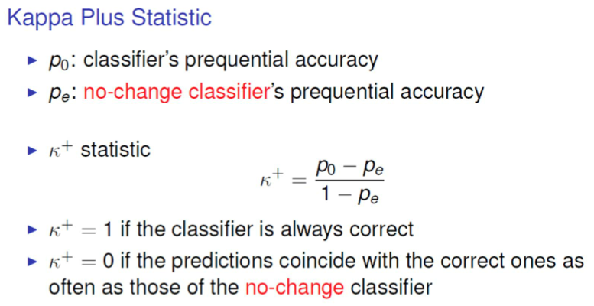
“Magic” = no-change classifier

Slide 19

SWT: Temporally Augmented Classifier

Slide 20
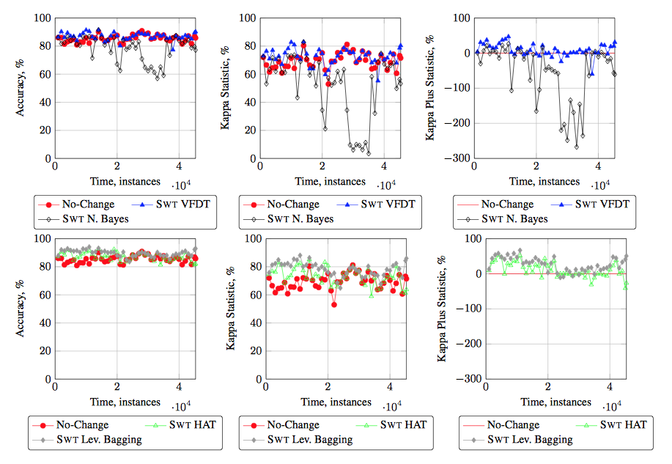
SWT: Accuracy and Kappa Plus, Electricity

Slide 21
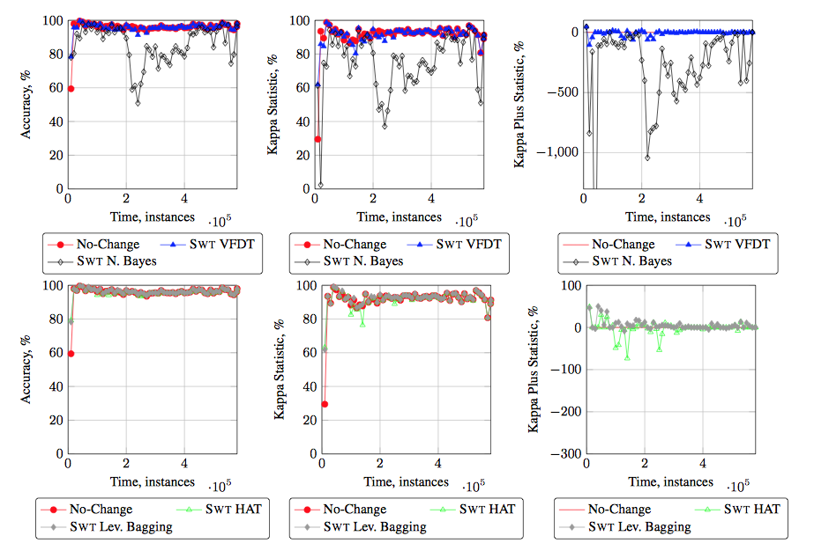
SWT: Accuracy and Kappa Plus, Forest Cover

Slide 22
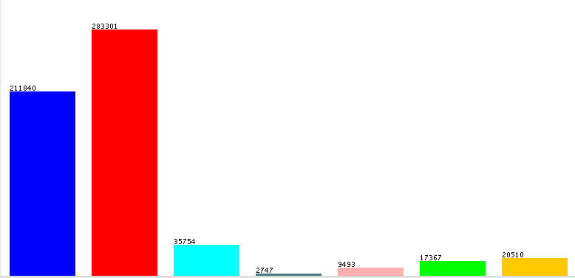
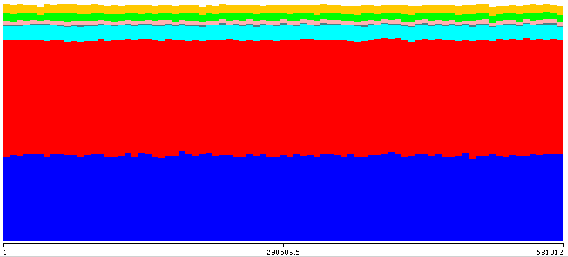
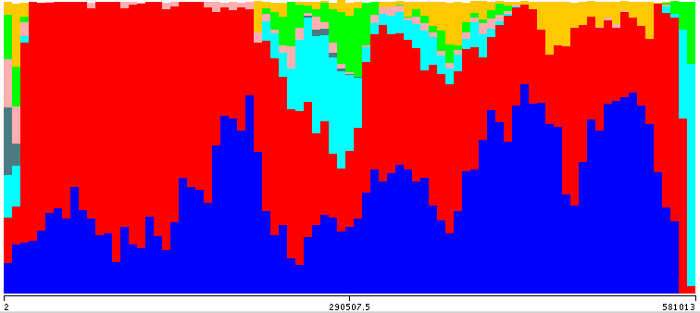
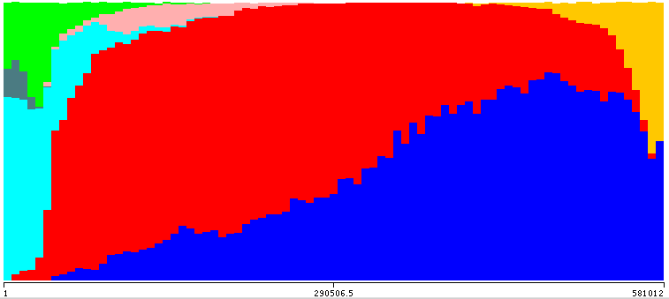
Forest Cover? “Time:” sorted by elevation

Slide 23
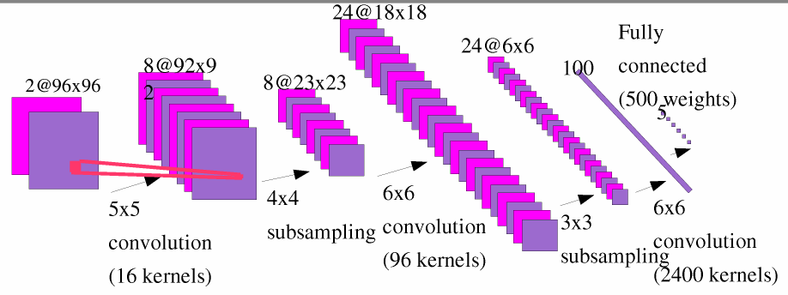
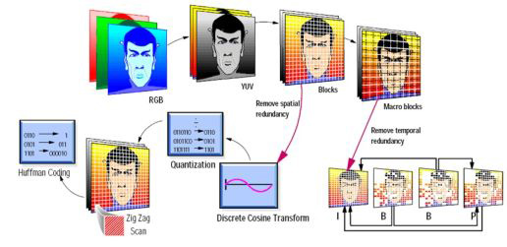
Can we exploit spatial correlation?
Deep learning for Image Processing does it:
Convolutional layers
Video encoding does it:
MPEG
(@IBM) (@Yann LeCun)

Slide 24
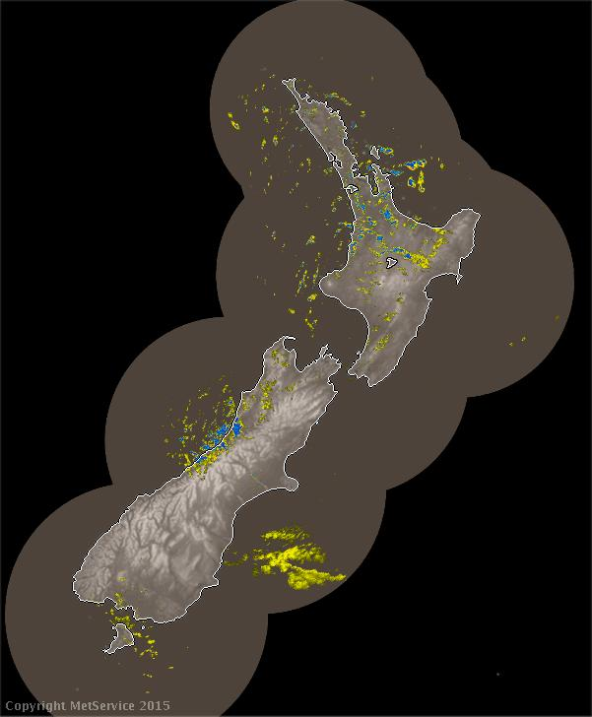
Rain radar image prediction
NZ rain radar images from metservice.com
Automatically collected every 7.5 minutes
Images are 601x728, ~450,000 pixels
Each pixel represents a ~7 km² area
Predict the next picture, or 1 hour ahead, …
http://www.metservice.com/maps-radar/rain-radar/all-new-zealand

Slide 25
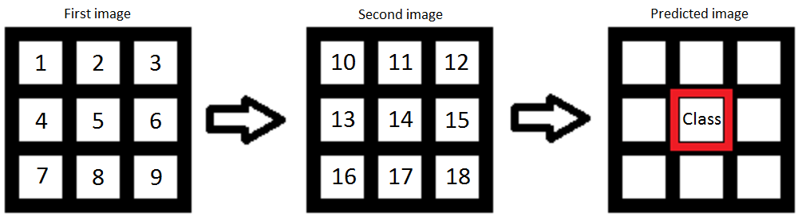
Rain radar image prediction
Predict every single pixel
Include information from a neighbourhood, in past images

Slide 26
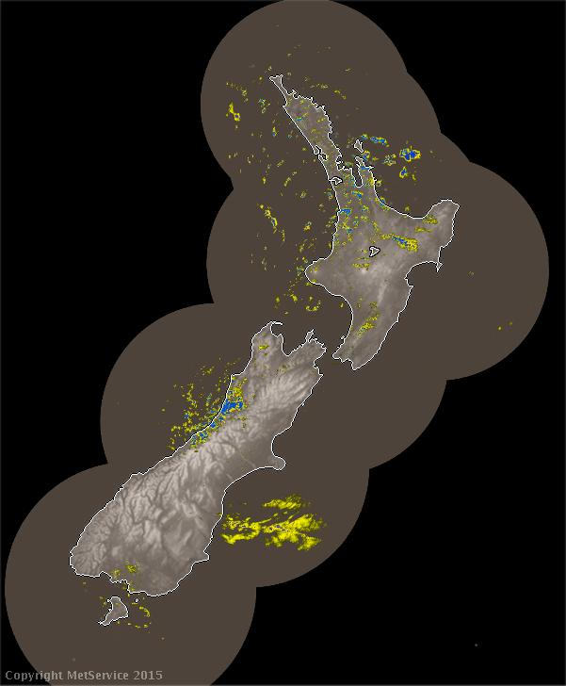
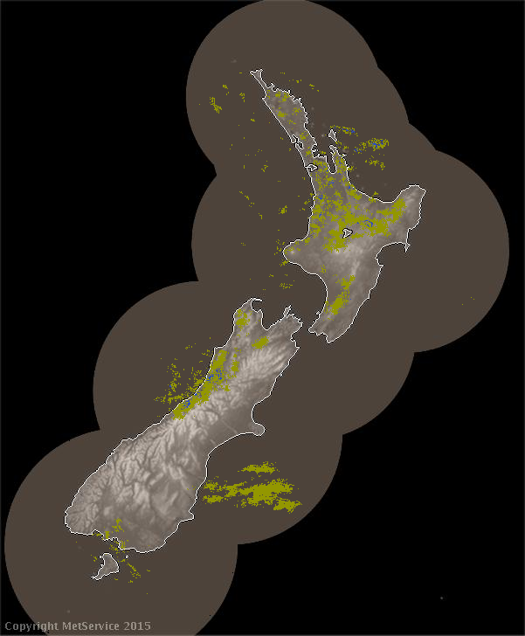
Results
Actual (left)
vs
Predicted (right)

Slide 27
Big Open Question: How to exploit spatio-temporal relationships in data with rich features?
Algorithm choice:
Hidden Markov Models?
Conditional Random Fields?
Deep Learning?
Feature representation:
Include information from “neighbouring” examples?
Explicit relational representation?

