Slide 1

Data Stream Mining
Lesson 3
Bernhard Pfahringer
University of Waikato, New Zealand
1
Notes:
1

Slide 2
Overview
Decision Trees:
Hoeffding tree
Numeric attributes
Functional adaptive leaves
Drift&Change
HOT
Ensembles
Why?
Bagging
Boosting
BLast (~ stacking)

Slide 3
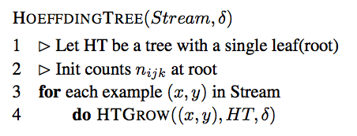
Decision Trees
Easy to adapt to streaming, if approximation is ok
At each leaf:
Accumulate sufficient statistics for split gain computation
Split when best split reaches confidence level
No Pruning (but see later)

Slide 4
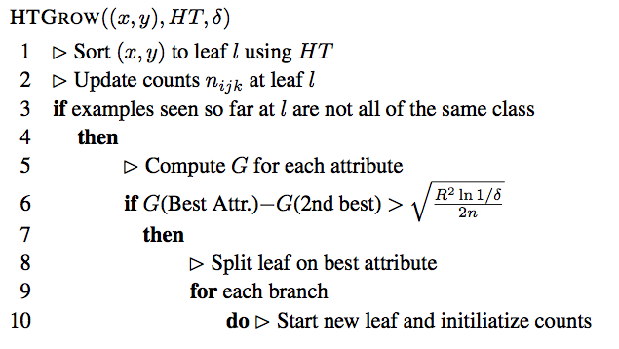
HoeffdingTree [Hulten&Domingos ‘00]

Slide 5
HoeffdingTree Engineering
Similar or even identical attributes => no winner
Growth would stall => split anyway, once Hoeffding bound below a threshold
Computing split gains is expensive =>
Only do it every N examples
Unbounded growth =>
Limit #nodes, also deactivate low-coverage/low-error leaves
Tree growth can be slow =>
Initialise with a batch tree

Slide 6
Numerical attributes?
Batch setting: scan sorted values to find best split point
Streaming:
Extreme 1: keep all values in a B-tree or similar (plus pruning …)
Extreme 2: estimate one normal distribution per class (3 sums each)
Unexplored alternatives:
1: simply keep examples locally (instead of stats)
2: use some incremental discretisation method

Slide 7
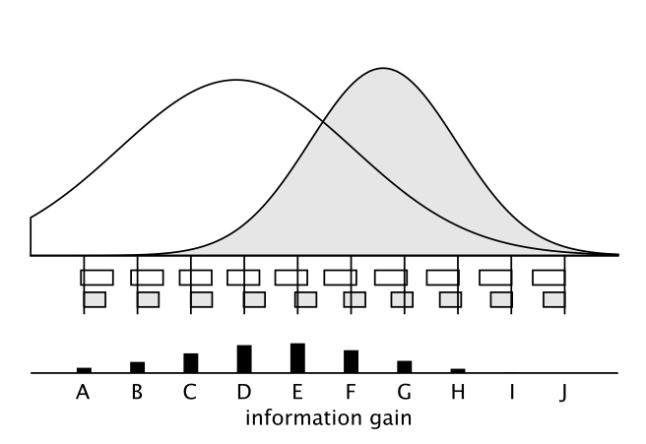
Normal distribution per class

Slide 8
Functional leaves
Stats stored in a leaf are exactly what a Naïve Bayes classifier needs:
=> replace majority class prediction by Naïve Bayes ☺
In Moa: also monitor performance of both Majority Class and Naïve Bayes (two additional error counts), use better one dynamically
[if one were to store examples locally => same trick, but kNN]

Slide 9
Tree: Change and drift?
Unbounded tree will automatically adapt over time,
But COST may be too high
Bounded scenario
Monitor performance of all nodes
Prune bad subtrees
Grow alternative subtree in parallel, using good alternative split
At some stage choose better one and cull worse one

Slide 10
Various implementations
CVFDT [Hulten etal ‘01]
VFDTc [Gama etal ‘06]
HAT [Bifet&Gavalda ‘09]
Uses an ADWIN instance for every node

Slide 11
HOT [Pfahringer etal ’07]
Hoeffding Option Tree:
Have permanent alternative branches
Exponential growth => must limit the number of alternatives
Incremental counting scheme ensures that every example goes to at most K leaves
Approximates an ensemble of K standard trees

Slide 12
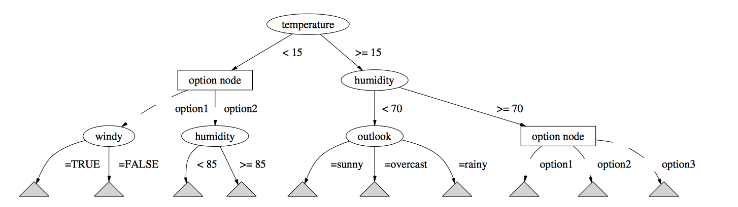
Option tree example

Slide 13
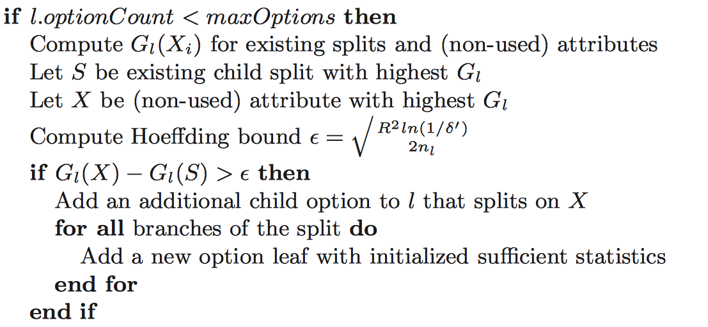
HOT induction

Slide 14
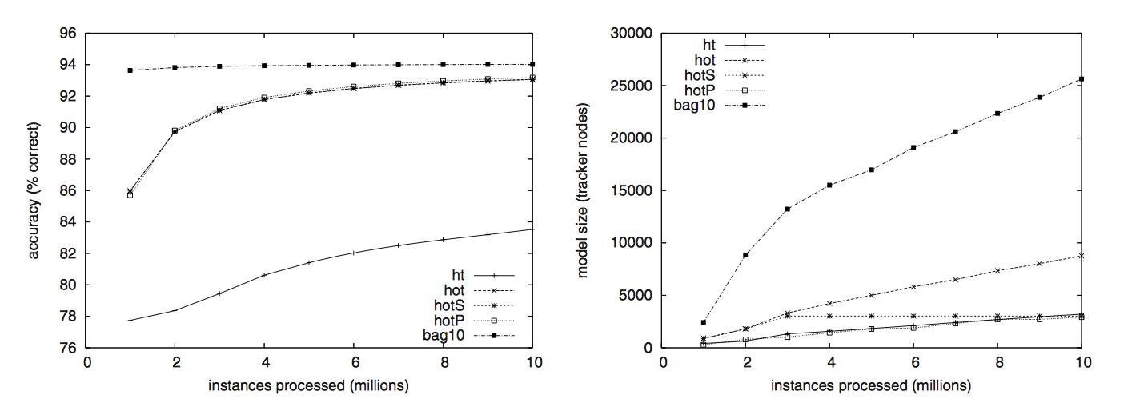
HOT performance
Performance, and memory consumption,
In between single tree and bagging ensemble
[Pruning is tricky, and unreliable]

Slide 15
Ensembles: Why?
Combine several classifiers to improve accuracy
Many methods: bagging, boosting, stacking, …
Simple probabilistic argument: if you vote 3 independent binary classifiers with a 40% error rate each, then majority vote achieves 35.2% error ☺
Other explanations include representation and search limitations

Slide 16
Bagging
Diversity through bootstrap sampling of the training data
Works well for “instable” base classifiers (e.g. trees)
Batch setting: sampling with replacement, ~63.2% unique
Streaming: Poisson(1) works similarly ☺

Slide 17
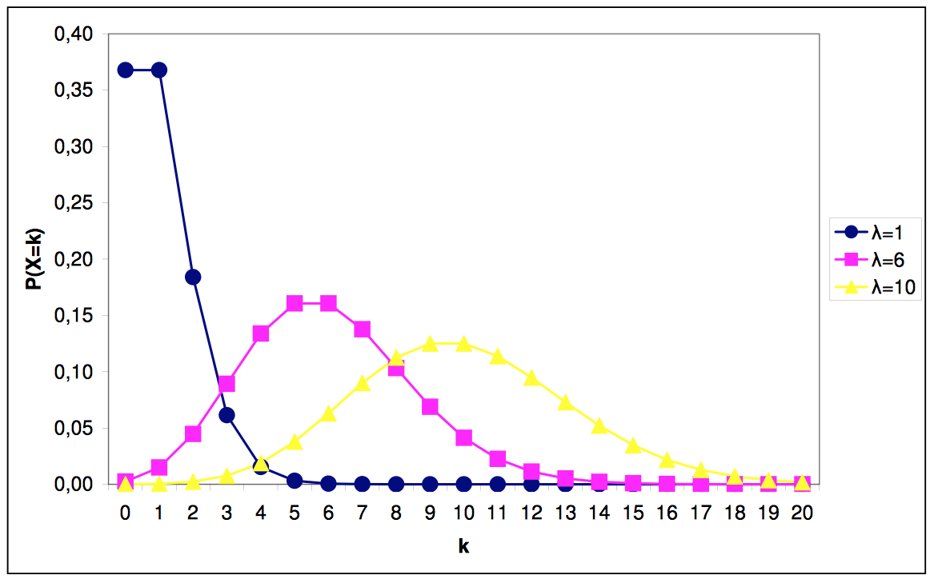
Poisson distribution

Slide 18
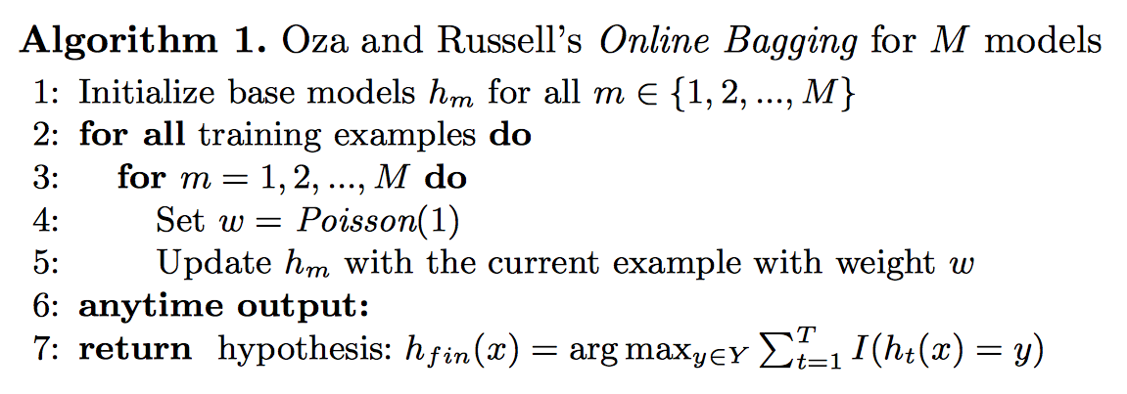
Bagging [Oza & Russell 2001]

Slide 19
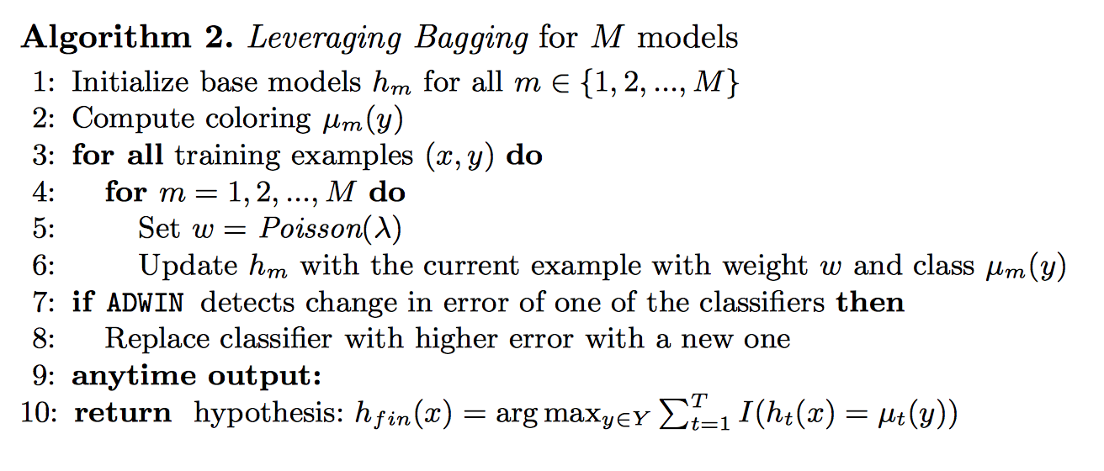
Leveraged Bagging [Bifet etal ‘10]

Slide 20
Success: good, yet diverse models
Trade-off:
Perfect single models are “identical”
Weaker models can be more diverse
Visualize: kappa-error diagram for all classifier-pairs
Mean error vs.
Kappa: measures agreement between 2 models:
0 .. Purely random agreement
1 .. Perfect agreement

Slide 21
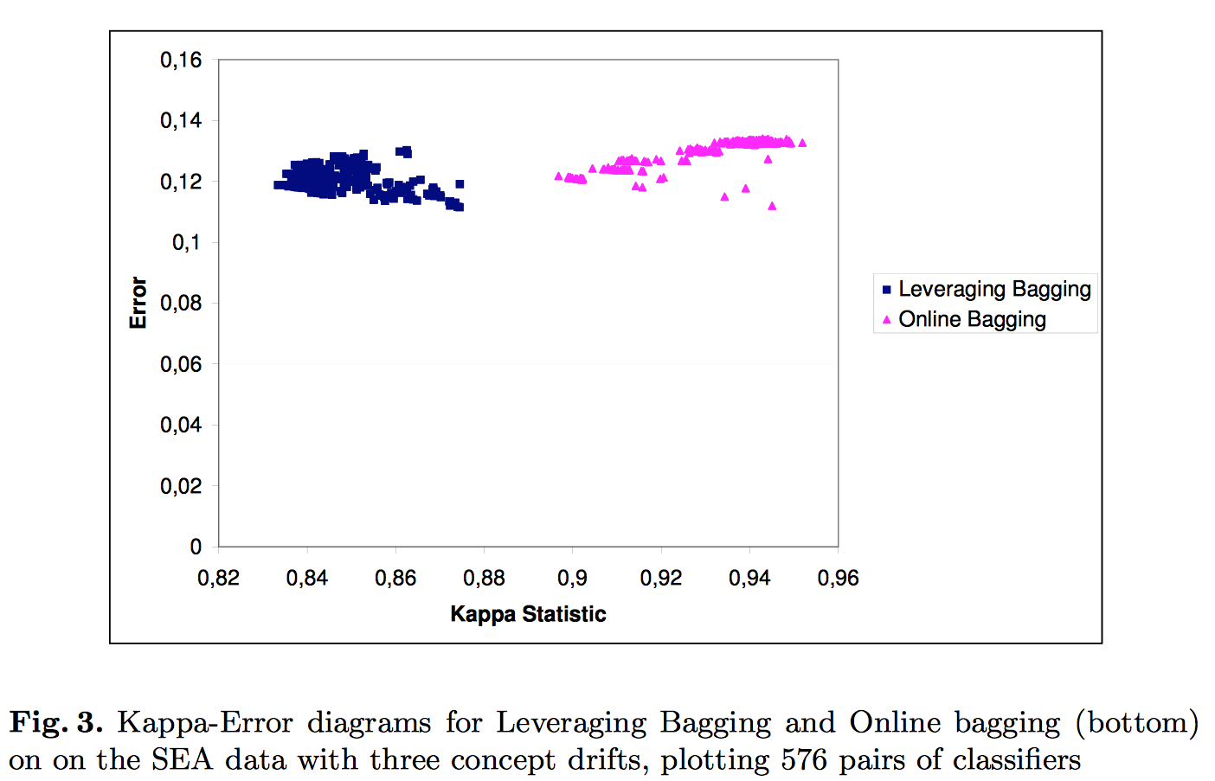
Kappa-error example

Slide 22
Boosting
Train ensemble members one by one
Reweight examples in-between:
Increase weight of misclassified ones
Decrease weight of correctly classified ones
Inherently “sequential” (bagging: embarrassingly parallel)
Achieves bias reduction (bagging: variance reduction)

Slide 23
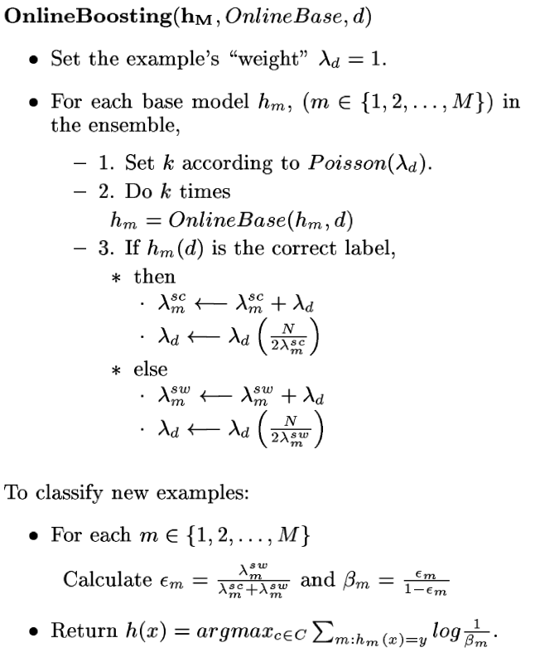
Online Boosting [Oza&Russell 2001]
Sequential, but could be pipelined
Does NOT outperform OnlineBagging (???)
Batch: Bagged(Boosting) works well
Streams: ?
Batch: XGBoost/LightGBM works well
Streams: ?

Slide 24
More ensemble methods
Random Forests: easy
Leverage/online bag a RandomHoeffdingTree (monitors only random attribute subsets at each node)
Adapt to change by regularly replacing worst tree
Perceptron Stacking of Restricted Hoeffding Trees [Bifet etal ‘12]:
Generate trees for all max-k-size attribute subsets
Feed prediction probabilities into a Perceptron as the meta-learner
Adaptive Size Hoeffding Tree Ensemble [Bifet etal ‘09]:
Ensemble member sizes are limited to powers of 2
Tree exceeds limit => reset to a single root node “Busy Beaver”
Weigh predictions by current accuracy estimate (from an EWMA)

Slide 25
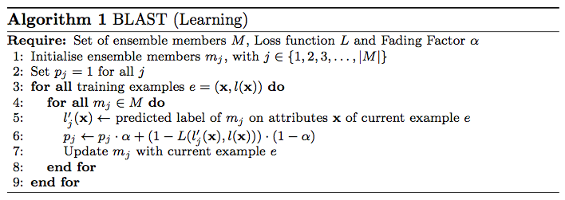
BLast (simplest form of Stacking)
From a set of diverse classifiers, choose the “Best Last” one:
Predict: use classifier with current maximum p_j, the “Best” one

Slide 26
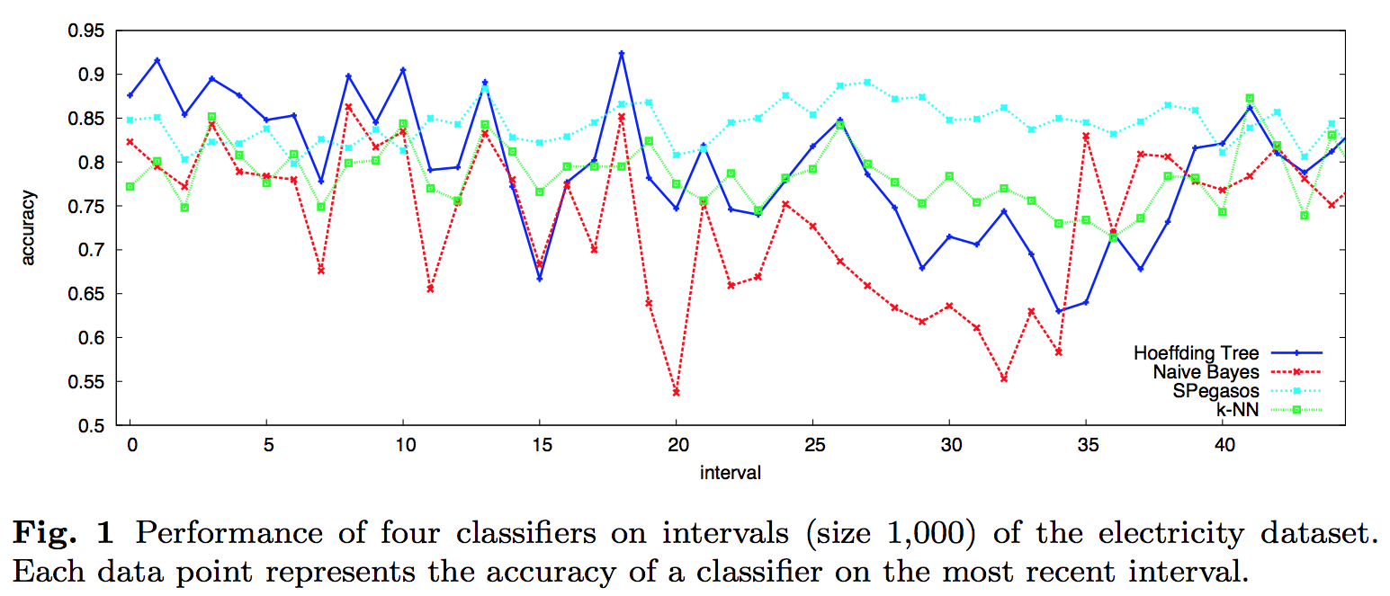
Why? Electricity again:

Slide 27
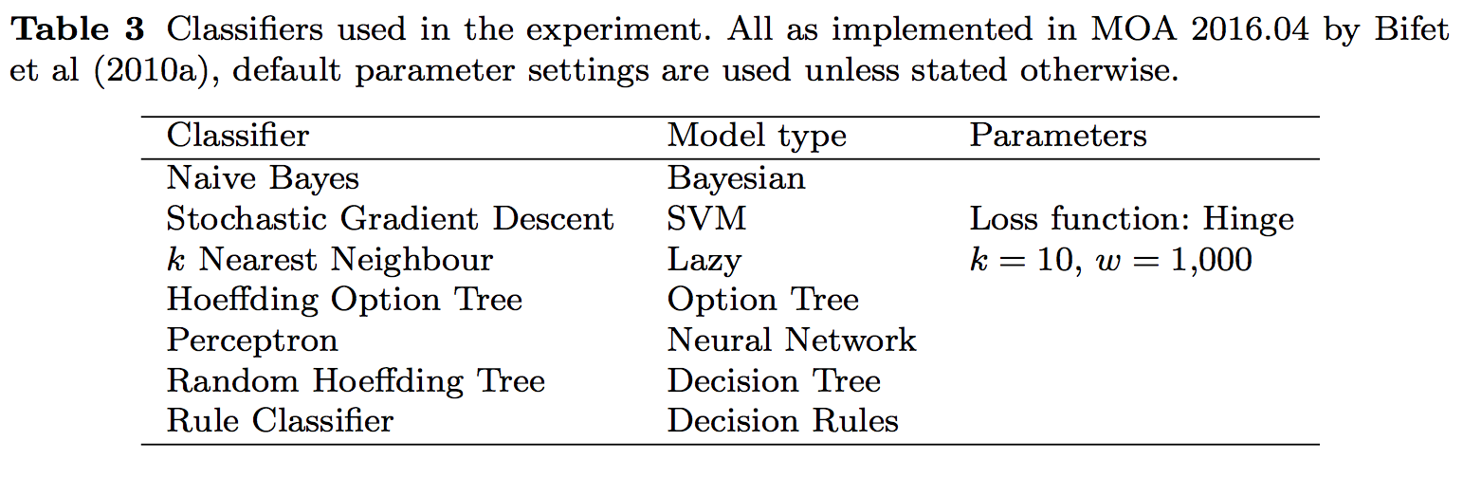
Which base level classifiers?

Slide 28
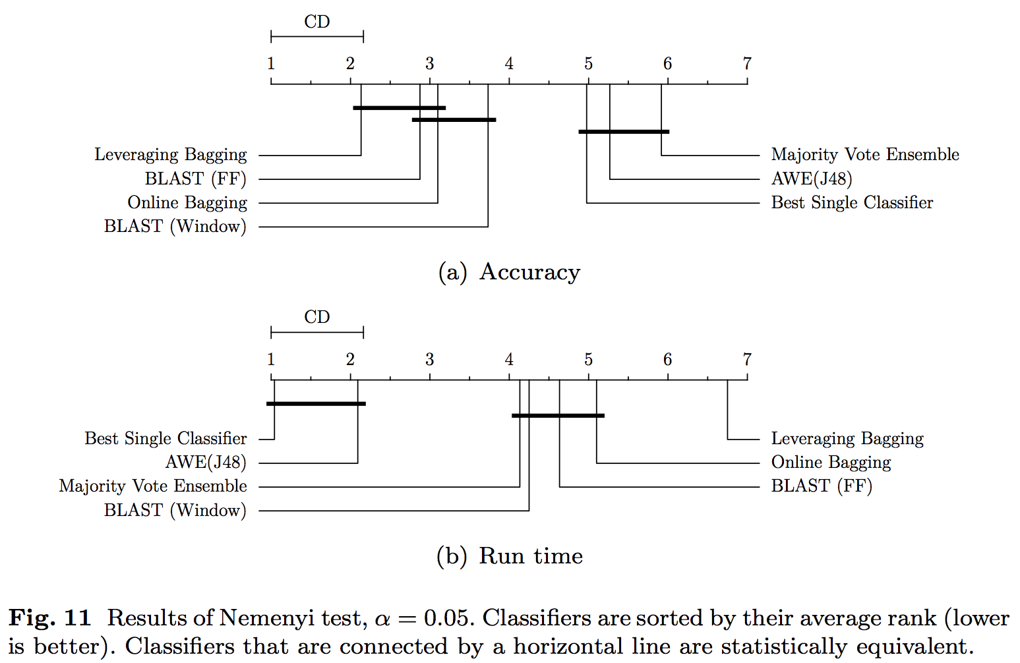
How good is BLast?

