Slide 1
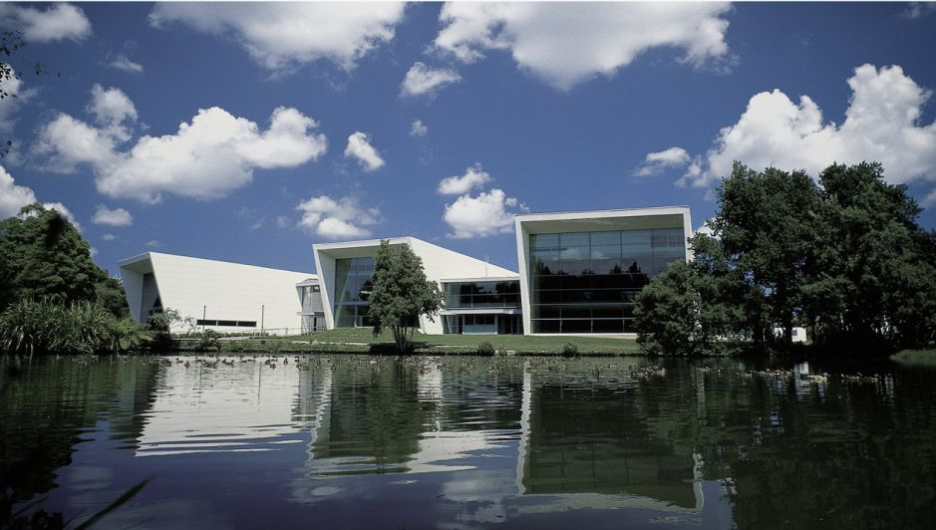
Data Stream Mining
Lesson 4
Bernhard Pfahringer
University of Waikato, New Zealand
1
Notes:
1

Slide 2
Overview
Discretisation:
Simple
PID
Clustering
Kmeans
Birch and variants
DBSCAN
DenStream
ClusTree
StreamKM++

Slide 3
Discretisation: Simple
Batch scenario:
Equal-width (may suffer from outliers)
Equal-frequency (more robust)
Single dimension k-means
Fayyad-Irani 1993: single dimension decision tree with MDL stopping criterion
Streams
Fayyad-Irani and k-means: no one has tried yet (afaik)
Partition-incremental discretisation (PID) [Pinto&Gama ‘05] standard

Slide 4
PID
Classical 2 tiered approach:
Level1 is instance-incremental
Very approximate equal frequency discretisation
Buckets gets too heavy: split evenly
Buckets gets too light: merge with smaller neighbour
Level2 is offline
done at regular intervals, or on demand
Can use any batch algorithm on the Level1 summaries
Level1 needs to be fine-grained enough

Slide 5
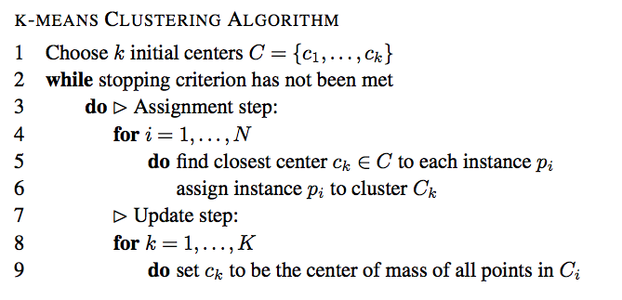
Clustering: K-means

Slide 6
Simple single-pass k-means
Initialise cluster K centres from the first N examples
Then simply update for each instance:
Add instance to closest centre
Or batch-incremental:
Cluster batches and try to match up (allows to study cluster evolution)
Or Merge and cluster old centres with new points

Slide 7
Micro-clusters, aka cluster features
K-means like cluster centers can be updated easily:
N: number of points seen
LS: linear sum over all points for each attribute
SS: sum of squares over all points for each attribute
O(1) update per example
Compute center and deviations from stats
Additive: merge clusters easily
Split: into halves by moving up and down a fraction of the stdev
Might want to use forgetting factor

Slide 8
Birch, and friends
Two-level algorithm:
Level1 incremental: build B-Tree of micro-clusters of defined max-radius
Level2 batch: apply k-means to the micro-clusters
BICO: variant that uses more sophisticated core-sets ideas to build a better tree [plus k-means++ offline], probably the fastest good stream clusterer currently
CLU-STREAM: adds time-stamp information to micro-clusters, calls them cluster features
If number of micro-clusters becomes to large:
Delete the oldest micro-cluster
Or merge the two oldest

Slide 9
Limitation of k-means and variants
Works best for spherical clusters
Cannot find odd-shaped clusters
[but can implicitly approximate if allowed many small clusters]
Alternatives:
density-based clustering
2 points are “connected” if they are close to each other, or can be reached via connected points.
All such points form one cluster
Any point of the cluster defines the cluster, can be its “core point”

Slide 10
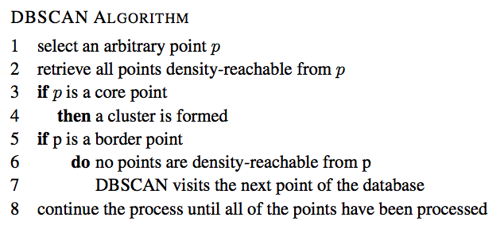
DBSCAN (batch)

Slide 11
DenStream
Streaming variant of DBSCAN:
Two-level approach with micro-clusters
Incrementally grow p-micro-clusters (potential core points) and o-micro-clusters (potential outliers)
Plus add a fading factor
Regularly run DBSCAN on the micro-clusters

Slide 12
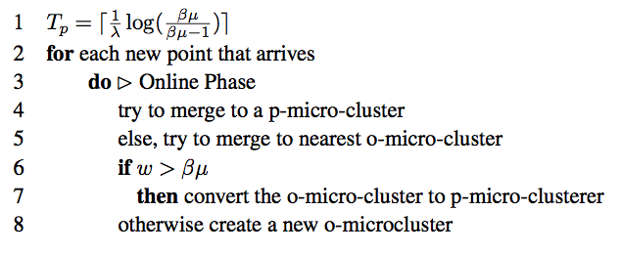
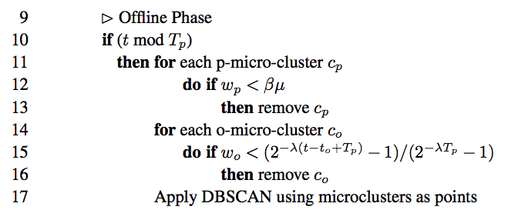
DenStream

Slide 13
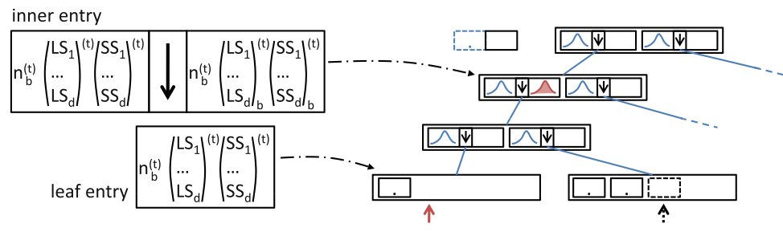
ClusTree [Kranen etal 2011]
Truly anytime, instance processing can be interrupted gracefully by next
Claims to be parameter-free
Keeps an R-tree like index of micro-clusters
Fast and compact

Slide 14
StreamKM++ [Ackermann etal ‘12]
K-means++ is smart about initialising the cluster centres:
First one chosen at random
Next k-1 at random with probability proportional to squared distance to already chosen ones [probabilistic, less extreme variant of FarthestFirst]
StreamKM++ uses this idea to generate core-sets:
Choose m examples like above
For each one compute number of closest examples => weight
Streaming: store examples into batches
Full => merge with previous by computing core-set of both
=> keeps only a logarithmic number of core-sets
Offline phase: k-means++ over all core-sets

Slide 15
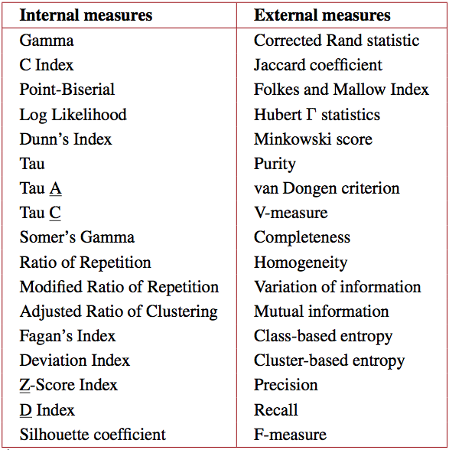
Problem: Evaluation, too many way
e.g. [Chen ’09]

