Slide 1
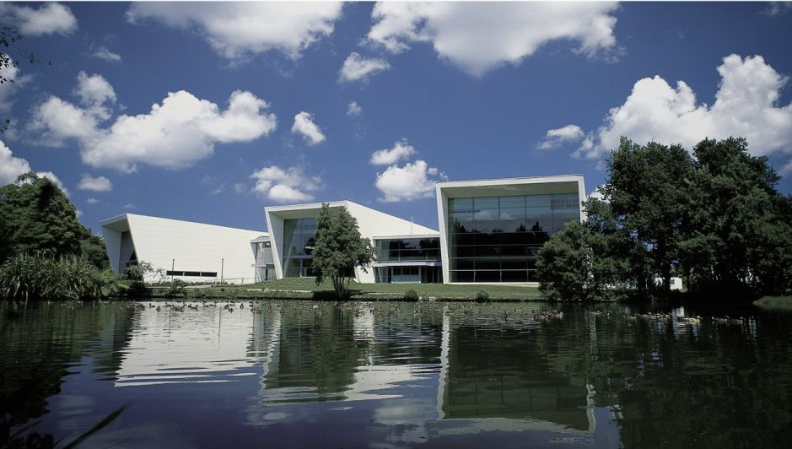
Data Stream Mining
Lesson 5
Bernhard Pfahringer
University of Waikato, New Zealand
1
Notes:
1

Slide 2
Overview
Regression
Pattern Mining
Preprocessing / Feature selection
Other open issues
Labels?
Sources
and even more ☺

Slide 3
Regression
Rather neglected area
Most approaches are adaptions of Classification Stream learners
Can simply adapt SGD for numeric loss, e.g.
Squared loss
Hinge loss
Huber loss

Slide 4
FIMT-DD [Ikonomovska etal 2011]
Fast Incremental Model Tree with Drift Detection
Split: minimize standard deviation of the target
Numeric attributes: full binary tree + internal pruning
Leave models: linear model SGD
Drift detection: Page-Hinkley in the nodes
Q-statistics based alternative branches
Also: Option-tree-based variant
State of the art

Slide 5
kNN
Simple, yet surprisingly effective, for regression (and classification)
Naturally incremental with a simple sliding window
Can be more sophisticated [Bifet etal ‘13]:
Keep some older data as well
Use Adwin to adapt window-size
Or use inside leveraged-bagging

Slide 6
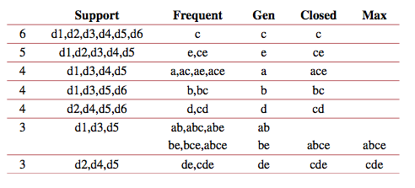
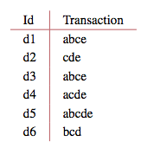
Pattern Mining

Slide 7
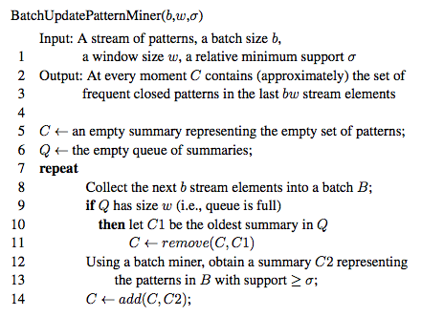
Generic batch-incremental approach

Slide 8
Various approaches
Use sketches to count frequencies (e.g. SpaceSaving)
Issue: memory
Issue: forgetting impossible
Moment [Chi etal ‘04] Mining Closed Itemsets Exactly over a Sliding Window
Uses a Closed Enumeration Tree with 4 types of nodes, complex update rules
FP-Stream [Gianella etal ‘02]
batch-incremental, FP-Tree based, using multiple levels of tilted-time windows
IncMiner [Quadrana etal ‘15]
More approximate, has false-negatives, but also much faster

Slide 9
Preprocessing
Somewhat neglected in stream mining
Fair amount of online PCA papers, but most assume i.i.d. data
Good discretization methods
Essential for application: 80/20

Slide 10
Trick question
Twins are born, about half an hour apart.
Legally speaking, the second-born is the older one.
Possible, or not?

Slide 11
Preprocessing lesson: use UTC
Time representation issues do happen in practise, e.g. smart meters …
Also, I once had a pre-paid hotel booking in Singapore:
Arrival date: 27 February 2000
Departure date: 2 March 2000
Duration: 3 nights
???

Slide 12
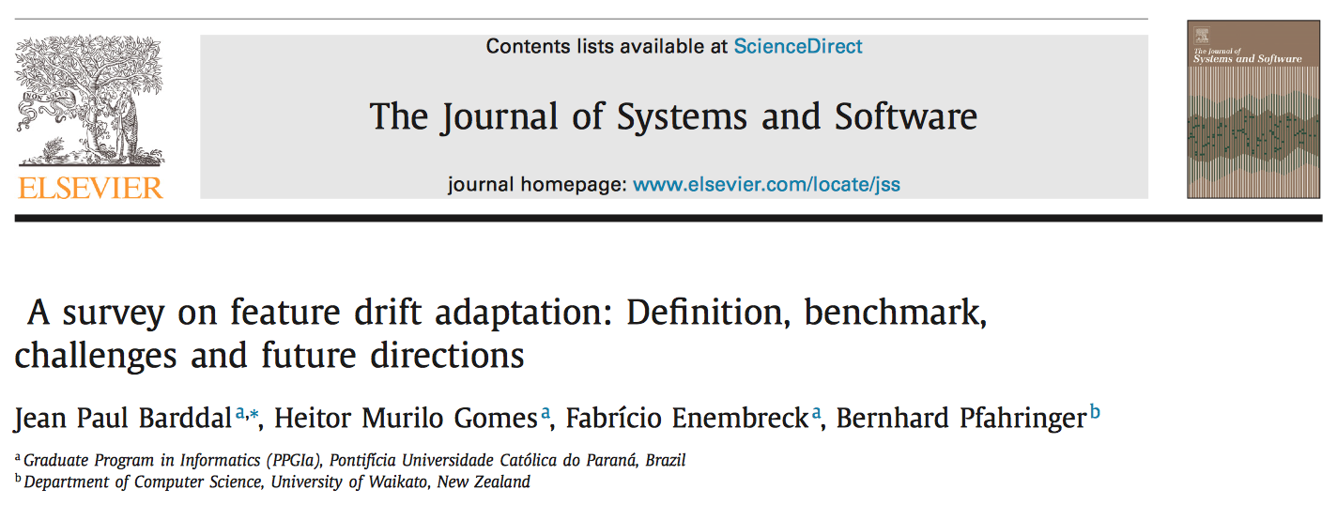
Feature Selection

Slide 13
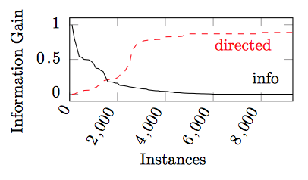
Feature Drift

Slide 14
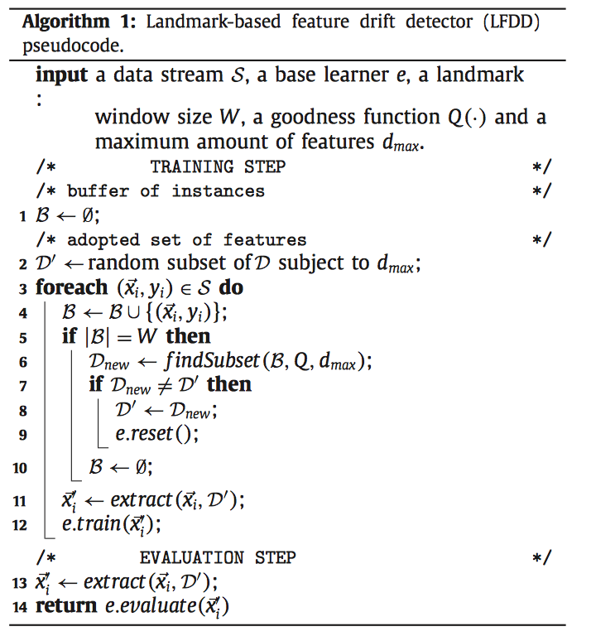
LFDD: landmark-based feature drift detector

Slide 15
Feature weighting as an alternative to selection
ECML2016 “On Dynamic Feature Weighting for Feature Drifting Data Streams” [Barddal etal]
Estimate feature weights based Symmetric Uncertainty (SU) [must discretize numeric features], over a sliding window
Modify NaiveBayes and Nearest Neighbour to use weighted features

Slide 16


Weighting formulas
KNN:
Naïve Bayes:
[w(.) is simply Symmetric Uncertainty]

Slide 17
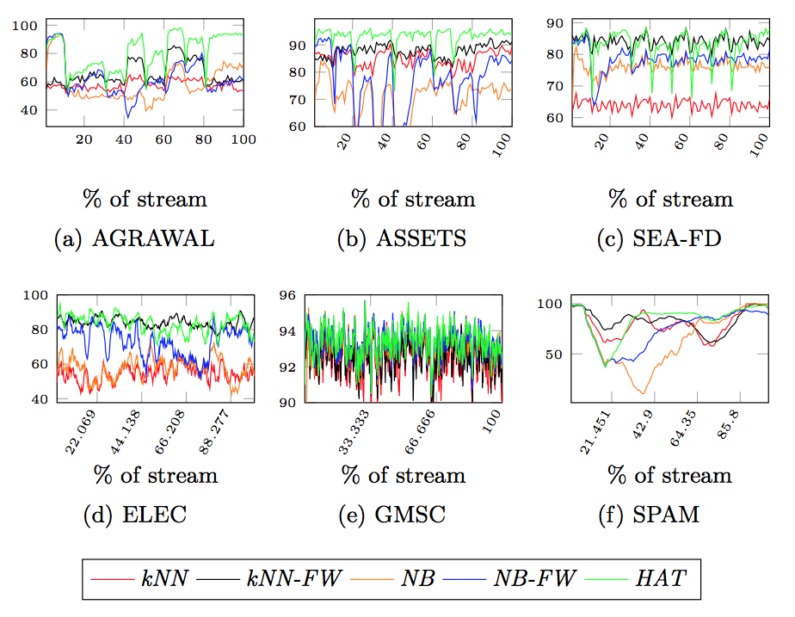
Feature weighting as an alternative to selection

Slide 18
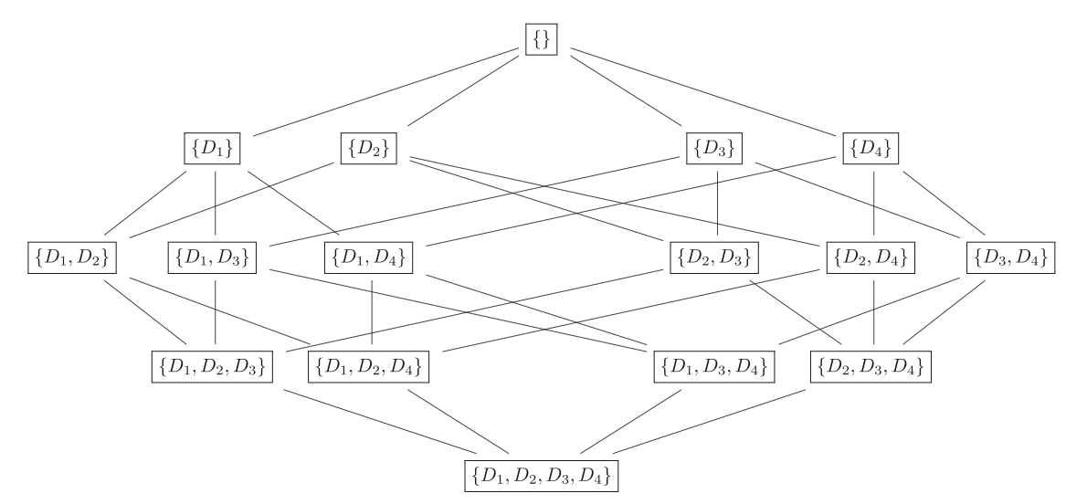
Can we do better? Online wrappers?
Time?

Slide 19
Heuristic: rank features, monitor some subsets
Ranking
D2
D3
D1
D4

Slide 20
Properties
Monitors only a linear number of subsets:
All one-feature ones
Exactly one subset of each size k > 1
Features are ranked by Symmetric Uncertainty
Must discretize numeric attributes, we use PID
Batch-incremental: updated after each window
Used inside online window-based kNN:
Euclidean distances can be updated incrementally
BUT: neighbors must be recomputed (can be sped up?)

Slide 21
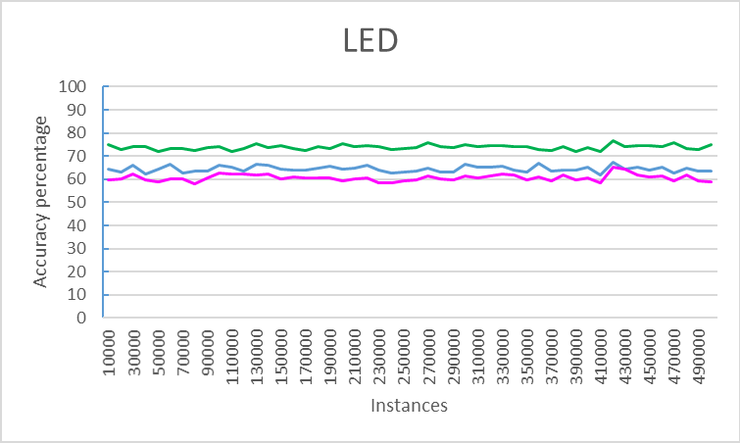
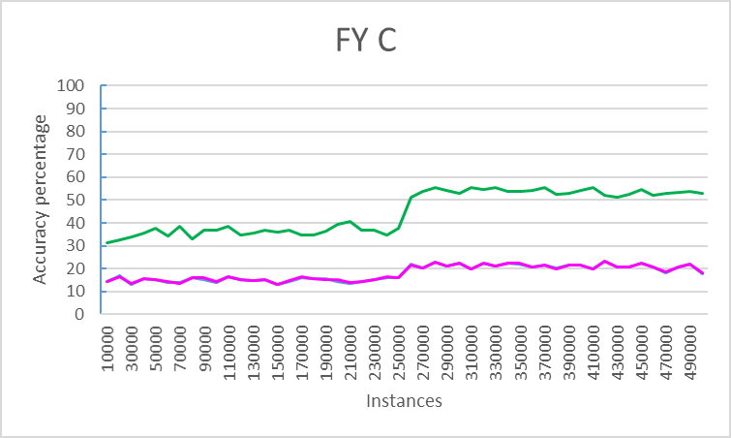
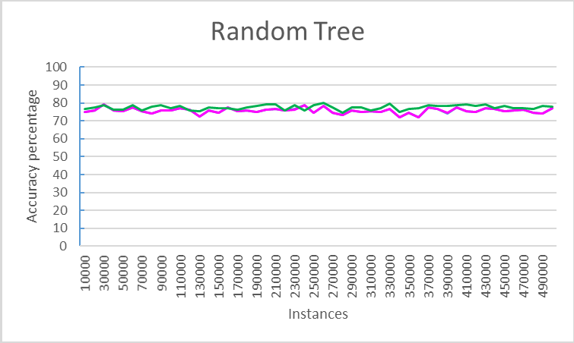
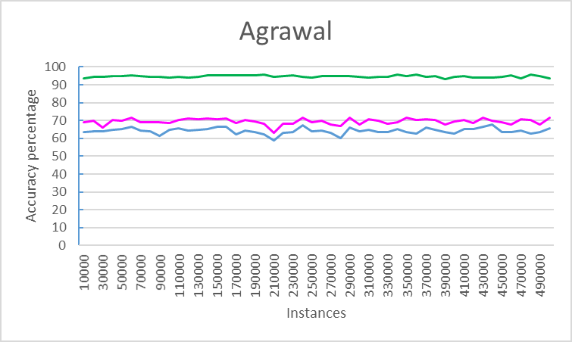

Performance [Yuan ’17 unpublished]

Slide 22
Labels? Which labels?
Might be delayed:
Predict the rainfall 1hour/1day ahead => receive true label 1hour/1day later
Might be expensive:
What is the polarity of a tweet?
Ground truth needs human: can never label all tweets
How long will this battery last:
Destructive testing can only use samples
House value/price:
Only some are sold per time unit
ONE solution: Active Learning, but …

Slide 23
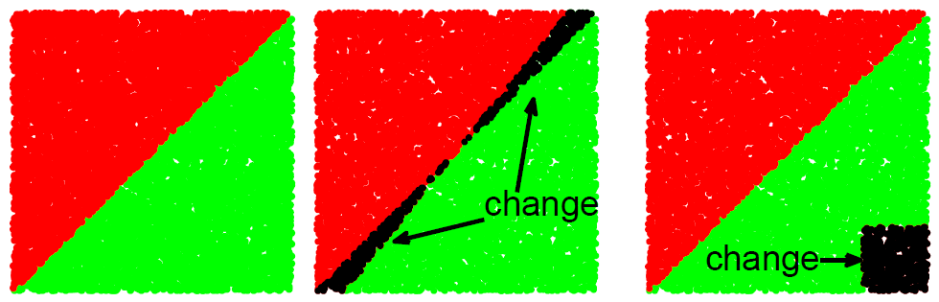
Changes can happen anywhere: may fool Uncertainty sampling
uncertainty ~ closeness to the decision boundary
changes happen in uncertain regions
changes happen in very certain regions
Notes:
23

Slide 24
Why use clustering / density?
Notes:
24

Slide 25
Why use clustering / density?
Notes:
25

Slide 26
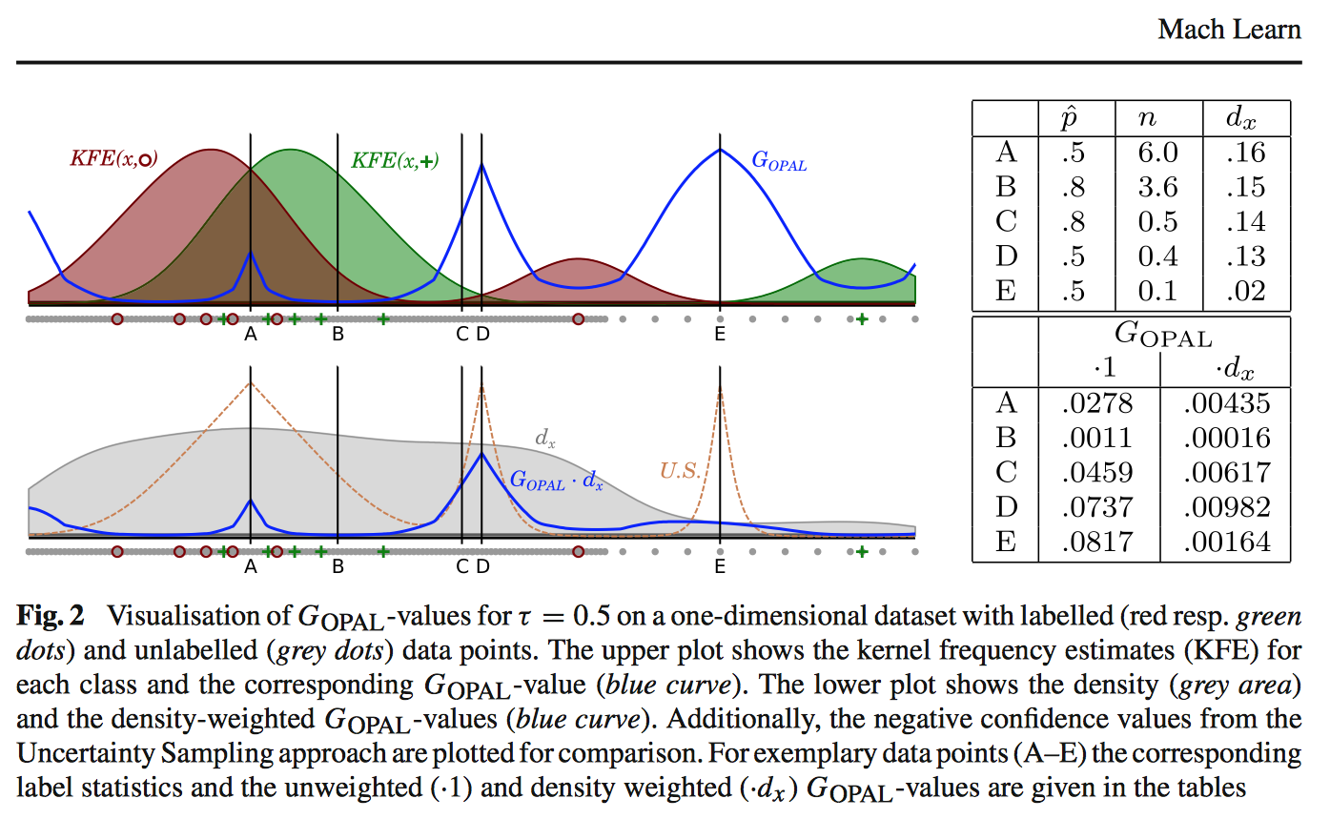
OPAL [Georg Krempl etal 2015]

Slide 27
Data sources
No easy access to real-world streams
Twitter: may collect, but not share ☹
Do we actually want/need “sets”, or
Publish/share sources instead?
Generators to the rescue

Slide 28
Other directions and angles
Distributed stream mining
Concept evolution, recurrent concepts
True real-time behaviour
Streams vs. Batch: could it be more of a continuum?
Streams & Deep Learning: is it feasible?

Slide 29
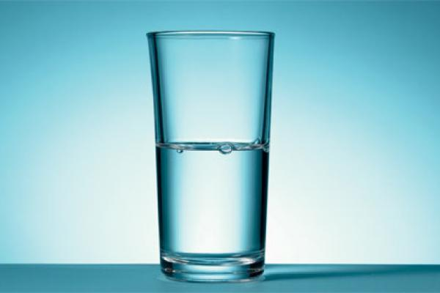
Stream mining summary
Stream mining = online learning without the IID assumption
Lots of missing bits => opportunity
Lots of space for cool R&D
THANK YOU!

Slide 30
Thank You, my co-authors
Ricard Gavaldà Albert Bifet Geoff Holmes
Eibe Frank Stefan Kramer Jesse Read Richard Kirkby Indre Zliobaite Mark A. Hall Felipe Bravo-Marquez Joaquin Vanschoren Quan Sun Timm Jansen Philipp Kranen Peter Reutemann Hardy Kremer Thomas Seidl Hendrik Blockeel Dino Ienco Kurt Driessens Grant Anderson Gerhard Widmer Mark Utting Ian H. Witten Johannes Fürnkranz Jan N. van Rijn Michael Mayo Stefan Mutter Samuel Sarjant Sripirakas Sakthithasan Tim Leathart Robert Trappl Claire Leschi Luís Torgo Madeleine Seeland Rita P. Ribeiro Christoph Helma Saso Dzeroski Michael de Groeve Russel Pears Min-Hsien Weng Boris Kompare Pascal Poncelet Tony Smith Paula Branco Wim Van Laer Jean Paul Barddal Fabrício Enembreck Roger Clayton Saif Mohammad Jochen Renz Gabi Schmidberger Johann Petrak Johannes Matiasek Ashraf M. Kibriya Christophe G. Giraud-Carrier John G. Cleary Wolfgang Heinz Xing Wu Klaus Kovar Gianmarco De Francisci Morales Leonard E. Trigg M. Hoberstorfer Heitor Murilo Gomes Maximilien Sauban Mi Li Michael J. Cree Henry Gouk Elizabeth Garner Hermann Kaindl Nils Weidmann Ernst Buchberger Hilan Bensusan Jörg Wicker Achim G. Hoffmann Andreas Hapfelmeier Christian Holzbaur Fabian Buchwald Remco R. Bouckaert Frankie Yuan

Slide 31
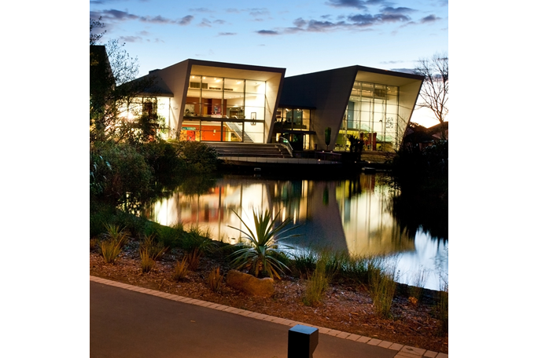
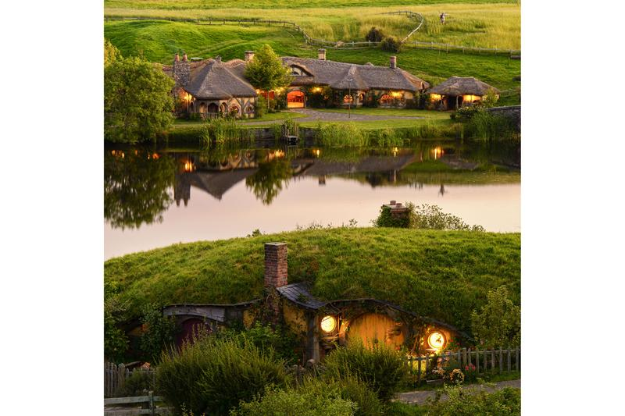
University of Waikato
Hamilton, New Zealand
http://www.waikato.ac.nz/research/scholarships/UoWDoctoralScholarship.shtml 31 Oct / 30 April
Research visits

