Slide 1
References
Uncanny valley and avatar perception
[1] Mori, M. The Uncanny Valley. Energy 7(4), 33-35, 1970.
[2] MacDorman, K.F., Ishiguro, H. The Uncanny Advantage of Using Androids in Cognitive and Social Science Research. Interaction Studies 7(3), 297-337, 2006.
[3] McDonnell, R., Breidt, M., Bulthoff, H.H. Render Me Real? ACM TOG 31(4), 2012.
[4] Dill, V. et al. Evaluation of the Uncanny Valley in CG Characters. IVA 2012, 511-513.
[5] Zell, E. et al. To Stylize or Not to Stylize? ACM TOG 34(6), 2015.
[6] Cihodaru-Stefanache, S., Podina, I.R. The Uncanny Valley Effect in Embodied Conversational Agents. Frontiers in Psychology 16, 2025.
[7] Zibrek, K., McDonnell, R. Social Presence and Place Illusion are Affected by Photorealism in Embodied VR. ACM MIG, 2019.
Trust and measurement
[8] Mayer, R.C., Davis, J.H., Schoorman, F.D. An Integrative Model of Organizational Trust. AMR 20(3), 709-734, 1995.
[9] Bartneck, C. et al. Measurement Instruments for Anthropomorphism, Animacy, Likeability... Int. J. Social Robotics 1(1), 71-81, 2009.
[10] Ho, C.-C., MacDorman, K.F. Revisiting the Uncanny Valley Theory. Computers in Human Behavior 26(6), 1508-1518, 2010.
[11] Canales, R., Roble, D., Neff, M. The Impact of Avatar Stylization on Trust. IEEE VR, 418-428, 2024.
[12] Dubosc, C. et al. Effect of Avatar Stylization and Facial Expression Intensity in Virtual Interactions. Virtual Reality 29(4), 2025.
[13] Gao, Y. et al. Trust in Virtual Agents. IEEE TVCG 31(5), 3623-3633, 2025.
[14] Tao, Z. et al. Impact of Virtual Avatar Appearance Realism. Frontiers in Psychology 16, 2025.
[15] Alipour, A., Hartmann, T., Alimardani, M. Would You Rely on an Eerie Agent? Computers in Human Behavior Reports 23, 2026.
[16] Demsar, J. Statistical Comparisons of Classifiers over Multiple Data Sets. JMLR 7, 1-30, 2006.
Non-photorealistic rendering
[17] Lake, A. et al. Stylized Rendering Techniques for Scalable Real-Time 3D Animation. NPAR, 13-20, 2000.
[18] Barla, P., Thollot, J., Markosian, L. X-Toon: An Extended Toon Shader. NPAR, 127-132, 2006.
[19] Raskar, R., Cohen, M. Image Precision Silhouette Edges. I3D, 135-140, 1999.
[20] Isenberg, T. et al. A Developer's Guide to Silhouette Algorithms for Polygonal Models. IEEE CG&A 23(4), 28-37, 2003.
[21] Marr, D., Hildreth, E. Theory of Edge Detection. Proc. R. Soc. B 207(1167), 187-217, 1980.
[22] Gonzalez, R.C., Woods, R.E. Digital Image Processing. Pearson, 2018.
[23] Kyprianidis, J.E., Kang, H., Dollner, J. Image and Video Abstraction by Anisotropic Kuwahara Filtering. CGF 28(7), 1955-1963, 2009.
[24] Lino Roshaan, M.K. AHEAD: Adaptive Hierarchical Edge Detection for Real-Time Artistic Stylization, 2026.
Abstraction Mechanisms for Virtual Avatars

Slide 2
Media credits
Video, slide 2
Figures
Mark Zuckerberg: First Interview in the Metaverse, Lex Fridman Podcast #398. YouTube.
youtube.com/watch?v=MVYrJJNdrEg
Avaturn: Realistic 3D Avatars for Gaming from Photo. YouTube.
youtube.com/watch?v=rSb0Io92_R8
How Apple Vision Pro's New Spatial Persona Changes Everything. YouTube, 11 April 2024.
youtube.com/watch?v=H3PB2zA6Q-c
Slide 3, uncanny valley curve: after Mori, reference [1].
Slides 4 and 5, figures and named results: references [1] to [24].
Slides 9, 10 and 13 to 20, and all backup slides: own work. Renders from the Unity project, plots from the study data.
Avatars: Avaturn, Meta Avatars SDK and Mixamo, used under their respective terms.
Logo: University of Konstanz.
Excerpts shown for scholarly illustration under the German right of quotation, section 51 UrhG.
Abstraction Mechanisms for Virtual Avatars

Slide 3
Backup
Supporting Material

Slide 4
Visual quality assessment of all eight techniques
Technique | Facial | Temporal | Artefacts | Abstraction | Candidate
V1 Outline | yes | yes | after tuning | not alone | yes
V2 Toon | yes | yes | yes | no interior lines | -
V2.2 X-Toon | yes | yes | yes | manual mode chosen | yes
V3 Normal edge | landmarks missed | yes | yes | yes | -
V4 Sobel | after tuning | after tuning | after preprocessing | yes | yes
V4.2 Gauss Sobel | no gain over V4 | after tuning | yes | yes | -
V5 Hierarchical | segments unclear | yes | nose bridge artefact | yes | yes
V6 Kuwahara | fails at large radius | yes | yes | yes | yes
Five of the eight became candidates for the composite. The parameter adjustment study then removed V5 and V6, leaving V1, V2.2 and V4.
Abstraction Mechanisms for Virtual Avatars

Slide 5
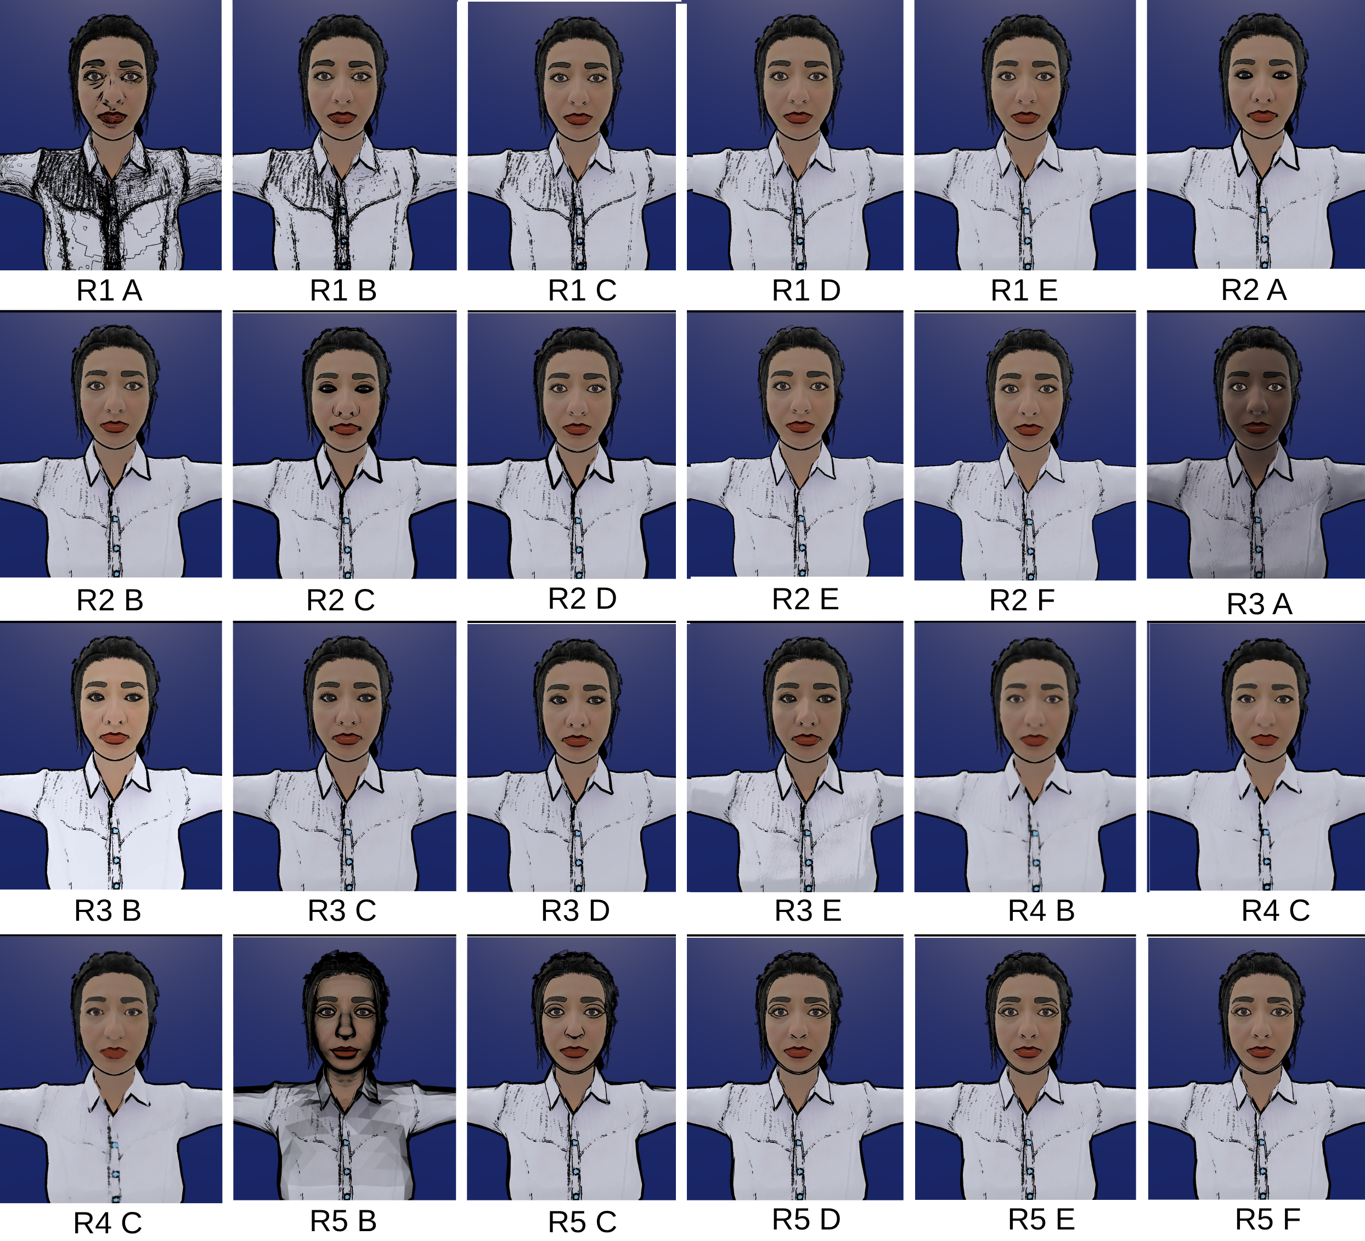
All variants shown in the parameter adjustment study
Abstraction Mechanisms for Virtual Avatars

Slide 6
Final composite parameters
Parameter | Value | Source
Outline width | 0.003 | R2 Borda winner
Depth offset | On | R2 Borda winner
Inner line threshold | 0.05 | R1 appeal tiebreaker
Shadow strength | 0.0 | R3 appeal tiebreaker
Detail bias | 0.5 | R3 appeal tiebreaker
Kuwahara filter | Off | R4 excluded (p = .003)
Hierarchical layer | Off | R5 excluded (p < .001)
Three of the seven values came from a separate visual appeal question, since no configuration in those rounds was statistically ahead of its runner-up.
Abstraction Mechanisms for Virtual Avatars

Slide 7
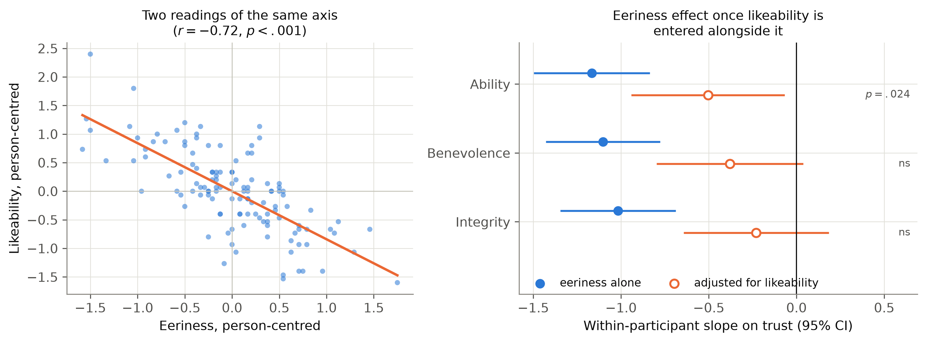
Eeriness against likeability
Within participants the two correlate at r = -.72, sharing 52% of their variance. Entering both in one model absorbs most of the eeriness effect: it survives on ability (b = -0.50, p = .024) but not benevolence (p = .075) or integrity (p = .273), while likeability holds on all three.
Abstraction Mechanisms for Virtual Avatars

Slide 8
Full statistics table
Subscale | Omnibus | C1 vs C2 | C1 vs C3 | C2 vs C3
Likeability | F(2,80)=26.85, p<.001, eta2p=.40 | p<.001, g=0.92 | p<.001, g=1.02 | p=.54, g=0.08
Eeriness | F(2,80)=20.39, p<.001, eta2p=.34 | p<.001, g=0.98 | p<.001, g=0.98 | p=.66, g=0.07
Ability | F(2,80)=10.91, p<.001, eta2p=.21 | p=.004, g=0.53 | p<.001, g=0.75 | p=.21, g=0.20
Benevolence | F(2,80)=14.31, p<.001, eta2p=.26 | p<.001, g=0.59 | p<.001, g=0.79 | p=.18, g=0.19
Integrity | F(2,80)=12.47, p<.001, eta2p=.24 | p=.001, g=0.66 | p<.001, g=0.80 | p=.27, g=0.16
Subscale | Position F(2,80) | p | Version F(2,38) | p
Likeability | 3.04 | .054 | 7.07 | .002
Eeriness | 2.47 | .091 | 5.57 | .008
Ability | 1.32 | .274 | 1.23 | .304
Benevolence | 2.10 | .130 | 1.26 | .296
Integrity | 1.72 | .186 | 2.04 | .144
Intraclass correlations, H3
Eeriness models: .48 to .57. Likeability models: .57 to .63.
Half or more of the variance in each trust subscale sits between participants rather than within them, which is consistent with large individual differences in general trustingness.
Abstraction Mechanisms for Virtual Avatars

