Slide 1
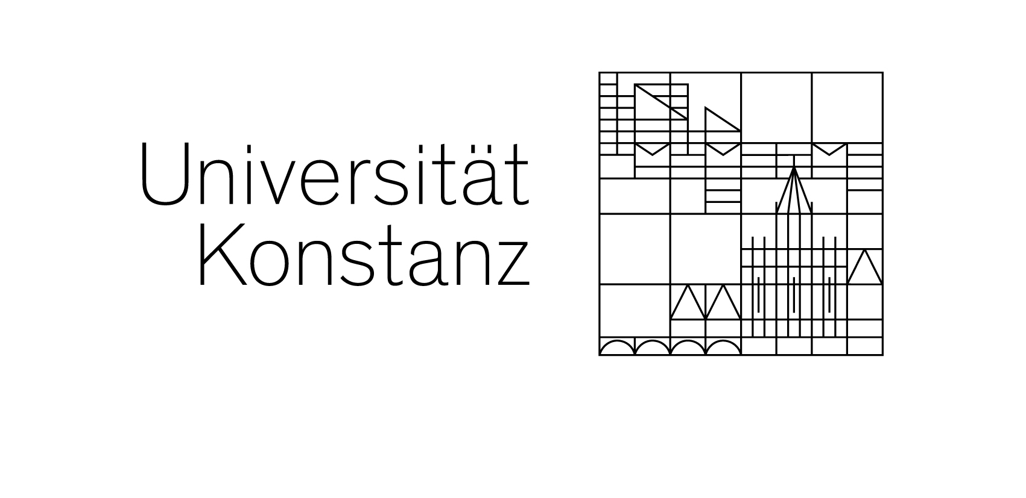
Abstraction Mechanisms for Virtual Avatars
NPR across Avatar Platforms and its Effect on Perceived Trust
Nidanur Gunay
Master's Thesis Defense
First reviewer: Prof. Dr. Oliver Deussen
Second reviewer: Prof. Dr. Tiare Feuchtner
University of Konstanz, 2026

Slide 2
Motivation
Already part of our daily lives, through VR and generative AI
Virtual avatars in everyday use
13 seconds
They present, they teach, they advise and they sell. How they are drawn decides how much we believe them.
Clips: Lex Fridman Podcast #398 · Avaturn · Apple Vision Pro Spatial Persona (YouTube). Full credits at the end.
Nidanur Gunay | Abstraction Mechanisms for Virtual Avatars
2

Slide 3
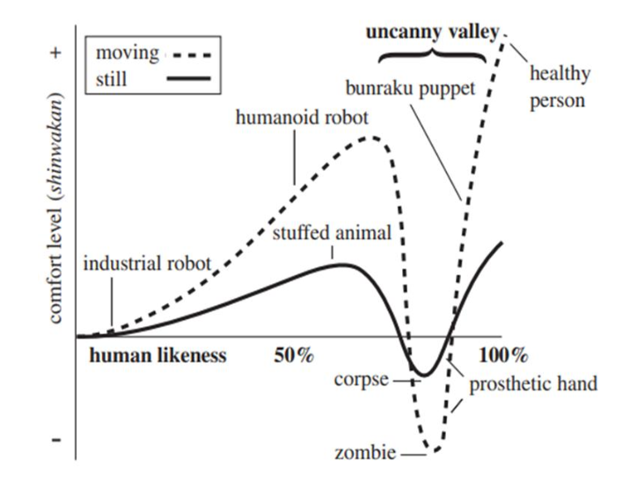
Problem statement
More human likeness is not always better
• Comfort rises with human likeness, but only up to a point
• Almost human, not quite: creepy instead
• That dip: the uncanny valley (Mori, humanoid robots)
• Later confirmed for CG characters
The uncanny valley (Mori, 1970)
Nidanur Gunay | Abstraction Mechanisms for Virtual Avatars
3

Slide 4
What this builds on
The problem is documented, the operators exist, the trust evidence disagrees
The valley reaches avatars
Mori proposed the curve, MacDorman & Ishiguro measured it.
McDonnell et al.: ten render styles, appeal and trust lowest in the middle. Both ends are viable.
Dill et al.: it holds for CG film and game characters, worst at eyes and mouth.
Zell et al.: material governs eeriness, and a mismatch with shape makes it worse.
NPR supplies the operators
Toon shading (Lake), X-Toon (Barla et al.), inverted hull silhouette (Raskar & Cohen), feature lines (Isenberg et al.).
Sobel and Gaussian prefiltering (Gonzalez & Woods, Marr & Hildreth), anisotropic Kuwahara (Kyprianidis et al.), layered edges (AHEAD).
All built on images and generic shapes. Avatar studies varied coarse style levels, not named operators.
The trust evidence disagrees
Canales et al.: no trust penalty for stylisation, semi-realistic won the behavioural choice.
Dubosc et al.: stylised avatars rated significantly less eerie in VR.
Tao et al., meta-analysis: high realism rated more trustworthy.
Alipour et al., 53 studies: the eeriness-to-trust link is inconsistent.
Gao et al.: a real speaker beat a stylised agent on all three trust dimensions.
Three gaps follow, and they are the three research questions. (1) Nobody has built one technique set across production avatar platforms that differ in rendering architecture. (2) Which operator balances abstraction against facial legibility is unstudied. (3) No study sets a real speaker, a photorealistic avatar of that speaker and an NPR version of that same avatar against one another.
Nidanur Gunay | Abstraction Mechanisms for Virtual Avatars
4

Slide 5
Research questions
RQ1 Technical transfer
How can NPR techniques be adapted to avatar platforms with different rendering architectures, and what does each platform allow or forbid?
RQ2 Technique selection
Which technique or combination best balances visual abstraction against facial legibility?
RQ3 Perception
How does NPR stylisation affect perceived eeriness and trustworthiness, and can a stylised avatar reach a photorealistic avatar and a real human speaker?
RQ1 and RQ2 are answered by the system. RQ3 is answered by the user study, which is where this talk spends most of its time.
Nidanur Gunay | Abstraction Mechanisms for Virtual Avatars
5

Slide 6
What was built
Eight techniques, three platforms, one shader system
Version | Limitation it answers
V1 Silhouette outline | no shape cue at all
V2 Toon shading | continuous, unreadable lighting
V2.2 X-Toon | no control over abstraction level
V3 Normal edges | no interior structure
V4 Sobel | misses colour boundaries
V4.2 Gaussian Sobel | Sobel is noisy on photo texture
V5 Hierarchical | one cue is not enough
V6 Kuwahara | edges only, no painterly surface
Platform | Access
Mixamo | full
Avaturn | full, photo texture
Meta SDK | one fragment hook
Environment
Unity 2022.3 LTS, URP.
Meta Quest 3 target.
No extra render passes on the SDK.
Each version was motivated by a concrete failure of the one before it. All are switchable at runtime, without recompiling.
Nidanur Gunay | Abstraction Mechanisms for Virtual Avatars
6

Slide 7
RQ1 answer
What transfers between pipelines, and what does not
Transfers with retuning
Every technique ran on all three platforms.
Identical parameter values produced visibly different output per host.
The dividing line
Not the technique's complexity, but whether it needs new parameter values or a new input signal.
New values: always possible.
New signal: only where the pipeline is open.
Needs a substitute signal
Meta SDK gives one fragment hook, no depth or normal buffer, no second pass.
Hierarchical layer: camera-distance derivative instead of a depth texture.
Kuwahara: loses its Gaussian smoothing entirely.
Avaturn was chosen for the study because it is the only platform with all three of: open URP shader access, full blendshape animation, and a photorealistic face rebuilt from photos of the real speaker.
Nidanur Gunay | Abstraction Mechanisms for Virtual Avatars
7

Slide 8
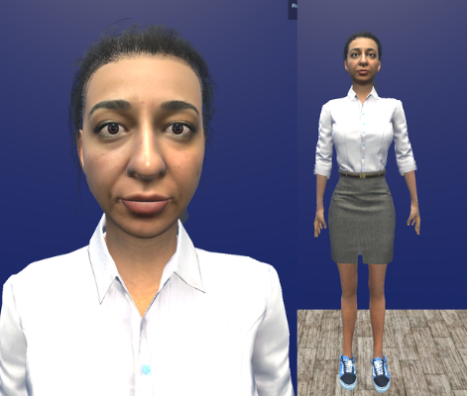
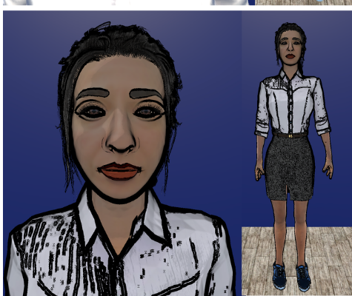
The stimulus
Same person, same animation, same voice
C1 - Real
C2 - Photorealistic
C3 - NPR
Video of the human speaker.
Ground-truth reference.
The Avaturn avatar was reconstructed from photographs of this same person.
Standard PBR, unmodified texture
Outline + X-Toon + Sobel, preprocessed head texture
Takeaway. C2 and C3 share identity, geometry, animation and voice. Only the rendering changes. That is the critical comparison.
Nidanur Gunay | Abstraction Mechanisms for Virtual Avatars
8

Slide 9
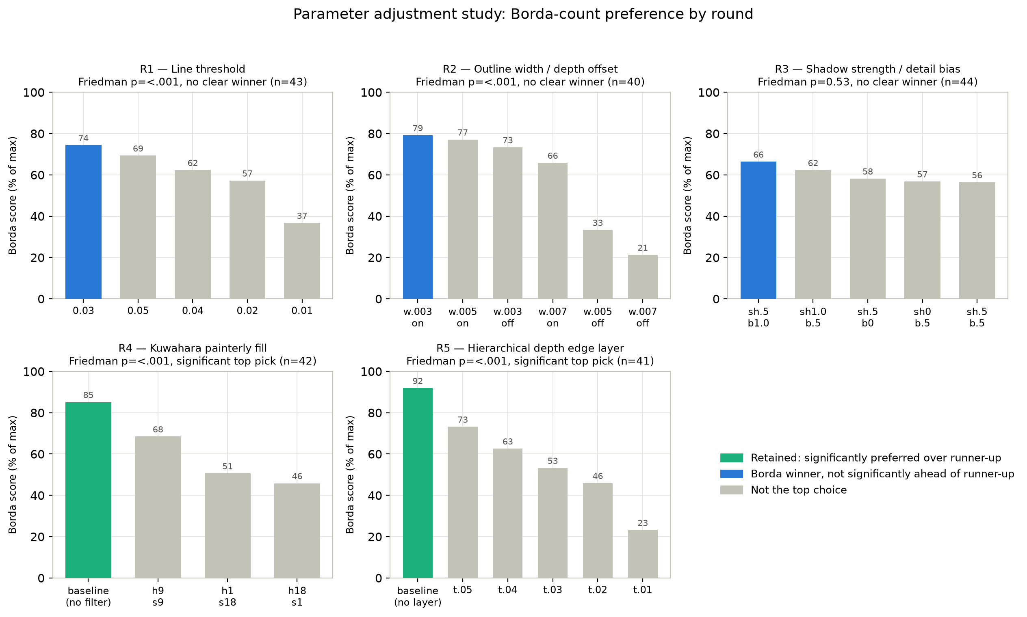
Parameter adjustment study
The composite was chosen by people, not by eye
Design. 45 participants ranked rendered variants by perceived trustworthiness. Five rounds, one parameter group each. Borda count, Friedman omnibus, Wilcoxon on the top pair.
Round | Winner | Significant?
R1 inner threshold | 0.03 | no (p = .31)
R2 outline width | 0.003 | no (p = .82)
R3 shadow / bias | 0.5 / 1.0 | no (p = .53)
R4 Kuwahara | none | yes (p = .003)
R5 Hierarchical | none | yes (p < .001)
R1 and R3 were settled by a separate visual appeal question.
Takeaway. Participants significantly preferred no post-processing. Kuwahara and the hierarchical layer were both removed. RQ2's answer is a three-part composite plus head texture preprocessing.
Nidanur Gunay | Abstraction Mechanisms for Virtual Avatars
9

Slide 10
Main user study
Within-subjects, video based
Task. Read a decision vignette, watch an advisor recommend one option, then rate the advisor. Three times, once per condition.
Scenarios. Career choice, travel route, learning resource. Each targets a different trust dimension. Recommended option and discussion order alternate.
Counterbalancing. 3 x 3 Latin square, three study versions.
Sample. 52 enrolled, 11 excluded on gating checks, n = 41 complete. Age M = 27.6 (SD = 5.4); 23 women, 17 men, 1 non-binary.
Measures per video block
Subscale | Source | alpha
Likeability | Godspeed | .94
Eeriness | Ho & MacDorman | .87
Ability | Mayer et al. | .96
Benevolence | Mayer et al. | .95
Integrity | Mayer et al. | .92
After all three blocks
Forced ranking: who would you consult, who is most trustworthy, who is least unsettling.
All subscales exceeded alpha = .70 overall and within every condition.
Nidanur Gunay | Abstraction Mechanisms for Virtual Avatars
10

Slide 11
Four hypotheses
 | Prediction | Test
H1 | NPR (C3) is rated less eerie than the photorealistic avatar (C2). | RM-ANOVA, Holm pairwise
H2 | NPR (C3) does not cost trust relative to C2. | Pairwise plus TOST equivalence, d = 0.3 bound
H3 | Eeriness lowers trust and likeability raises it, within each participant. | Person-centred multilevel regression
H4 | NPR (C3) does not cost trust relative to the real speaker (C1). | Same as H2, against C1
H2 and H4 predict a null. A non-significant p is not evidence of equivalence, so both also carry a pre-specified TOST equivalence test.
Nidanur Gunay | Abstraction Mechanisms for Virtual Avatars
11

Slide 12
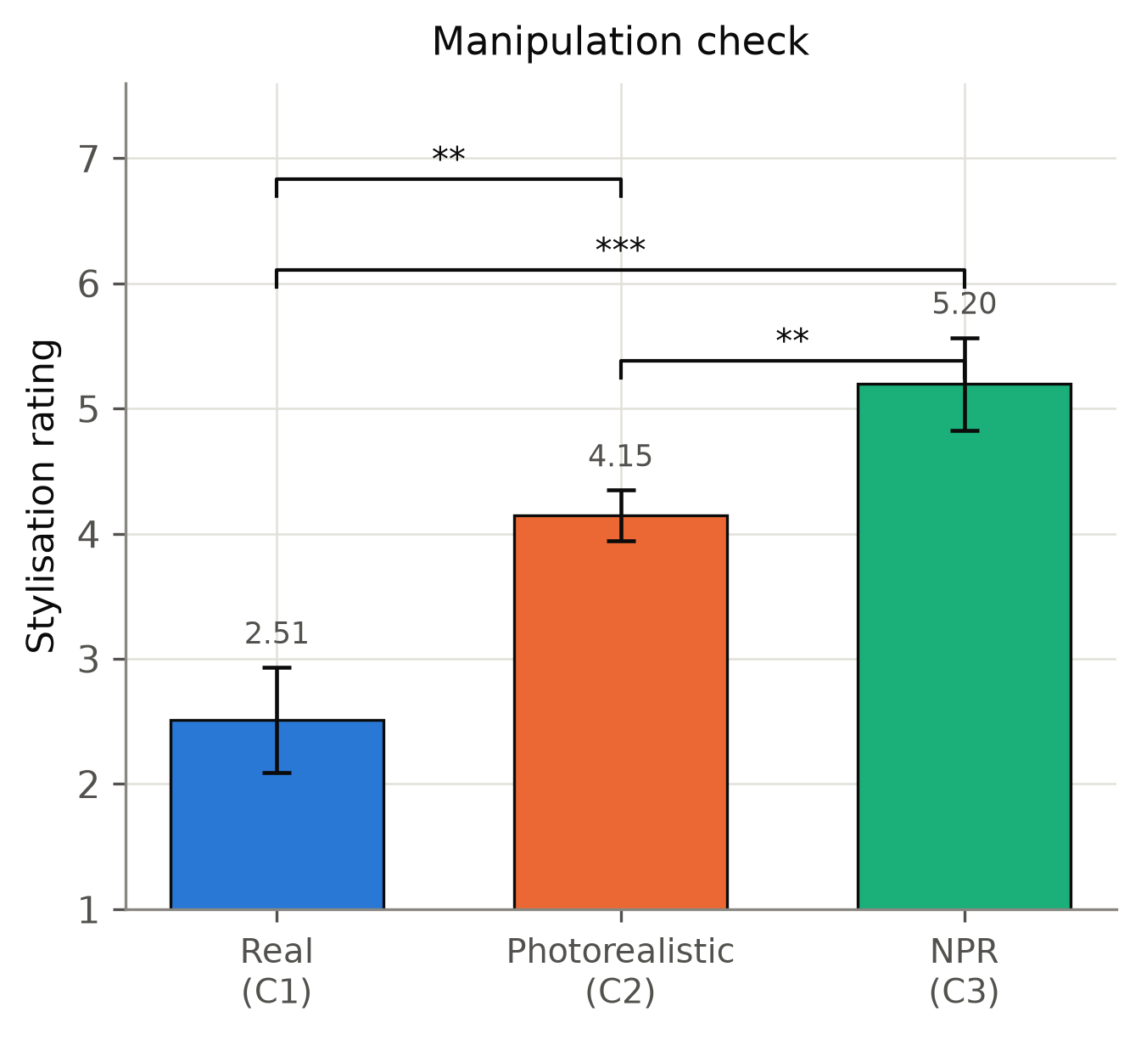
Manipulation check
Did participants actually see a difference?
Part H asked how stylised each advisor looked, from 1 (completely realistic) to 7 (very stylised).
Omnibus | F(2,80) = 15.45, p < .001, eta2p = .28
C1 vs C2 | p = .001, g = 0.87
C1 vs C3 | p < .001, g = 1.23
C2 vs C3 | p = .004, g = 0.55
Ratings rise monotonically from Real to Photorealistic to NPR. All three conditions separate.
Takeaway. The manipulation worked. No null result below can be blamed on participants not noticing the rendering.
Nidanur Gunay | Abstraction Mechanisms for Virtual Avatars
12

Slide 13
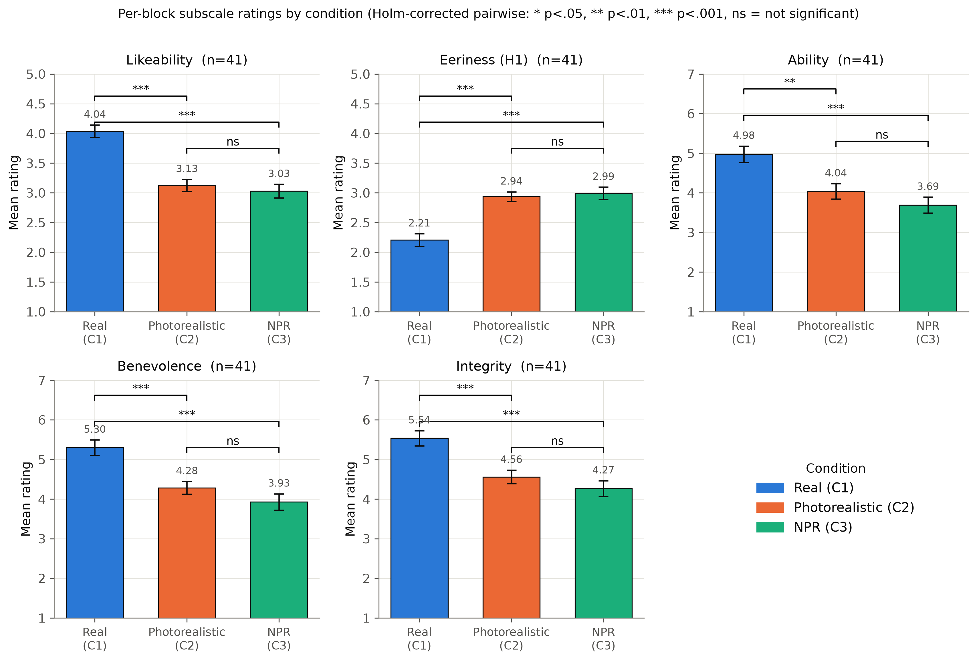
All five subscales at once
The real speaker separates from both avatars on every subscale.
The two avatars separate from each other on none of them.
Nidanur Gunay | Abstraction Mechanisms for Virtual Avatars
13

Slide 14
H1 - Does NPR reduce eeriness?
Eeriness | C1 vs C2 | C1 vs C3 | C2 vs C3
p | < .001 | < .001 | .66
g | 0.98 | 0.98 | 0.07
H1 NOT SUPPORTED
Omnibus: F(2,80) = 20.39, p < .001, eta2p = .34
Participants saw the stylisation, as the manipulation check confirmed. They just did not find it less eerie.
Stylisation and eeriness turn out to be separate effects here.
• Eeriness rose from C1 to C2 to C3, the opposite of the prediction.
• The real speaker differed from both avatars.
• The two avatars were statistically indistinguishable. Effect size g = 0.07 is essentially zero.
Nidanur Gunay | Abstraction Mechanisms for Virtual Avatars
14

Slide 15
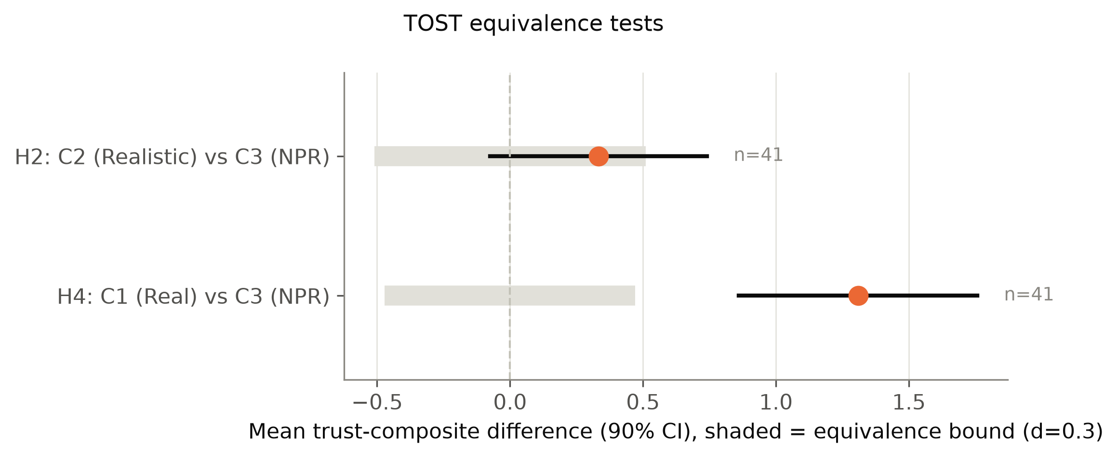
H2 - Does NPR cost trust against the photorealistic avatar?
Step 1. Pairwise comparisons, C2 vs C3
 | p | g
Ability | .21 | 0.20
Benevolence | .18 | 0.19
Integrity | .27 | 0.16
Step 2. TOST equivalence, trust composite
 | Diff. | Bound | TOST p
C2 vs C3 | 0.33 | +/- 0.51 | .240
Realised power near 0.20 at n = 41.
H2 INCONCLUSIVE
No difference detected, but equivalence not established either. Roughly three times the sample is needed to separate the two.
Nidanur Gunay | Abstraction Mechanisms for Virtual Avatars
15

Slide 16
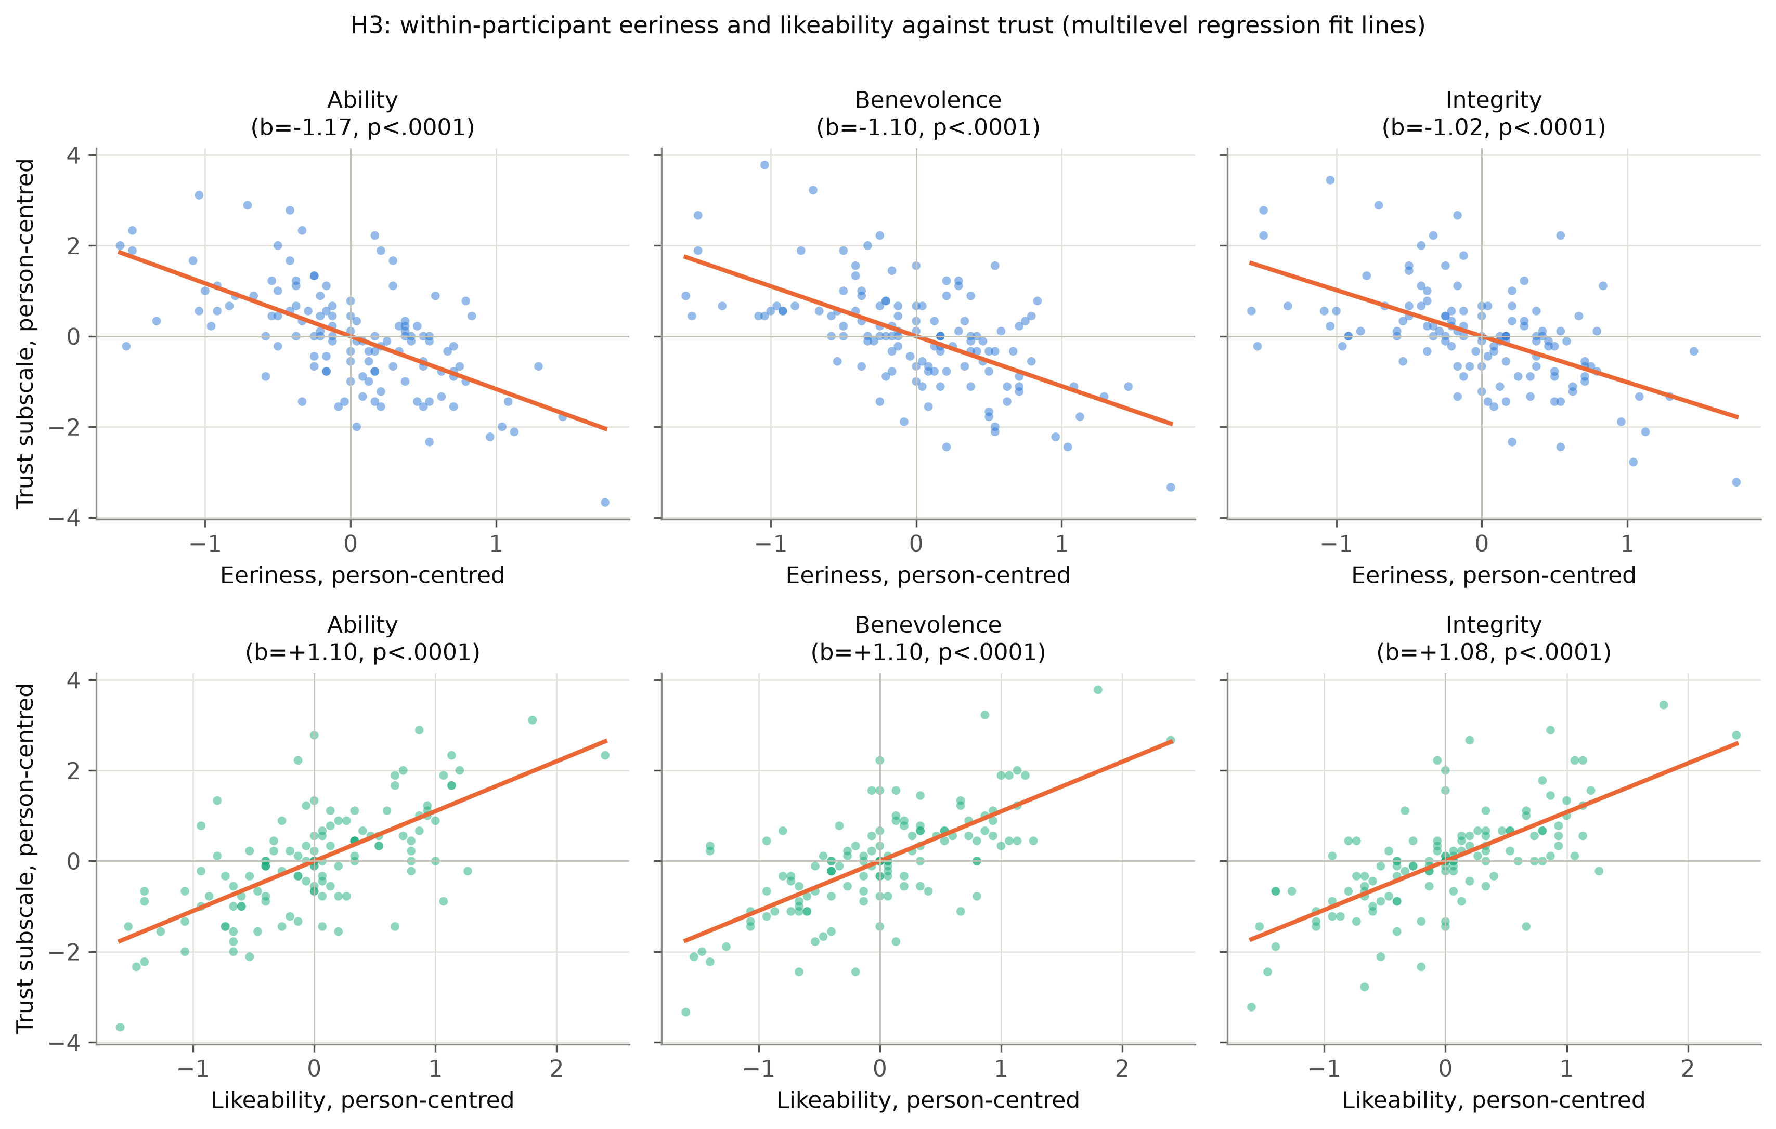
H3 - Eeriness, likeability and trust
 | Eeriness | Likeability
Ability | -1.17 | +1.10
Benevolence | -1.10 | +1.10
Integrity | -1.02 | +1.08
Fixed-effect slopes, all p < .001
H3 CONFIRMED
One point more eeriness costs about one point of trust, on every dimension. Likeability lifts it by the same amount.
Caveat: the two correlate at r = -.72 within participants and cannot be separated cleanly here.
Takeaway. The route from appearance to trust is open. The composite never travelled it.
Nidanur Gunay | Abstraction Mechanisms for Virtual Avatars
16

Slide 17
H4 - Does NPR reach the real human speaker?
Pairwise, C1 vs C3. Ability, benevolence and integrity were all significantly higher for the real speaker (p < .001, g = 0.75 to 0.80).
H4 NOT SUPPORTED
TOST equivalence, trust composite
Two explanations stay open
1. The uncanny valley predicts exactly this gap.
2. Some participants may have recognised the speaker, who is the researcher.
This design cannot separate them.
 | Diff. | Bound | TOST p
C1 vs C3 | 1.31 | +/- 0.47 | .998
The difference is nearly three times the equivalence bound. This is not a marginal shortfall.
Nidanur Gunay | Abstraction Mechanisms for Virtual Avatars
17

Slide 18
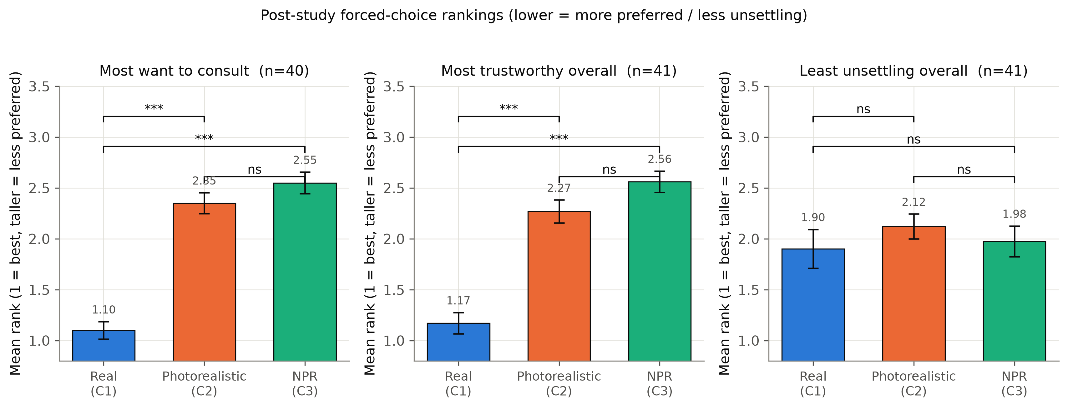
The behavioural measure
Forced ranking after all three videos
Question | Friedman | C1 vs C2/C3 | C2 vs C3
Most want to consult | chi2(2) = 49.40, p < .001 | p < .001 | p = .21
Most trustworthy | chi2(2) = 44.05, p < .001 | p < .001 | p = .07
Least unsettling | chi2(2) = 1.02, p = .60 | p = .97 | p = .97
Canales et al. found ratings and behaviour diverge. Here they converged. C3 attracted no more behavioural endorsement than C2.
Nidanur Gunay | Abstraction Mechanisms for Virtual Avatars
18

Slide 19
Robustness checks
Three ways the null could have been an artefact, and was not
Order effects
Video position had no significant effect on any subscale. Likeability came closest at p = .054.
Study version groups differed on likeability and eeriness, but on no trust subscale. That comparison is between subjects.
Suspicion
24 of 41 named realism, stylisation or trust when asked what the study was about.
Re-running H1 and H2 on the remaining 17 did not change the pattern.
Participants answered on their own impressions, not on a guessed hypothesis.
Secondary measures
Agreement with the recommendation did not differ by condition, F(2,80) = 2.10, p = .13.
Dispositional trust did not predict the trust composite, r(39) = -.10, p = .52.
Preference shift was rare everywhere: 4, 5 and 1 of 41.
Nidanur Gunay | Abstraction Mechanisms for Virtual Avatars
19

Slide 20
Discussion
Two patterns that need explaining
Pattern 1
The real speaker sits far above both avatars, on every subscale and both significant rankings.
Pattern 2
The two avatars looked different to participants, yet scored identically on everything that mattered.
And one constraint on any explanation:
Eeriness and likeability did predict trust (H3). The road was open.
The composite changed what people saw without travelling it.
Nidanur Gunay | Abstraction Mechanisms for Virtual Avatars
20

Slide 21
Why eeriness did not fall
Two mismatches inside the composite
1. Material versus shape
The composite stylises the material and leaves the shape untouched.
Zell et al.: material drives eeriness, so this should have helped.
But the same work reports eeriness rises when material and shape disagree in stylisation level.
C3 is exactly that case: a stylised surface on a photogrammetric face.
The abstraction may have removed one source of eeriness while adding another.
2. Appearance versus performance
Both avatars inherit the same recorded human voice, gaze and lip animation.
C3 therefore pairs a fully human performance with a visibly abstracted face.
Cihodaru-Stefanache & Podina: uncanniness arises from features perceived at inconsistent levels of anthropomorphism.
A shading operator changes appearance only. It could only widen that gap.
Nidanur Gunay | Abstraction Mechanisms for Virtual Avatars
21

Slide 22
Three more explanations on the table
The comparison set
Once a real person anchors the top of the scale, the only judgement left is how far below.
Both avatars were recognisably CG. A rendering difference competes against a categorical one.
C3 followed C1 directly in two versions of three. C2 never did.
Generative AI expectations
One participant asked afterwards which AI system generated the videos.
Nothing in the materials ruled that reading out.
Scepticism towards machine-made media depresses both avatars equally.
The video setting
Flat screen, prerecorded, no interaction, no shared space.
Zibrek et al. found render style significantly moved presence in VR.
What is too weak in a browser window may register once the avatar shares your room.
Nidanur Gunay | Abstraction Mechanisms for Virtual Avatars
22

Slide 23
Limitations
Session length
Both studies had to fit 10 to 15 minutes, and every measure was repeated three times. That capped how many measures and conditions were affordable.
Sample size
The submission deadline set the collection window, which fell in the semester break. n = 41 met the power requirement for detecting a difference, not the far larger one equivalence demands.
One configuration only
One composite, one avatar identity, one platform, three scenarios. The findings describe this configuration, not NPR as a category.
Counterbalancing
Three conditions need six orders for a full design. That needs roughly twice the sample, so three orders were used.
Nidanur Gunay | Abstraction Mechanisms for Virtual Avatars
23

Slide 24
Conclusion
What the three questions ended up answering
RQ1 Adaptation across platforms
All eight techniques ran on all three platforms. The dividing line is whether an operator needs new parameter values, which is always possible, or a new input signal, which only an open pipeline provides.
RQ2 Best balance of abstraction and legibility
No technique reached it by rendering alone on a photogrammetric avatar. The answer is a three-part composite, outline plus X-Toon plus Sobel, paired with head texture preprocessing.
RQ3 Effect on eeriness and trust
H1 not supported, H2 inconclusive, H3 confirmed, H4 not supported. The composite did not lower eeriness, and it also carried no observed trust penalty.
A developer choosing the stylised version need not assume a disadvantage.
The real distance is not between two render styles. It is to the actual human.
Nidanur Gunay | Abstraction Mechanisms for Virtual Avatars
24

Slide 25
Future work
Settle the open question
Repeat C2 versus C3 with roughly 120 participants. Inside the bound confirms no trust cost, outside exposes one too small to see here.
Replace the point with a curve
Sweep abstraction strength continuously instead of testing one setting. That traces how eeriness and trust move together and can reveal an optimum between the extremes.
Test the competing explanations
Extend abstraction to the geometry, not just the material.
Drop the real speaker and let the two avatars be compared alone.
State up front that the videos are not AI-generated.
Restore what video removed
Interaction and shared space, in VR.
Widen the sample of avatars
Multiple identities and platforms, to separate a general effect from one specific to this face.
Nidanur Gunay | Abstraction Mechanisms for Virtual Avatars
25

Slide 26
Thank you
Questions
Eight NPR techniques, three avatar platforms, two studies, 86 participants.
Stylisation was clearly seen, cost no measurable trust,
and did not close the gap to a real human.
Nidanur Gunay | nidanur.guenay@uni-konstanz.de

Slide 27
References
Uncanny valley and avatar perception
[1] Mori, M. The Uncanny Valley. Energy 7(4), 33-35, 1970.
[2] MacDorman, K.F., Ishiguro, H. The Uncanny Advantage of Using Androids in Cognitive and Social Science Research. Interaction Studies 7(3), 297-337, 2006.
[3] McDonnell, R., Breidt, M., Bulthoff, H.H. Render Me Real? ACM TOG 31(4), 2012.
[4] Dill, V. et al. Evaluation of the Uncanny Valley in CG Characters. IVA 2012, 511-513.
[5] Zell, E. et al. To Stylize or Not to Stylize? ACM TOG 34(6), 2015.
[6] Cihodaru-Stefanache, S., Podina, I.R. The Uncanny Valley Effect in Embodied Conversational Agents. Frontiers in Psychology 16, 2025.
[7] Zibrek, K., McDonnell, R. Social Presence and Place Illusion are Affected by Photorealism in Embodied VR. ACM MIG, 2019.
Trust and measurement
[8] Mayer, R.C., Davis, J.H., Schoorman, F.D. An Integrative Model of Organizational Trust. AMR 20(3), 709-734, 1995.
[9] Bartneck, C. et al. Measurement Instruments for Anthropomorphism, Animacy, Likeability... Int. J. Social Robotics 1(1), 71-81, 2009.
[10] Ho, C.-C., MacDorman, K.F. Revisiting the Uncanny Valley Theory. Computers in Human Behavior 26(6), 1508-1518, 2010.
[11] Canales, R., Roble, D., Neff, M. The Impact of Avatar Stylization on Trust. IEEE VR, 418-428, 2024.
[12] Dubosc, C. et al. Effect of Avatar Stylization and Facial Expression Intensity in Virtual Interactions. Virtual Reality 29(4), 2025.
[13] Gao, Y. et al. Trust in Virtual Agents. IEEE TVCG 31(5), 3623-3633, 2025.
[14] Tao, Z. et al. Impact of Virtual Avatar Appearance Realism. Frontiers in Psychology 16, 2025.
[15] Alipour, A., Hartmann, T., Alimardani, M. Would You Rely on an Eerie Agent? Computers in Human Behavior Reports 23, 2026.
[16] Demsar, J. Statistical Comparisons of Classifiers over Multiple Data Sets. JMLR 7, 1-30, 2006.
Non-photorealistic rendering
[17] Lake, A. et al. Stylized Rendering Techniques for Scalable Real-Time 3D Animation. NPAR, 13-20, 2000.
[18] Barla, P., Thollot, J., Markosian, L. X-Toon: An Extended Toon Shader. NPAR, 127-132, 2006.
[19] Raskar, R., Cohen, M. Image Precision Silhouette Edges. I3D, 135-140, 1999.
[20] Isenberg, T. et al. A Developer's Guide to Silhouette Algorithms for Polygonal Models. IEEE CG&A 23(4), 28-37, 2003.
[21] Marr, D., Hildreth, E. Theory of Edge Detection. Proc. R. Soc. B 207(1167), 187-217, 1980.
[22] Gonzalez, R.C., Woods, R.E. Digital Image Processing. Pearson, 2018.
[23] Kyprianidis, J.E., Kang, H., Dollner, J. Image and Video Abstraction by Anisotropic Kuwahara Filtering. CGF 28(7), 1955-1963, 2009.
[24] Lino Roshaan, M.K. AHEAD: Adaptive Hierarchical Edge Detection for Real-Time Artistic Stylization, 2026.
Nidanur Gunay | Abstraction Mechanisms for Virtual Avatars
27

Slide 28
Media credits
Video, slide 2
Figures
Mark Zuckerberg: First Interview in the Metaverse, Lex Fridman Podcast #398. YouTube.
youtube.com/watch?v=MVYrJJNdrEg
Avaturn: Realistic 3D Avatars for Gaming from Photo. YouTube.
youtube.com/watch?v=rSb0Io92_R8
How Apple Vision Pro's New Spatial Persona Changes Everything. YouTube, 11 April 2024.
youtube.com/watch?v=H3PB2zA6Q-c
Slide 3, uncanny valley curve: after Mori, reference [1].
Slide 4, all named results: references [1] to [24].
Slides 8, 9 and 12 to 19, and all backup slides: own work. Renders from the Unity project, plots from the study data.
Avatars: Avaturn, Meta Avatars SDK and Mixamo, used under their respective terms.
Logo: University of Konstanz.
Excerpts shown for scholarly illustration under the German right of quotation, section 51 UrhG.
Nidanur Gunay | Abstraction Mechanisms for Virtual Avatars
28

Slide 29
Backup slides

Slide 30
Backup - Visual quality assessment of all eight techniques
Technique | Facial | Temporal | Artefacts | Abstraction | Candidate
V1 Outline | yes | yes | after tuning | not alone | yes
V2 Toon | yes | yes | yes | no interior lines | -
V2.2 X-Toon | yes | yes | yes | manual mode chosen | yes
V3 Normal edge | landmarks missed | yes | yes | yes | -
V4 Sobel | after tuning | after tuning | after preprocessing | yes | yes
V4.2 Gauss Sobel | no gain over V4 | after tuning | yes | yes | -
V5 Hierarchical | segments unclear | yes | nose bridge artefact | yes | yes
V6 Kuwahara | fails at large radius | yes | yes | yes | yes
Five of the eight became candidates for the composite. The parameter adjustment study then removed V5 and V6, leaving V1, V2.2 and V4.
Nidanur Gunay | Abstraction Mechanisms for Virtual Avatars
30

Slide 31
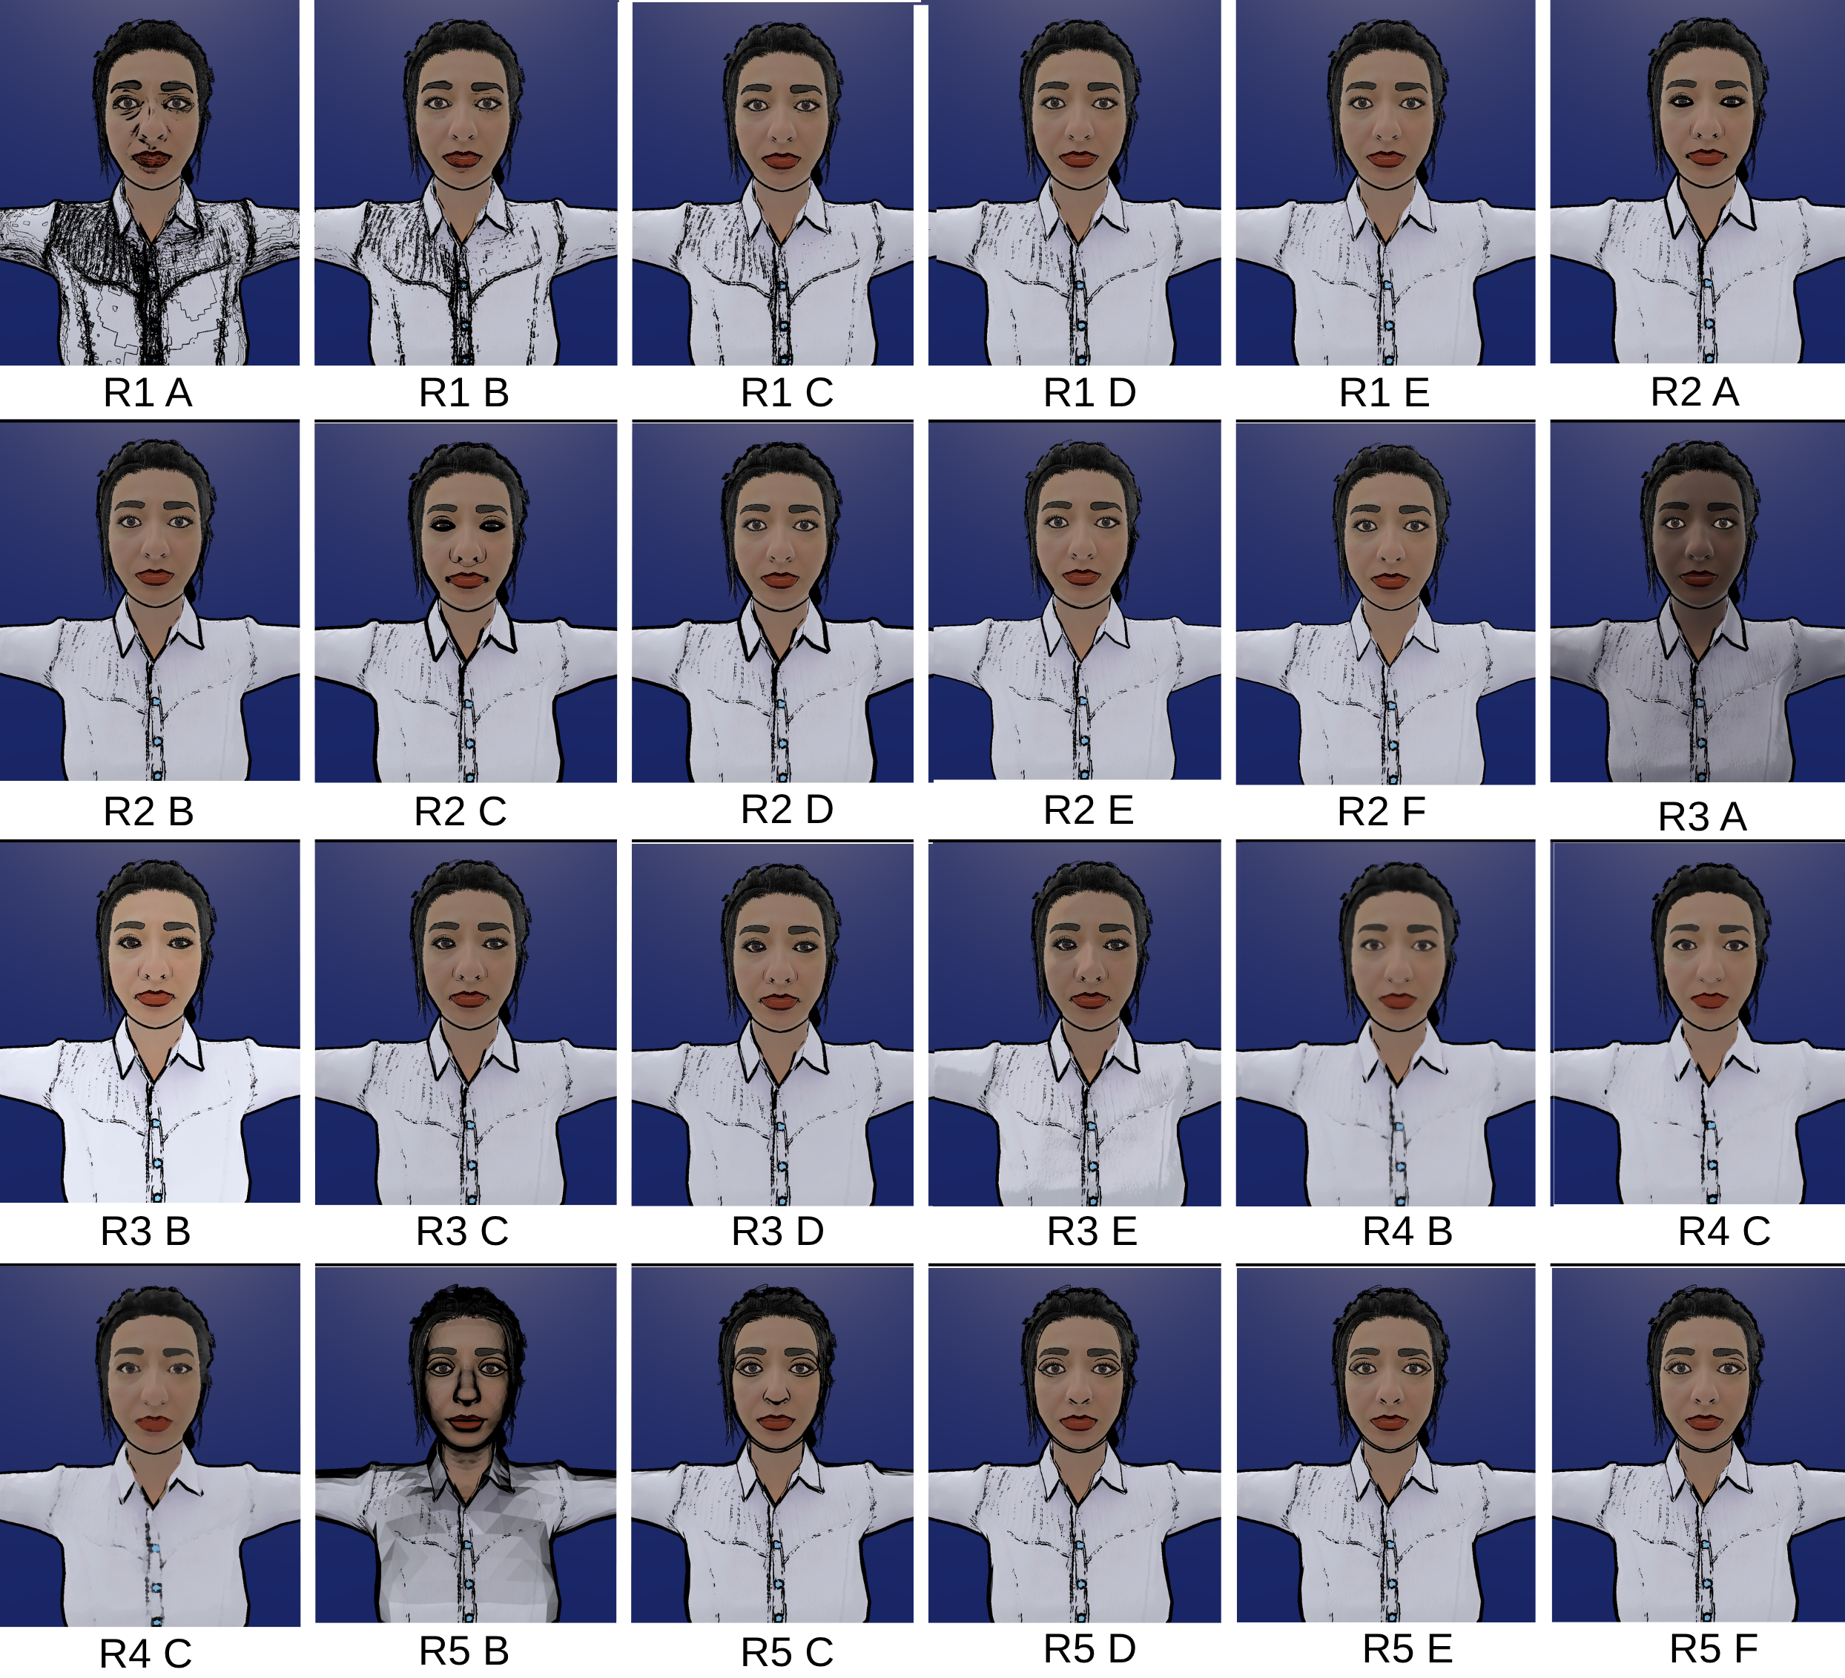
Backup - All variants shown in the parameter adjustment study
Nidanur Gunay | Abstraction Mechanisms for Virtual Avatars
31

Slide 32
Backup - Final composite parameters
Parameter | Value | Source
Outline width | 0.003 | R2 Borda winner
Depth offset | On | R2 Borda winner
Inner line threshold | 0.05 | R1 appeal tiebreaker
Shadow strength | 0.0 | R3 appeal tiebreaker
Detail bias | 0.5 | R3 appeal tiebreaker
Kuwahara filter | Off | R4 excluded (p = .003)
Hierarchical layer | Off | R5 excluded (p < .001)
Three of the seven values came from a separate visual appeal question, since no configuration in those rounds was statistically ahead of its runner-up.
Nidanur Gunay | Abstraction Mechanisms for Virtual Avatars
32

Slide 33
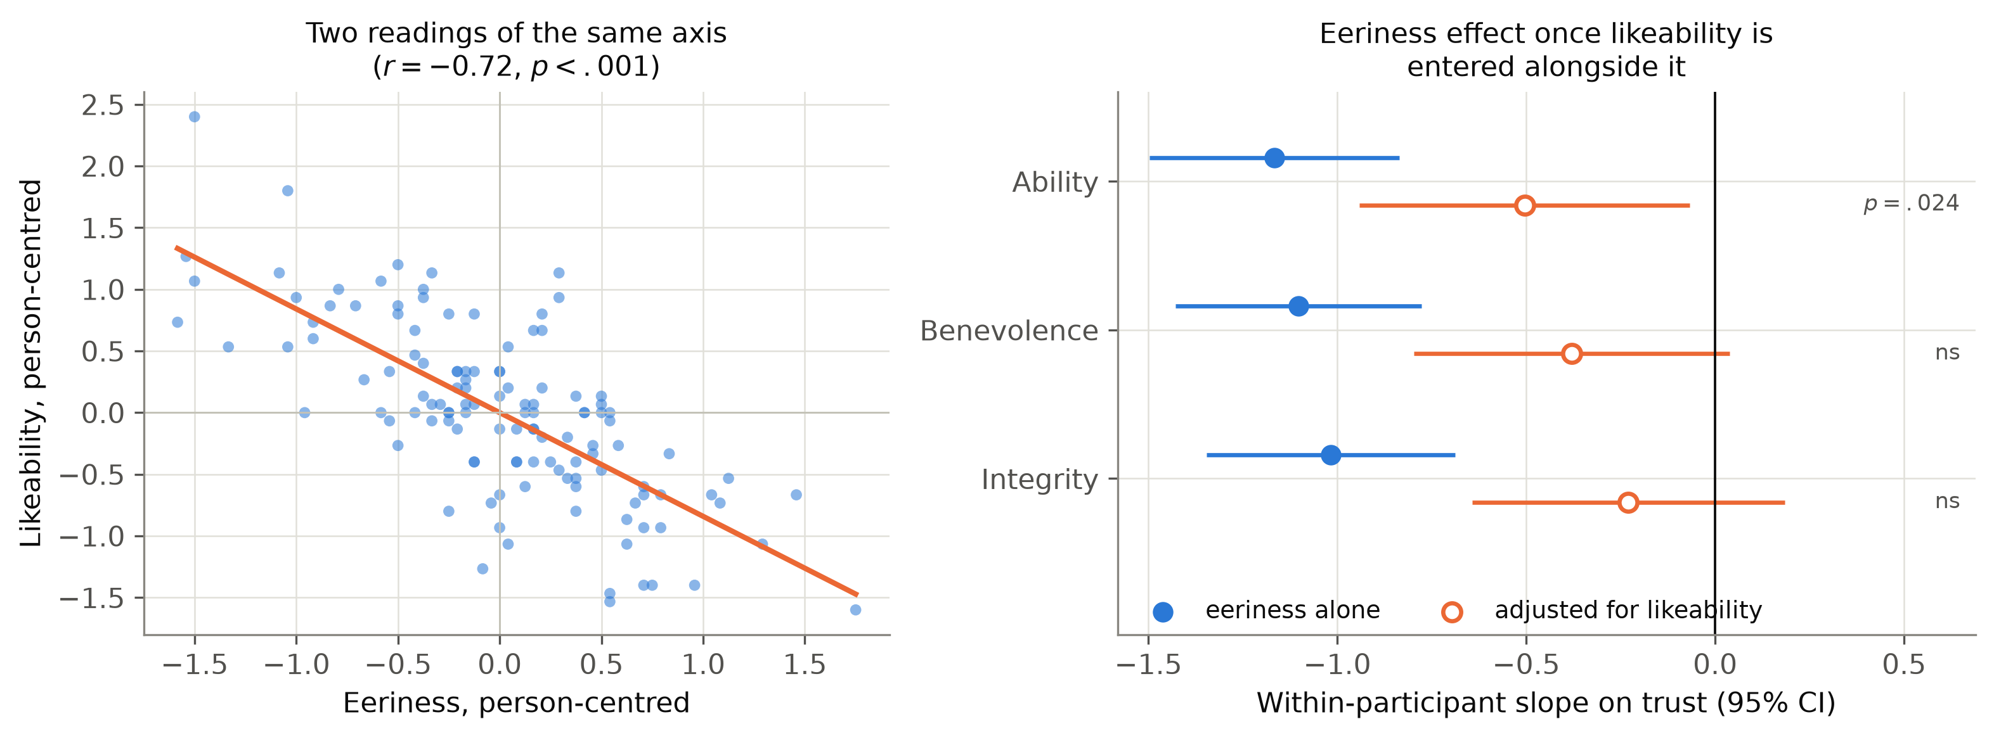
Backup - Eeriness against likeability
Within participants the two correlate at r = -.72, sharing 52% of their variance. Entering both in one model absorbs most of the eeriness effect: it survives on ability (b = -0.50, p = .024) but not benevolence (p = .075) or integrity (p = .273), while likeability holds on all three.
Nidanur Gunay | Abstraction Mechanisms for Virtual Avatars
33

Slide 34
Backup - Full statistics table
Subscale | Omnibus | C1 vs C2 | C1 vs C3 | C2 vs C3
Likeability | F(2,80)=26.85, p<.001, eta2p=.40 | p<.001, g=0.92 | p<.001, g=1.02 | p=.54, g=0.08
Eeriness | F(2,80)=20.39, p<.001, eta2p=.34 | p<.001, g=0.98 | p<.001, g=0.98 | p=.66, g=0.07
Ability | F(2,80)=10.91, p<.001, eta2p=.21 | p=.004, g=0.53 | p<.001, g=0.75 | p=.21, g=0.20
Benevolence | F(2,80)=14.31, p<.001, eta2p=.26 | p<.001, g=0.59 | p<.001, g=0.79 | p=.18, g=0.19
Integrity | F(2,80)=12.47, p<.001, eta2p=.24 | p=.001, g=0.66 | p<.001, g=0.80 | p=.27, g=0.16
Subscale | Position F(2,80) | p | Version F(2,38) | p
Likeability | 3.04 | .054 | 7.07 | .002
Eeriness | 2.47 | .091 | 5.57 | .008
Ability | 1.32 | .274 | 1.23 | .304
Benevolence | 2.10 | .130 | 1.26 | .296
Integrity | 1.72 | .186 | 2.04 | .144
Intraclass correlations, H3 models
Eeriness models: .48 to .57. Likeability models: .57 to .63.
Half or more of the variance in each trust subscale sits between participants rather than within them, which is consistent with large individual differences in general trustingness.
Nidanur Gunay | Abstraction Mechanisms for Virtual Avatars
34

