Slide 1
F1 Twitter Sentiment Analysis
SENG 8080: Case Studies Group Project
Presented by Naveen Dharni, Harshit Tiwari & Nida Tuz Zohra

Slide 2
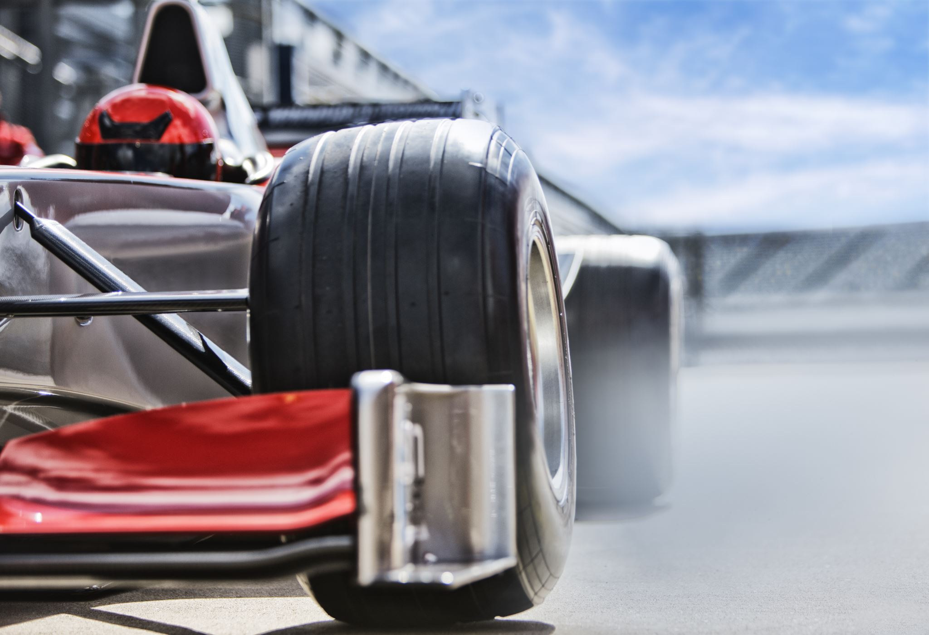
Outline
Motorsport History
Problem Statement
Project Key Components
Solution Design
Technology Demo
Impact Analysis
Q & A

Slide 3
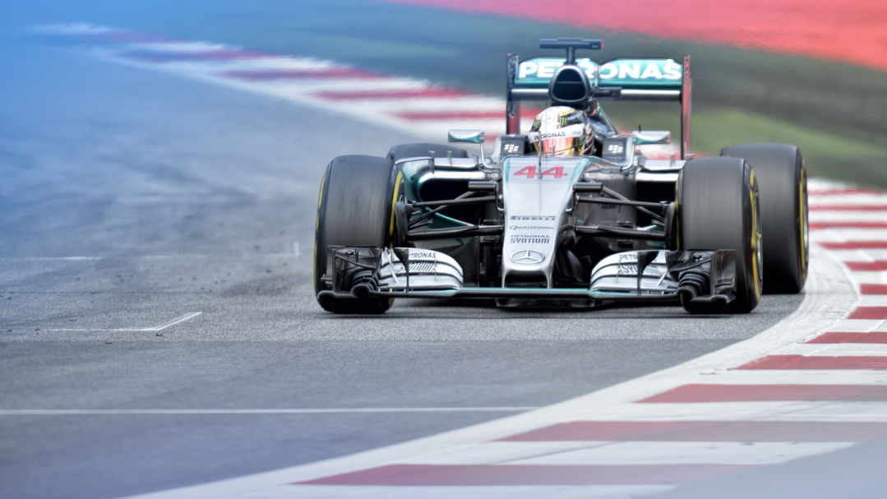
History
First known motorsport racing took place in 1894 France
Post WW2, grand prix races were more formally organized
Now, motorsports racing is divided based on the vehicles
FIA governs four or more wheeled vehicle competition
FIM governs two wheeled vehicles competition (Glifford, 2006)
This Photo by Unknown Author is licensed under CC BY-ND
Notes:
French Grand prix – done on steam powered vehicles
After WW1 – European countries organized gp races

Slide 4
F1 Timeline
1946
Formula one first defined by the FIA
1950
1953
1968
FIA introduced unrestricted sponsorship
Official world championship for drivers introduced by FIA
First official race outside of Europe, in Argentina
1969-2007
Changes in rules and regulations, engine sizes, minimum cockpit size, etc

Slide 5
F1 Timeline
2008
2014
2017
2018
2021
13% increase in viewership
Start of F1 popularity decline ~600 mil viewers
Continuing the steep decline
Dropped to 352 mil viewers
Spike in viewership ~490 mil viewers, Liberty Media takes over

Slide 6
Problem Statement
Formula 1 has successfully flipped a steep and steady decline in popularity to a sudden hike in viewership
Tracking the process and cause of this transformation can be beneficial in extending its viewership to underserved groups, like countries where F1 isn’t and has never been popular
In reality, tracking this transformation is a complex problem since there isn’t one cause, rather it is an amalgamation of several causes
Our project seeks to analyze the sentiments of F1 fans on twitter by observing their tweets based on a set of diverse keywords

Slide 7
Project Key Components
Sentiment analysis
Also called opinion mining
To determine the sentiments of a given set of data
Uses natural language processing (NLP) to determine polarity
Scraping Twitter to collect relevant Tweets
Obtaining a conclusive decision or opinion
Twitter
237.8 million daily active users as of Q2 2022(Published by S. Dixon & 11, 2022)
Twitter API
Endpoints to fetch tweets, user info, spaces, lists, etc
Register for developer account
Elevated access

Slide 8
Project Key Components
Keywords
Research social media posts
Follow popular influencers & hashtags
Curate list of most used keywords
Solution design
Combining all key components to design the solution

Slide 9
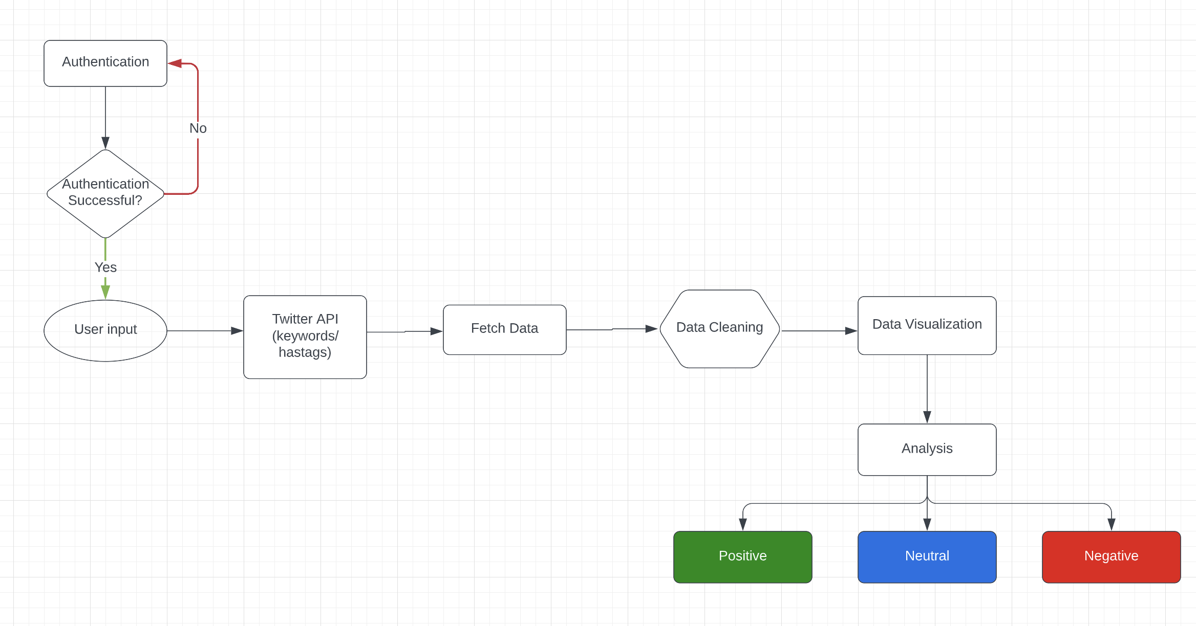
Solution Plan & Architecture

Slide 10
Technology Demonstration
Python as programming language.
TextBlob: Natural language processing (NLP) library
Tweepy: For accessing the twitter api & fetching the data(tweets)
Pandas: To analyze the data
Wordcloud and Matplotlib: Data visualizations libraries
GitHub & Git: Hosting service and version control tool
PyCharm CE and MS Excel: IDE
GitHub: https://github.com/nidatuzohra/TwitFormula1

Slide 11
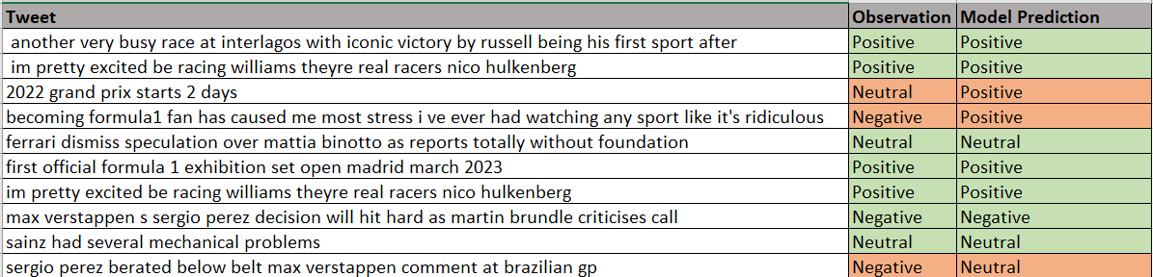
Model Validation
We have extracted the random sample tweets to validate the model’s accuracy.
Our Model accuracy is 70%
Observation Vs Sentiment Analysis Result

Slide 12
Impact Analysis
Technical Impact
One of the fundamental concepts that are related to data is Variety. The dataset should include diverse data. It is important to use a diverse range of different data to build the model. if the dataset is limited and not diverse it can represent a very biased result.
Another Major factor is Variability, data changes every day, so the solution should be robust to capture, manage and analyze changing data so that model can represent the current view.
The current model represents a narrow view as Dataset has a small sample, but since it includes diverse data, it can only be considered for a POC purpose.
Ethical Impact
Data is the Core of sentiment analysis, and to validate the model, the data must follow the Veracity concept. Competitors may ignore the veracity concept, and to take advantage, they can use this kind of model to depict a negative narrative towards the F1 Team or player.
This kind of model should disclose the data to make the model transparent. Especially if it’s available for public review.
This model can be improved on polarity. As we know, NLP libraries can understand the part of speech, but we know that sarcasm nor the social, cultural, or embodied context is not identifiable by this kind of model.

Slide 13
References
Gifford, C. (2006). Racing: The ultimate motorsports encyclopedia. Kingfisher/Houghton Mifflin Co.
Wikimedia Foundation. (2022, November 6). History of formula one. Wikipedia. Retrieved November 14, 2022, from https://en.wikipedia.org/wiki/History_of_Formula_One
Racers, F. (n.d.). Flow racers. – FLOW RACERS. Retrieved November 14, 2022, from https://flowracers.com/blog/is-f1-dying/
Silaparasetty, N. (2022, May 26). What is twitter sentiment analysis in data science? Medium. Retrieved November 14, 2022, from https://medium.com/ai-for-women/what-is-twitter-sentiment-analysis-in-data-science-c8839e925769
Silaparasetty, N. (2022, May 26). Twitter sentiment analysis for data science using python in 2022. Medium. Retrieved November 15, 2022, from https://medium.com/@nikitasilaparasetty/twitter-sentiment-analysis-for-data-science-using-python-in-2022-6d5e43f6fa6e
Published by S. Dixon, & 11, N. (2022, November 11). Twitter global mdau 2022. Statista. Retrieved November 15, 2022, from https://www.statista.com/statistics/970920/monetizable-daily-active-twitter-users-worldwide/
Step by step: Twitter sentiment analysis in Python. (n.d.). Retrieved November 16, 2022, from https://towardsdatascience.com/step-by-step-twitter-sentiment-analysis-in-python-d6f650ade58d

