Slide 1
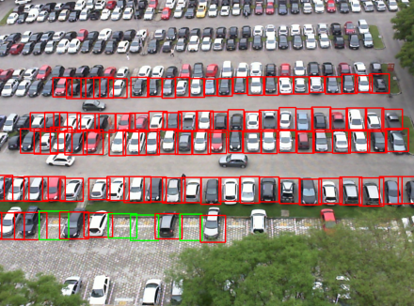
RESEARCH BRIEFING
AI-Based Smart
Parking Analytics
Benchmarking camera-based detection
of empty and occupied parking bays
Annotated PKLot-derived image
NIDDENA KIRAN
SMART PARKING ANALYTICS
01 / 12
Notes:
This briefing reports an offline parking-bay detector benchmark and outlines a proposed analytics system.
Source: Niddena Kiran, AI Based Smart Parking Analytics in Smart Cities, project manuscript. Image: 00_MASTER_PARKING_BENCHMARK_COLAB.ipynb, ground-truth visualization. Dataset: https://www.kaggle.com/datasets/duythanhng/parking-lot-database-for-yolo

Slide 2
EXECUTIVE SUMMARY
YOLO11s is the pilot candidate
It led this test split on both strict mAP and recorded processing time.
98.8%
20.0 ms
Test mAP@0.50–0.95
Measured processing per image
Before rollout, validate counts and latency on an unseen camera.
SMART PARKING ANALYTICS
02 / 12
Notes:
The 0.1 percentage-point lead over YOLOv8s is descriptive. Each model has one recorded run. A pilot would test transfer and end-to-end performance.
Source: Niddena Kiran, AI Based Smart Parking Analytics in Smart Cities, project manuscript. Table 7 and Section 6.

Slide 3
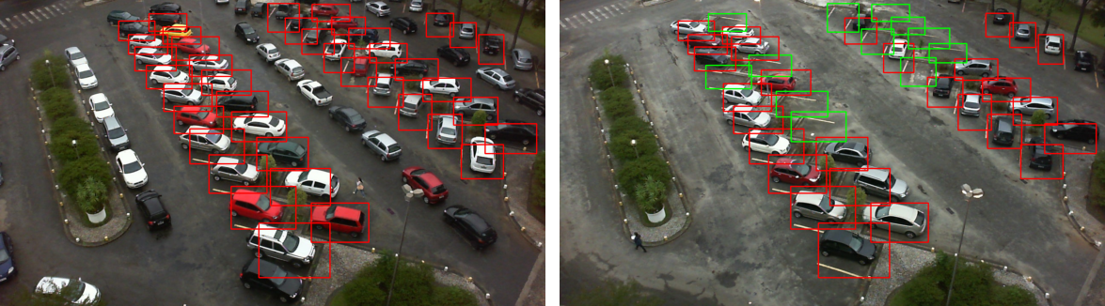
DETECTION TASK
The detector labels individual bays
Fixed-camera images provide the input. Each detection has a box and an occupancy class.
Green boxes mark empty bays
Red boxes mark occupied bays
SMART PARKING ANALYTICS
03 / 12
Notes:
These boxes are dataset annotations. The benchmark measures how well predicted boxes match annotated bays.
Source: 00_MASTER_PARKING_BENCHMARK_COLAB.ipynb, ground-truth visualization. Dataset: https://www.kaggle.com/datasets/duythanhng/parking-lot-database-for-yolo

Slide 4
DATASET
5,742 images passed the audit
The PKLot-derived dataset was cleaned and split with seed 42.
4,306
861
575
Training
Validation
Test
34,400 bay annotations in the test set
19,053 empty bays and 15,347 occupied bays
SMART PARKING ANALYTICS
04 / 12
Notes:
Related images from fixed cameras may span the random image splits. This protocol does not establish transfer to new cameras.
Source: Niddena Kiran, AI Based Smart Parking Analytics in Smart Cities, project manuscript. Tables 2–3. Dataset: https://www.kaggle.com/datasets/duythanhng/parking-lot-database-for-yolo

Slide 5
EXPERIMENT DESIGN
Four detectors, one dataset
Validation guided checkpoint selection. The held-out image split supplied the test metrics.
YOLOv8s
YOLOv5su
YOLO11s
RT-DETR-L
Runtime
Google Colab on Tesla T4
Training
30 planned epochs, 640 px, AdamW
Batch size
32 for YOLO and 8 for RT-DETR-L
SMART PARKING ANALYTICS
05 / 12
Notes:
The notebook reports Ultralytics 8.3.40, seed 42 and mixed precision training. Test evaluation uses batch size 1.
Source: Niddena Kiran, AI Based Smart Parking Analytics in Smart Cities, project manuscript. Table 5 and notebook training configuration.

Slide 6
MODEL COMPARISON
The YOLO models finished close together
Test results for 575 images. Strict mAP averages ten IoU thresholds from 0.50 to 0.95.
Model | Epochs | mAP@0.50 | mAP@0.50–0.95 | Time / image
YOLOv8s | 30 / 30 | 99.50% | 98.70% | 30.60 ms
YOLOv5su | 30 / 30 | 99.50% | 98.30% | 31.00 ms
YOLO11s | 30 / 30 | 99.50% | 98.80% | 20.00 ms
RT-DETR-L* | 6 / 30 | 97.58% | 69.21% | 54.77 ms
* RT-DETR-L checkpoint from interrupted training. Its test run used half precision.
SMART PARKING ANALYTICS
06 / 12
Notes:
The 0.1 percentage-point gap between YOLO11s and YOLOv8s comes from one run per model. Timing comparisons retain the precision-setting difference.
Source: Niddena Kiran, AI Based Smart Parking Analytics in Smart Cities, project manuscript. Tables 6–7 and 9.

Slide 7
PROCESSING TIME
YOLO11s had the lowest recorded latency
34.6%
lower processing time
than YOLOv8s
* Incomplete run. Stage timing excludes video capture and dashboard updates.
SMART PARKING ANALYTICS
07 / 12
Notes:
(30.60 − 20.00) / 30.60 = 34.64%. The measured sum includes preprocessing, inference and postprocessing. RT-DETR-L was explicitly evaluated in half precision.
Source: Niddena Kiran, AI Based Smart Parking Analytics in Smart Cities, project manuscript. Table 9.

Slide 8
TRAINING INTERRUPTION
RT-DETR-L completed six epochs
Training stopped during epoch seven of a planned 30.
6 / 30
Completed epochs
Test scores describe the checkpoint available after the interruption.
SMART PARKING ANALYTICS
08 / 12
Notes:
The log records a cancellation during epoch seven. The saved test evaluation used best.pt from the incomplete run. The exact selected checkpoint epoch is unverified.
Source: 00_MASTER_PARKING_BENCHMARK_COLAB.ipynb, training log. Niddena Kiran, AI Based Smart Parking Analytics in Smart Cities, project manuscript. Section 4.2 and Table 6.

Slide 9
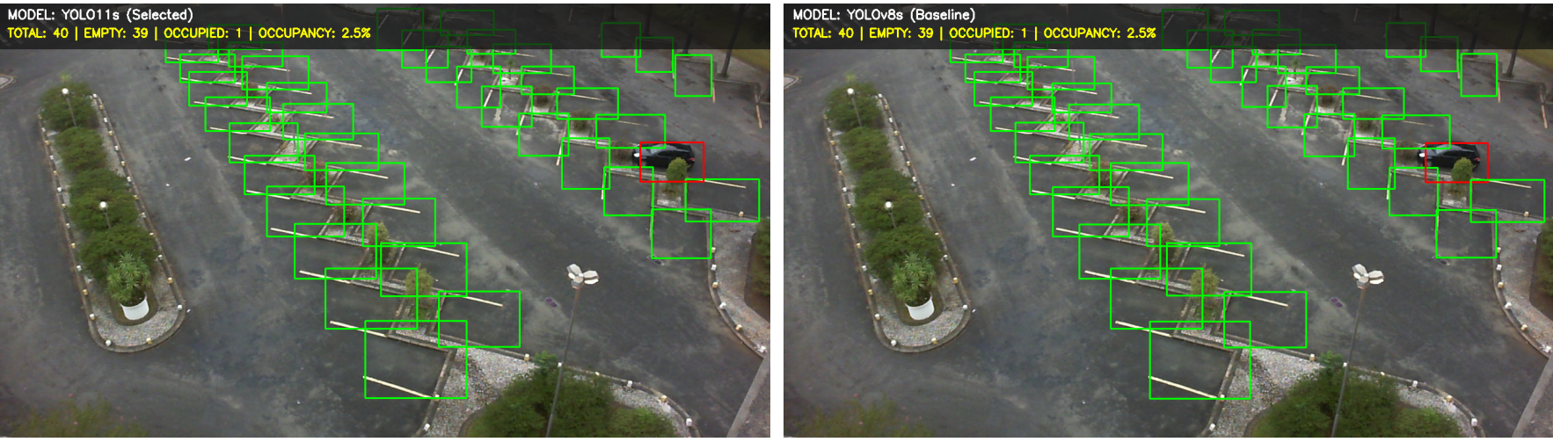
SAVED-IMAGE DEMO
The example reports 2.5% occupancy
Both models reported 39 empty detections and one occupied detection.
1 occupied detection ÷ 40 total detections
SMART PARKING ANALYTICS
09 / 12
Notes:
The demonstration uses one stored test image and computes occupancy among detected bays. It does not validate physical capacity or live count accuracy.
Source: 00_MASTER_PARKING_BENCHMARK_COLAB.ipynb, saved-image demonstration, 2013-04-14_08_25_02.jpg. Niddena Kiran, AI Based Smart Parking Analytics in Smart Cities, project manuscript. Figure 10.

Slide 10
PROPOSED SYSTEM
Proposed parking analytics workflow
The benchmark covers image detection. The operational workflow is proposed.
01
Associate bays
Map detection boxes to a registered inventory of physical bays.
02
Track occupancy
Stabilize changes across frames and record bay state, time and confidence.
03
Report availability
Show occupancy and unknown states. Use validated histories for demand forecasts.
SMART PARKING ANALYTICS
10 / 12
Notes:
Availability and forecasting require stable bay identifiers and validated occupancy histories. The proposed workflow has not been tested as an integrated service.
Source: Niddena Kiran, AI Based Smart Parking Analytics in Smart Cities, project manuscript. Figure 11 and Section 5.

Slide 11
VALIDATION ROADMAP
Evidence needed before a live pilot
Camera transfer
Group the split by camera or date and evaluate on a held-out view.
Count accuracy
Compare occupied counts with human labels and track unknown bays.
Video performance
Measure end-to-end latency, state-change delay and flicker.
Fair model comparison
Complete RT-DETR-L training and repeat tests with matched precision.
SMART PARKING ANALYTICS
11 / 12
Notes:
The existing dataset split is random by image. The benchmark uses one run per detector and does not include a live video pipeline. Define acceptable thresholds with the pilot site before testing.
Source: Niddena Kiran, AI Based Smart Parking Analytics in Smart Cities, project manuscript. Sections 6.4–6.5 and Table 10.

Slide 12
RECOMMENDATION
Test YOLO11s on
an unseen camera
Use a small set of human-labeled bays to measure count error,
unknown states and latency from capture to display.
NIDDENA KIRAN
SMART PARKING ANALYTICS
12 / 12
Notes:
YOLO11s is the first pilot candidate based on its reported strict mAP and processing time. The next experiment should verify transfer and operational metrics before deployment.
Source: Niddena Kiran, AI Based Smart Parking Analytics in Smart Cities, project manuscript. Section 7.

