Slide 1

Weather Forecasting using ML

Slide 2

The Challenges of Traditional Weather Forecasting
1
Complexity of Atmospheric Systems
2
Limited Data Sources
Traditional weather forecasting relies on a limited number of data sources, such as ground-based weather stations and satellite observations, which can be sparse or incomplete.
The atmosphere is a highly complex and dynamic system, with numerous interacting variables that make it challenging to accurately predict weather patterns.
3
Computational Limitations
The computational power required to model and simulate the entire atmosphere in real-time has been a major challenge for traditional weather forecasting methods.

Slide 3

The Role of Machine Learning in Weather Forecasting
Data-Driven Insights
Improved Accuracy
Adaptive Forecasting

Slide 4

Data Collection and Preprocessing
1
Data Acquisition
Gathering weather data from NOAA is a United States government agency responsible for monitoring and predicting changes in the Earth's environment, including the atmosphere, oceans, and climate.
2
Data Cleaning
We have taken historical data of the past 23 years it has different datatypes as follows AWND, PRCP, SNOW, SNWD, TAVG, TMAX, TMIN, ETC. will filter the data as per our requirements.
3
Feature Engineering
Creating informative features from the raw data to enhance the predictive power of the machine learning models.

Slide 5
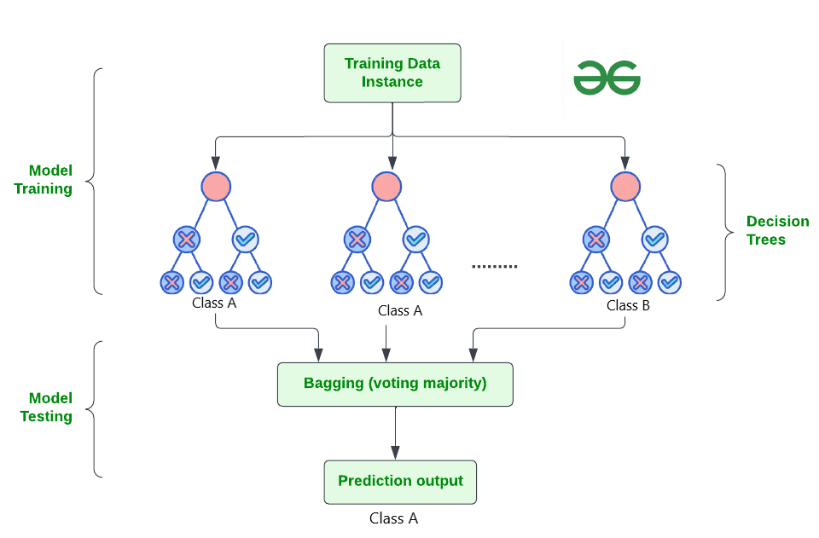
Random Forest Workflow for Weather Prediction
Random Forest builds multiple decision trees during training.
Each tree is trained on a random subset of the training data and a random subset of the features.
During prediction, each tree in the forest independently predicts the target variable, and the final prediction is determined by averaging or voting across all trees.

Slide 6
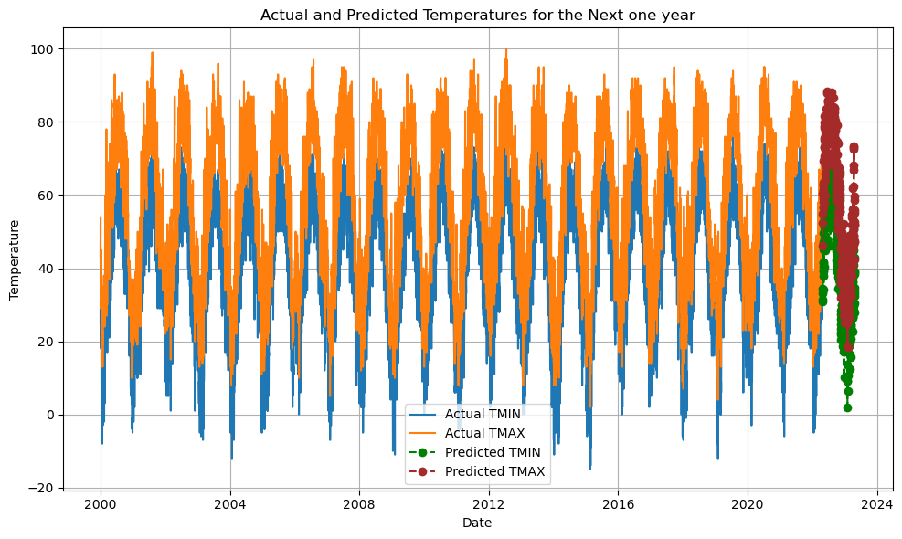
EVALUATION MATRICS
GRAPH
Evaluation metrics for TMIN:
Mean Absolute Error (MAE): 3.2340950424005213
Mean Squared Error (MSE): 17.324850014899976
Root Mean Squared Error (RMSE): 4.1623130606550935
Evaluation metrics for TMAX:
Mean Absolute Error (MAE): 3.704945662100456
Mean Squared Error (MSE): 25.438486225010873
Root Mean Squared Error (RMSE): 5.043658020228064

Slide 7
Conclusion and Future Outlook
Improved Accuracy
Machine learning-based weather forecasting models have demonstrated significant improvements in prediction accuracy, especially for short-term and localized weather events.
Adaptive Forecasting
ML models can continuously learn and adapt to changing weather patterns, leading to more reliable and up-to-date forecasts over time.
Expanding Data Sources
The integration of new data sources, such as crowdsourced weather data and IoT sensor networks, can further enhance the capabilities of ML-based weather forecasting.
Computational Advancements
Ongoing advancements in computing power and parallel processing techniques will enable more complex and resource-intensive weather models to be deployed in real-time.

Slide 8

Thank You
We hope this presentation has provided valuable insights. Thank you for your time and attention.

