Slide 1

Project Title - Seasonal Agriculture Performance Analysis
Student Name – Nidhay Shukla
College Name – Shri Saraswati Bhuvan Education Society College of Science
AICTE STU ID : STU66cd85948b0f71724745108

Slide 2

PROBLEM STATEMENT
Agricultural activities are influenced by seasonal variations in environmental conditions, farming practices, resource availability and market conditions. As a result, agricultural performance may differ from one season to another. However, raw agricultural data does not clearly explain how agricultural performance changes across seasons or what patterns can be observed in different seasonal conditions. The problem is to analyze the given agricultural dataset and investigate seasonal differences in agricultural performance by identifying meaningful patterns, trends, relationships and variations within the available data.

Slide 3
Project Description
Study of agricultural performance across different seasons.
Comparison of different crops based on yield, production, revenue and profit.
Analysis of the relationship between rainfall, yield and farm area.
Comparison of different irrigation methods and water efficiency.
Analysis of revenue and cost across Kharif, Rabi and Zaid seasons.
Use of statistical analysis and graphs to find patterns in the dataset.
Additional analysis of crop profitability, irrigation efficiency and seasonal revenue and cost.
Dataset: 4,000 records | 28 columns

Slide 4

WHO ARE THE END USERS?
Farmers – To compare crop performance, profit and water usage.
Agricultural Departments – To understand seasonal and crop-wise performance.
Agricultural Researchers – To study patterns in agricultural data.
Agriculture Consultants – To help in farm planning and analysis.
Government and Policy Makers – To understand agricultural performance and plan future studies.

Slide 5

Technology Used
Python – Main programming language
Pandas – Data handling and analysis
NumPy – Numerical calculations
Matplotlib – Data visualization
Seaborn – Statistical graphs and visualization
Google Colab – Coding and analysis environment

Slide 6
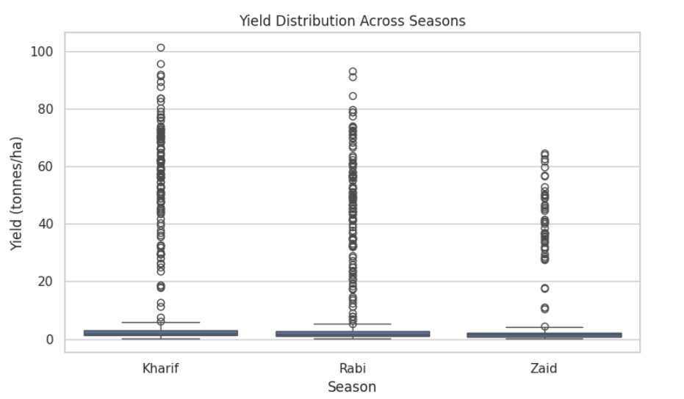
RESULTS
Explanation: The bar plot compares the average yield across Kharif, Rabi and Zaid seasons. It helps to identify which season has higher or lower average agricultural yield in the dataset.

Slide 7
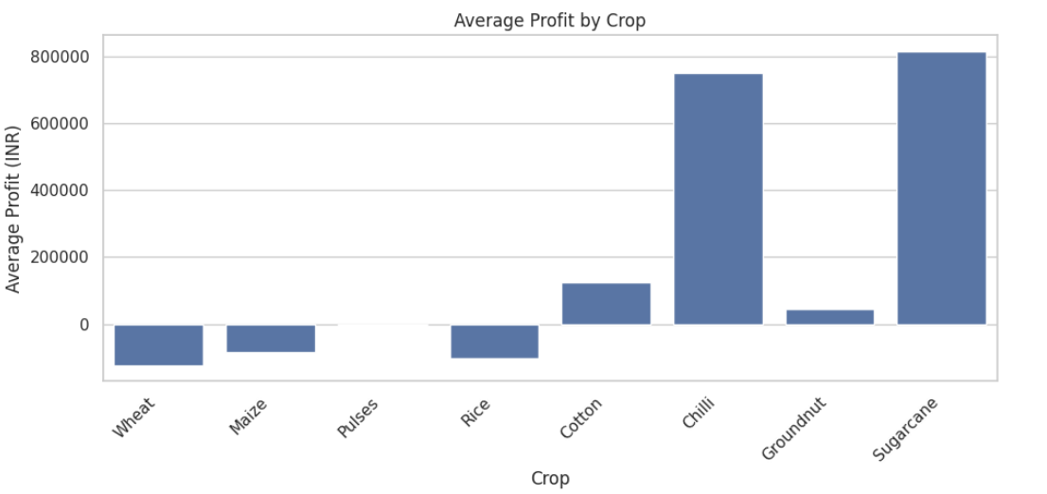
RESULTS
Explanation:
The bar plot compares the average profit generated by different crops. It shows that Sugarcane and Chilli have higher average profits, while some crops have negative average profit in the dataset.

Slide 8
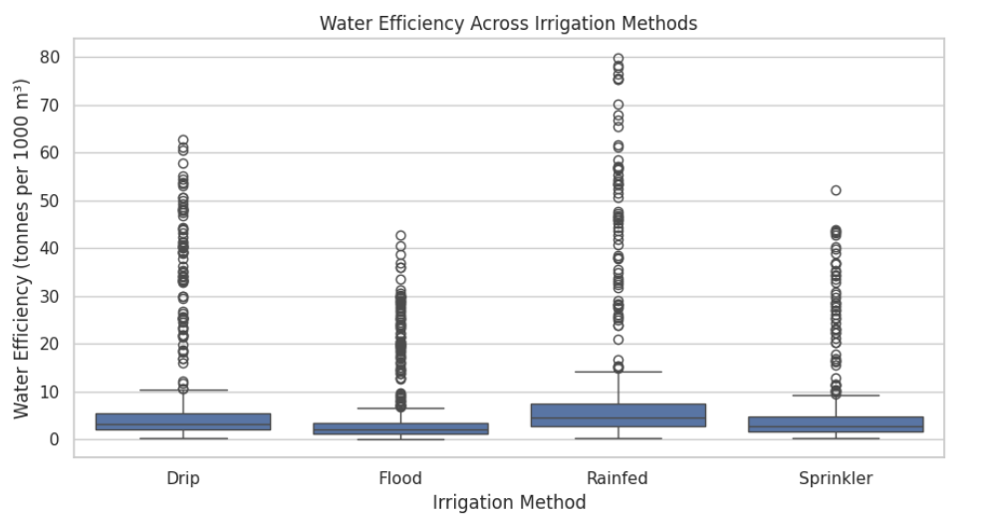
RESULTS
Explanation:
The box plot compares water efficiency across different irrigation methods. It shows that water efficiency varies between Rainfed, Drip, Sprinkler and Flood irrigation methods.

Slide 9
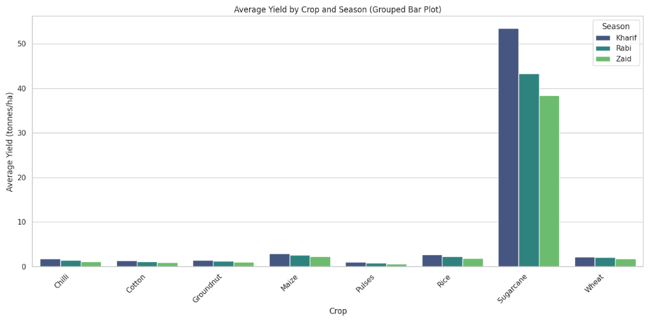
RESULTS
Explanation:
The grouped bar plot compares the average yield of different crops across Kharif, Rabi and Zaid seasons. It helps to see how the yield of each crop differs between seasons.

Slide 10
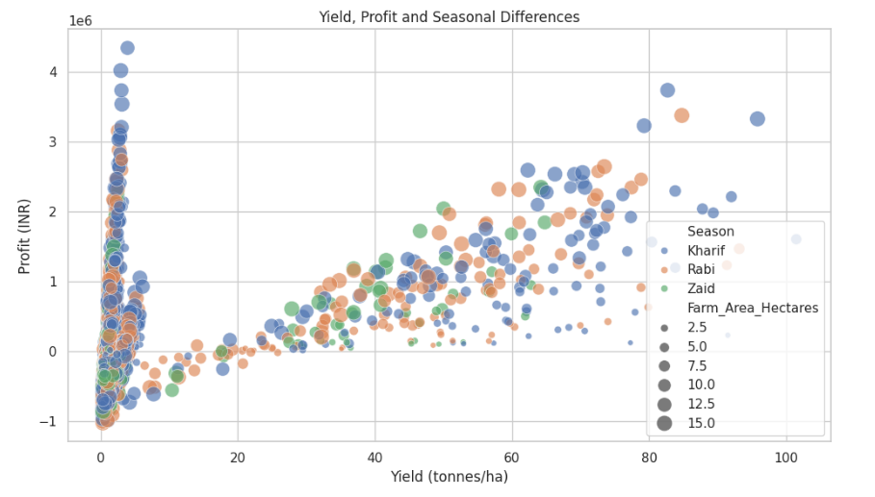
RESULTS
Explanation:
The scatter plot shows the relationship between yield and profit across different seasons. It helps to see how profit values vary with agricultural yield in the dataset.

Slide 11
Future scope
Add data from different years for better comparison.
Study agricultural performance state-wise and district-wise.
Analyze more factors such as soil, rainfall and temperature.
Compare more crops and irrigation methods.
Study long-term trends in agricultural performance.

Slide 12
GitHub Link
https://github.com/nidhayshukla45/Seasonal-Agriculture-Performance-Analysis.git

Slide 13

VOIS Course completion certificate - Course name- Data Visualization

Slide 14
Thank you

