Slide 1
IIIT KOTTAYAM · SOFTWARE ARCHITECTURE · SEM 4
FoundIt
Lost, found, and sold — all on campus.
A campus-scoped Lost & Found and Student Marketplace web platform — verified access, smart matching, server-side trust and community moderation.
Nidhi Rakesh
Shenza P M
Muhammed Shanid
Hadi M
2024BCD0006
2024BCD0002
2024BCD0034
2024BCD0058
Team Lead & Backend
Frontend & UI/UX
Auth & Admin
Marketplace & DevOps
Full-Stack Web Application · Team of 4 · One-Semester Project · September 2026
Notes:
FoundIt is our campus Lost & Found plus student marketplace. Built as a full-stack web app by a team of four over one semester. Today: introduction, requirements, and architecture.

Slide 2






AGENDA
What this deck covers
01
02
03
Introduction
Requirements
Architecture
The campus problem, why today's options fail, and what FoundIt sets out to do.
Four roles, 24 functional requirements across five modules, nine quality attributes.
Event-driven style, the layered system view, and the patterns holding it together.
04
05
06
Data & Security
Delivery
Team & Outcome
Firestore collections, denormalisation, role-based access and defence in depth.
Cloud Functions, scoring algorithms, environments and the deployment pipeline.
Who owned what, and the working platform this semester delivers.
Notes:
Three mandatory sections — introduction, requirements, architecture — with data, security and delivery treated as part of the architecture story.

Slide 3


01 · INTRODUCTION
Two problems every campus repeats
Things get lost
Things go unused
ID cards, water bottles, calculators and chargers disappear every week. Whoever finds them has no reliable way to reach the owner, and the owner has nowhere to look.
Textbooks, cycles, lab coats and hostel essentials pile up — especially at graduation and move-out — with no organised way to pass them down to juniors.
TODAY'S WORKAROUND
Both problems run on scattered WhatsApp groups and physical notice boards. Posts get buried within hours, nothing is searchable, there is no claim process — and no way to verify who is on the other side of the conversation.
Notes:
Start with the lived problem. Both halves of FoundIt come from the same failure: no structured, trusted place for campus-local exchange.

Slide 4



01 · INTRODUCTION
Why the existing options fall short
Public marketplaces
Chat groups
Notice boards
OLX · Facebook Marketplace
WhatsApp · Telegram
Physical, outside the office
WHAT IT OFFERS
WHAT IT OFFERS
WHAT IT OFFERS
City-wide second-hand buying and selling, with a large audience.
Informal sharing inside batch and hostel groups people already use.
The traditional way to put up a lost-and-found notice on campus.
WHERE IT FALLS SHORT
WHERE IT FALLS SHORT
WHERE IT FALLS SHORT
Open to strangers, no campus verification, real safety and trust concerns — and no lost-and-found at all.
Unstructured — posts get buried, nothing is searchable, no claim workflow and no moderation.
Not searchable, limited reach, easily missed — and no marketplace side whatsoever.
No single, trusted, campus-only platform combines lost-and-found recovery with a student marketplace.
That gap is exactly what FoundIt fills.
Notes:
Competitors are either too broad and untrusted, too unstructured, or too narrow. None does both jobs for one verified community.

Slide 5



01 · INTRODUCTION
One verified platform, two flows
FoundIt is a single web application behind a verified campus login. A user posts a lost or found item with details, an image and a campus zone; the system suggests likely matches and the owner claims the item through an approve-or-reject flow. In the marketplace, users list goods with price and condition, browse and filter, then confirm a deal through a two-party handshake and rate each other afterwards.
4
4
Modules
User roles
Campus-scoped
A verified campus email is the gate, and every post is tagged to a campus zone.
Smart matching
24
10
Five-factor scoring pairs lost reports with found reports automatically.
Accountable by design
Functional requirements
AI-assisted features
Trust scores, a claim workflow and community moderation replace guesswork.
Notes:
One login, two flows. The numbers on the right are the shape of the build: five modules behind four roles, 24 functional requirements, ten AI-assisted features with deterministic fallbacks.

Slide 6


01 · INTRODUCTION
Five objectives for the semester
01
Lost & found recovery
A campus-only platform where verified students report lost and found items and get matched to recover them.
02
Student marketplace
A structured space to buy, sell, rent or give away second-hand student goods.
03
Trust and safety
Access limited to verified campus members, with safe, accountable in-app communication.
04
Smart matching
Automatic suggestions pairing lost and found reports on category, keywords and location.
05
Moderation and control
Role-based access, community flagging and an admin dashboard keep the platform clean.
Notes:
Five objectives, and each maps onto a module you will see in the requirements section.

Slide 7



01 · INTRODUCTION
Scope and who it serves
IN SCOPE
WHO USES IT
Responsive web app for desktop and mobile browsers
Students who lost or found something on campus and need to report or claim it.
One campus community, one verified login
Four modules and four permission roles
Students buying, selling, renting or giving away used textbooks, cycles and hostel goods.
Image upload, campus-zone tagging, chat, notifications
Graduating or relocating students clearing out belongings at the end of a semester.
Moderation queue and an admin analytics dashboard
OUT OF SCOPE
Faculty and lab assistants who recover misplaced items and need somewhere to log them.
Real money handling — deals settle in person
A native mobile application
Campus administrators and moderators keeping the platform safe and spam-free.
Multi-campus federation
Notes:
Scope is deliberately bounded: no payment gateway, no native app, one campus. Everything else is in.

Slide 8




02 · REQUIREMENTS
Four roles, enforced end to end
Guest / Visitor
Registered User
Moderator
Administrator
Not signed in yet.
Verified student or staff — the core user.
A trusted reviewer of reported content.
The system owner.
KEY PERMISSIONS
KEY PERMISSIONS
KEY PERMISSIONS
KEY PERMISSIONS
Browse a limited public view
Post reports and listings
Approve or remove flagged posts
Manage users and assign roles
Register or log in
Search, claim, chat and rate
Mediate claim disputes
View the analytics dashboard
Cannot post, claim or message
Manage own profile and posts
Issue warnings and strikes
Configure categories and zones
Roles live as Firebase custom claims (auth.token.role) and are checked again inside Firestore Security Rules — the client never decides its own permissions.
Notes:
Four roles with distinct permissions. The key point for the viva: the role is a server-set custom claim, not a client-side flag.

Slide 9




02 · REQUIREMENTS
24 functional requirements, five modules
FR-1 → FR-5
FR-6 → FR-11
FR-12 → FR-16
Authentication & User Management
Lost & Found
Marketplace
5 requirements
6 requirements
5 requirements
Campus-email registration, verification, secure sessions, profiles and roles.
Report lost and found items, tag campus zones, receive suggested matches, claim and resolve.
Create listings, browse and filter, handshake a deal, archive sold items, keep a watchlist.
Communication & Trust
FR-17 → FR-20
Administration & Moderation
FR-21 → FR-24
4 requirements
4 requirements
Item-linked chat, post-exchange ratings, content flagging and live notifications.
Review flagged content, manage users and roles, analytics, categories and campus zones.
Notes:
Requirements are labelled FR-1 to FR-24 for traceability, grouped by the module that owns them.

Slide 10
02 · REQUIREMENTS · FUNCTIONAL
Authentication and Lost & Found
Authentication & User Management
Lost & Found
FR-1 Users shall register with a valid campus email address and verify it before accessing full features.
FR-6 Users shall post a lost-item report with title, description, category, date, last-seen location and an optional image.
FR-2 Users shall log in and log out securely, with passwords stored in hashed form.
FR-7 Users shall post a found-item report with the item's details, its current location and an image.
FR-8 The system shall let users tag a location on a map or select from a list of campus zones.
FR-3 Users shall reset a forgotten password through an emailed link.
FR-9 The system shall suggest possible matches between lost and found reports using category, keywords and location.
FR-4 Each user shall have an editable profile — name, hostel or department, contact preference and photo.
FR-10 A user shall raise a claim on a found item; the finder shall approve or reject that claim.
FR-5 The system shall assign roles (User, Moderator, Admin) and restrict features accordingly.
FR-11 Users shall mark an item 'Returned' or 'Resolved', which closes the report.
Notes:
FR-9 is the interesting one — smart matching. It is implemented server-side as a five-factor score, which we come back to in the architecture section.

Slide 11
02 · REQUIREMENTS · FUNCTIONAL
Marketplace, trust and administration
Marketplace
Communication & Trust
Administration & Moderation
FR-12 Create a listing with title, description, category, condition, price (or Free / For rent) and images.
FR-17 Exchange messages through an in-app chat tied to a specific item or listing.
FR-21 Moderators shall review flagged content and approve, hide or remove it.
FR-13 Browse, search and filter listings by category, price range, condition and keyword.
FR-18 Rate and review the other party after a completed exchange.
FR-22 Administrators shall manage users, assign roles and suspend accounts.
FR-14 Mark a listing 'Sold' or delete it; sold items are archived, not shown in active search.
FR-19 Report or flag suspicious posts, spam or inappropriate content.
FR-23 Administrators shall view an analytics dashboard — active listings, resolved items, user activity.
FR-15 Simulate a transaction handshake so buyer and seller confirm a deal — no payment gateway.
FR-20 Send notifications for new matches, claims, messages and status changes.
FR-24 Administrators shall manage the list of item categories and campus zones.
FR-16 Bookmark listings and lost/found posts to a personal watchlist.
Notes:
FR-15 is deliberately a handshake, not a payment: both parties confirm, then the listing is marked sold and reviews unlock.

Slide 12
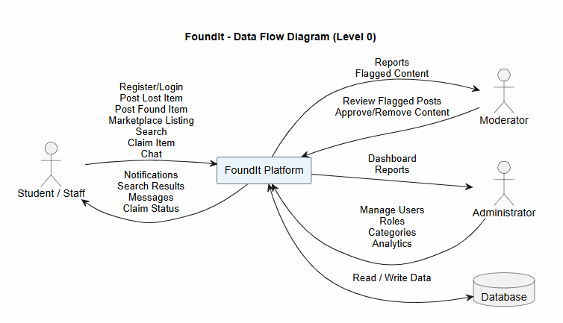

02 · REQUIREMENTS
System context — who interacts with FoundIt
Student / Staff
Registers, posts lost and found items, lists goods, searches, claims and chats.
Moderator
Receives flagged content, then reviews, approves or removes the post.
Administrator
Manages users, roles and categories, and reads the analytics dashboard.
Data store
Every read and write passes through Security Rules before reaching Firestore.
Notes:
The level-0 context diagram: three human actors plus the data store, and the flows each one exchanges with the platform.

Slide 13








02 · REQUIREMENTS
Nine quality attributes
Usability
Performance
Scalability
Responsive and mobile-first. Posting an item or searching takes no more than three clicks.
Pages and search return in about two seconds; images are compressed on upload.
Indexed queries and pagination carry several thousand users without a redesign.
Security
Privacy
Reliability
Hashed passwords, token sessions, role-based access and inputs validated against injection.
Contact details stay private by default; users talk in-app. Campus-verified accounts only.
A 99% uptime target through the demo period, with graceful and readable error handling.
Maintainability
Compatibility
Accessibility
Modular, documented code with a clear split between UI, data layer and backend.
Current Chrome, Firefox and Edge, plus Android and iOS mobile browsers.
Readable contrast, alt text on images and keyboard-navigable forms throughout.
Notes:
Nine non-functional requirements. Security and privacy are the ones the architecture spends the most effort on.

Slide 14



03 · ARCHITECTURE
Technology stack
Frontend
React 19
Vite 7
CSS Custom Properties
Lucide Icons
Client-rendered SPA
Real-time listeners
Dark / light theming
Backend & Data
Firebase Auth
Cloud Firestore
Cloud Storage
Serverless, event-driven
Cloud Functions v2 (Node 22)
Security Rules
Delivery & Intelligence
Vercel
Firebase Emulator Suite
Git + GitHub
Gemini 1.5 Flash
Hosting, tooling, external APIs
OpenMeteo API
Notes:
Firebase gives real-time listeners, offline caching and serverless scale on a free tier. Vercel hosts the frontend for per-PR preview deploys.

Slide 15



03 · ARCHITECTURE
Event-driven at the core
User action
Firestore write
Cloud Function trigger
Side effects
Post, claim, flag, confirm
Document created or changed
onDocumentWritten / onCall fires
Scores, statuses, notifications
CQRS
CQRS
Command path
Query path
The client writes items, claims, listings, reviews and flags straight into Firestore. It never computes anything the system will later trust.
The client reads denormalised feed documents through onSnapshot listeners, so every connected screen updates the moment the data changes.
The client writes data; the server reacts. Trust scores, match scores and item statuses are computed only inside Cloud Functions and written back to the document — Firestore rules reject any client write that tries to change them.
Notes:
If asked for the architectural style in one sentence: event-driven, with CQRS separating what the client writes from what the server computes.

Slide 16


03 · ARCHITECTURE
Layered system view
CLIENT — React 19 single-page app
Presentation UI components · AuthContext identity facade · hooks (useFeed, useNotifications)
Data access lib/*.js repositories — feed · claims · deals · chat · flags · notifications · ai
Platform SDK Firebase JS SDK — firestore · auth · storage
HTTPS / WebSocket
FIREBASE PLATFORM — managed backend
Managed services Authentication · Cloud Firestore · Cloud Storage
Cloud Functions v2 suggestMatches · onClaimCreated · onClaimResolved · onReviewCreated · onFlagCreated · confirmTransaction · resolveFlag · recomputeTrustScore · setUserRole
Gateway Security Rules — firestore.rules · storage.rules screen every read and write
REST
EXTERNAL APIS
Google Gemini 1.5 Flash text and vision, with a deterministic local fallback · OpenMeteo weather context for lost-item advice
Notes:
Three tiers. Note the gateway row: Security Rules are a real architectural layer here, not configuration.

Slide 17







03 · ARCHITECTURE
Patterns doing the work
Event-Driven
CQRS
Repository
Observer
Firestore document writes trigger Cloud Functions, which propagate every side effect.
Clients command by writing data; computed fields are written back only by the server.
lib/*.js wraps every Firestore call, so components never touch the SDK directly.
onSnapshot pushes feed, chat and notification changes to every connected client.
Strategy
State Machine
Saga
Chain of Responsibility
Each AI function tries Gemini first, then falls back to a deterministic local path.
Items move open → matched → claimed → resolved; listings active → sold.
confirmTransaction needs both buyer and seller before a listing is marked sold.
Flags accumulate, auto-hide the post at threshold, then escalate to a moderator.
Also in play — Gateway (Security Rules screen every read and write) and Facade (AuthContext merges Firebase Auth with the user profile into one identity).
Notes:
Eight patterns, each tied to a concrete file or function — useful if the examiner asks where a pattern actually lives in the code.

Slide 18


03 · ARCHITECTURE
Firestore data model
COLLECTION
DOCUMENT SHAPE
users/{uid}
name · email · hostelOrDept · trustScore · trustTier · role · ratingAvg · ratingCount · resolvedCount · strikes · verified
Denormalisation
lostFoundItems/{id}
type · title · description · category · keywords · location · imageURLs · status · postedBy · matchedWith · matchScore
Feed documents carry the poster's name, department, trust score and verified flag, so a 50-item feed needs no extra user reads. Firestore has no joins — the authoritative trust value still lives on users/{uid} and is recomputed server-side.
…/claims/{cid}
claimantUid · message · status · proofURLs
listings/{id}
title · description · price · priceType · condition · category · sellerUid · status · imageURLs · trustScore
reviews/{id}
raterUid · rateeUid · rating · comment · contextRef
notifications/{id}
userId · type · message · contextRef · read · createdAt
Indexing
Single fields are auto-indexed. Composite indexes in firestore.indexes.json cover notifications by userId + createdAt (desc) and reviews by rateeUid + createdAt.
flags/{id}
targetRef · reporterUid · reason · status
Notes:
Seven collections. The trade-off for losing joins is denormalisation, and the cost of denormalisation is staleness — handled by recompute triggers.

Slide 19
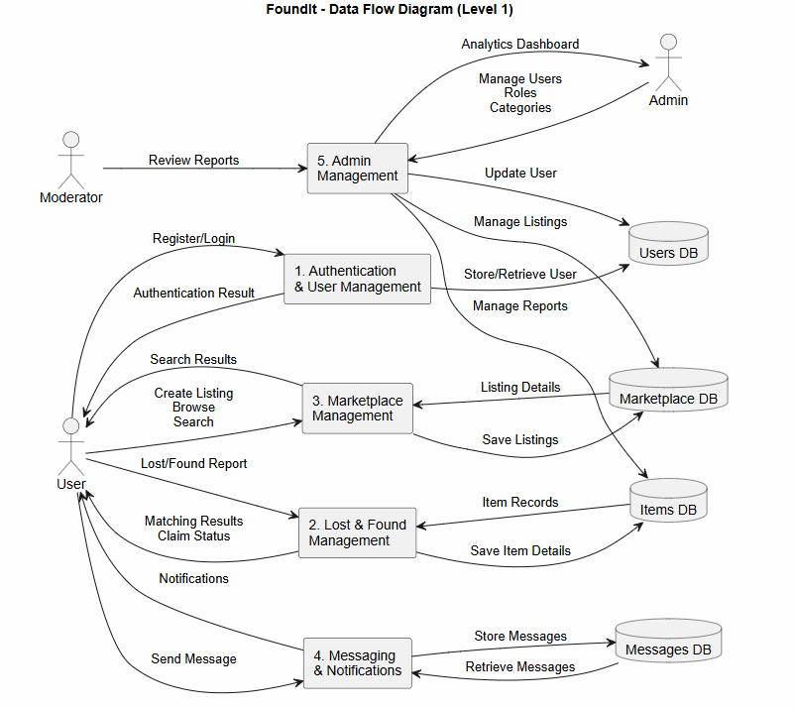
03 · ARCHITECTURE
Data flow — level 1
1
Authentication & User Management
Register and log in, store and retrieve the user record, return the auth result.
2
Lost & Found Management
Take lost and found reports in, save item records, return matching results and claim status.
3
Marketplace Management
Create listings, save them, serve browse and search results back to the user.
4
Messaging & Notifications
Store and retrieve messages, push notifications on matches, claims and status changes.
5
Admin Management
Review reports, manage users, roles and categories, and feed the analytics dashboard.
Notes:
Level 1 decomposes the platform into five processes and four data stores. Each process maps onto one requirements module.

Slide 20

03 · ARCHITECTURE
Defence in depth
1
signedIn()
The request must carry an authenticated Firebase session.
Role-based access
Student CRUD own items, submit claims and reviews, flag content.
2
isVerified()
The campus email address must be verified before any write.
Moderator Resolve flags, apply strikes, view every flag in the queue.
Admin Set user roles, plus all moderator powers.
3
Ownership
The caller's uid must match the document's owner field.
4
keeps(field)
Why a client cannot fake trust
Server-only fields cannot change in a client write.
keeps('trustScore') → request == resource
5
Business rules
Rules reject any write where trustScore differs from the stored value. Only Cloud Functions, running on the Admin SDK, bypass rules — so trust, status and match scores can only ever come from the server.
A review is allowed only after a resolved exchange.
Notes:
Five rule layers, applied in order. The keeps() helper is the single most important line of defence for server-computed fields.

Slide 21
03 · ARCHITECTURE
Cloud Functions — the API surface
Cloud Functions v2 on Node 22 · triggers react to document lifecycle events, onCall functions are invoked from the client over HTTPS
onDocumentWritten
onDocumentCreated
onDocumentWritten
suggestMatches
onClaimCreated
onClaimResolved
Scores every lost / found pair, writes the match onto both reports and notifies both posters.
Tells the item's poster a claim is waiting, so they can approve or reject it.
Updates item status and user stats, recomputes trust, notifies the claimant.
onDocumentCreated
onDocumentCreated
onCall · HTTPS
onReviewCreated
onFlagCreated
confirmTransaction
Aggregates the rating average and recomputes the ratee's trust score.
Increments flagCount and auto-hides the target once the threshold is hit.
Two-party handshake — marks the listing sold once both sides have confirmed.
onCall · HTTPS
onCall · HTTPS
onCall · HTTPS
resolveFlag
recomputeTrustScore
setUserRole
Closes a flag and optionally applies a strike to the offending user.
Recalculates trust from ratings, activity, verification, tenure and strikes.
Admin only — sets the Firebase custom claim and the user document role.
Notes:
Nine functions, split between document triggers and callable RPCs. Everything security-critical lives here rather than in the client. onClaimCreated is what makes the claim visible to the finder — without it FR-10 could not complete.

Slide 22

03 · ARCHITECTURE
How matching and trust are scored
Match score (0 – 100)
Trust score (0 – 100)
functions/src/scoring.js · weight contributed by each factor
Bayesian-damped, computed only in Cloud Functions
50
Baseline
Every new account starts here.
±40
Ratings
(avg − 3) × count / (count + 5) × 40
+25
Activity
log₂(resolved + 1) × 5, capped
+10
Verification
A verified campus email address
+10
Responsiveness
Derived from the chat response rate
+5
Tenure
Log of days since joining
matchScore = category + keywords + zone + recency + complementarity
−15
Strikes
Subtracted for each moderator strike
Keyword overlap is a Jaccard coefficient over the tokenised title and description; zone uses an adjacency matrix; recency decays exponentially over seven days; complementarity checks that one report is lost and the other found.
Damping is the point: one five-star review cannot outweigh a long record, and the client can never write the result.
Notes:
Two scoring algorithms, both server-side. Match score is a weighted sum; trust is Bayesian-damped so a small number of ratings cannot swing it.

Slide 23


03 · ARCHITECTURE
Environments and delivery
Local development
Preview
Production
Firebase Emulator Suite
Vercel preview per pull request
Vercel CDN + Firebase backend
auth 9099 · firestore 8080 · functions 5001 · storage 9199. A production build never connects to an emulator.
Every PR gets its own URL against a Firebase staging project, so reviewers click before merging.
web/dist served globally as an SPA with rewrites; Firebase carries auth, data, storage and functions.
PIPELINE
git push
Vercel build — npm run build
web/dist SPA with rewrites
Preview on PR, production on merge
Firebase backend ships separately: firebase deploy --only firestore:rules,functions,storage
Vercel
Firebase
External
CDN · web/dist
Auth · Firestore · Storage · Functions
Gemini 1.5 Flash · OpenMeteo
Notes:
Two deployment targets — Vercel for the frontend, Firebase for everything server-side. The trade-off we accepted for per-PR previews.

Slide 24
04 · TEAM
Who built what
NR
SP
MS
HM
Nidhi Rakesh
Shenza P M
Muhammed Shanid
Hadi M
2024BCD0006
2024BCD0002
2024BCD0034
2024BCD0058
Team Lead & Backend
Frontend & UI/UX
Auth & Admin
Marketplace & DevOps
Data model, Cloud Functions, the smart-matching logic, integration and version control.
React frontend, responsive layouts, listing pages, the search UI and animation.
Authentication, role-based access, the moderation flow and the admin dashboard.
Marketplace module, in-app chat, notifications, deployment, testing and documentation.
METHODOLOGY
Iterative and module-based. Week one fixed the data model and the function contract together; after that each member owned a vertical slice — frontend plus data — with shared components built first. Git and GitHub throughout, integrating continuously rather than merging once at the end.
Notes:
Four members, four vertical slices, one shared contract agreed in week one — which is why integration was continuous rather than a final merge.

Slide 25


05 · OUTCOME
A working platform, not a prototype
Verified students can recover lost items and trade second-hand goods inside their own campus — backed by search, smart matching, in-app chat, server-side trust scoring and community moderation. One trusted platform replaces the scattered WhatsApp groups and notice boards, and it demonstrates a complete full-stack system: authentication, real-time data, role-based access and a clean, mobile-friendly interface.
Real-time feed
Server-side trust
Two-party handshake
Community flagging
Lost, found, and sold — all on campus.
Thank you
Nidhi Rakesh · Shenza P M · Muhammed Shanid · Hadi M | IIIT Kottayam · September 2026
Notes:
Close on the outcome, then open the floor. Be ready for questions on CQRS, the keeps() rule helper and the two scoring algorithms.

