Slide 1

Explore Zomato restaurants dataset in the city of New Delhi

Slide 2
Introduction
New Delhi is the capital city of India. It is a part of the city of Delhi’s 11 districts. Delhi city itself has a population of 1.6 Cr. Delhi is famous for its tourist attractions,food,and it's marketplaces. Since its the national capital of the country one can explore Rashtrapati Bhavan, Parliament House, India Gate. If one is dedicated to history one can visit Qutub Minar, Humayun's Tomb.There are various types of dishes that are quite famous in India. Some of them are – Biryani, Butter Chicken, Samosas, Dal Makhani,tandoori meat, chaat, and more. The food of different cities of India reflect their unique cultural setup. Delhi is that one constant love that delivers, caters to all kinds of need and greed, be it Italian, Mexican,African,Chinese,Continental cuisine!Many tourists from West (USA and Europe) visit India and specifically Delhi. They are mostly interested in Continental Restuarants.
So as part of this project , we will list and visualize all major parts of New Delhi City .

Slide 3
Questions that can be asked using the above mentioned datasets
What is best location in New Delhi City for Continental Cuisine ?
Which areas have large number of Continental Restaurant Market ?
Which all areas have less number of restaurants ?
Which is the best place to stay if I prefer Continental Cuisine ?
What places have best restaurants in New Delhi?
We will identify categorization of localities as per the venue-type category using FourSquare API's?
Objectives

Slide 4
Data
For this project we need the following data :
New Delhi Restaurants data that contains list Locality, Restaurant name,Rating along with their latitude and longitude.
Data source : Zomato kaggel dataset
Description : This data set contains the required information. And we will use this data set to explore various locality of new delhi city.
Nearby places in each locality of new delhi city.
Data source : Fousquare API
Description : By using this api we will get all the venues in each neighborhood.

Slide 5
Approach
Approach
Collect the new delhi city data from Zomato kaggel dataset
Using FourSquare API we will find all venues for each neighborhood.
Filter out all venues that are nearby by locality.
Using aggregative rating for each resturant to find the best places.
Visualize the Ranking of neighborhoods using folium library(python)

Slide 6
Results

Slide 7
Localities categorization on Map

Slide 8
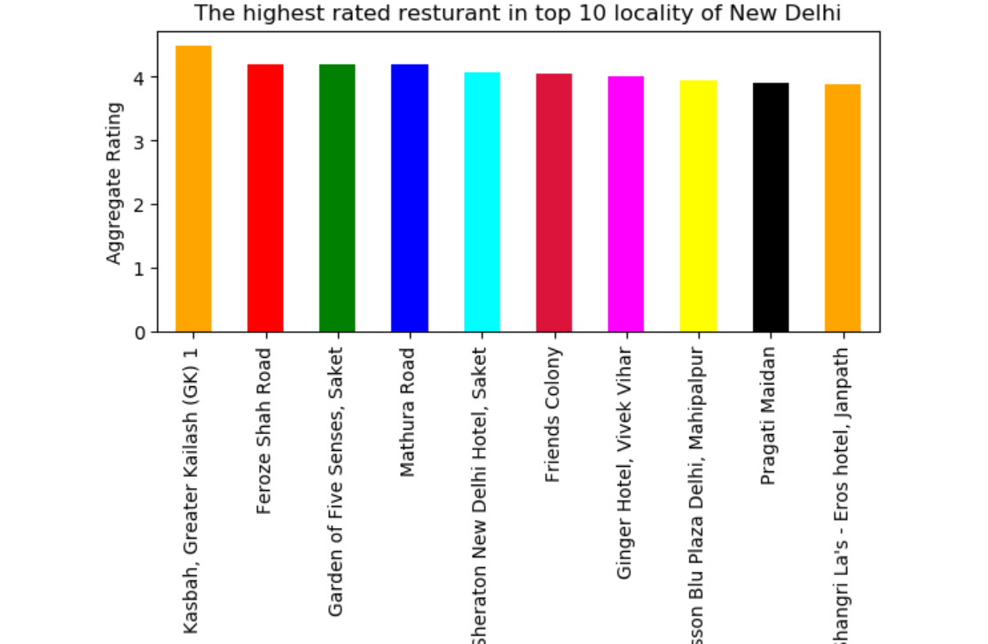

Slide 9
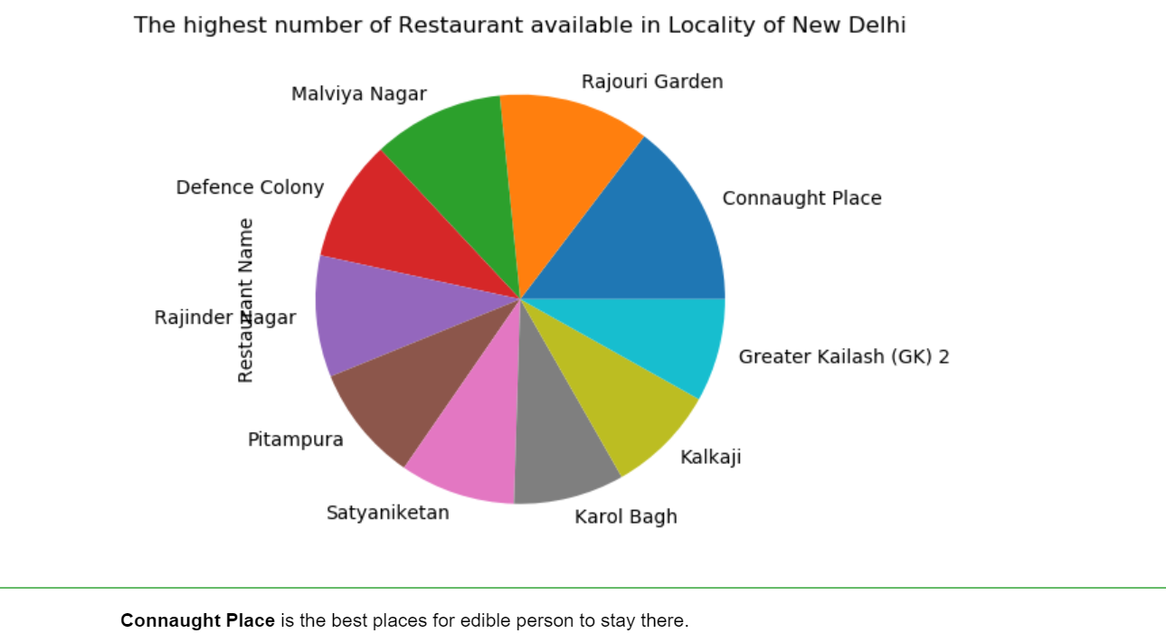

Slide 10
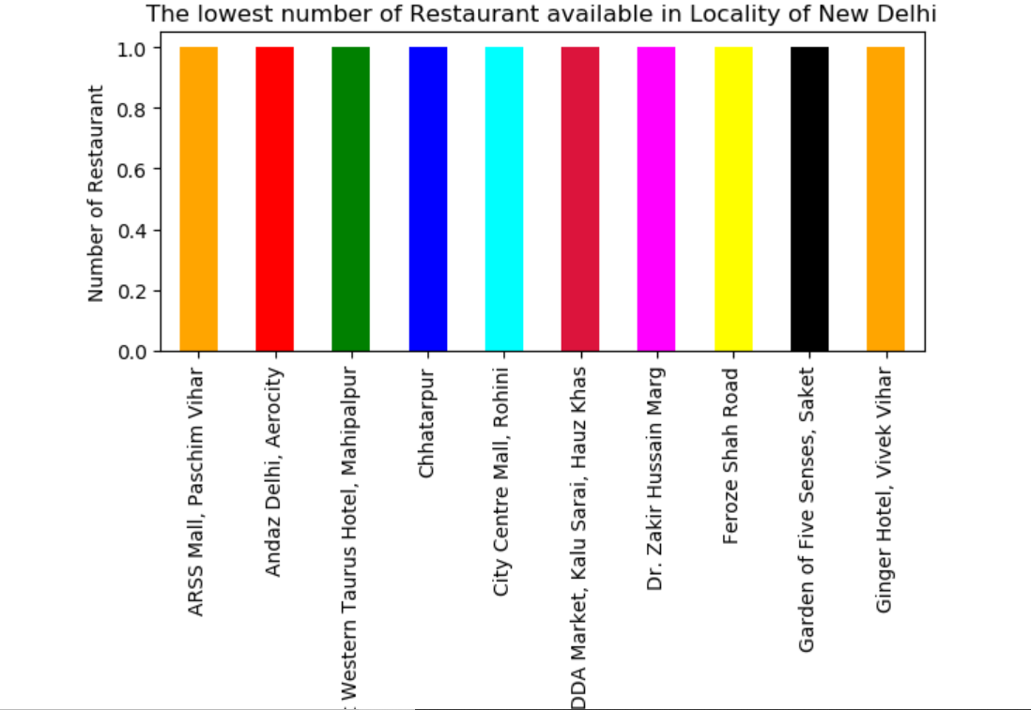

Slide 11
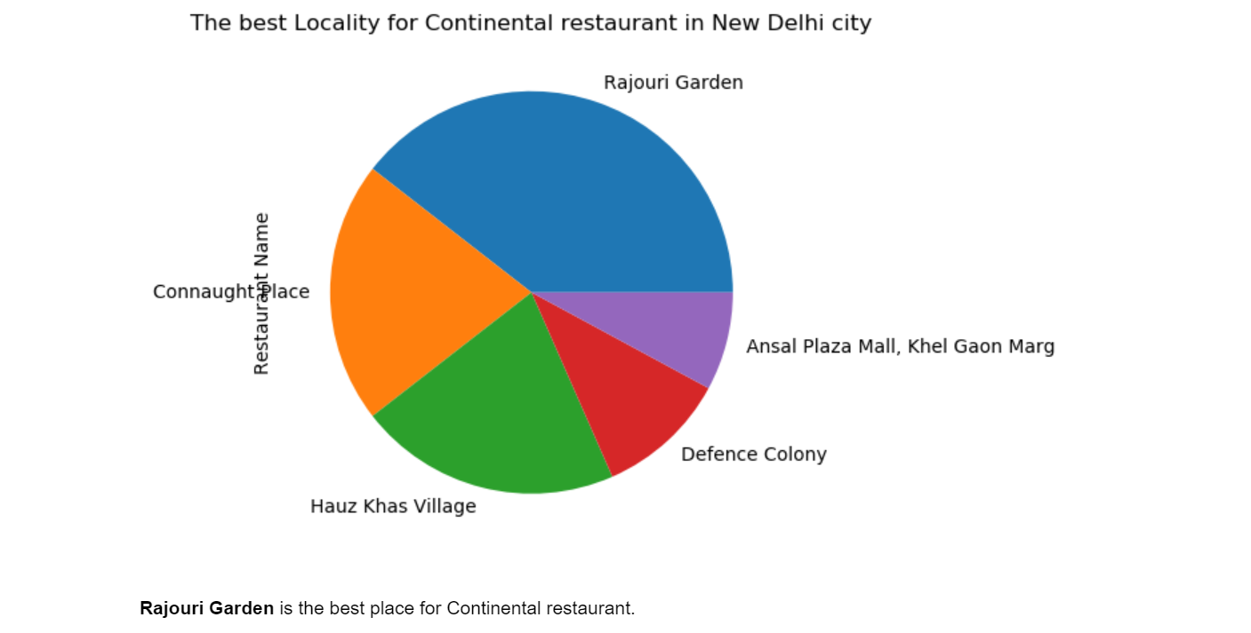

Slide 12
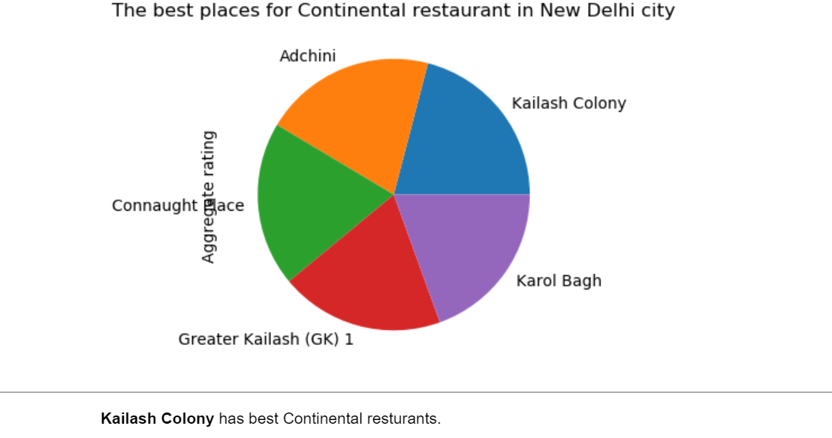

Slide 13
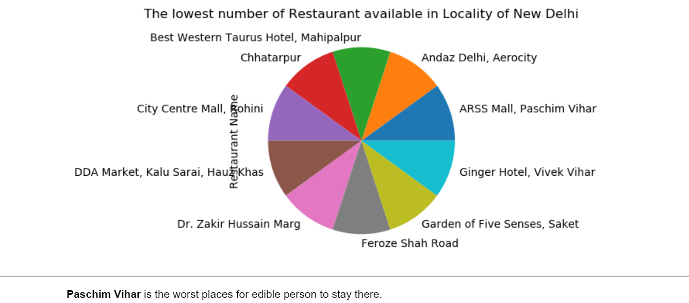

Slide 14
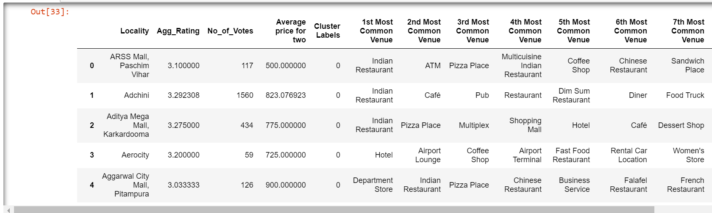
Cluster 1:
The Indian restaurants are most recommended venues nearby the locations.

Slide 15
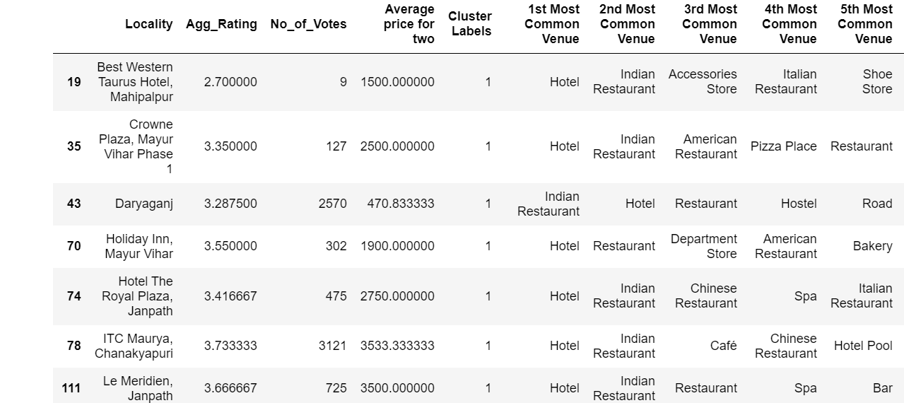
Cluster 2:
It is recommended for the Hotel and Nightclubs venues areas:

Slide 16
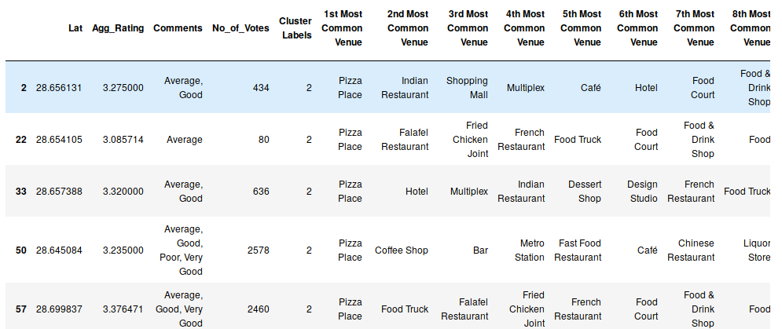
Cluster 3:
It seems like pizza place,

Slide 17
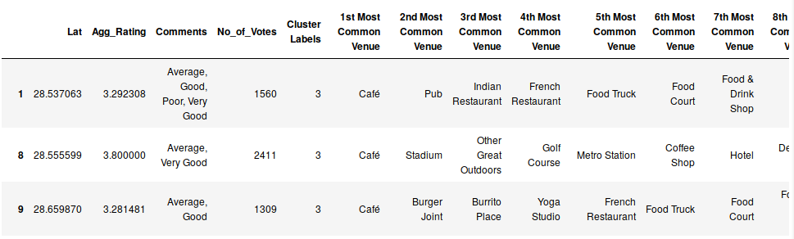
Cluster 4:
It’s most recommended for cafes

Slide 18
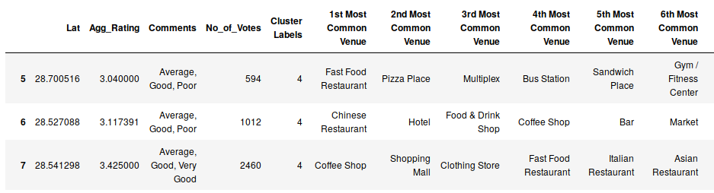
Cluster 4:
Fast food, cafes are the most recommended venues

Slide 19
Conclusion
The best restaurants are available in Kesbah, Greater Kailash area.
The worst restaurants are available in Piccadily Hotel, Janakpuri
Connaught Place is the best places for edible person to stay there.
Paschim Vihar is the worst places for edible person to stay there.
Rajouri Garden is the best place for Continental restaurants.
Kailash Colony has some of best Continental restaurants.
Connaught place, Rajouri garden, Malviya Nagar are the best places for edible person.
Greater Kailash, Feroze shah road, Saket have best restaurants in New Delhi.

