Slide 1

Name : Nidhi Singh
Mail id : nsnidhisingh2112@gmail.com
College Name : Rajkiya Engineering College Sonbhadra
College State : Uttar Pradesh
Internship Domain : Data Analytics
Internship start date : 12-06-2023
Internship end date : 24-07-2023

Slide 2
IBM – EDUNET DATA ANALYTICS
Case study: Analysis of superstore

Slide 3
Project Overview
End Users
Solution and Value Proposition
Modelling
Insights and Visualisations
Conclusion
Links

Slide 4
Project overview
Before venturing on to any data science project it is important to pre-process the data and also to explore the data. Today we will discuss a very basic topic of exploratory data analysis (EDA) using Python and also uncover how simple EDA can be extremely helpful in performing preliminary data analysis.

Slide 5
End users
Business managers, including executives and decision-makers, would be interested in understanding the overall performance of the superstore. They would want insights into sales trends, profitability, inventory management, and potential areas for improvement. This analysis can help inventory and supply chain managers optimize their stock levels, forecast demand, and reduce inefficiencies. Customer service representatives may use the analysis to identify common customer complaints or issues, helping them provide better support and service.

Slide 6
Solution and value of proposition
The data analysis could uncover areas where the superstore is underperforming or facing challenges. The solution would involve identifying specific strategies to optimize performance, such as focusing on high-margin products, streamlining inventory management, or improving customer service processes. The data analysis project provides valuable insights derived from factual data rather than relying solely on intuition or assumptions. This enables the superstore to make informed decisions based on evidence, reducing the risk of costly mistakes.

Slide 7
Modelling
This project utilized data preprocessing, exploratory analysis, customer segmentation, time series analysis, regression, market basket analysis, predictive modeling, and sentiment analysis. These insights enabled the superstore to optimize performance, enhance customer experience, and make informed decisions for sustained business growth and success. Visualizations and reports facilitated effective communication with stakeholders.

Slide 8

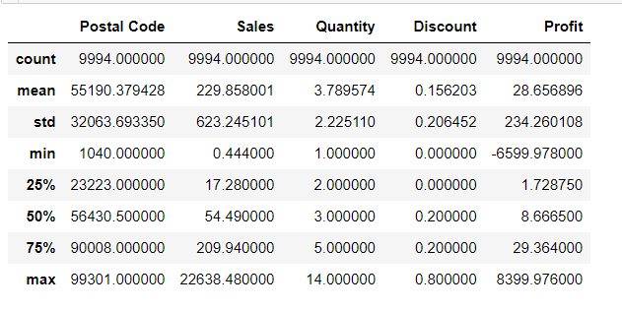
STATISTICAL INFORMATION ABOUT DATA

Slide 9
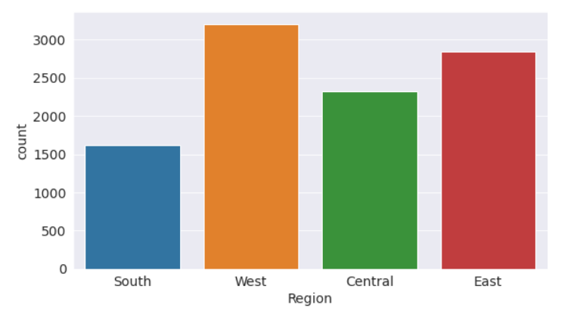
AGGREGATE SALES ACROSS REGIONS

Slide 10
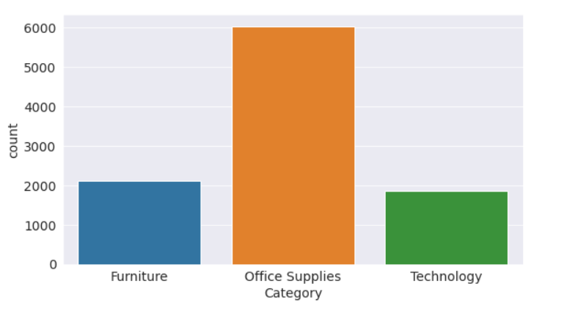
MOST POPULAR CATEGORY PRODUCT USED BY CUSTOMERS

Slide 11
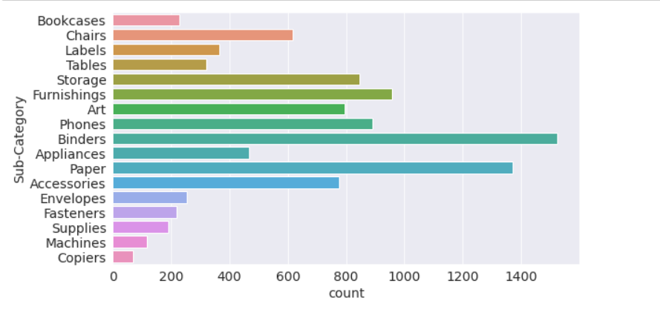
PRODUCT QUANTITY WITH RESPECT TO SUB CATEGORY

Slide 12
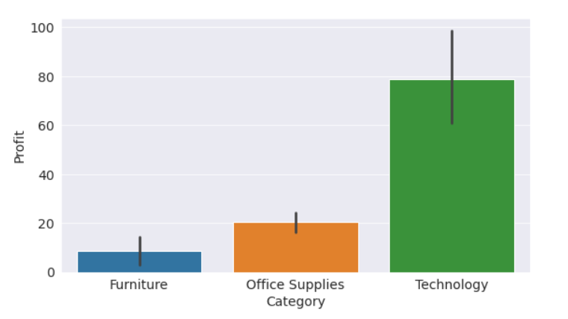
MOST PROFITABLE CATEGORY

Slide 13
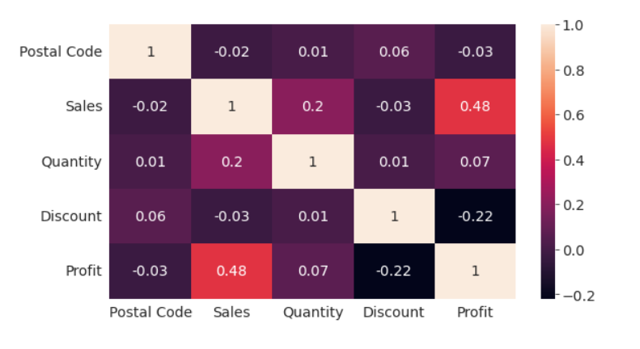
CORRELATION HEATMAP

Slide 14
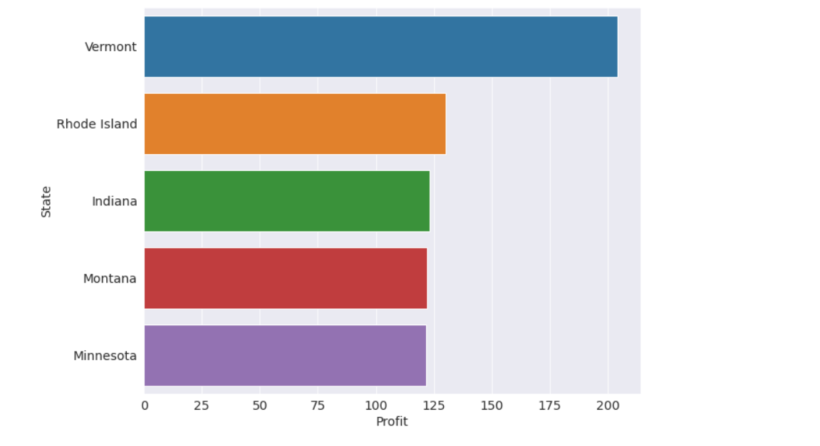
WHICH CITY IS SELLING THE PRODUCTS WITH MOST PROFIT ?

Slide 15
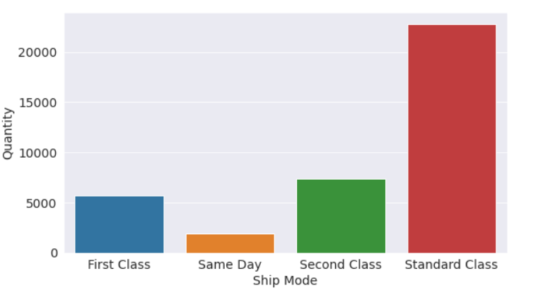
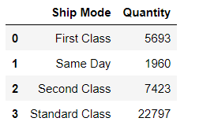
WHICH SHIPPING MODE IS USED FOR MAXIMUM PRODUCTS ?

Slide 16
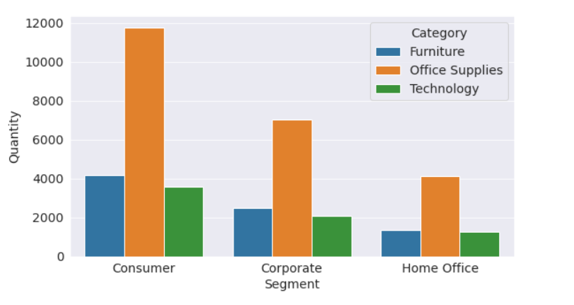
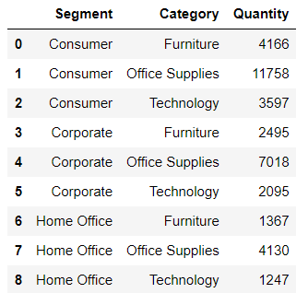
WHICH CATEGORY PRODUCT IS MOSTLY PURCHASED BY WHICH SEGMENT OF CUSTOMERS ?

Slide 17
conclusion
The data analysis project on "Case Study - Analysis of Superstore" provides actionable insights to optimize performance, enhance customer experience, and drive profitability. Utilizing evidence-based strategies, it empowers the superstore for sustained growth, adaptability in the market, and confident decision-making, ensuring long-term success in the competitive retail industry.

Slide 18
links
Github Link for pynb file :
https://github.com/nidhi-sin-gh/IBM_EDUNET_INTERNSHIP/blob/main/analysis-of-superstore-database%20(1).ipynb
Dataset :
https://github.com/nidhi-sin-gh/IBM_EDUNET_INTERNSHIP/blob/main/SampleSuperstore.csv

Slide 19
THANK YOU

