Slide 1

Code Refactoring and Bug Fixing
NAME - NIDHI SINGH
INTERN ID - IN1240275

Slide 2
About me
Hello there! I’m NIDHI SINGH, a data science enthusiast currently interning at Innomatics Research Labs.
When it comes to academics, I will be graduating with a B Tech (Computer Science and Engineering) in July 2024.
Driven by a passionate interest in data science, I chose to pursue further learning at Innomatics Research labs. Currently, I’m gaining hands on experience as an intern in the field.
Sure thing! Feel free to get in touch whenever you’d like. Whether it’s about data science, career advice, or just to chat, I’m always available and happy to connect with you.

Slide 3
Scenario
A group of passionate data scientists set out on a project to create a Note Taking Application using Python, Flask, and HTML. Unfortunately, their limited background in backend development resulted in issues, hindering the application's functionality. Given your expertise in backend development, you have been assigned the responsibility of rectifying the code and ensuring the smooth operation of the application.

Slide 4
Task
Revamp the current codebase to guarantee the optimal performance of the Note Taking Application. Thoroughly document any identified bugs encountered during the debugging process. It's important to note that the objective is not to build the application from the ground up but rather to address and rectify issues in the existing codebase, ensuring the application functions according to its intended design.

Slide 5
About the Application
Within the application's home route, there is a user interface featuring a text field and a button. This setup allows users to input and submit notes. The noteworthy aspect is that all added notes dynamically appear as an unordered list beneath the text field on the same page. This design fosters a seamless and user-friendly experience, enabling users to effortlessly track and manage their notes within the application.

Slide 6
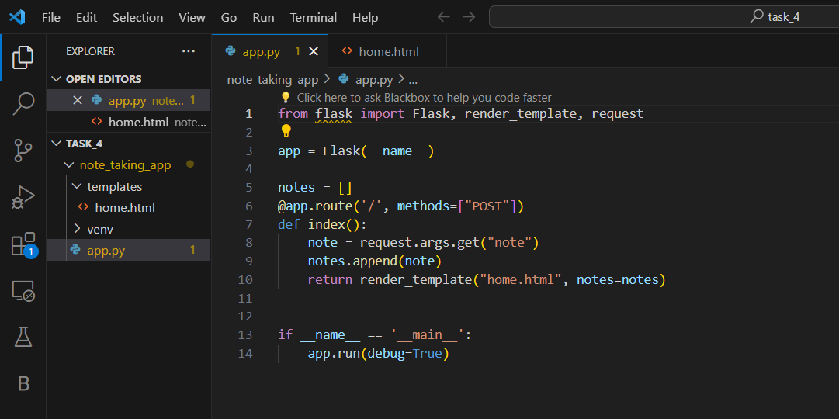
Initial Code

Slide 7
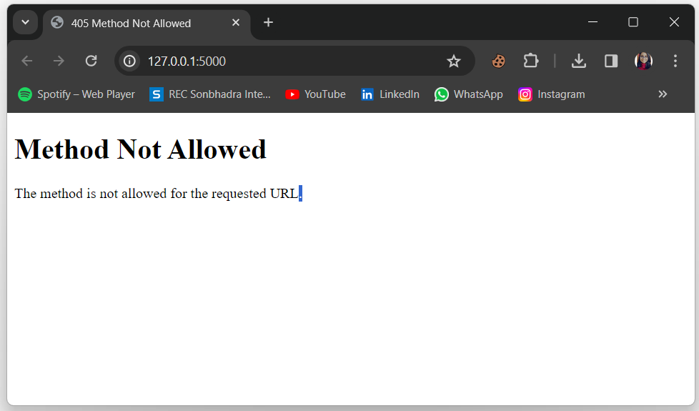
Working of the code after refactoring and bug fixing, displayed in the browser:

Slide 8
Bugs in the Code
Issue:
The route for handling form submission is set to `methods=["POST"]`, but the form in HTML is submitting with the `GET` method. This leads to the form data not being captured correctly.
Approach to Resolution:
Updated the route method to `methods=["GET", "POST"]` in order to handle both GET and POST requests.
Ensured that the form submission method matches the allowed methods in the Flask route.

Slide 9
Issue:
In the `index()` function, the note is being retrieved using ‘request.args.get("note")’, which is incorrect for form submission. It should be ‘request.form.get("note")’
Approach to Resolution:
Changed the code to use ‘request.form.get("note")’ to correctly retrieve the note from the form during form submission.
This ensures that the correct method is used to access form data.

Slide 10
Issue:
The ‘render_template’ function is used to render "home.html," but there was no indication of the HTML file provided in the codebase.
Approach to Resolution:
Assumed the existence of an HTML file named "home.html" with the appropriate structure for displaying notes.
Make sure to include the actual HTML file in the codebase or update the filename in the ‘render_template’ function accordingly.

Slide 11
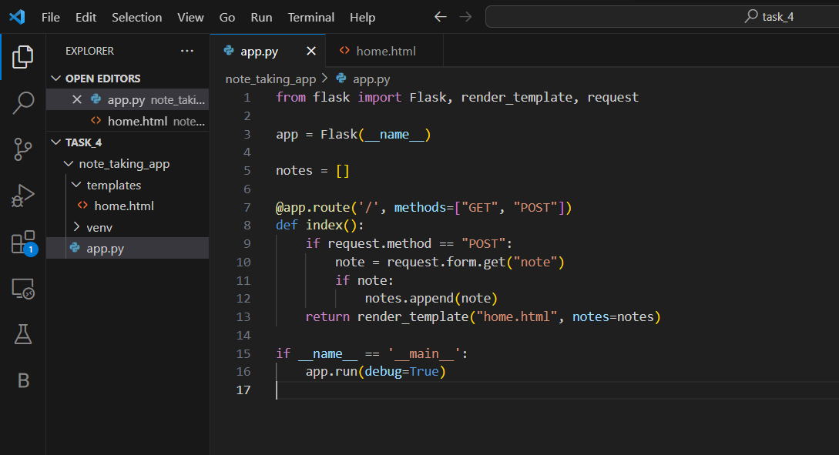
Corrected Version of Code

Slide 12
The revised code addresses several issues found in the initial implementation
Form Data Retrieval: In the original code, the incorrect method ‘request.args.get("note")’ was used to fetch form data, which is more suitable for query parameters in the URL. In the corrected version, ‘request.form.get("note")’ is employed to accurately retrieve form data.
Conditional Note Addition: The corrected code incorporates a conditional check to verify if the request method is POST before attempting to retrieve and append the note. This ensures that notes are only added when the form is submitted via a POST request, enhancing the robustness of the application.

Slide 13
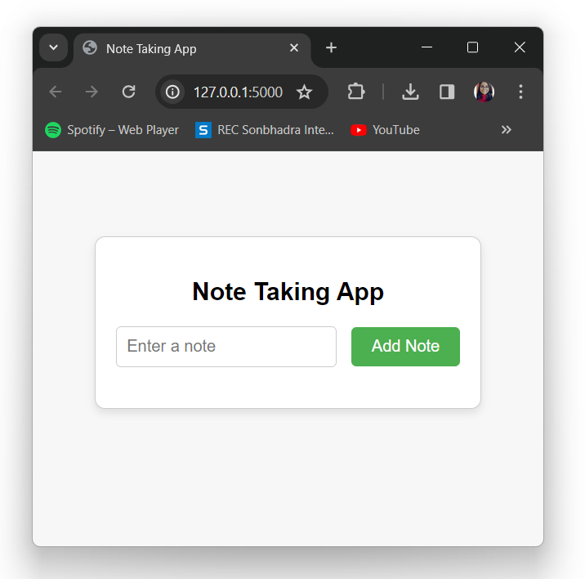
Working of the code after refactoring and bug fixing, displayed in the browser:
This Flask application allows users to add notes through a form and displays the added notes on the home page.

Slide 14

THANK YOU

